Slide 1

Dealing with People in a School Environment
PRESENTED BY:
Rosita Guy
Dip. IR., Cert. IR., Cert. Sup. Mgt., Accredited Consultant Extended DISK (Level2),
Principal Rosita Guy Associates
People & Business Management Coaching & Training Specialist, Christchurch, NZ.
https.nzlinkedin.com/in/rositaguy

Slide 2
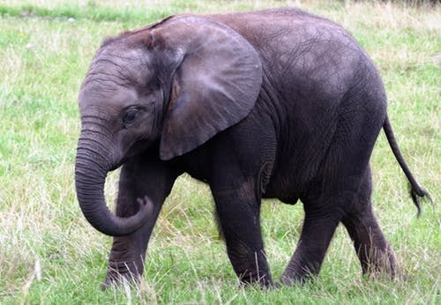
Communication with Clarity
“If you expect it and don’t tell people
you want it – you’ll never get it.
People are lousy mind readers”
James A. Belasco
“Teaching the Elephant to Dance”

Slide 3

Common Communication Problems
1. Not Truly Listening
2. Assuming You Know the Message before the Person Finishes
3. Interrupting the Speaker
Using “You” Statements Instead of “I”
Statements

Slide 4
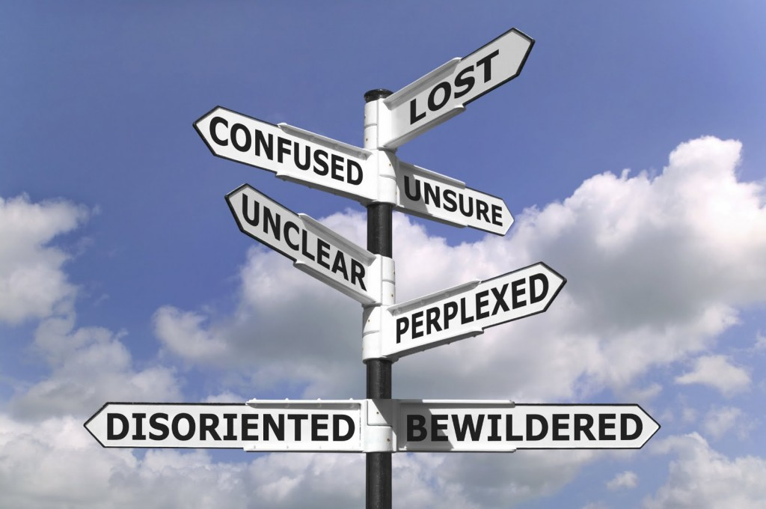
Common Communication Problems
5. Letting Your Emotions Dictate Your Response
6. Failing to Account for Cultural Differences in Communication
7. Misinterpretations and Assumptions
8. Being Indirect

Slide 5
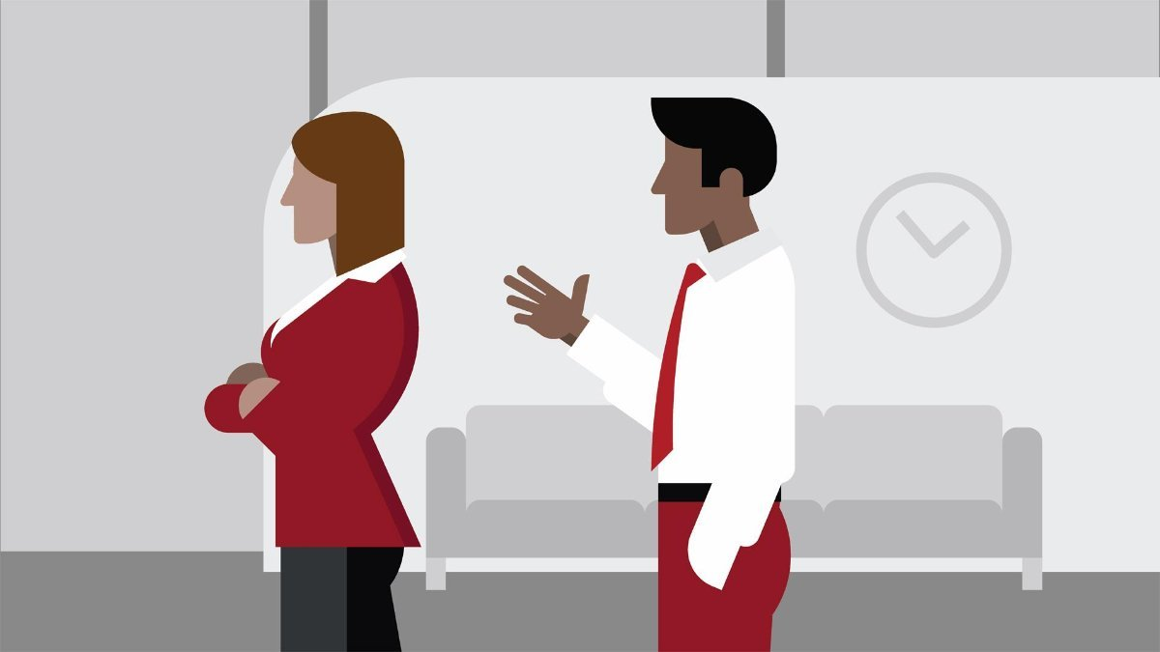
Common Communication Problems
9. Attacking Character Rather than Behaviour
10. Avoiding Difficult Conversations
11. Lack of Standards
Communication Barriers
Mixing Work and Personal Communication

Slide 6

Common Communication Problems
14. Lack of Factual Communication
Failure to Disperse Communication
Privacy
Attitude
Lack of Follow Through

Slide 7
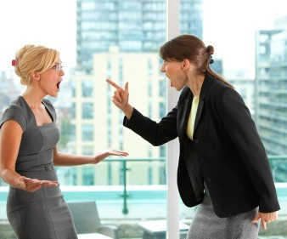
Dealing with Difficult Situations
Listen.
Stay calm.
Do not judge
Reflect respect and dignity toward the other person.
Look for the hidden need.

Slide 8
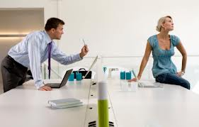
Dealing with Difficult Situations
Look for others around you who might be able to help.
Don't demand compliance.
Saying, "I understand," usually makes things worse.
Avoid smiling, as this may look like you are mocking the person.
Don’t act defensively.

Slide 9

Dealing with Difficult Situations
Don’t return anger with anger.
Use a low, calm, even monotone voice.
Don't argue
Keep extra space between you
and the other person.
Saying, “I’m sorry,” or, “I’m going to try to fix this,”

Slide 10
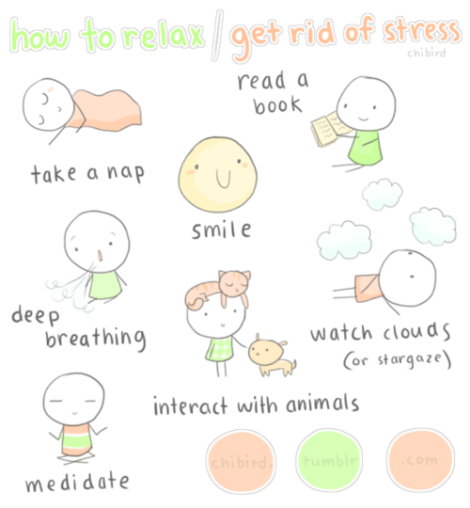
Dealing with Difficult Situations
Set limits and boundaries.
Trust your instincts.
One response does not fit all.
Debrief.
Discharge your own stress
Give yourself credit

Slide 11

Dealing With People You Don’t Like
Smart People:
Accept that they are not going to like everyone
Bear with (not ignore or dismiss) those they don’t like.
Ensure small efforts make big changes in life
Treat those they don’t like
with civility

Slide 12
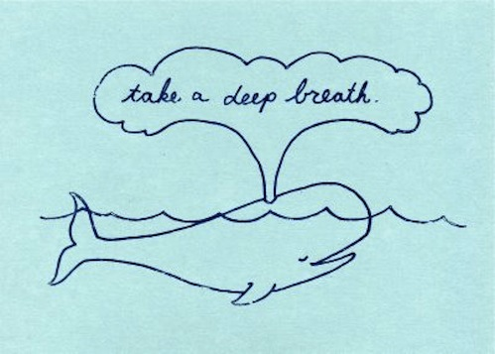
Dealing With People You Don’t Like
check their own expectations
turn inwards and focus on themselves
pause and take a deep breath
voice their own needs
allow space between them

Slide 13
The Change Process Begins with YOU
THE SAME WIND BLOWS
UPON US ALL.
IT IS NOT THE BLOWING OF THE WIND
BUT THE SET OF THE SAIL WHICH
MAKES THE DIFFERENCE
JIM ROHN

Slide 14

“The Pessimist complains about the wind.
The Optimist expects it to change.
The Activist adjusts the sails.”
John Maxwell

