Slide 1
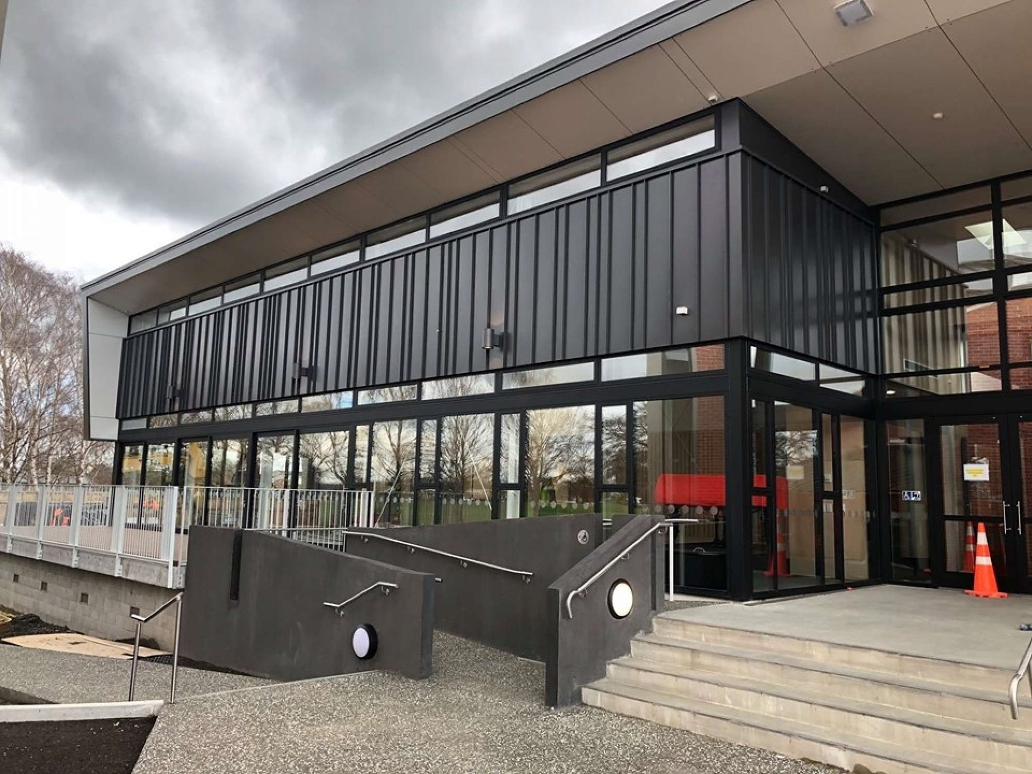

St Bede’s College
St Bede’s College Performing Arts Centre; George Berry
Pre-departure Information

Slide 2

Rector’s Welcome
On behalf of the College and the
Bedean Community we are pleased to
respond to your interest in our school.
St Bede’s College welcomes
International Students and is proud of
its longstanding tradition in hosting
students from many nations.
For many years the College has hosted
young men from overseas nations and we are pleased to bring these students into our community and to share in our culture and beliefs.
We have a fully resourced International Department and our staff is experienced in meeting the needs of International Students. Our curriculum offers excellent educational opportunities and our grounds and facilities are first rate.
The College’s motto is Fide et Opere (By Faith and Works), and our aim is to produce young men who are hardworking and live their lives by a code of good values and consideration for others.
Parents should be assured that St Bede’s College will look after their sons and looks forward to assisting parents as they make this most important decision.
Justin Boyle
Rector

Slide 3
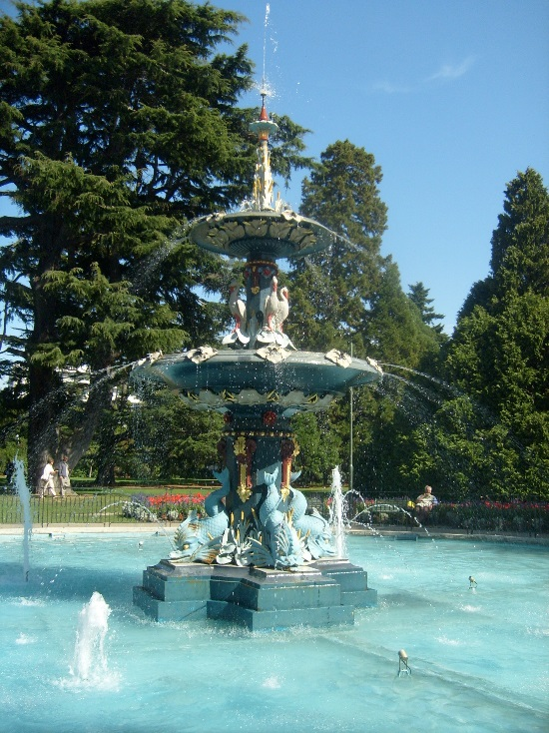
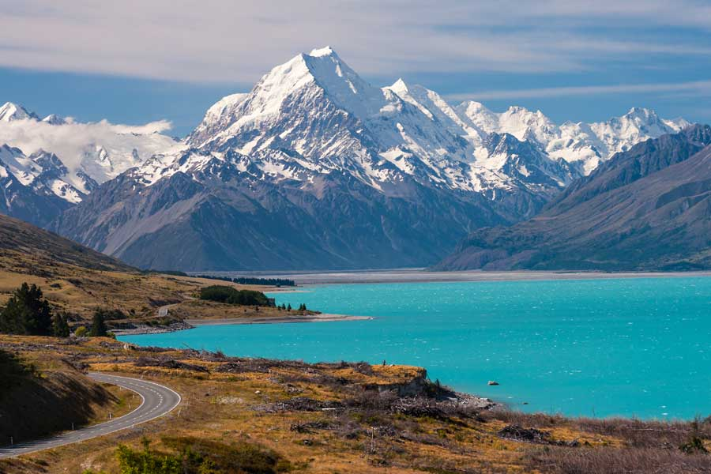
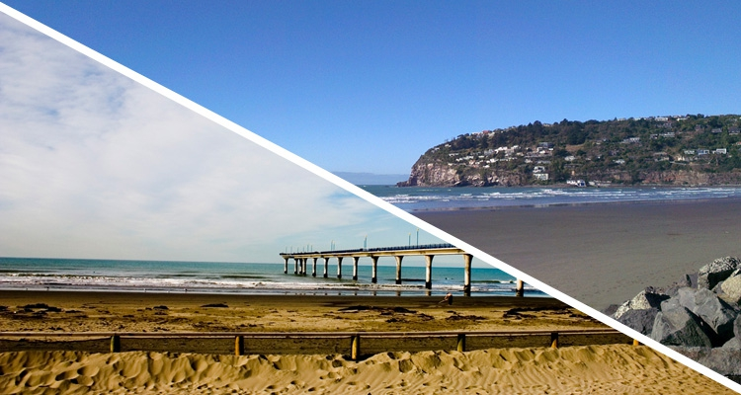
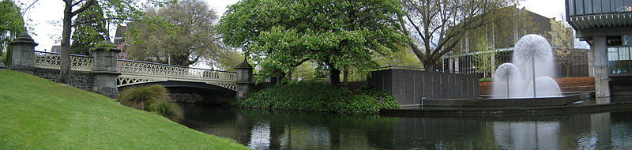
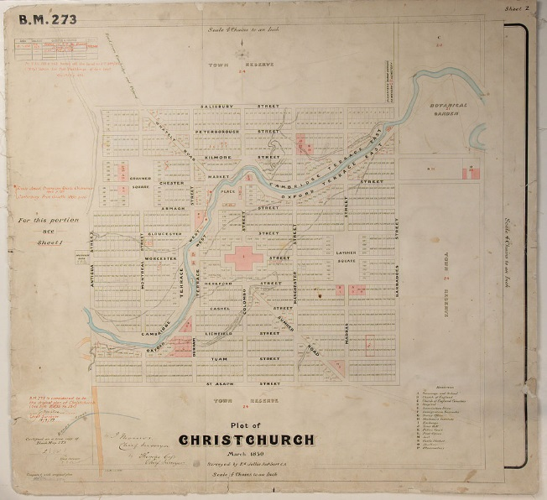
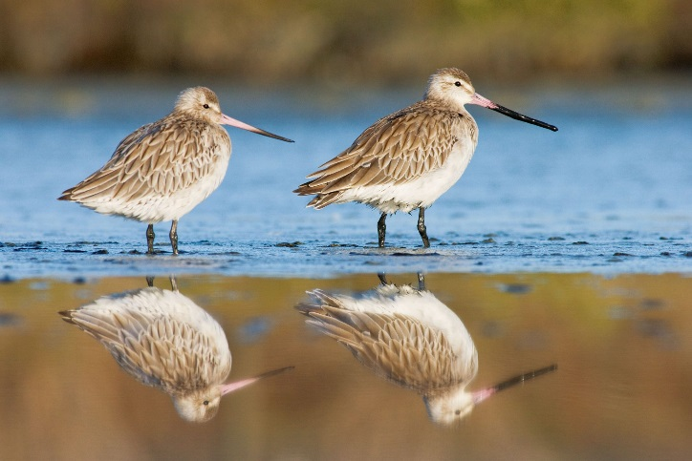
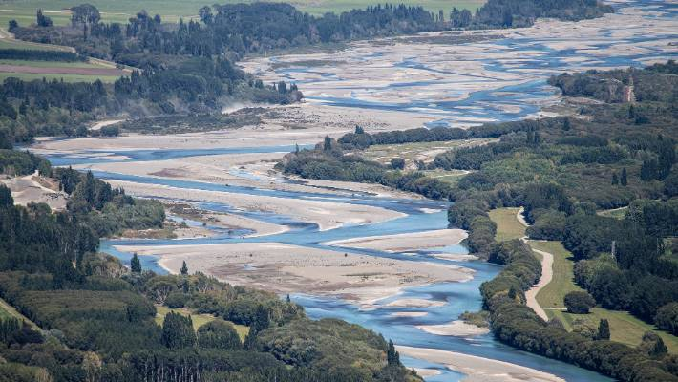

Christchurch
We are known as ‘The Garden City’, we are the largest city in the South Island and the 3rd largest city in New Zealand.
Christchurch has a population of around 385,000.
Peacock Fountain,
Christchurch Botanic Gardens
Southern Alps
Christchurch sits on the edge of the Canterbury Plains. The Port Hills sit to the South of the city, and the Southern Alps are the Western border of Canterbury.
We are close to the coast line and can head there any day we like.
Sumner Beach (top)
Brighton Beach and Pier (bottom)
Christchurch Town Hall from Victoria Square
The Estuary of the Heathcote and Avon Rivers (Ihutai) is one of New Zealand’s most important coastal wetlands. Many different birds make the estuary their home.
Christchurch is crossed by 2 rivers; the Avon River (Ōtākaro) and the Heathcote River (Ōpāwaho).
Godwits, Christchurch Estuary/Ihutai
One of Original city planning maps.
North of Christchurch, the Waimakariri River is popular for jet boating, although it can be a bit dangerous for swimming, and extra care is needed when doing so.
Christchurch city was originally planned on a grid network, meaning that once you get used to which streets are in the ‘One Way System’, it is relatively simple to find your way around the city.
The Maori name for Christchurch is Ōtautahi, and you will see this on signs and buildings throughout the city.
Waimakariri River, looking from the River Gorge.

Slide 4
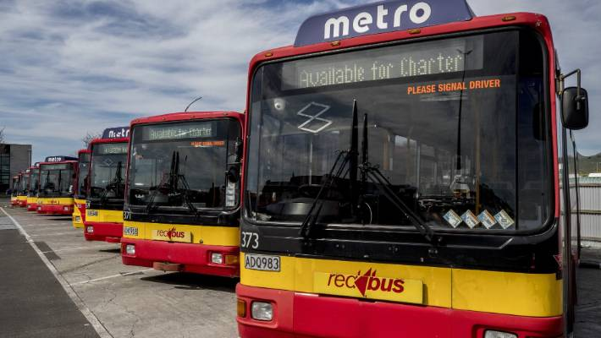
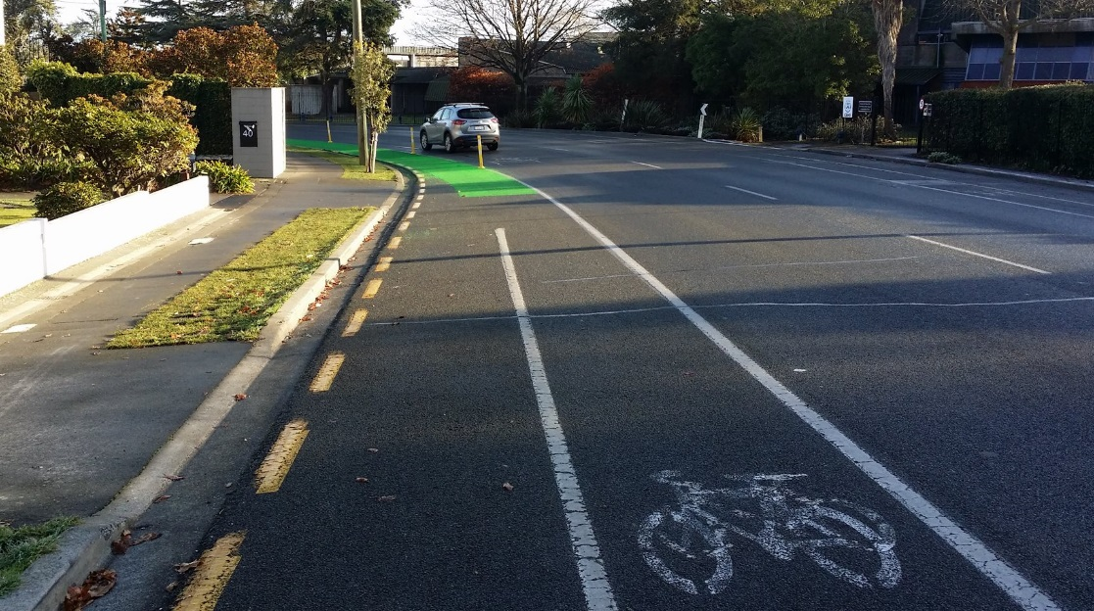
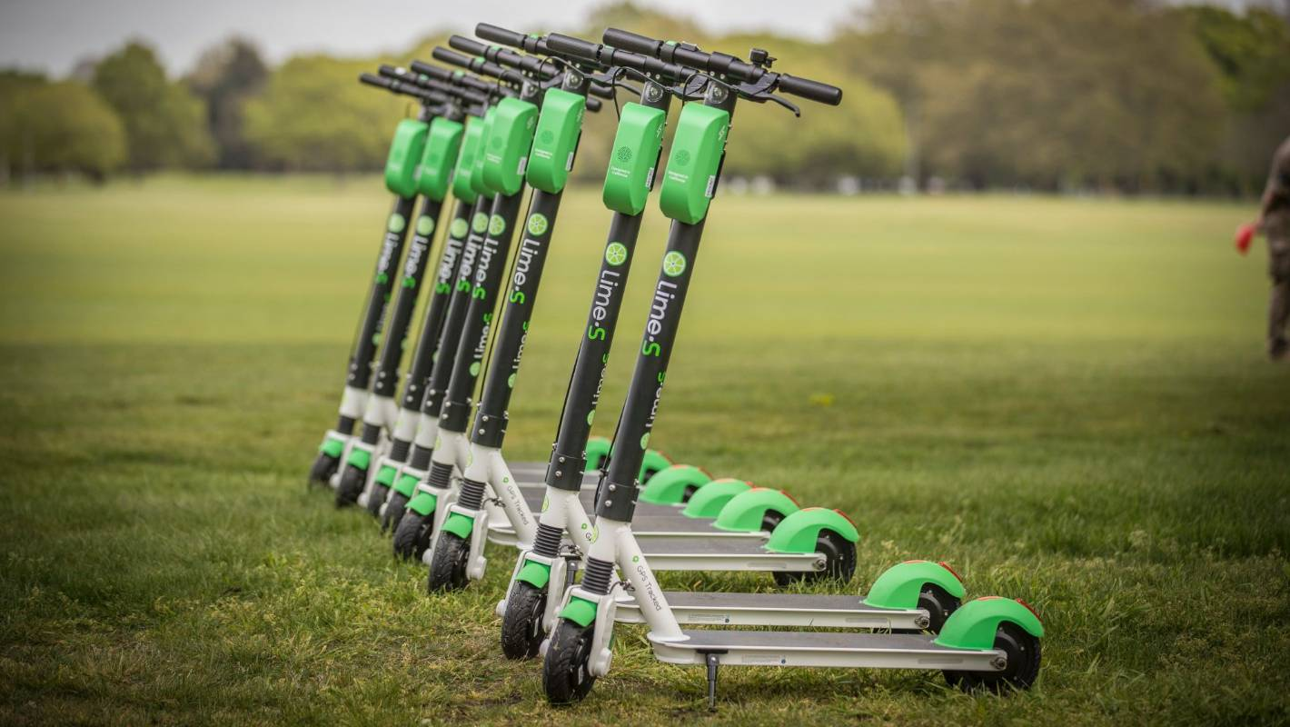
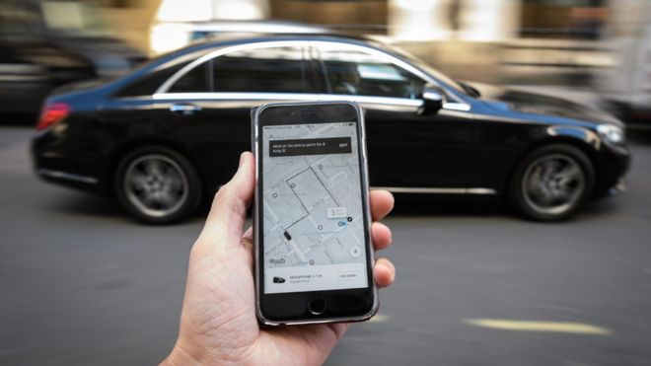
Getting Around
Christchurch is an easy city to find your way in.
The streets in the Central City are laid out in a grid pattern.
There is a good bus system in Christchurch. When you first arrive, either your agent or someone from St Bede’s will help you get a Metrocard which is used on the bus.
Buses run frequently and in most cases you only need to take one bus to get where you want to go.
Christchurch has a network of cycle lanes on most city streets. Christchurch is a cycle friendly city and if you take the usual precautions when cycling it can be a safe way to travel to and from school. We do not recommend you cycle late at night. Cyclists MUST wear a helmet while riding and it is highly recommended that you wear a high visibility jacket. If you would like to cycle to school, please talk to your host family first and then talk to school
Christchurch has e-scooters for hire in the city. You MUST be extremely careful if you choose to ride one of these. Each of the companies require an app and a credit card, they can be very expensive. International students are not permitted to use these as a mode of transport.
Taxis are available for hire, but they are expensive. If you are needing transport at night or in the evenings, we recommend you try a ride share service like Uber. You will need to download the app before you need the car.

Slide 5
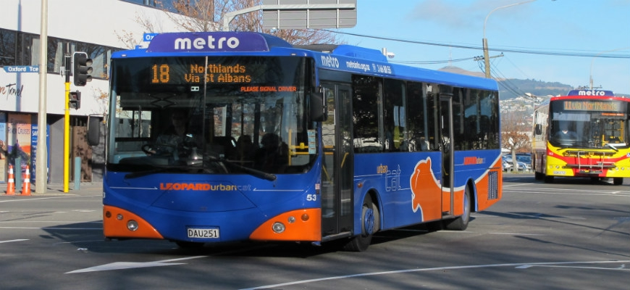

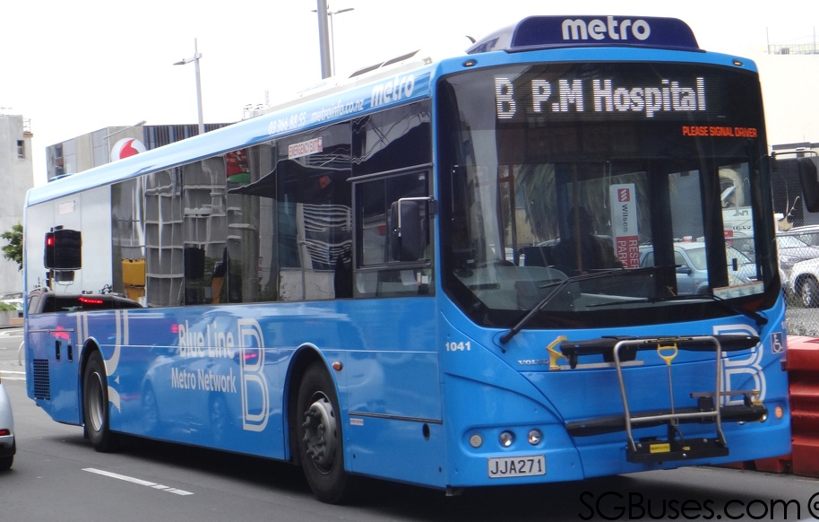
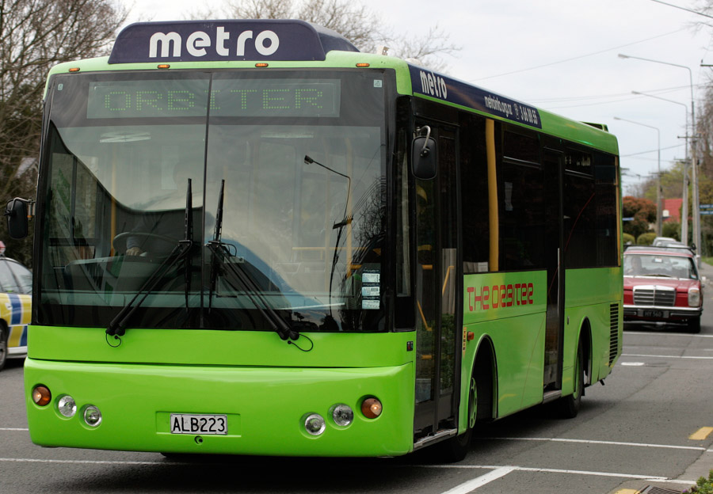
Christchurch Buses
By far the most convenient method of getting around Christchurch is on the bus.
Christchurch has very good bus links between shopping malls as well as in to the central city.
A Metrocard is used to purchase fares. This is loaded with funds, much like a debit card. When the card balance runs low, it is easy to top up your card. For more information on how to use Metrocard, please see: Metro Info
When you arrive in Christchurch, either your agent or someone from St Bede’s will help you purchase your Metrocard.
The 2 major bus lines are the Orbiter and the Blue Line.
The Orbiter circles the city and stops at the main shopping centres, it runs in both directions. This bus runs every 10-15 minutes during daylight hours.
The Blue Line runs between Cashmere in the South of Christchurch through to Belfast in the North. This bus stops outside Northlands Shopping Centre and outside St Bede’s College. This bus runs throughout the day at 15-20 minute intervals.

Slide 6
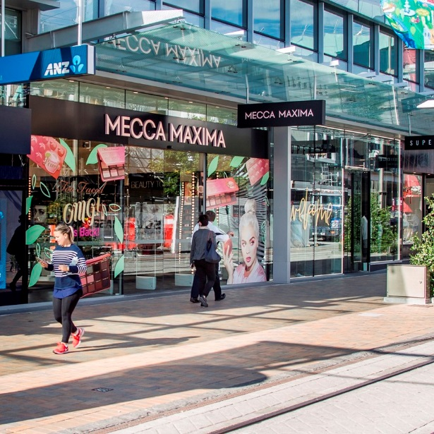

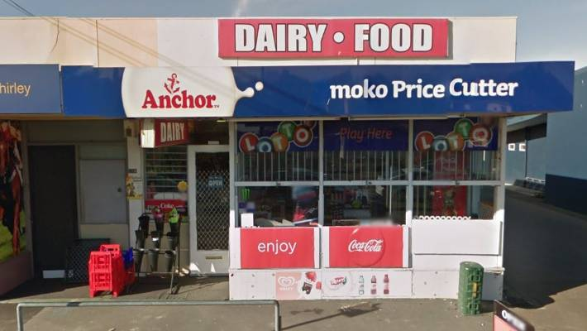
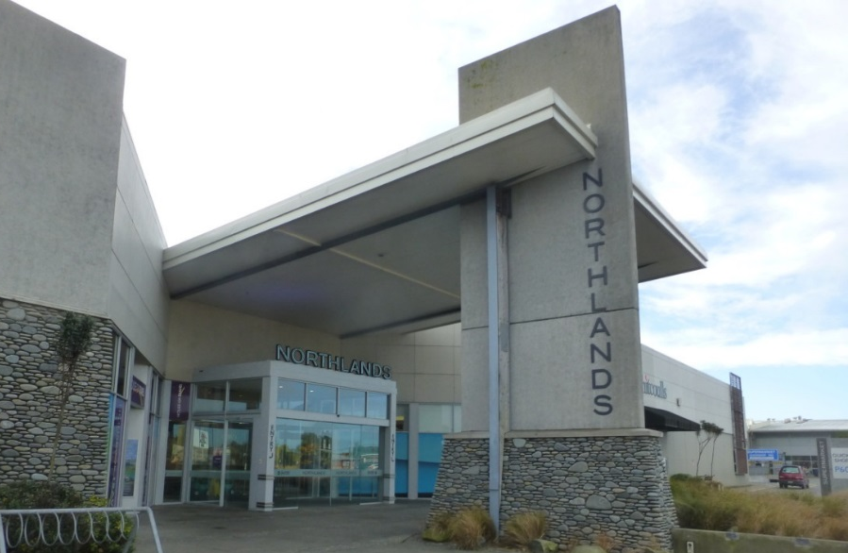
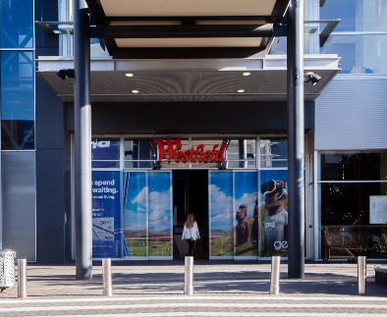
Shopping
There are many ways to purchase what you need in Christchurch. We have several shopping centres, 1 in close proximity to St Bede’s College.
We also have corner shops or ‘dairies’. However, it is not a good idea to buy a lot of groceries from here, as they are quite a bit more expensive than the supermarkets.
As the central city continues to grow, new and exciting brands are coming into Christchurch. There are many more boutique stores in the Central city, with the larger chain stores in our Shopping Centres
The 2 main shopping malls in Christchurch are Northlands and Westfield. Northlands is an easy walk from St Bede’s. These malls have a wide variety of shops and eateries in them, as well as supermarkets to purchase food and toiletries.
For more information please see:
Northlands Shopping Centre
Westfield Riccarton.
These malls also have cinemas and other entertainment options, a lot of Christchurch teenagers go to the mall in the morning and spend all day there with their friends. Christchurch shops are open 7 days a week. Sunday trading is usually shorter hours.
Christchurch also has several Asian Warehouses, meaning we are able to get delicious ingredients and produce from Asian countries, this also makes it easy for Asian students to find a taste of home!
Facebook links:
Kosco
Big T
Oriental Warehouse
Sunson Asian Market

Slide 7
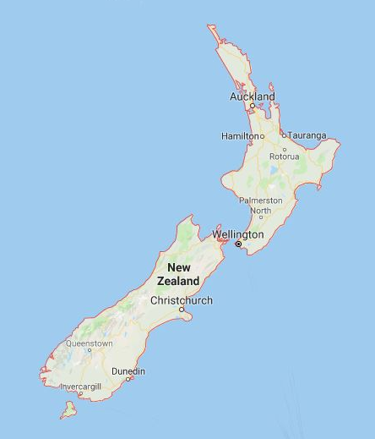
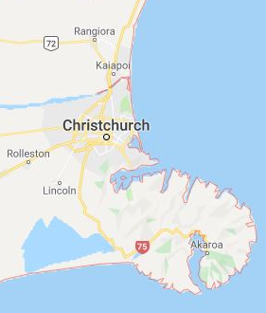
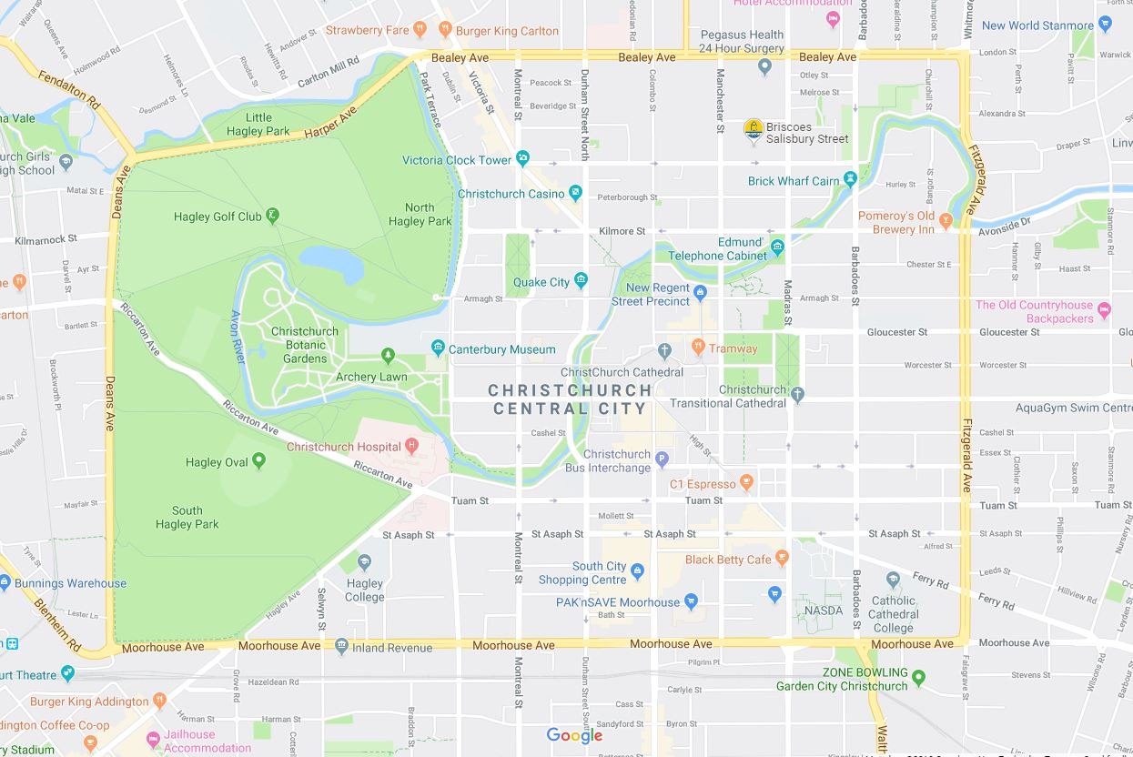
Where is Christchurch ?
National
South Island
Christchurch City
Google Maps

Slide 8
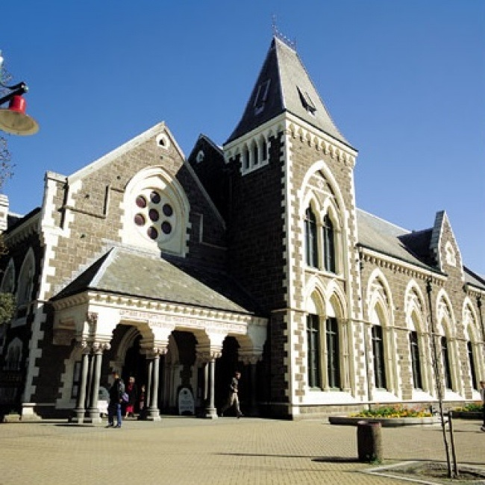
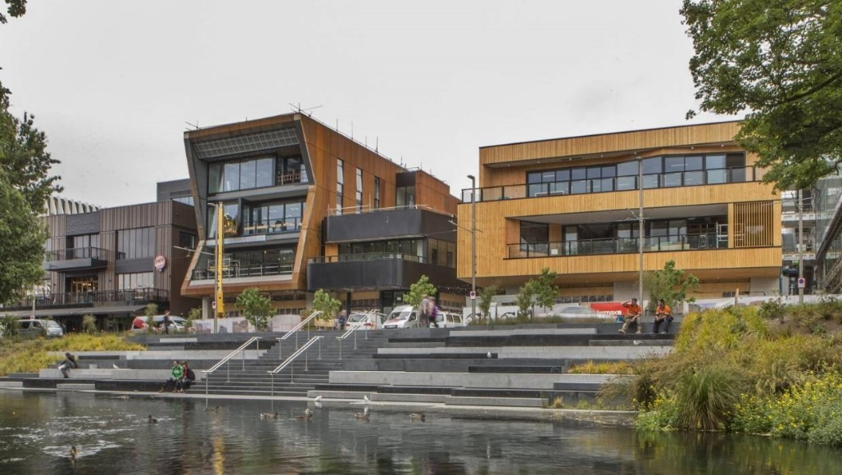
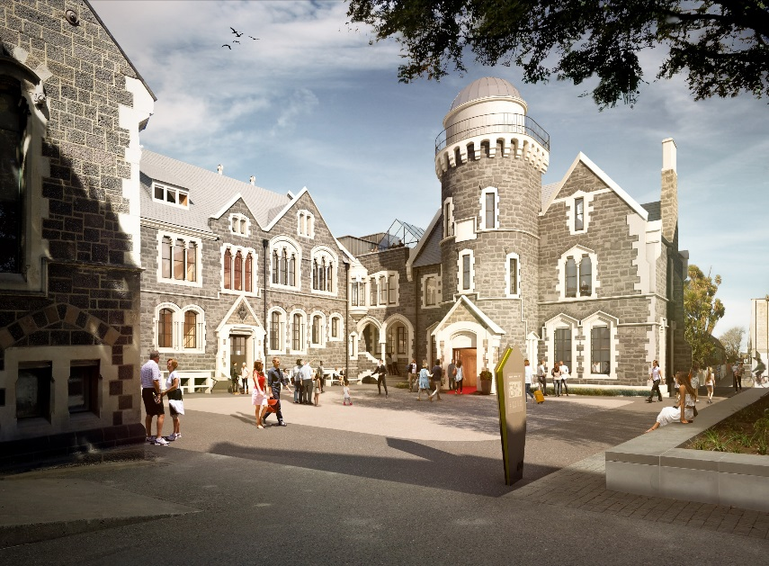
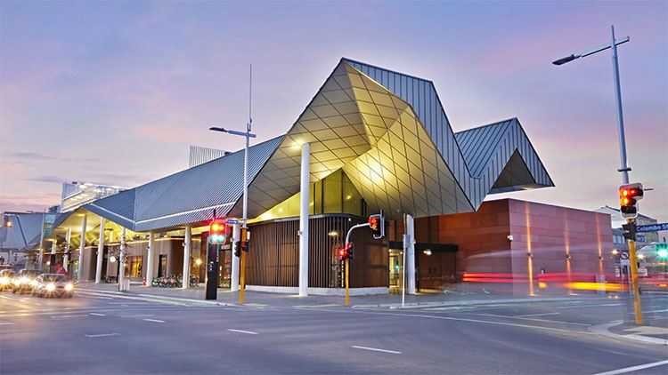
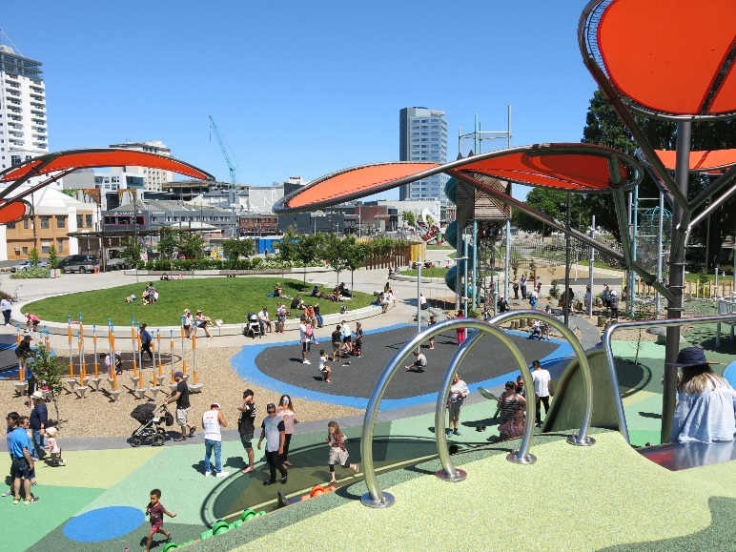
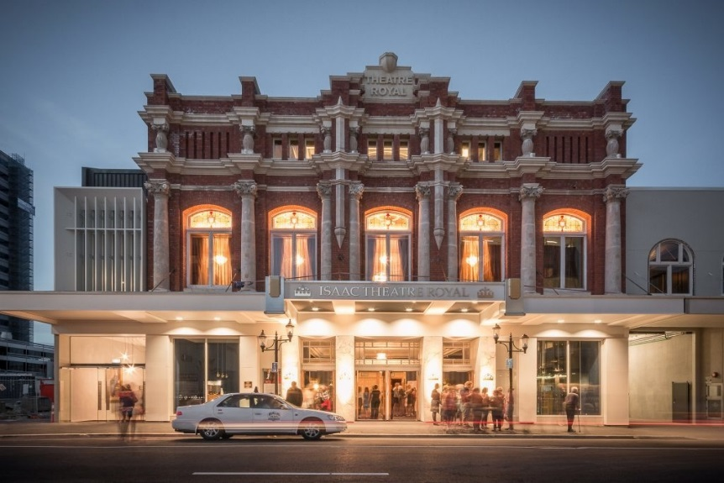
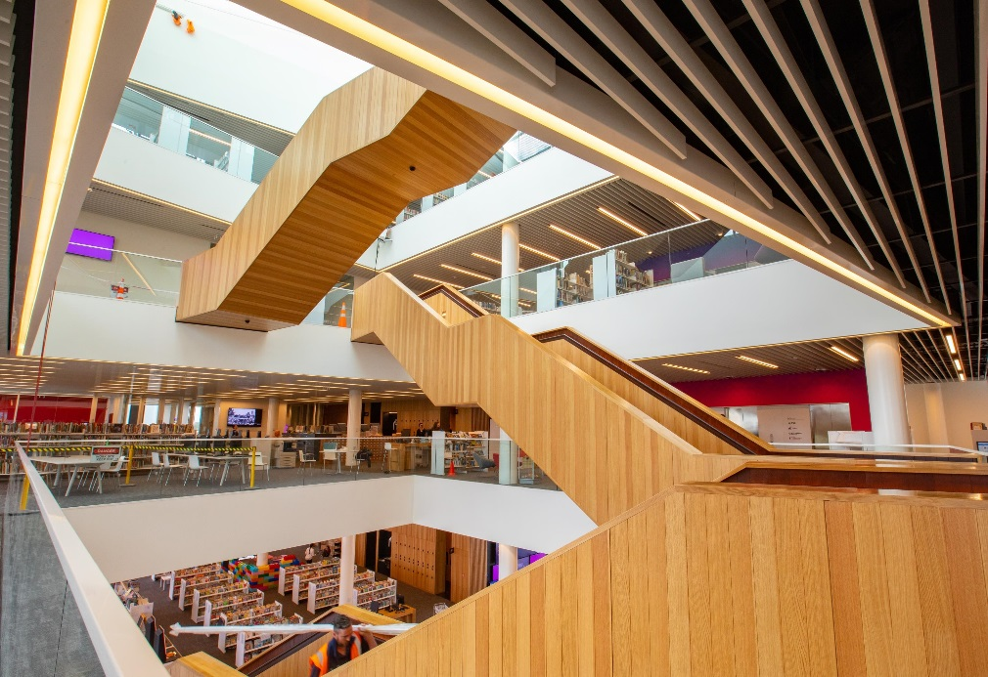
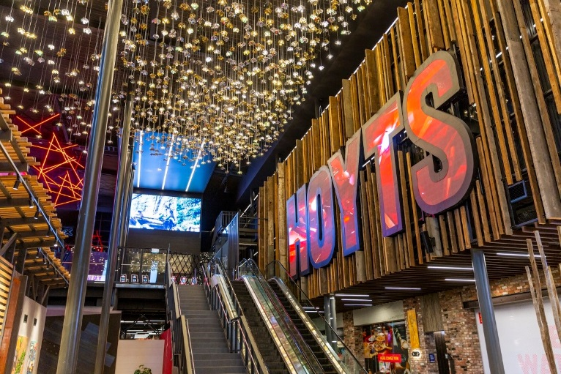
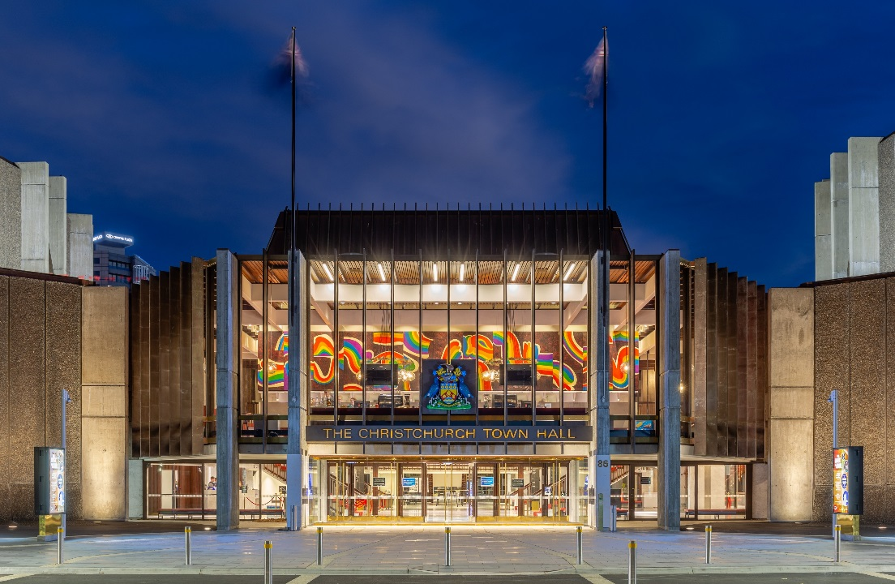
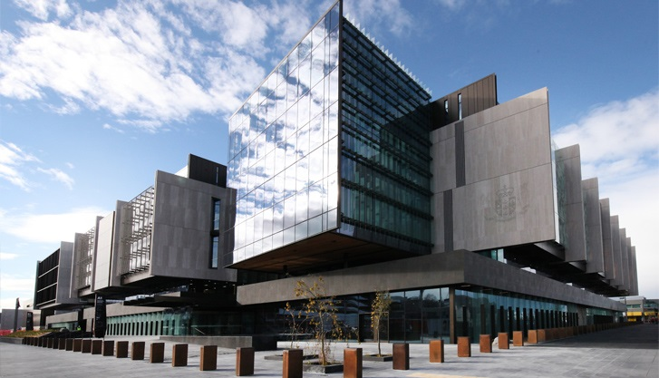
Christchurch Earthquakes
The Observatory. Christchurch Arts Centre
In 2010-2011, Christchurch was hit by a series of devastating earthquakes, sadly 185 people from 20 countries lost their lives in this dreadful tragedy.
Since then, Christchurch is being transformed into a vibrant and cosmopolitan city. Well over 900 homes have been rebuilt to a higher standard then before, and many families have settled in Christchurch from other cities in New Zealand as well as large numbers of overseas families.
The central city is fast becoming a real attraction, new buildings have been completed and other significant buildings are under way.
Before the Earthquakes, Christchurch was a very ‘English’ city with many old buildings. The old buildings that survived the earthquake now stand alongside modern, dynamic buildings to create a city that now has its own very progressive personality!

Slide 9
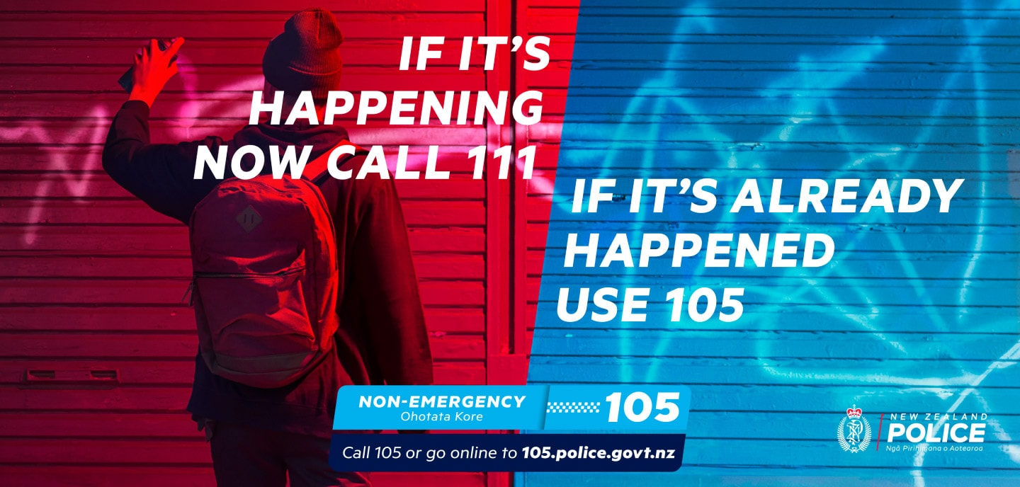
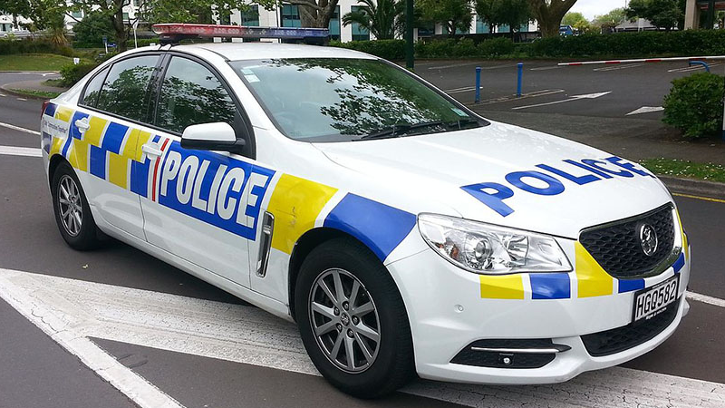
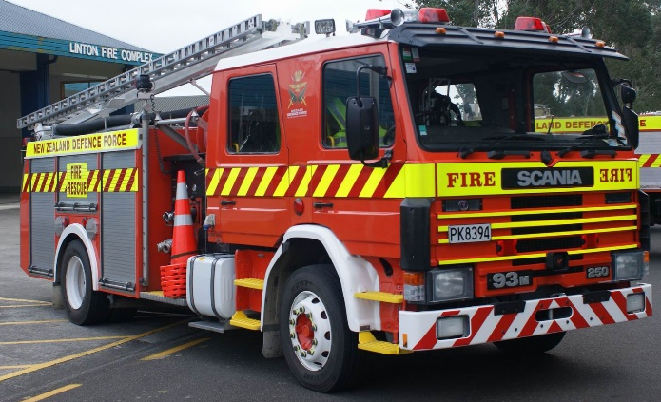
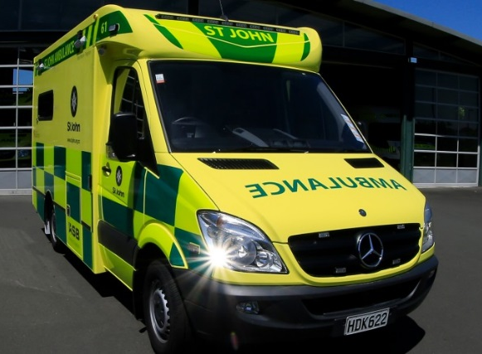
Help is at Hand
There are many different ways to get help if you need it, whether you are at home or out and about.
If you are out how do you contact the Emergency Services?
The Emergency phone number in New Zealand is 111.
When the operator answers you will be asked “Which service do you require?” You reply with either Police, Fire or Ambulance.
Follow the instructions given over the phone, ask the operator to slow down if you are finding it hard to understand – explain that you are an International Student at St Bede’s College.
This number is for an emergency that is still happening.
If the emergency has happened but you still need help, dial 105 and follow the same steps as for an emergency that is happening.
At School: The first person to see for any school, Boarding or Homestay problems is Mr Tappenden.
What if he is not available?
If the problem is to do with your class, Mr Davidson will be able to help.
If you are having a problem in your Homestay, see Miss Castle.
If you are having a problem in the Boarding School, see one of the Assistant Managers – Joe or George or the Boarding Director Mr Williams.

Slide 10
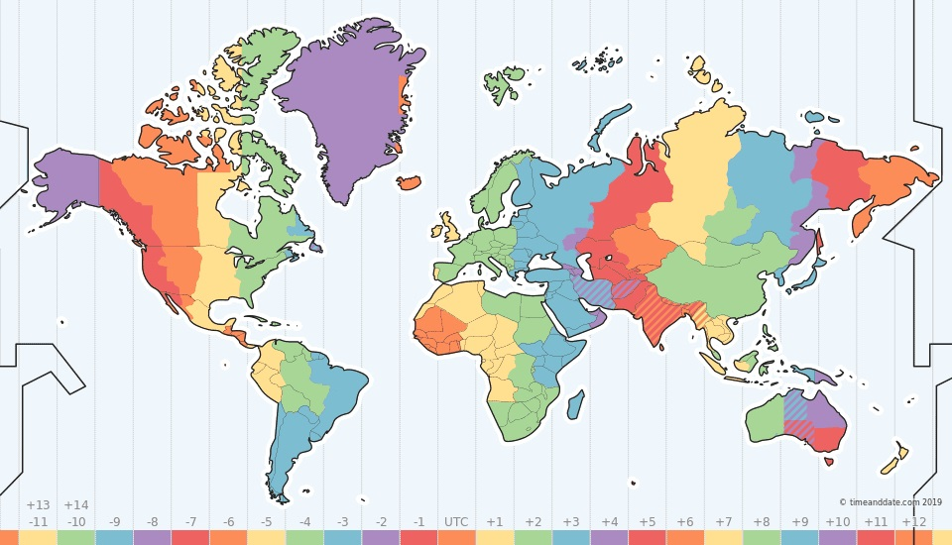
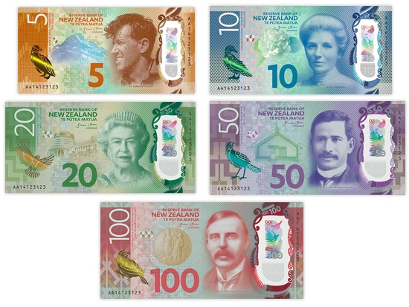
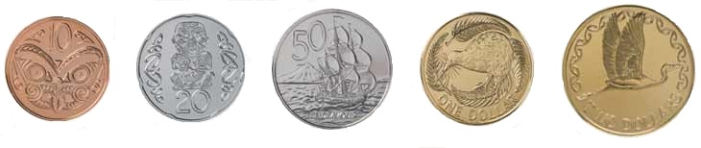
Time Zone
NZ Standard Time is +12hrs GMT
Daylight Saving runs from September to April, clocks go forward 1 hour in September and go back 1 hour in April.
This gives us our long summer evenings. Watch out for sand-flies and mosquitos though!
World time Zones
Climate
Christchurch has cold crisp winters and hot dry summers. We have less rainfall than the other main centres.
In Christchurch the prevailing wind is an Easterly and depending where you are in the city it can be quite cold as it comes from over the sea.
In summer we have a hot, dry Nor’West wind that blows across the plains.
Our cold weather comes from the South, with Antarctic winds a winter feature.
Christchurch average Temperature and Rainfall
Currency
New Zealand Notes and Coins
1 New Zealand Dollar = 100 cents
We have $100, $50, $20, $10 and $5 notes. $2, $1, 50c, 20c, 10c coins
NZD 1.00 = 65-70 JPY approx.
NZD 1.00 = 4-8 CNY approx.
NZD 1.00 = 19 THB approx.
NZD 1.00 = 9,000 IDR approx.
NZD 1.00 = 08-1.00 SGD approx.
NZD 1.00 = 750-760 KRW approx.

Slide 11
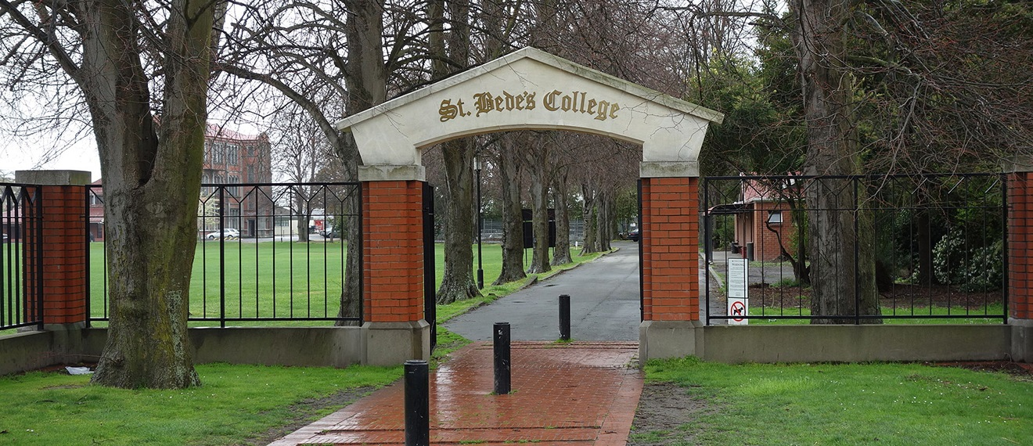

St Bede’s College
Established in 1911 by the Marist Order of Priests.
Named for The Venerable Bede (AD 673–735), regarded as the Father of English history.
College motto: “Fide et Opere”, by Faith and Works.
The oldest Catholic Boy’s Secondary School in the South Island.
The only Catholic Boy’s Boarding School in the South Island.
Every student is allocated a ‘house’.
Either: Benedict Gold
Colin Light Blue
McCarthy Green
Mannix Dark Blue
Redwood Maroon
St Bede’s College accepts boys from Years 9 (aged 12/13 yrs) to Year 13 (aged 17/18 yrs)
The Catholic Faith is an important part of the daily life of every Bedean.
3 Boarding Houses
Durham – Years 9 & 10
Jarrow – Years 11 & 12
Wearmouth – Years 13
Boarding Capacity = 142
Current Roll = 811
Our current Rector is the first Rector in the College’s history to not be an ordained Catholic Priest.
Extensive grounds and modern facilities for learning.
St Bede’s is currently in the process of rebuilding and upgrading buildings damaged in the 2011 Christchurch Earthquakes.
In 2019, the cornerstone of the College, The Chapel of St Bede was opened. The original Chapel was demolished due to earthquake damage. The College was very fortunate to have been able to salvage wood carvings and stained glass from the original chapel; these have been installed in the new chapel, giving a tangible link to the College’s past while maintaining its focus on the future.
For more information: St Bede’s College

Slide 12
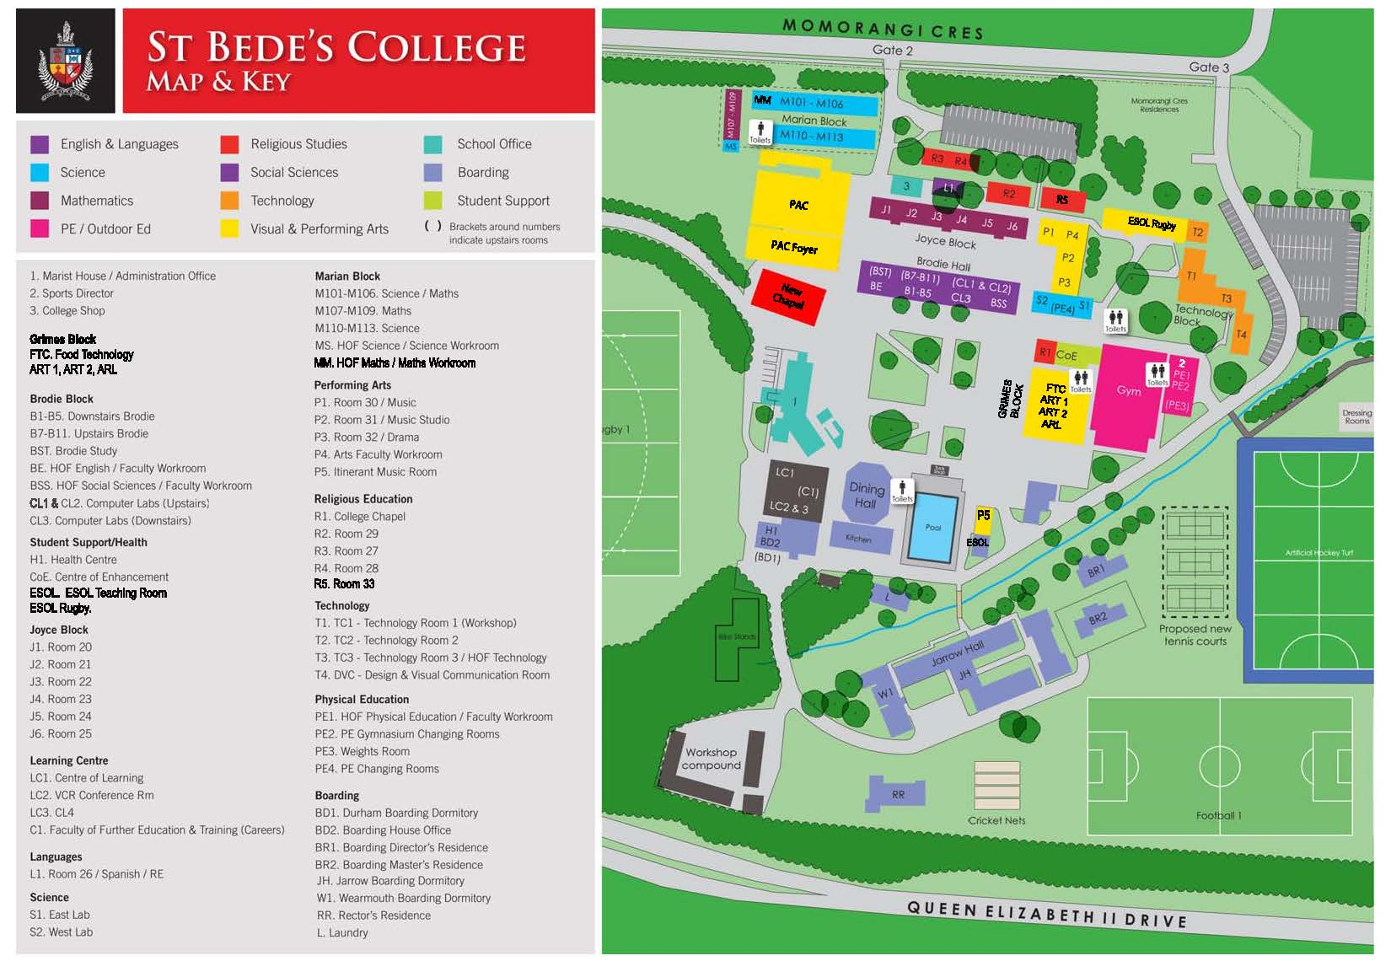
St Bede’s College Map
For more information on St Bede’s and the Policies and responsibilities of all students, please visit: SBC Policies and Procedures
See the College come to life with our Virtual Tour

Slide 13
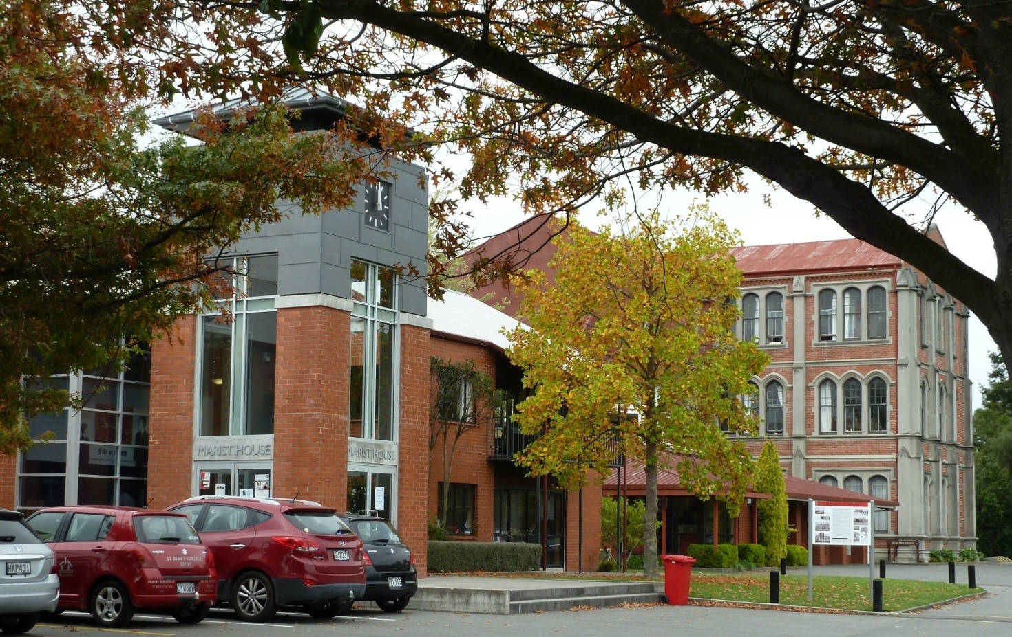
St Bede’s Key Staff
Mr Robert Tappenden – Director international Students
Mr Tappenden runs the International Programme. He is the first person to talk to if you have a question about school or your classes or if you just need someone to talk to .
Miss Madeleine Castle – Homestay Coordinator and International Administrator
Miss Castle looks after all the paperwork and forms as well as finding Homestay placements for all students. Miss Castle is in the Student Office behind Reception.
Mr. Justin Boyle – Rector
Mr Boyle is the rector at St Bede’s College, he is our Headmaster. He makes sure the College runs well and looks after the teachers as well as the students. He is also one of the musicians during Mass
Mr Gerry Davidson – Deputy Rector (Pastoral)
Mr Davidson looks after the students wellbeing, he makes sure our boys are proud to be Bedeans and happy at the College
Mr Jon McDowall - Deputy Rector (Curriculum)
Mr McDowall is responsible for the subjects and courses studied at St Bede’s. He is also heavily involved in Rugby at the College.
Mr Wiremu Gray – Counsellor
Mr Gray is one of our school counsellors, he is there to talk to if you need. Sometimes you may be feeling a little sad or overwhelmed by going to school in a different country, Mr Gray can help
Mr Dai Williams – Boarding Director / Counsellor
Mr Williams looks after the running of the Boarding School and the Boarding students.

Slide 14

New Zealand Education
The education system in New Zealand may be different to what you are used to at home. In New Zealand, teacher and students work together, teachers expect their students to ask questions and there is usually a lot of discussion.
Senior students sit NCEA in Years 11 to 13. This is an internationally recognised qualification and can be used as part of your home country university entrance criteria. For more information, please see: Understanding NCEA.
The school year starts in late January and is made up of 4 terms. The school year ends in December.
Term 1 January – April
Term 2 April – July
Term 3 July – Late September
Term 4 October – December
After Terms 1, 2 and 3 the school closes for 2 weeks holiday.
After Term 4, the school closes for 6 weeks holiday, we expect ALL international students to return home for this holiday
During the year are several Public Holiday that schools close for:
Waitangi Day 6th February
Good Friday These days are movable, and often fall in the Easter Monday term 1 holiday, Easter Tuesday is a school-
Easter Tuesday only holiday
ANZAC Day 25th April
Queen’s Birthday 1st Monday in June
Labour Day 4th Monday in October
Canterbury Anniversary 2nd Friday after 1st Tuesday in November
Christmas Day 25th December
Boxing Day 26th December
New Years Day 1st January
2nd January 2nd January
The Christmas and New Year public holidays occur during the end of year school holiday
St Bede’s College is a BYOD School (Bring Your Own Device). You will need to bring a laptop.
For more information, please see: e-Learning at SBC

Slide 15
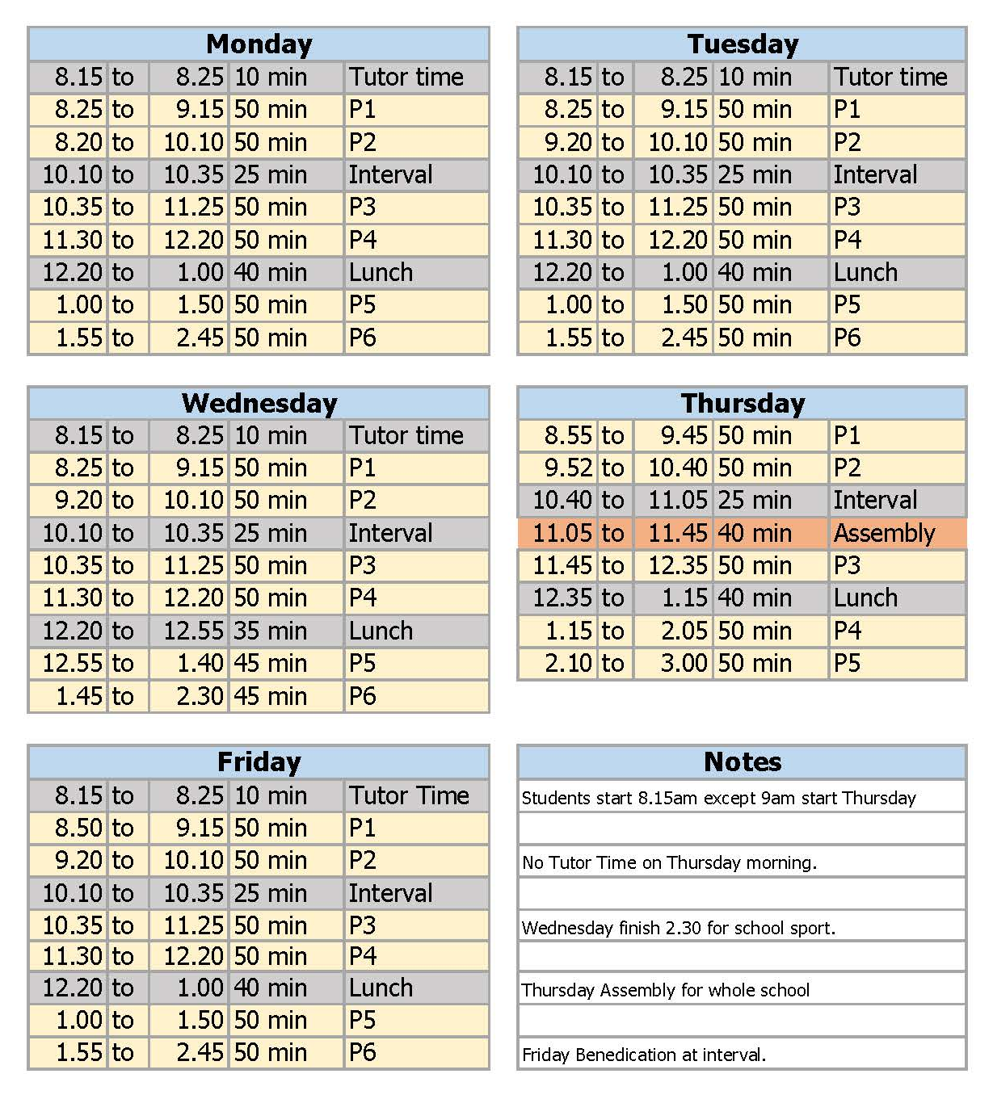
Daily Timetable

Slide 16
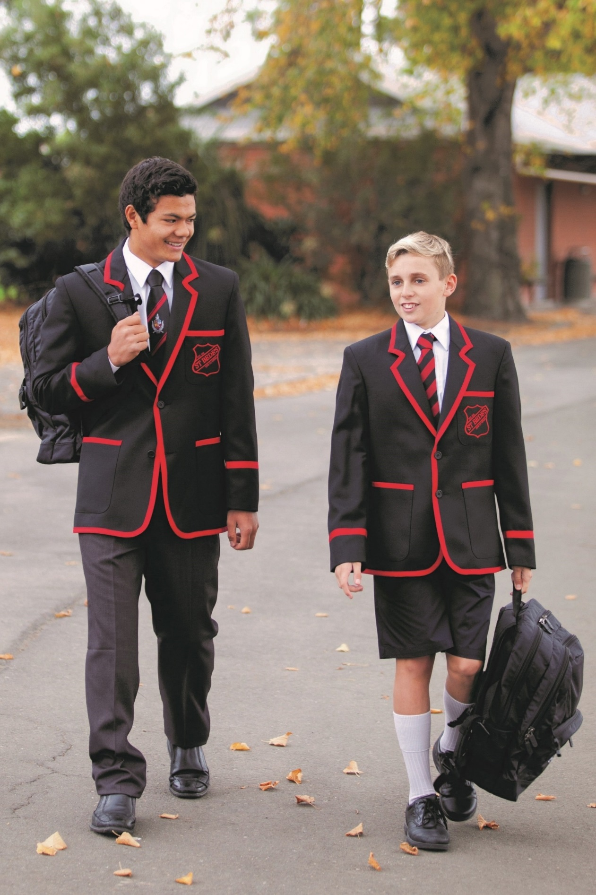
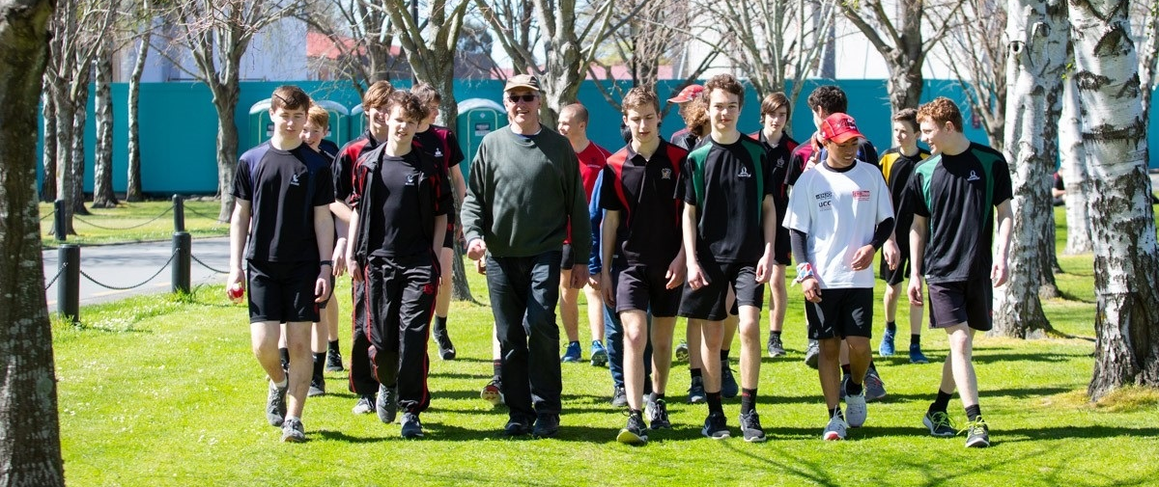
Uniform
All International Students are to wear correct College uniform at all times.
In the first few days of a students arrival, the uniform is fitted. The initial purchase of the uniform is covered by the invoice paid during the application process.
There are slight differences in the uniform that Juniors wear compared with the uniform worn by Senior Students. Year 13 students wear a different tie, and senior students may wear a different jersey if they wish.
All students will receive a sport uniform which includes a House Shirt with the House Logo and colour featuring on it.
You will need to bring your own pair of School Shoes. These are to be closed-toe, and black. The style can be either lace up or loafer style. Canvas shoes or sports shoes are not permitted as school shoes.
A belt and black socks are useful to bring.
The uniform can only be purchased from the College Uniform shop.
When they leave, many International Students donate their uniform to the College for hiring to short-term students, however, the tie and House shirt make good keepsakes of your time at St Bede’s.
The College Shop stocks various gift items that you can take home as well

Slide 17
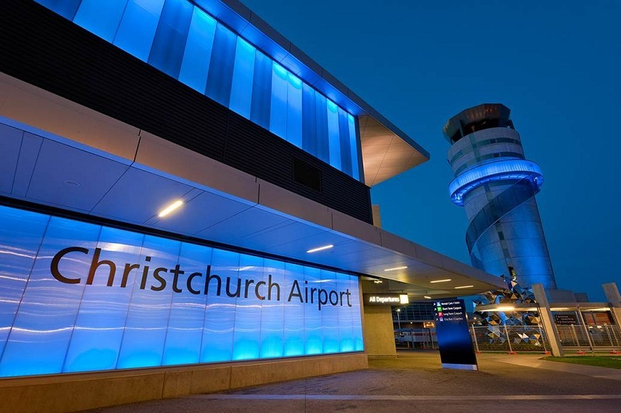
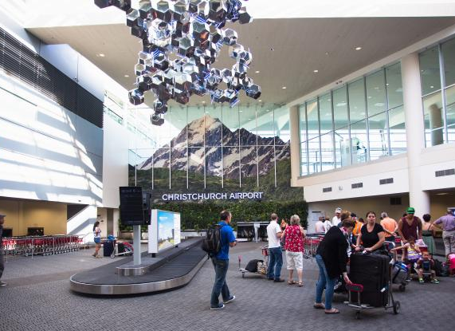

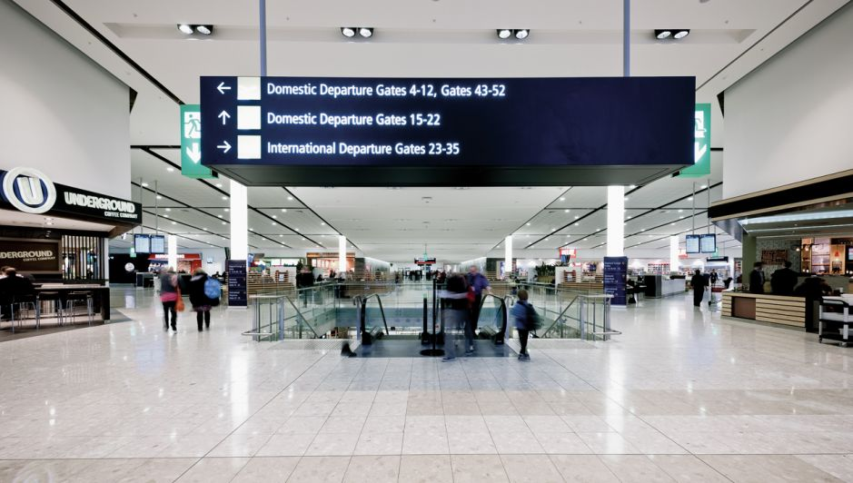
Arriving in Christchurch
Christchurch Airport is the gateway to the South Island.
When you arrive in New Zealand, you will need to go through Customs and
Immigration. It is important that you complete your Passenger Arrival Card fully, completely and honestly.
New Zealand has very strict biosecurity laws and there are harsh penalties if these are broken. For more information go to: Items to Declare
If you arrive at the Auckland International Terminal, you will need to transfer to the Domestic Terminal to continue to Christchurch. This is well signposted and will take around 10 mins walking or there are free buses every 15 mins. There are boards throughout the terminal in various languages to assist visitors.
Once at Christchurch, you will be met by either a representative of your agent or someone from St Bede’s. These arrangements will be confirmed before you leave home.
You will then be taken to your Homestay or to the St Bede’s College Boarding School, depending on where you will be staying while you are here.

Slide 18
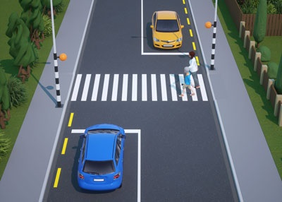
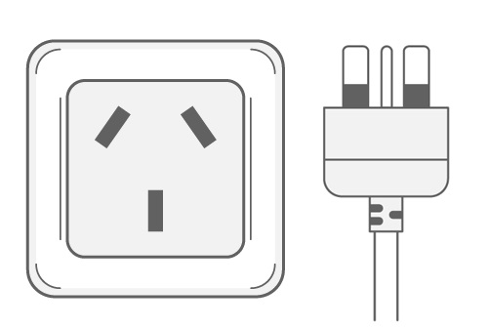


Living in Christchurch
In Christchurch, we drive on the left side of the road; this means you MUST be very careful when crossing the road if you come from a country where drivers drive on the opposite side of the road.
The safest way is to cross at either a controlled crossing or a pedestrian (zebra) crossing.
Even then: Stop, Look Left and listen, look Right and listen, Look Left again. ONLY if it safe to do so, Cross the Road.
In New Zealand our power voltage is 230 V and the frequency is 50 Hz. You can use your electric devices here if the standard voltage in your country is between 220 - 240 V (as it is in the UK, Europe, Australia and most of Asia and Africa).
We have a three pin socket; you will need to bring a plug adapter if this is different to the plugs at home.
New Zealand homes are generally heated using electricity, very few homes have reticulated gas. Water heating is a major expense in Christchurch households, and this water is stored in small tanks. We ask that all our students are aware of this and keep their showers short.
Christchurch tap water is safe to drink. The Christchurch City Council is undergoing a large scale operation to upgrade the water well heads around the city, this has meant additives in the water have altered the taste very slightly in some parts of the city.
You will need a New Zealand SIM card for your mobile phone. These can be purchased very cheaply and either your agent or the College will help you get this when you arrive.

Slide 19

What to Bring

