Slide 1

More Trees Please
An Otago Polytechnic student project
Semester One 2018

Slide 2
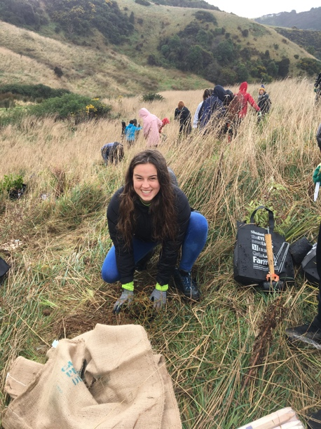
Otago University Students Association
2 partners
Conservation Volunteers Coastal Otago

Slide 3
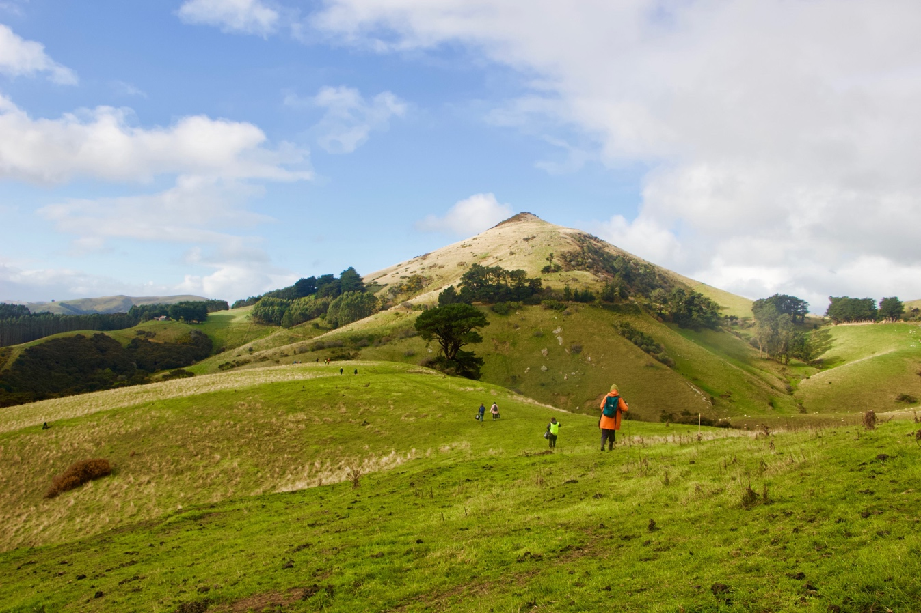
1 beautiful location

Slide 4
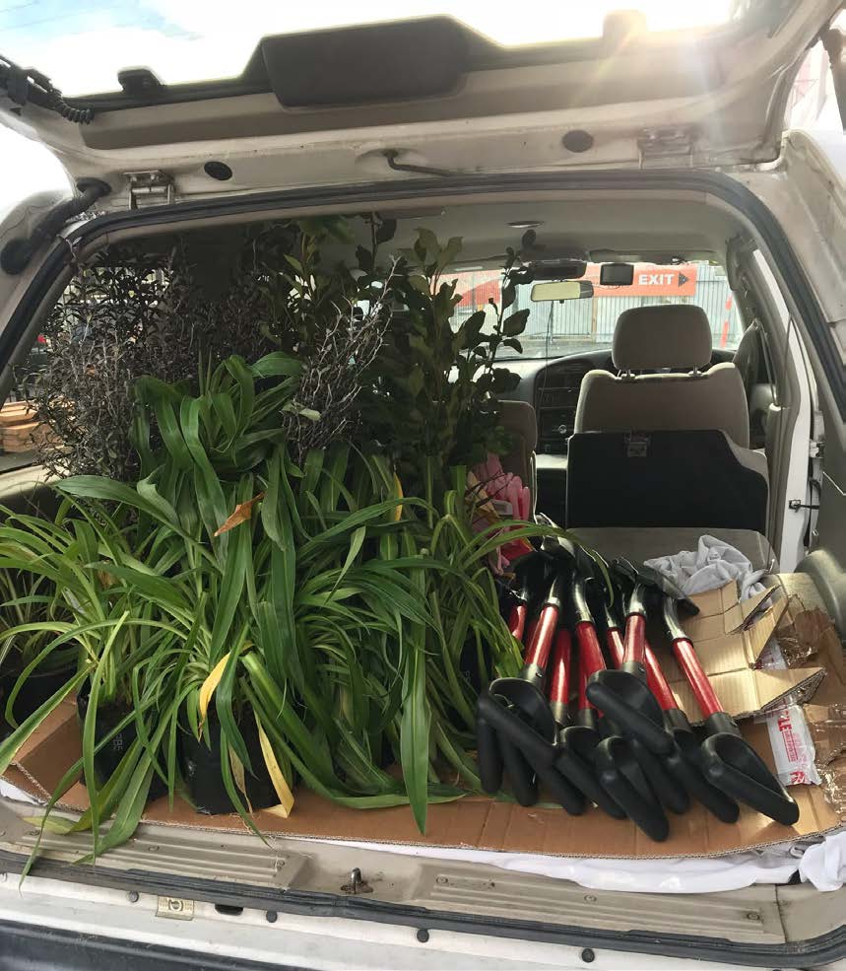
3 generous sponsors
Mitre 10
Go Bus
Otago Polytechnic

Slide 5
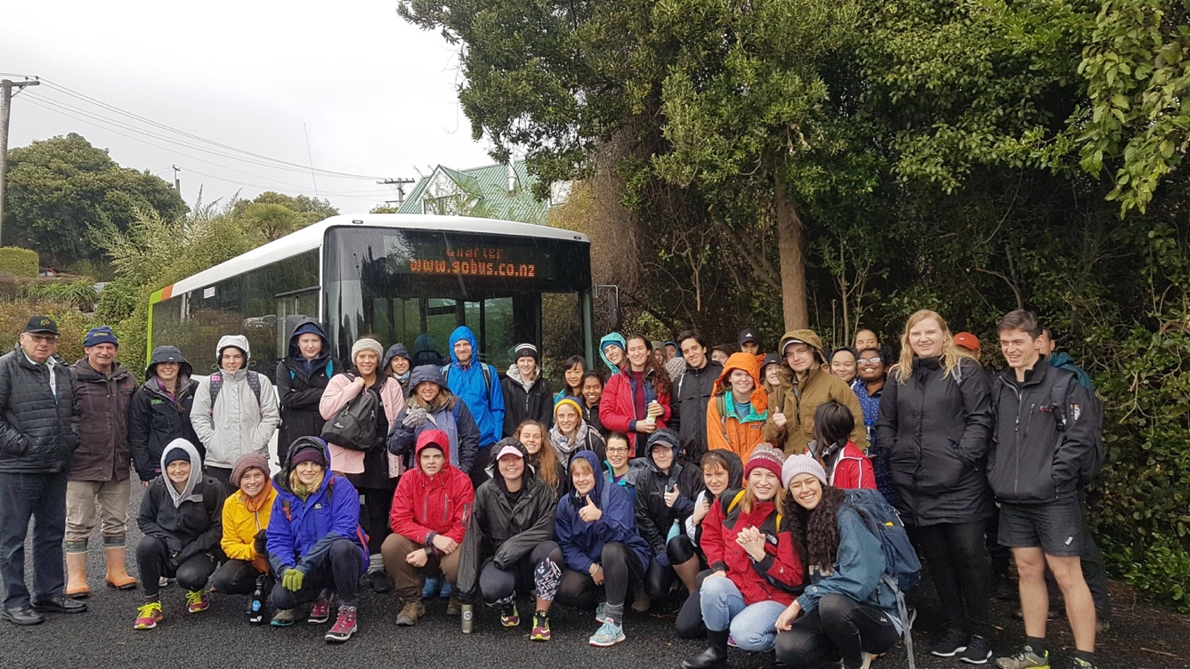
42 student volunteers

Slide 6
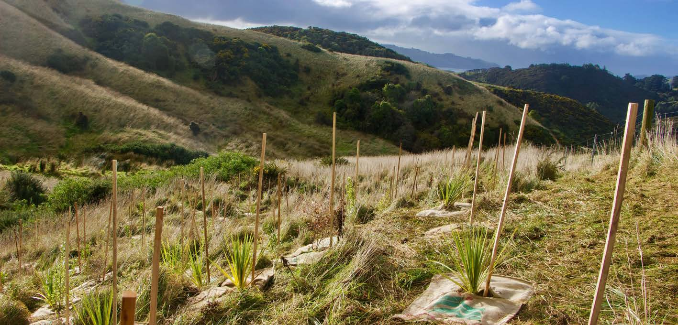
200 trees

Slide 7
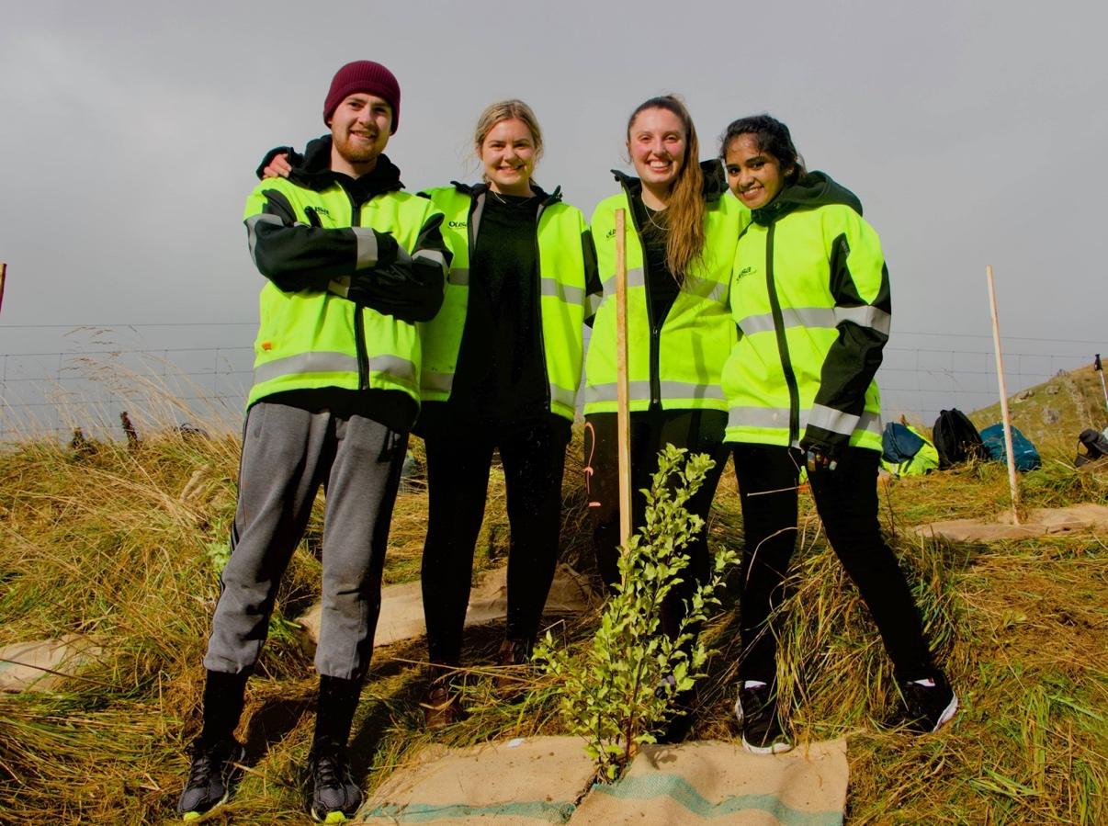
4 Tourism students

