Slide 1

St Catherine’s College
Sports Awards 2023
A celebration of the sporting achievements of our students
Notes:
Antonina – Welcome
Special Character Leaders- Opening Prayer

Slide 2


St Catherine’s College
2023 Prizegiving
BADMINTON

Slide 3
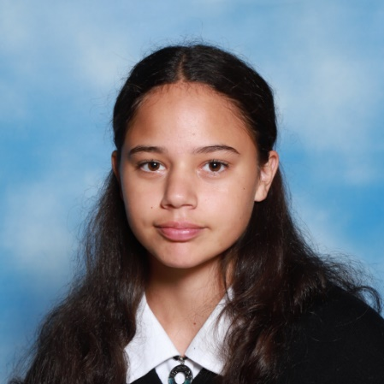
St Catherine’s College
2023 Prizegiving
JUNIOR BADMINTON
SCC 1 Most Improved Player
Maddison Coleman

Slide 4
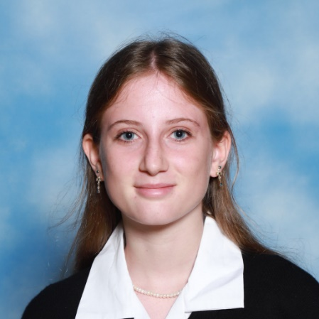
St Catherine’s College
2023 Prizegiving
JUNIOR BADMINTON
SCC 1 Most Improved Player
Maddison Coleman
SCC 1 Most Valuable Player
Lilly-Anne Menzies

Slide 5
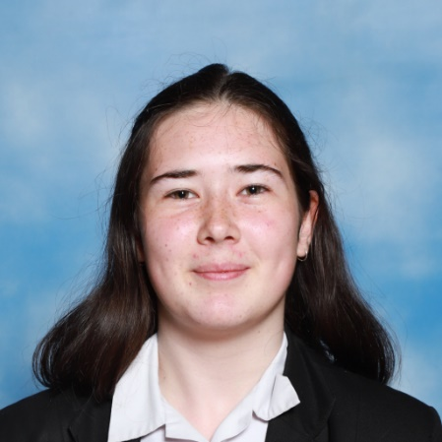
St Catherine’s College
2023 Prizegiving
SENIOR BADMINTON
SCC 5 Most Improved Player
Ella de Jong

Slide 6
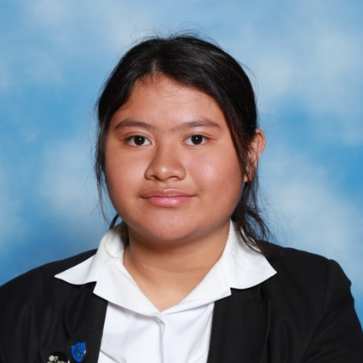
St Catherine’s College
2023 Prizegiving
SENIOR BADMINTON
SCC 5 Most Improved Player
Ella de Jong
SCC 5 Most Valuable Player
Joces Tolentino

Slide 7
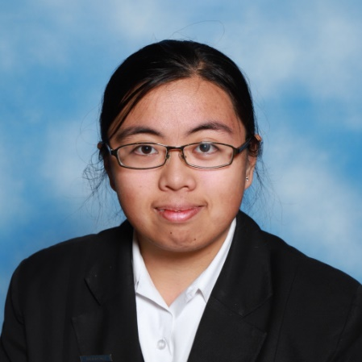
St Catherine’s College
2023 Prizegiving
SENIOR BADMINTON
SCC 5 Most Improved Player
Ella de Jong
SCC 5 Most Valuable Player
Joces Tolentino
SCC 4 Most Improved Player
Michaela Borja

Slide 8
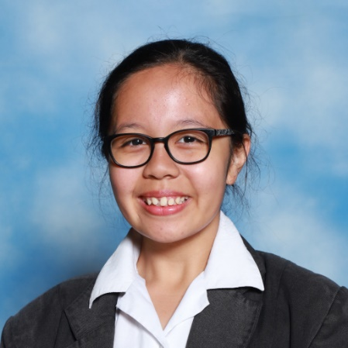
St Catherine’s College
2023 Prizegiving
SENIOR BADMINTON
SCC 5 Most Improved Player
Ella de Jong
SCC 5 Most Valuable Player
Joces Tolentino
SCC 4 Most Improved Player
Michaela Borja
SCC 4 Most Valuable Player
Mishka Calizar

Slide 9
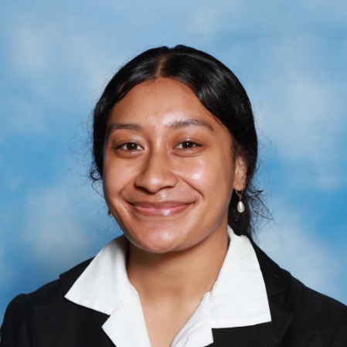
St Catherine’s College
2023 Prizegiving
SENIOR BADMINTON
SCC 3 Most Improved Player
Lupe Ropati

Slide 10
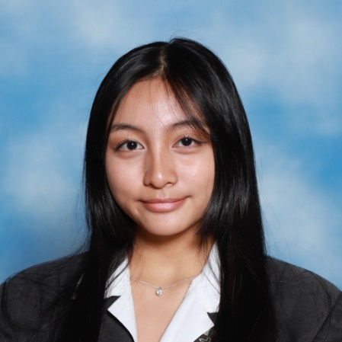
St Catherine’s College
2023 Prizegiving
SENIOR BADMINTON
SCC 3 Most Improved Player
Lupe Ropati
SCC 3 Most Valuable Player
Eunice Quito

Slide 11
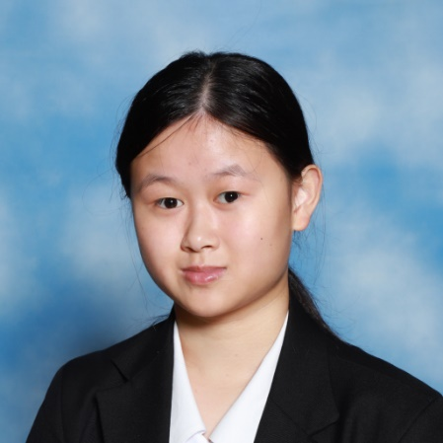
St Catherine’s College
2023 Prizegiving
SENIOR BADMINTON
SCC 3 Most Improved Player
Lupe Ropati
SCC 3 Most Valuable Player
Eunice Quito
SCC 2 Most Improved Player
Joanna Tim

Slide 12
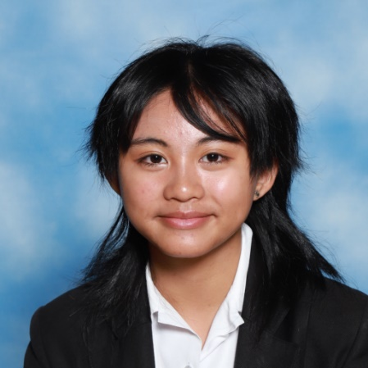
St Catherine’s College
2023 Prizegiving
SENIOR BADMINTON
SCC 3 Most Improved Player
Lupe Ropati
SCC 3 Most Valuable Player
Eunice Quito
SCC 2 Most Improved Player
Joanna Tim
SCC 2 Most Valuable Player
Anna Quito

Slide 13
St Catherine’s College
2023 Prizegiving
NETBALL

Slide 14
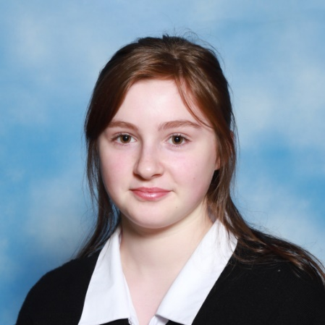
St Catherine’s College
2023 Prizegiving
JUNIOR NETBALL
SCC 5 Most Improved Player
Mia Adams

Slide 15
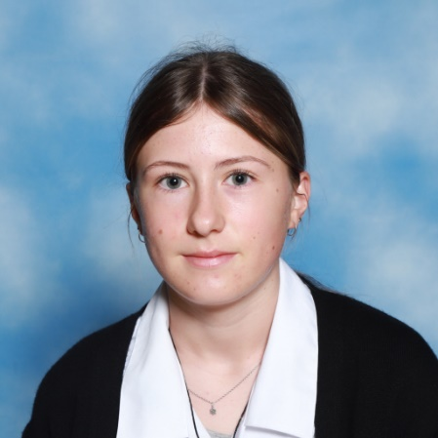
St Catherine’s College
2023 Prizegiving
JUNIOR NETBALL
SCC 5 Most Improved Player
Mia Adams
SCC 5 Most Valuable Player
Liliana Natoli

Slide 16
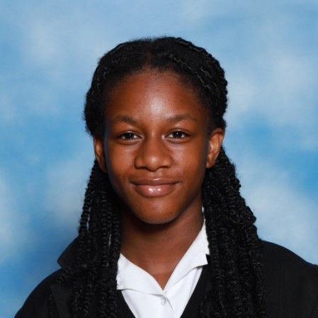
St Catherine’s College
2023 Prizegiving
JUNIOR NETBALL
SCC 5 Most Improved Player
Mia Adams
SCC 5 Most Valuable Player
Liliana Natoli
SCC 4 Most Improved Player
Chimere Kelechi

Slide 17
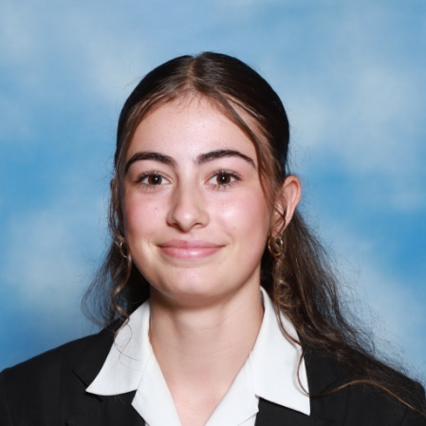
St Catherine’s College
2023 Prizegiving
JUNIOR NETBALL
SCC 5 Most Improved Player
Mia Adams
SCC 5 Most Valuable Player
Liliana Natoli
SCC 4 Most Improved Player
Chimere Kelechi
SCC 4 Most Valuable Player
Petra Bouras

Slide 18
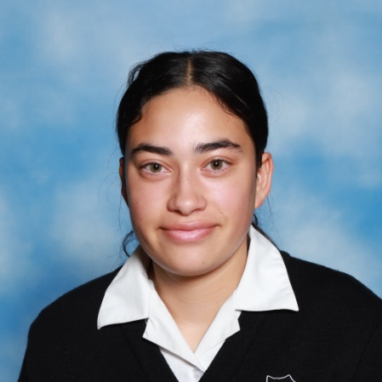
St Catherine’s College
2023 Prizegiving
SENIOR NETBALL
SCC 2 Most Improved Player
Marama Cowan-Rauhihi

Slide 19
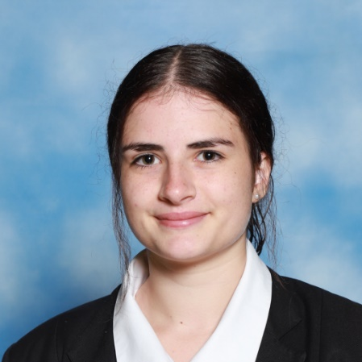
St Catherine’s College
2023 Prizegiving
SENIOR NETBALL
SCC 2 Most Improved Player
Marama Cowan-Rauhihi
SCC 2 Most Valuable Player
Helena Basile

Slide 20
St Catherine’s College
2023 Prizegiving
VOLLEYBALL

Slide 21
St Catherine’s College
2023 Prizegiving
VOLLEYBALL
Junior Blue Most Improved Player
Lilly-Anne Menzies

Slide 22
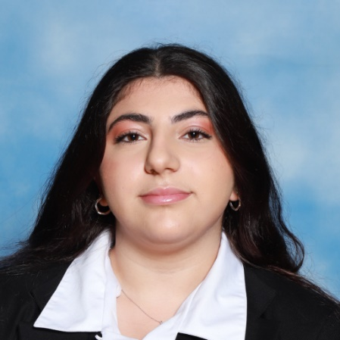
St Catherine’s College
2023 Prizegiving
VOLLEYBALL
Junior Blue Most Improved Player
Lilly-Anne Menzies
Junior Blue Most Valuable Player
Miriam Issa

Slide 23
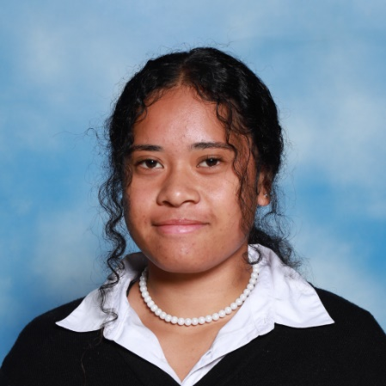
St Catherine’s College
2023 Prizegiving
VOLLEYBALL
Junior Blue Most Improved Player
Lilly-Anne Menzies
Junior Blue Most Valuable Player
Miriam Issa
Senior B Most Improved Player
Alize Va’aua

Slide 24
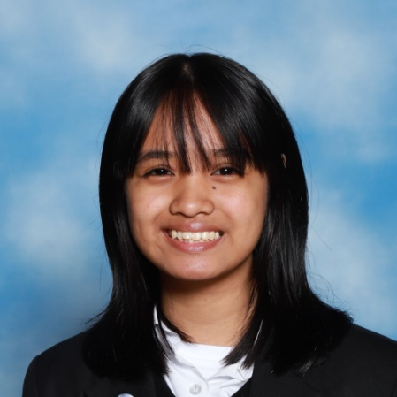
St Catherine’s College
2023 Prizegiving
VOLLEYBALL
Junior Blue Most Improved Player
Lilly-Anne Menzies
Junior Blue Most Valuable Player
Miriam Issa
Senior B Most Improved Player
Alize Va’aua
Senior B Most Valuable Player
Miranda Lerum

Slide 25
St Catherine’s College
2023 Prizegiving
ULTIMATE FRISBEE

Slide 26
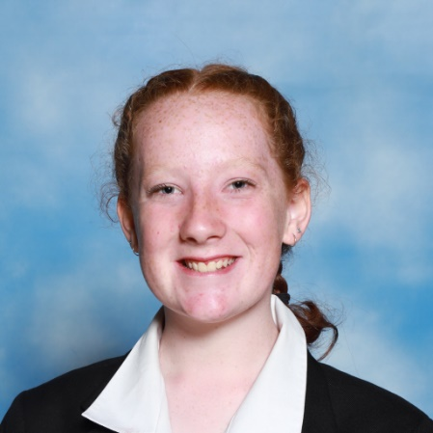
St Catherine’s College
2023 Prizegiving
ULTIMATE FRISBEE
Most Improved Player
Isabelle Neal

Slide 27
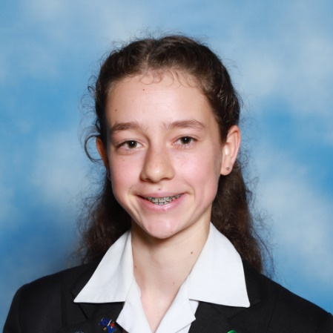
St Catherine’s College
2023 Prizegiving
ULTIMATE FRISBEE
Most Improved Player
Isabelle Neal
Most Valuable Player
Hannah Stark

Slide 28
St Catherine’s College
2023 Prizegiving
  SPORTS COMMITTEE

Slide 29
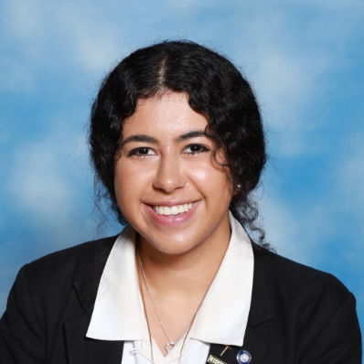
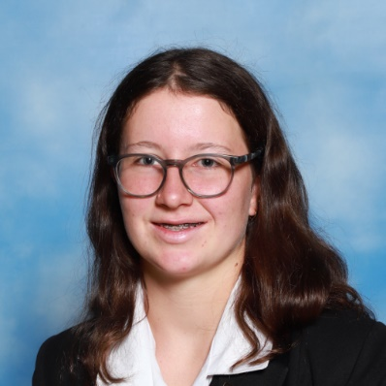
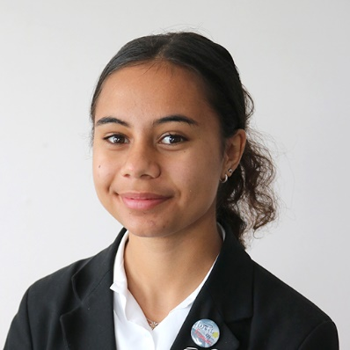
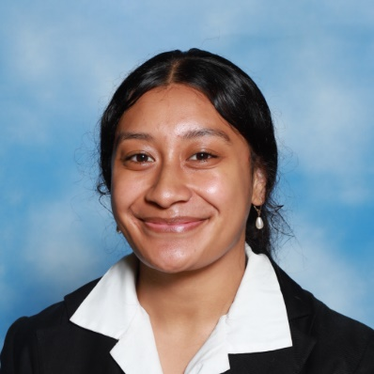
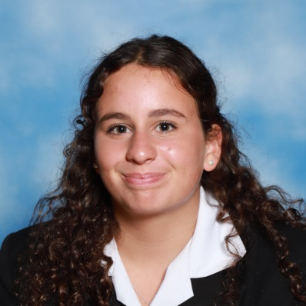
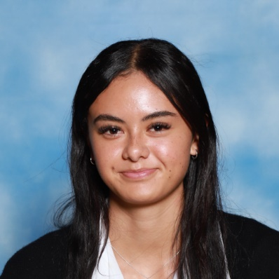
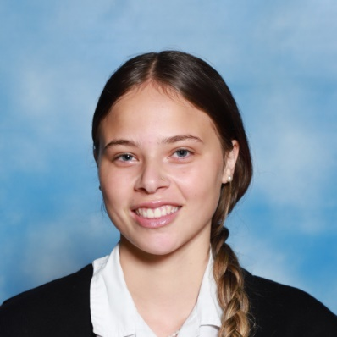
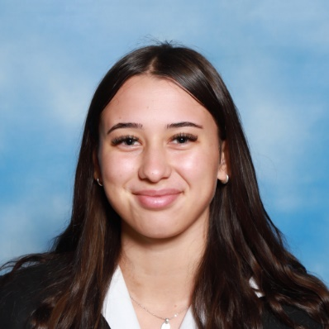
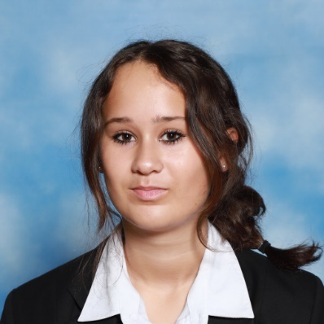
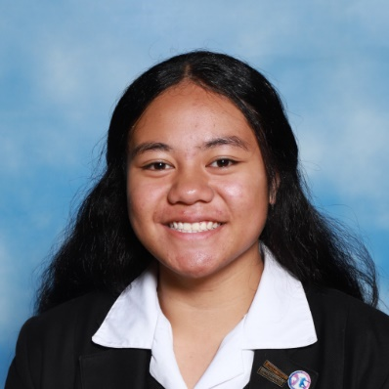
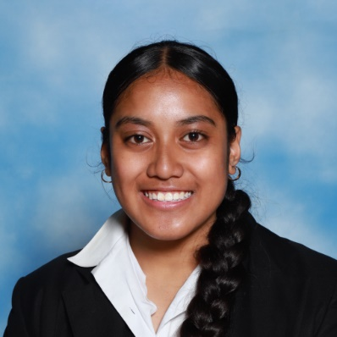
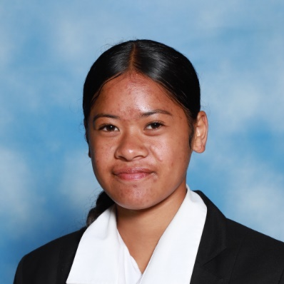
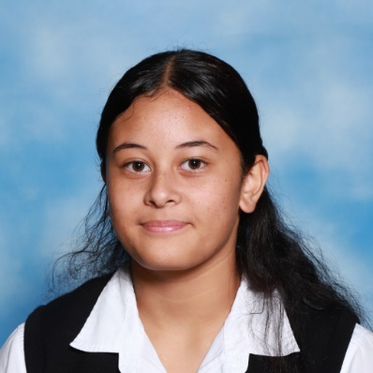
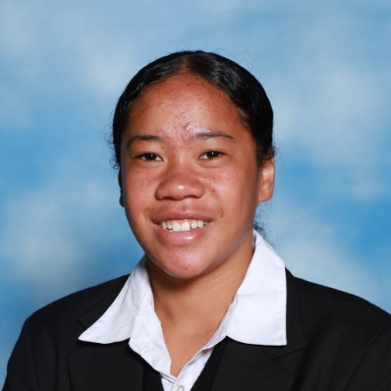
St Catherine’s College
2023 Prizegiving
SPORTS COMMITTEE

Slide 30
St Catherine’s College
2023 Prizegiving
ATHLETICS

Slide 31

St Catherine’s College
2023 Prizegiving
ATHLETICS
Junior Champion
Star Va’aua

Slide 32
St Catherine’s College
2023 Prizegiving
ATHLETICS
Junior Champion
Star Va’aua
Intermdiate Champion
Helena Basile

Slide 33
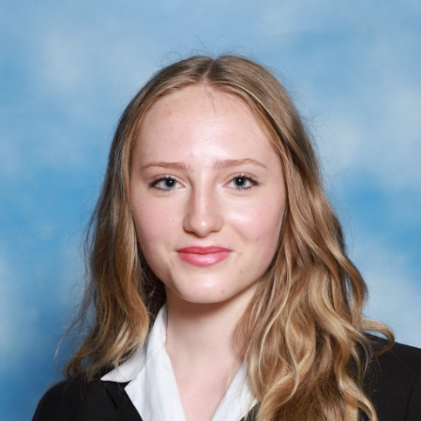
St Catherine’s College
2023 Prizegiving
ATHLETICS
Junior Champion
Star Va’aua
Intermdiate Champion
Helena Basile
Senior Champion
Kate Woolcott

Slide 34
St Catherine’s College
2023 Prizegiving
BADMINTON

Slide 35
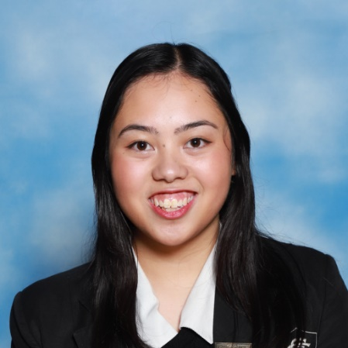
St Catherine’s College
2023 Prizegiving
SENIOR BADMINTON
Senior Most Improved Player
Bianca Blanch

Slide 36
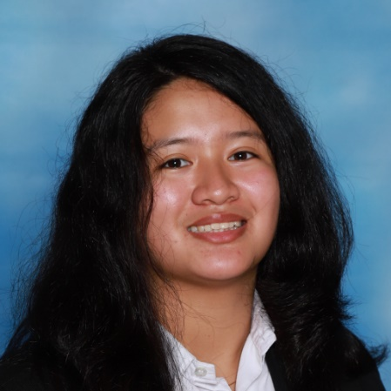
St Catherine’s College
2023 Prizegiving
SENIOR BADMINTON
Senior Most Improved Player
Bianca Blanch
John Compton Cup for the Senior Badminton Player of the year
Ayesha Mina

Slide 37
St Catherine’s College
2023 Prizegiving
BASKETBALL

Slide 38

St Catherine’s College
2023 Prizegiving
BASKETBALL
Junior Player of the Year
Te Ariki Va’aua

Slide 39
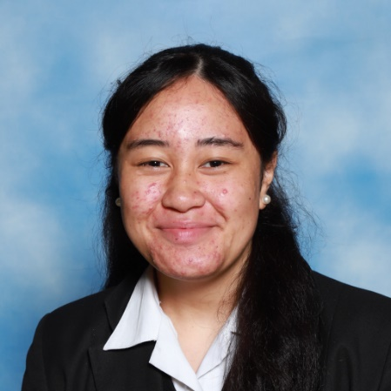
St Catherine’s College
2023 Prizegiving
BASKETBALL
Junior Player of the Year
Te Ariki Va’aua
Most Improved Senior Player
Anayah Masina

Slide 40
St Catherine’s College
2023 Prizegiving
BASKETBALL
Junior Player of the Year
Te Ariki Va’aua
Most Improved Senior Player
Anayah Masina
Senior Player of the Year
Alize Va’aua

Slide 41
St Catherine’s College
2023 Prizegiving
CRICKET

Slide 42
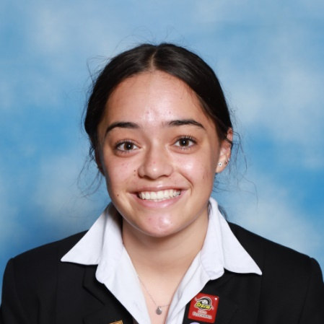
St Catherine’s College
2023 Prizegiving
CRICKET
The Spirit of Cricket Award for Enthusiastic and Positive Contribution
Leilani Garnons-Williams

Slide 43

St Catherine’s College
2023 Prizegiving
CRICKET
The Spirit of Cricket Award for Enthusiastic and Positive Contribution
Leilani Garnons-Williams
Most Improved Player
Victoria Wilson

Slide 44
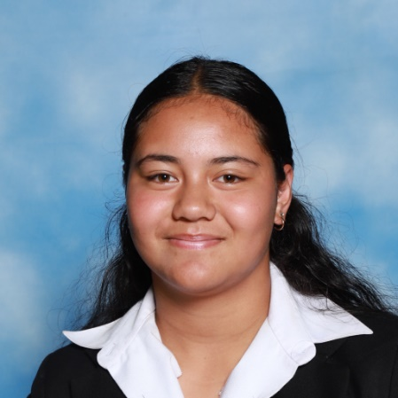
St Catherine’s College
2023 Prizegiving
CRICKET
Sylvester Cup for Junior Player of the Year
Ahena Patelesio

Slide 45
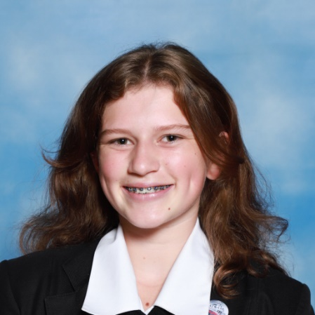
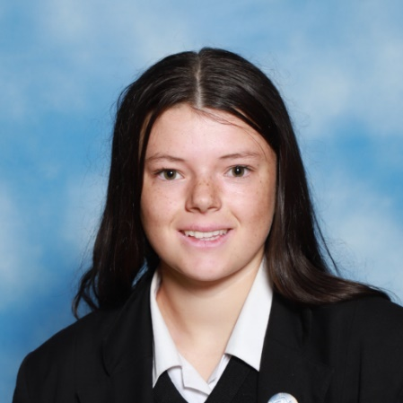
St Catherine’s College
2023 Prizegiving
CRICKET
Sylvester Cup for Junior Player of the Year
Ahena Patelesio
Stebbing Cup for Senior Player of the Year
Katherine Hickey & Meika Joyce

Slide 46
St Catherine’s College
2023 Prizegiving
CROSS COUNTRY

Slide 47
St Catherine’s College
2023 Prizegiving
CROSS COUNTRY
Under 16 Champion
Meika Joyce

Slide 48
St Catherine’s College
2023 Prizegiving
CROSS COUNTRY
Under 16 Champion
Meika Joyce
Under 19 Champion
Katherine Hickey

Slide 49
St Catherine’s College
2023 Prizegiving
FOOTBALL

Slide 50
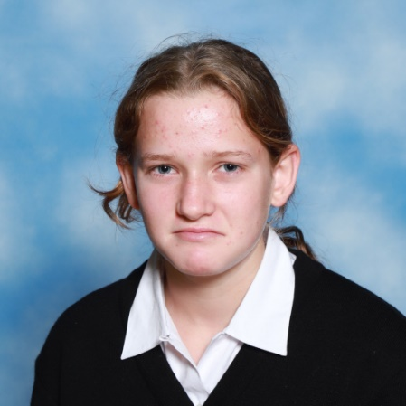
St Catherine’s College
2023 Prizegiving
FOOTBALL
Most Improved Player
Trixie Baird-Smith

Slide 51
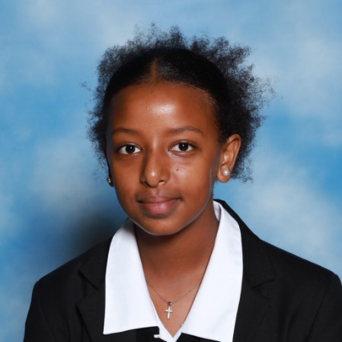
St Catherine’s College
2023 Prizegiving
FOOTBALL
Most Improved Player
Trixie Baird-Smith
Most Outstanding Player
Yordonas Tensae

Slide 52
St Catherine’s College
2023 Prizegiving
NETBALL

Slide 53
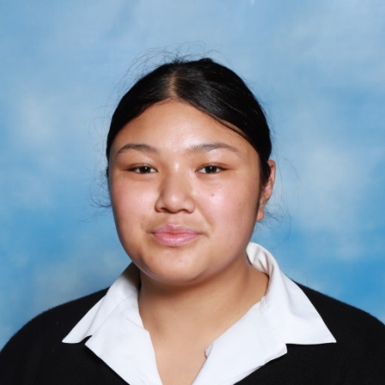
St Catherine’s College
2023 Prizegiving
NETBALL
Most Improved Junior A Netballer
Caroline Tafaese-Schmidt

Slide 54
St Catherine’s College
2023 Prizegiving
NETBALL
Most Improved Junior A Netballer
Caroline Tafaese-Schmidt
Most Valuable Junior A Netballer
Te Ariki Va’aua

Slide 55
St Catherine’s College
2023 Prizegiving
NETBALL

Slide 56
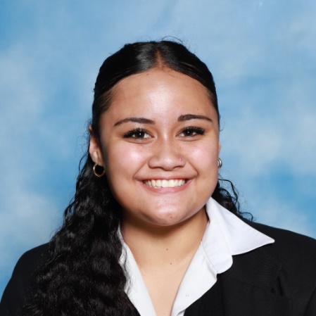
St Catherine’s College
2023 Prizegiving
NETBALL
Most Promising Junior Netballer
Cahrelle Fa’amau

Slide 57
St Catherine’s College
2023 Prizegiving
NETBALL
Most Promising Junior Netballer
Cahrelle Fa’amau
Most Improved Senior A Netballer
Leilani Garnons-Williams

Slide 58

St Catherine’s College
2023 Prizegiving
NETBALL
Most Promising Junior Netballer
Cahrelle Fa’amau
Most Improved Senior A Netballer
Leilani Garnons-Williams
Most Valuable Senior A Netballer
Christianna Tavale

Slide 59
St Catherine’s College
2023 Prizegiving
RUGBY

Slide 60
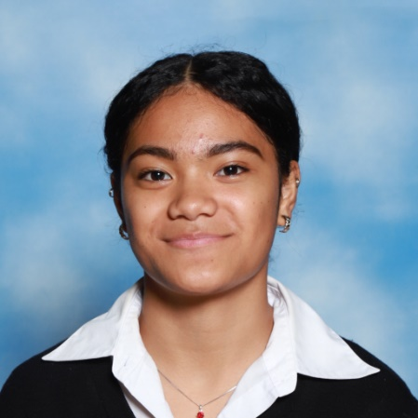
St Catherine’s College
2023 Prizegiving
RUGBY
Most Improved Player
Praise Nansen

Slide 61
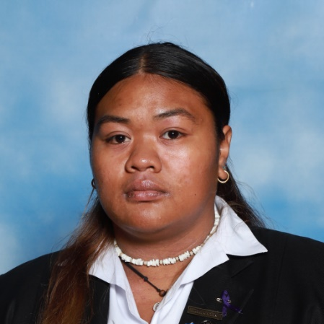
St Catherine’s College
2023 Prizegiving
RUGBY
Most Improved Player
Praise Nansen
Most Valuable Player
Maria Fa’i

Slide 62
St Catherine’s College
2023 Prizegiving
SWIMMING

Slide 63

St Catherine’s College
2023 Prizegiving
SWIMMING
Swimmer of the Year
Alessandra Unsworth

Slide 64
St Catherine’s College
2023 Prizegiving
VOLLEYBALL

Slide 65
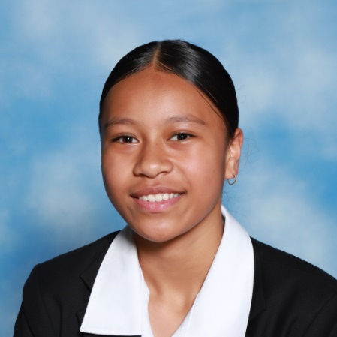
St Catherine’s College
2023 Prizegiving
VOLLEYBALL
Most Improved Junior Player
Rosie Taualii

Slide 66

St Catherine’s College
2023 Prizegiving
VOLLEYBALL
Most Improved Junior Player
Rosie Taualii
Most Valuable Junior Player
Tyla Walmsley

Slide 67

St Catherine’s College
2023 Prizegiving
VOLLEYBALL
Most Improved Senior Player
Hana Burkitt

Slide 68

St Catherine’s College
2023 Prizegiving
VOLLEYBALL
Most Improved Senior Player
Hana Burkitt
Most Valuable Senior Player
Lydia Mehari

Slide 69
St Catherine’s College
2023 Prizegiving
VOLUNTEER OF THE YEAR

Slide 70
Thank you to the following Coaches, Managers, Referee’s and Umpires
Andrew Fok, Elwyn Lipana, Lavinia Foliaki, Dalton Letawsky, Lupe Ropati, Lydia Mehari, Christianna Tavale, Rociana Ropati, Tania Hopmans, Fay Frean-Va’ai Teena Sims, Kala Madar, Chelsea Grootveld, Emmy Garnons-Williams, Clare Maihi, Palolo Bali, Sama Tulili, Chapman Vili, Masina Taualii, Krissie Va’aua, Gemma Natoli, Lynda Adams, Kirsten Bouras, Meika Joyce, Rosie Fa’I, Tara Kerr, Theresa Leo, Richard Kerr-Bell, Mandy Page, Sameer Khan, Michael Fa’amau, Laura Heil, Jules Hickey, Colin Palamo, Jenny O’Brien, Heidi Meudt, Alize Va’aua, Khaliah, Ashleigh Gore

Slide 71

St Catherine’s College
2023 Prizegiving
VOLUNTEER OF THE YEAR
ANDREW FOK
VOLLEYBALL COACH

Slide 72
St Catherine’s College
2023 Prizegiving
SERVICE TO SPORT

Slide 73

St Catherine’s College
2023 Prizegiving
BADMINTON
Ashika Chander

Slide 74

St Catherine’s College
2023 Prizegiving
BADMINTON
Ashika Chander
Isla Richards

Slide 75
St Catherine’s College
2023 Prizegiving
BASKETBALL
Alize Va’aua

Slide 76
St Catherine’s College
2023 Prizegiving
BASKETBALL
Alize Va’aua
Lupe Ropati

Slide 77

St Catherine’s College
2023 Prizegiving
NETBALL
Alize Va’aua

Slide 78

St Catherine’s College
2023 Prizegiving
NETBALL
Alize Va’aua
Amelia Savali

Slide 79

St Catherine’s College
2023 Prizegiving
NETBALL
Alize Va’aua
Amelia Savali
Elyon Leota

Slide 80

St Catherine’s College
2023 Prizegiving
NETBALL
Alize Va’aua
Amelia Savali
Elyon Leota
Hana Burkitt

Slide 81

St Catherine’s College
2023 Prizegiving
NETBALL
Alize Va’aua
Amelia Savali
Lupe Ropati
Elyon Leota
Hana Burkitt

Slide 82

St Catherine’s College
2023 Prizegiving
NETBALL
Alize Va’aua
Amelia Savali
Lupe Ropati
Madison Kooiman-Vili
Elyon Leota
Hana Burkitt

Slide 83

St Catherine’s College
2023 Prizegiving
NETBALL
Alize Va’aua
Amelia Savali
Lupe Ropati
Madison Kooiman-Vili
Elyon Leota
Hana Burkitt
Marama Cowan-Rauhihi

Slide 84

St Catherine’s College
2023 Prizegiving
NETBALL
Alize Va’aua
Amelia Savali
Lupe Ropati
Madison Kooiman-Vili
Elyon Leota
Hana Burkitt
Marama Cowan-Rauhihi
Mihi-Terina Grootveld

Slide 85
St Catherine’s College
2023 Prizegiving
SWIMMING
Alessandra Unsworth

Slide 86
St Catherine’s College
2023 Prizegiving
VOLLEYBALL
Alize Va’aua

Slide 87
St Catherine’s College
2023 Prizegiving
VOLLEYBALL
Alize Va’aua
Elyon Leota

Slide 88

St Catherine’s College
2023 Prizegiving
VOLLEYBALL
Alize Va’aua
Elyon Leota
Gemma Lipana

Slide 89
St Catherine’s College
2023 Prizegiving
VOLLEYBALL
Alize Va’aua
Elyon Leota
Gemma Lipana
Hana Burkitt

Slide 90
St Catherine’s College
2023 Prizegiving
VOLLEYBALL
Alize Va’aua
Elyon Leota
Lupe Ropati
Gemma Lipana
Hana Burkitt

Slide 91

St Catherine’s College
2023 Prizegiving
VOLLEYBALL
Alize Va’aua
Elyon Leota
Lupe Ropati
Lydia Mehari
Gemma Lipana
Hana Burkitt

Slide 92

St Catherine’s College
2023 Prizegiving
VOLLEYBALL
Alize Va’aua
Elyon Leota
Lupe Ropati
Lydia Mehari
Gemma Lipana
Hana Burkitt
Rhiley Coleman

Slide 93
St Catherine’s College
2023 Prizegiving
AMBASSADOR TO SPORT

Slide 94
St Catherine’s College
2023 Prizegiving
AMBASSADOR TO SPORT 2023
This is a student who we wish to recognise in a higher capacity.
The criteria for this award are as follow;
The length of time representing the sporting code
Representation of a higher level played beyond the college competitions
Encouragement for team members/other in their sport codes
Commitment to all aspects of being involved in sports team/code
Fair play and sportsmanship
Notes:
Criteria

Slide 95

St Catherine’s College
2023 Prizegiving
AMBASSADOR TO SPORT
Lupe Ropati

Slide 96
St Catherine’s College
2023 Prizegiving
Thank - You
Final prayer
Notes:
Special Character Leaders to say the final, prayer,

