Slide 1
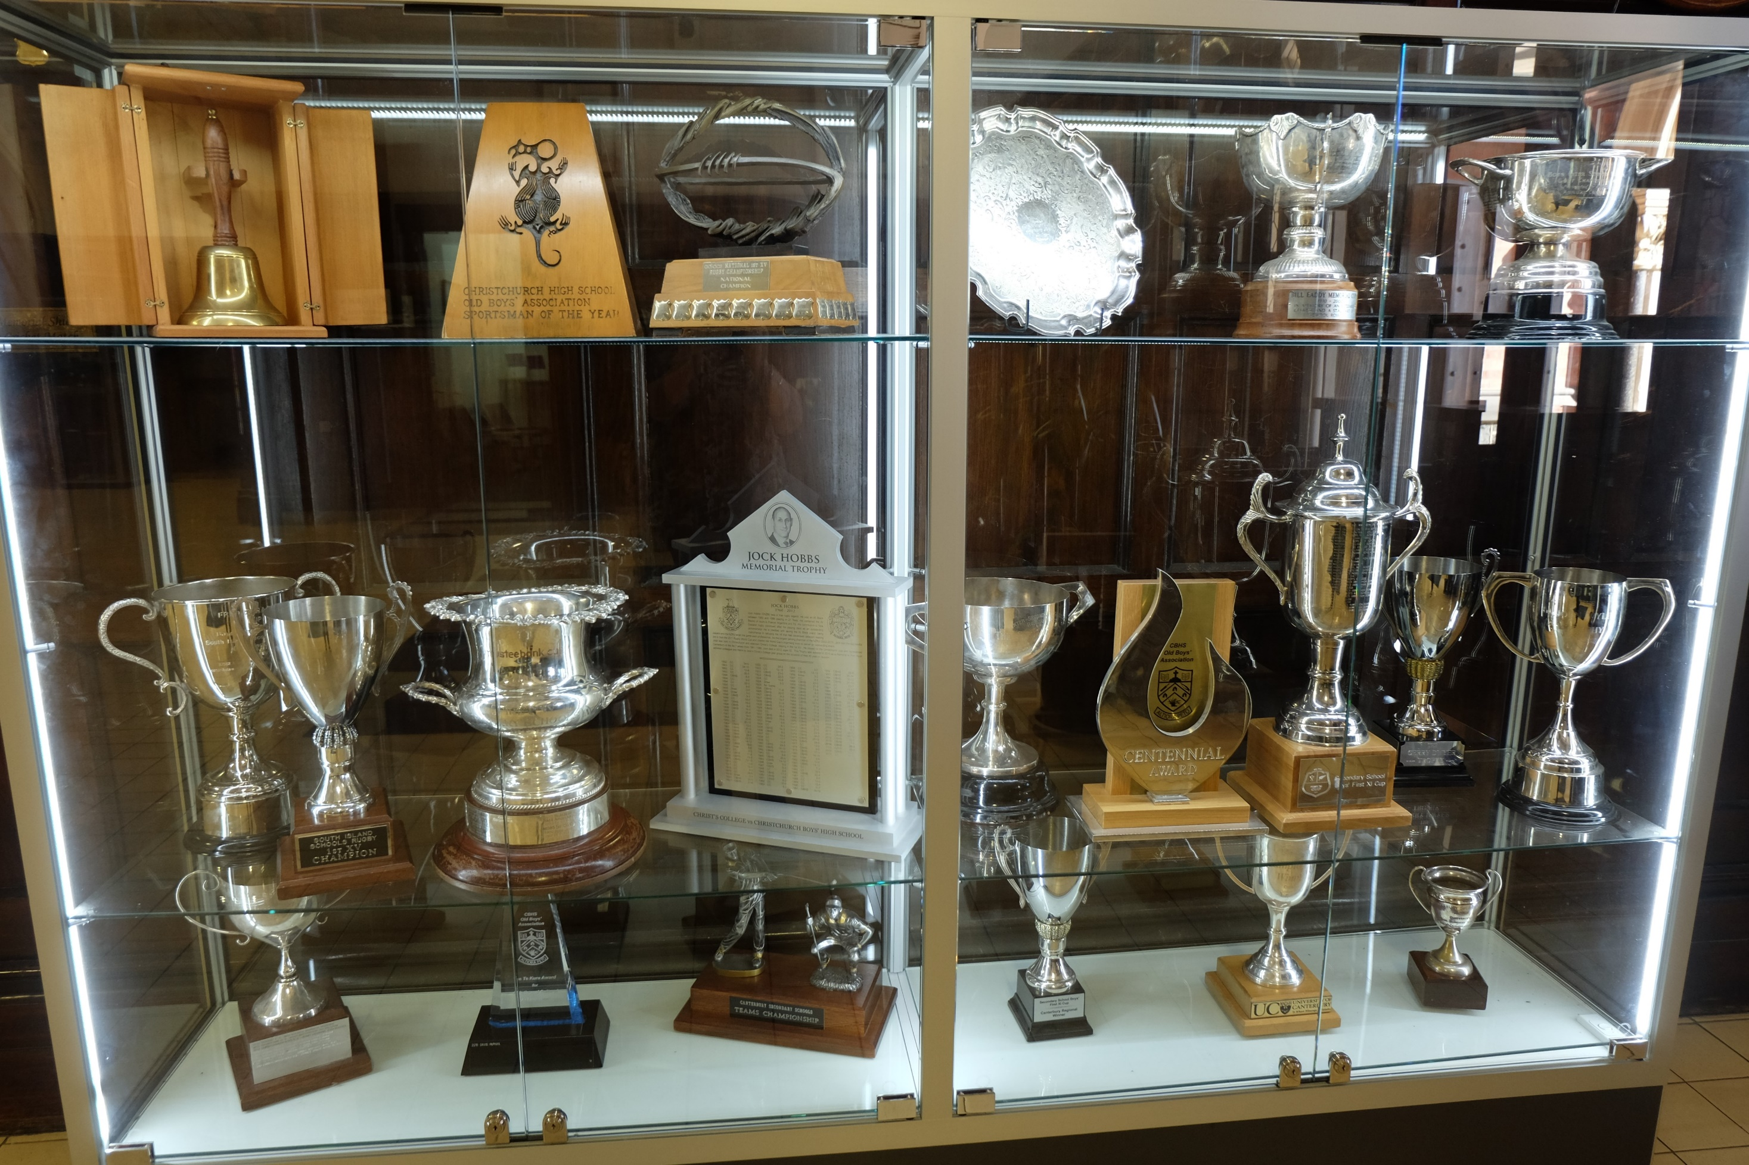
CBHS Sports Achievements

Slide 2
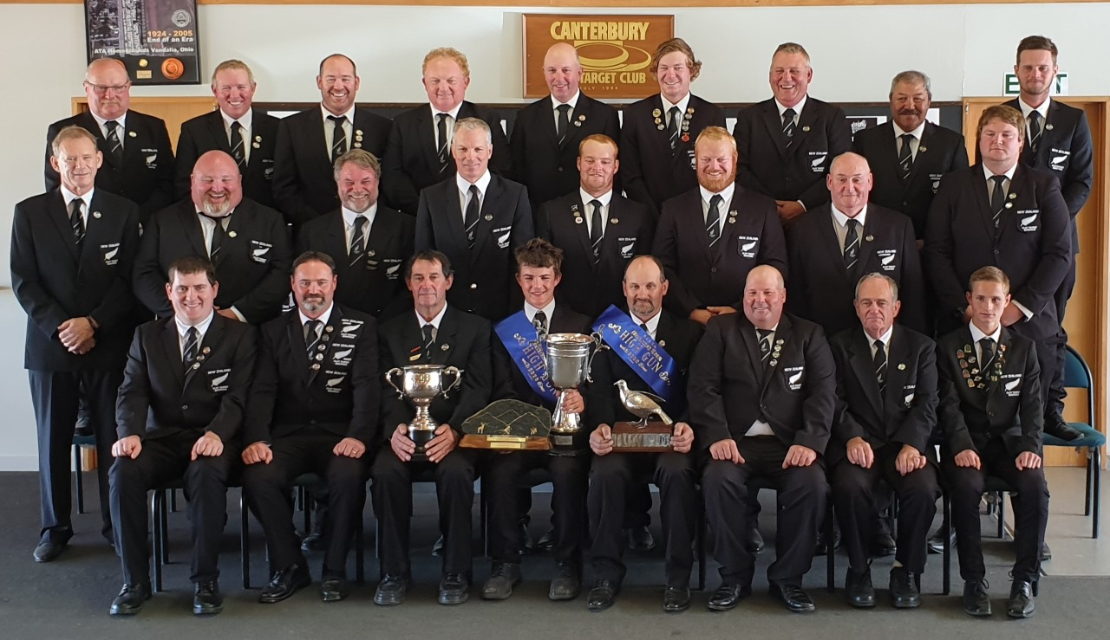
CBHS Sports Achievements
Griffin Evans
NZ Open Shooting Team
NZCTA Murray Havill Cup
NZCTA Mackintosh Qualifying High Gun Cup

Slide 3
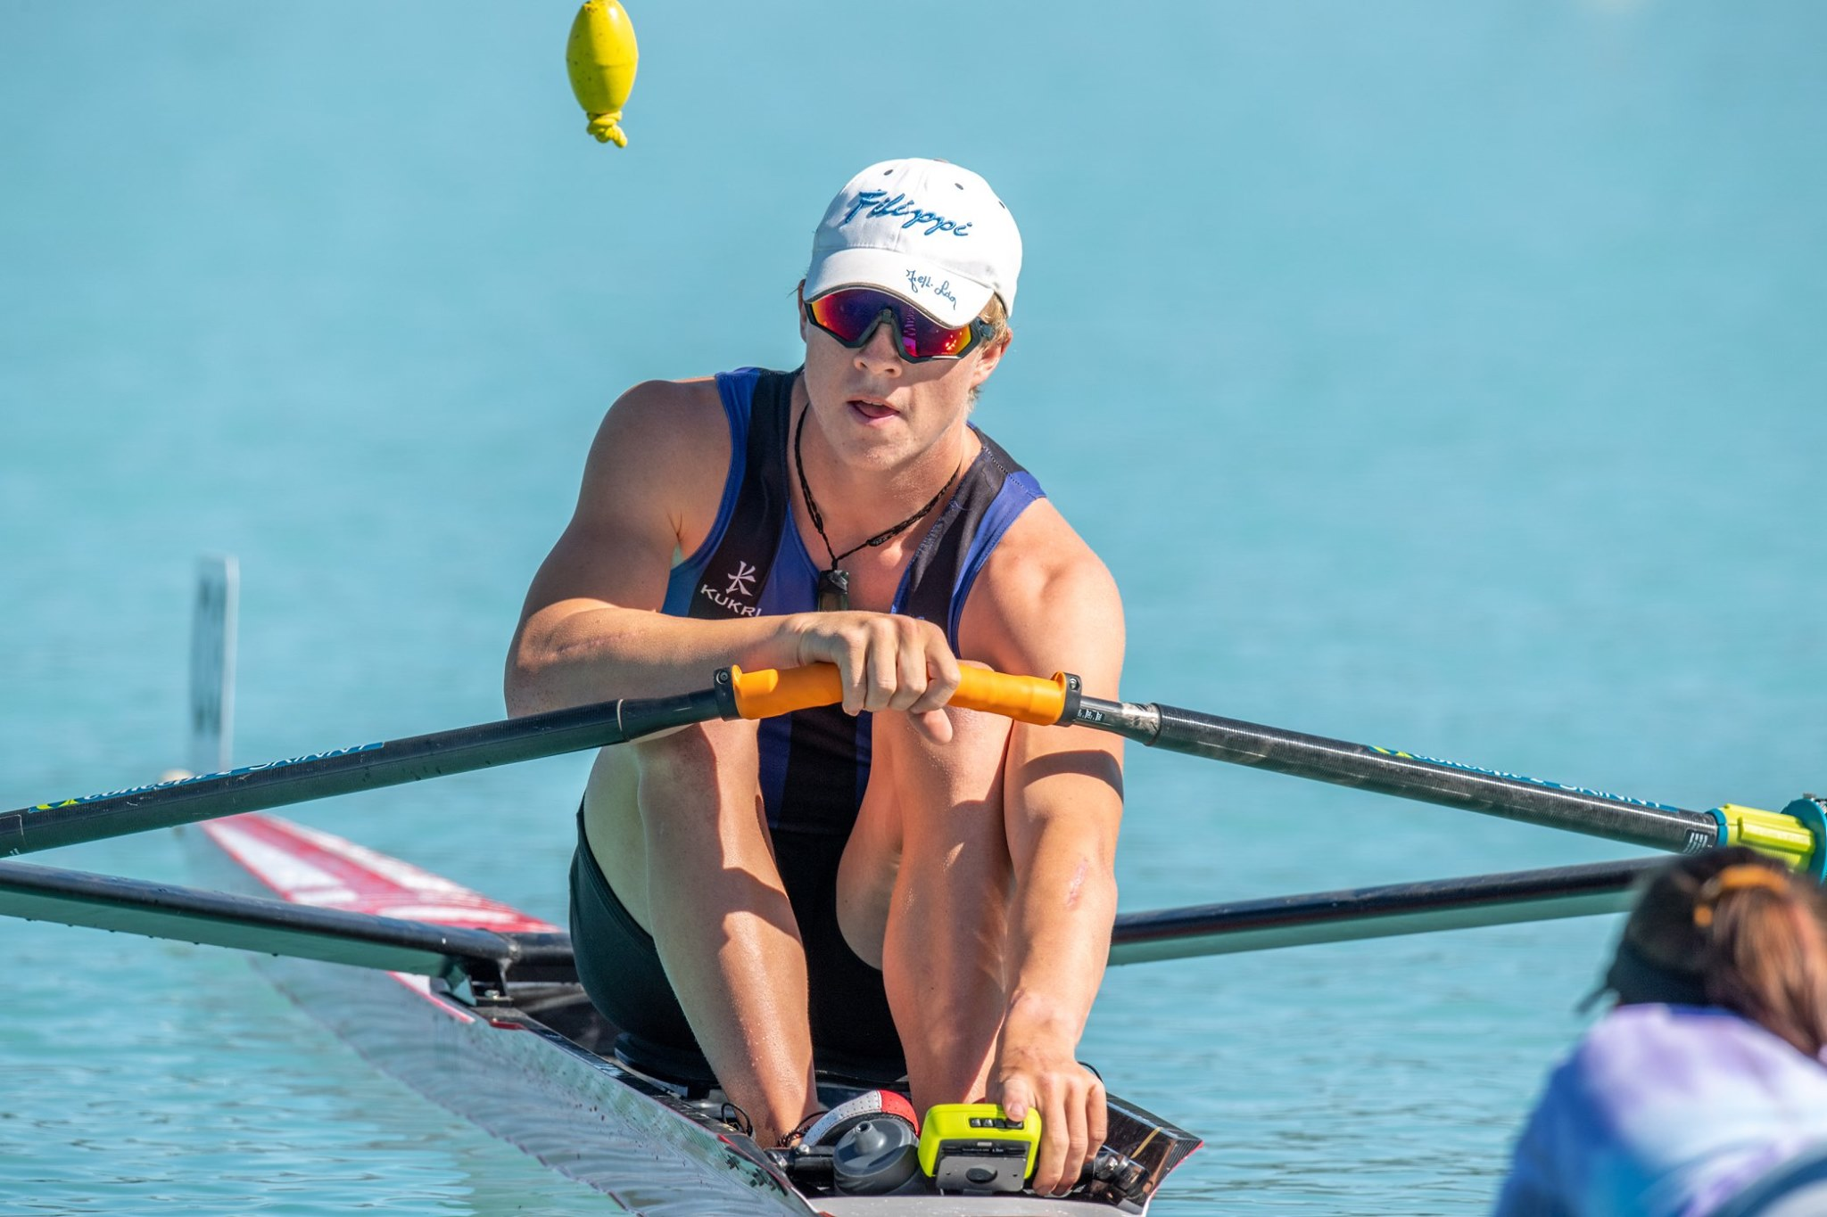
CBHS Sports Achievements
Scott Shackleton
GOLD
U18 Single Sculls U18 Double Sculls U18 Coxed Quad Sculls U18 Coxless Pair

Slide 4
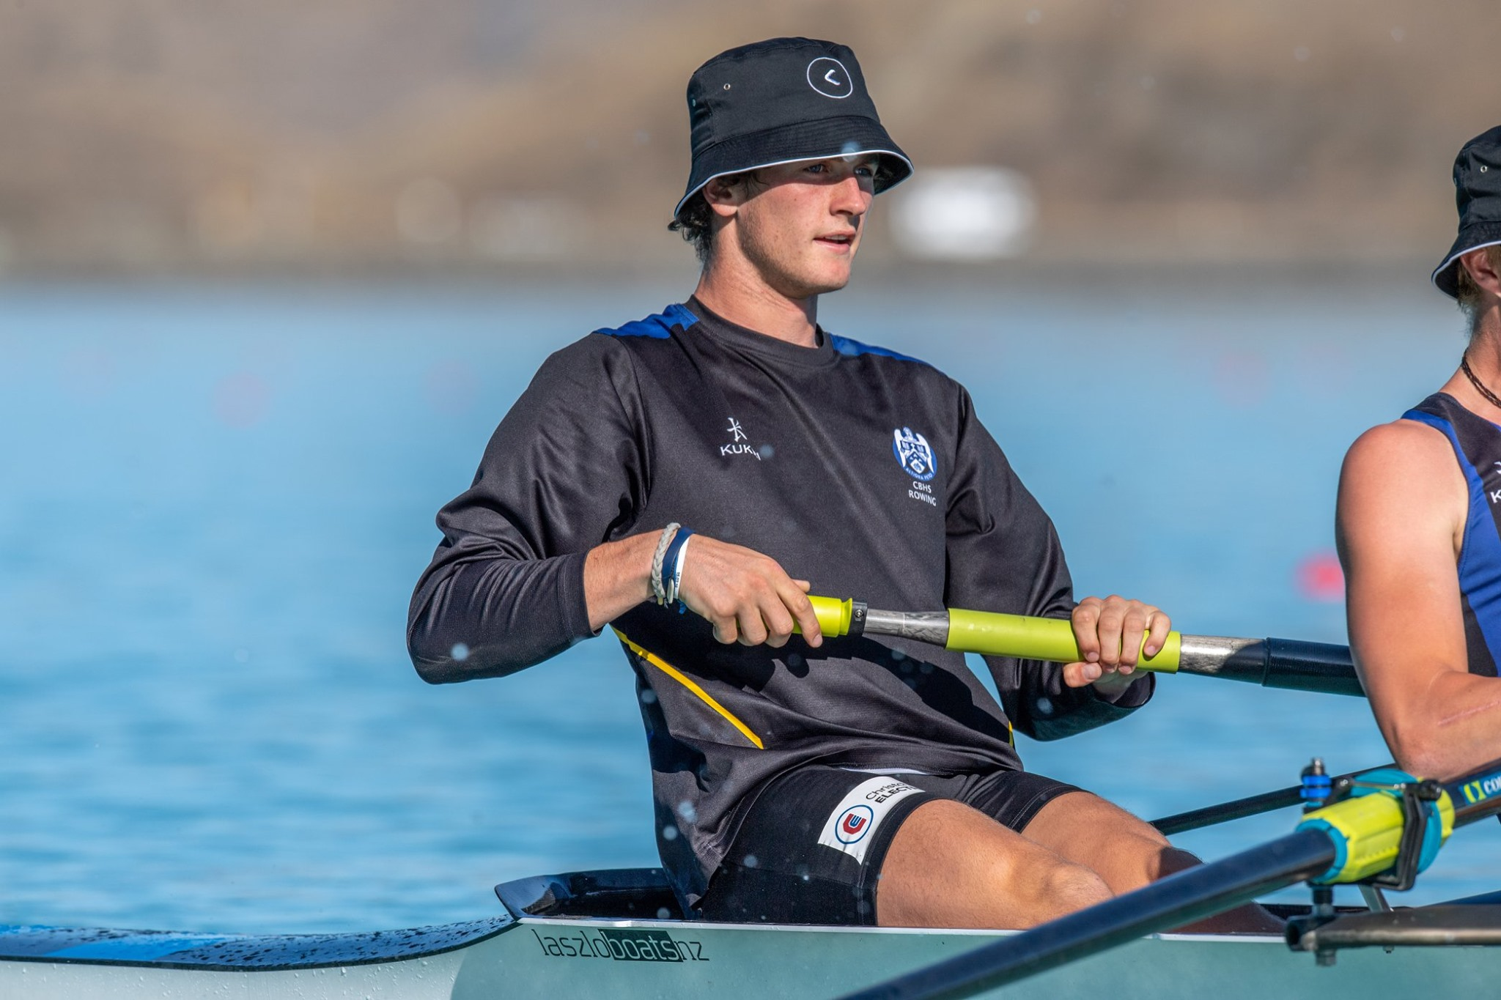
CBHS Sports Achievements
Liam Behrnes
GOLD
U18 Coxed Four
U18 Coxed Quad Sculls
U18 Coxless Pair

Slide 5
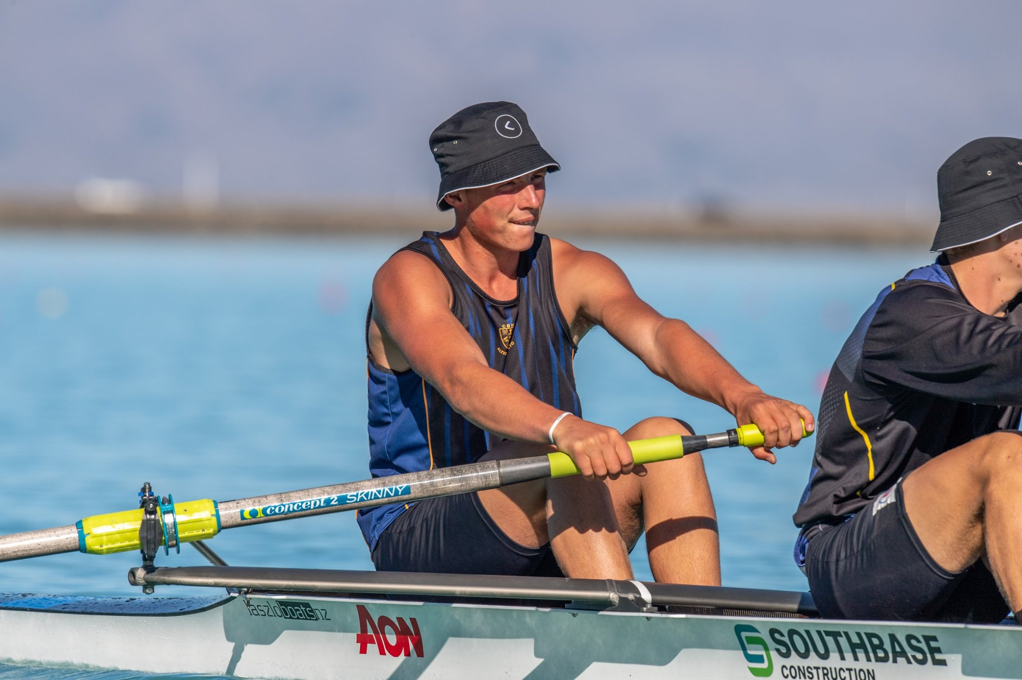
CBHS Sports Achievements
Oli Taylor
GOLD
U18 Coxed Four
U18 Coxed Quad Sculls

Slide 6
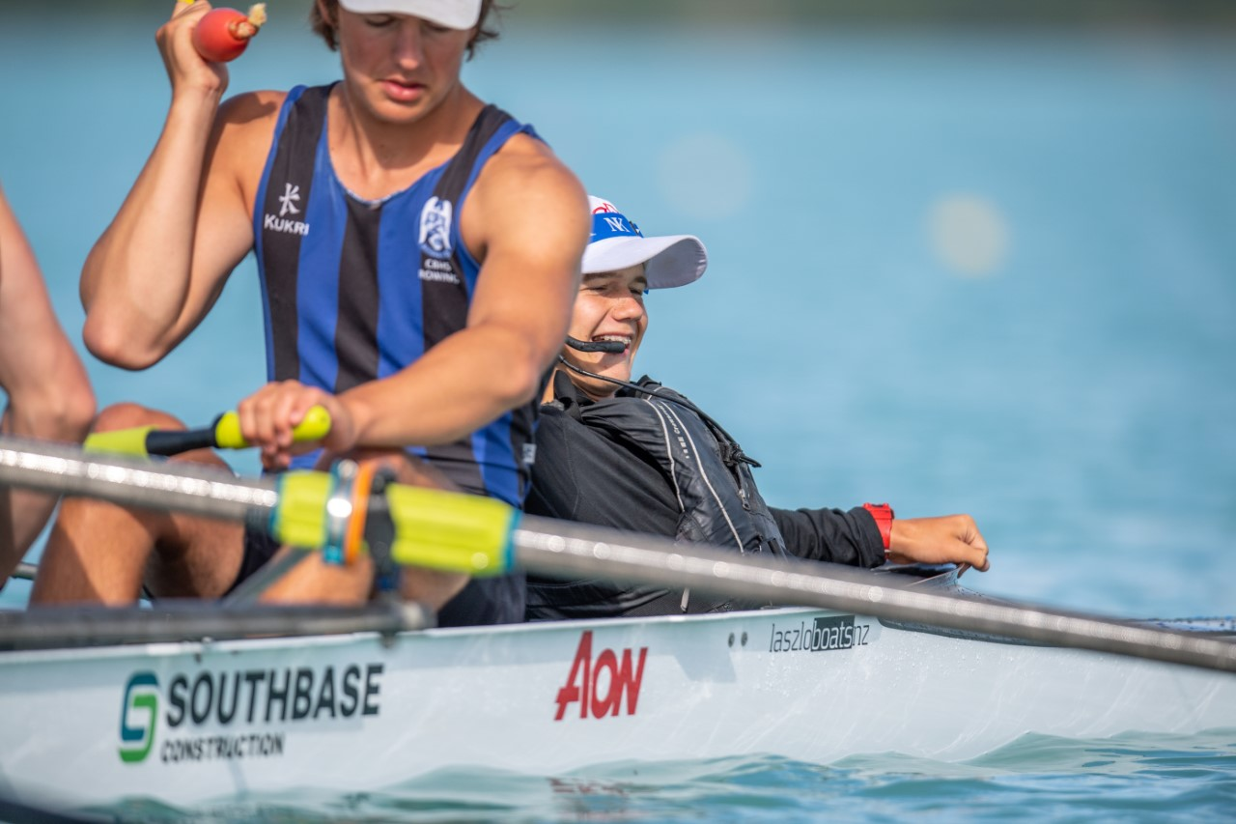
CBHS Sports Achievements
Caleb Fitzsimmons
GOLD
U18 Coxed Quad Sculls

Slide 7
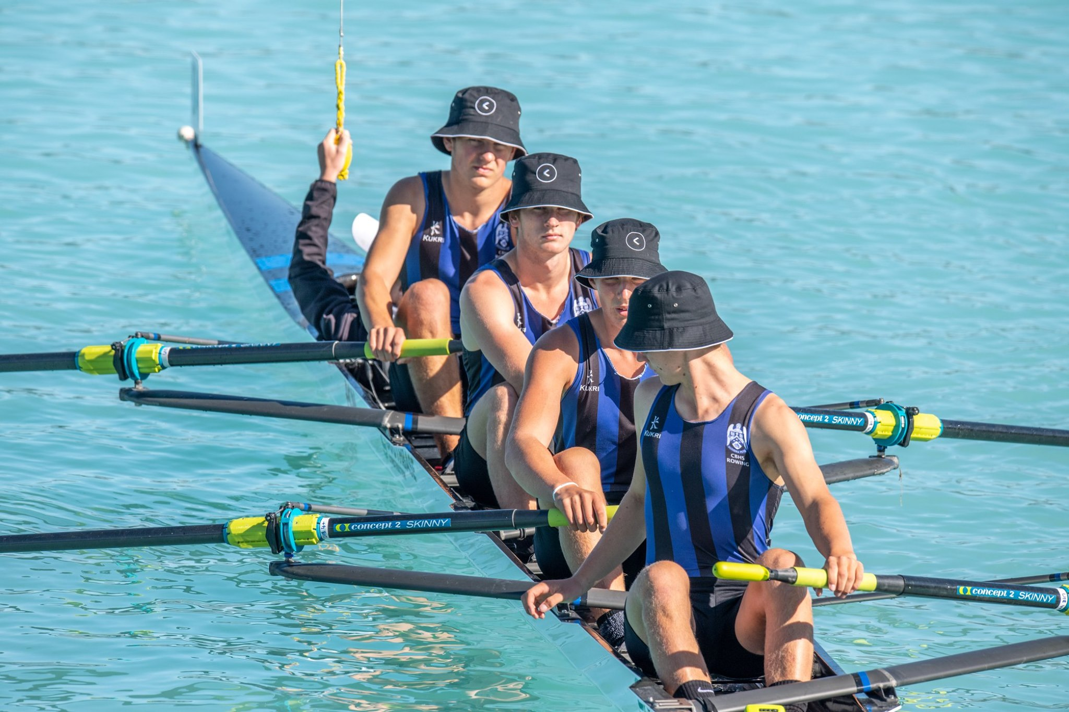
CBHS Sports Achievements
Will Bentley
GOLD
U18 Coxed Four

Slide 8
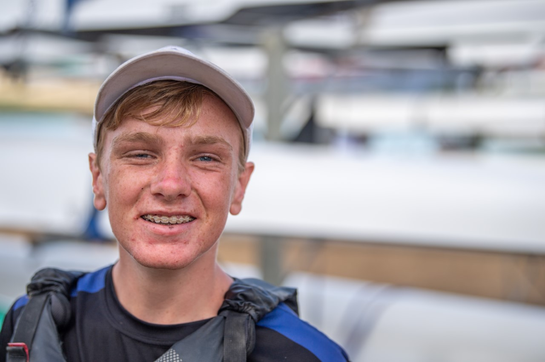
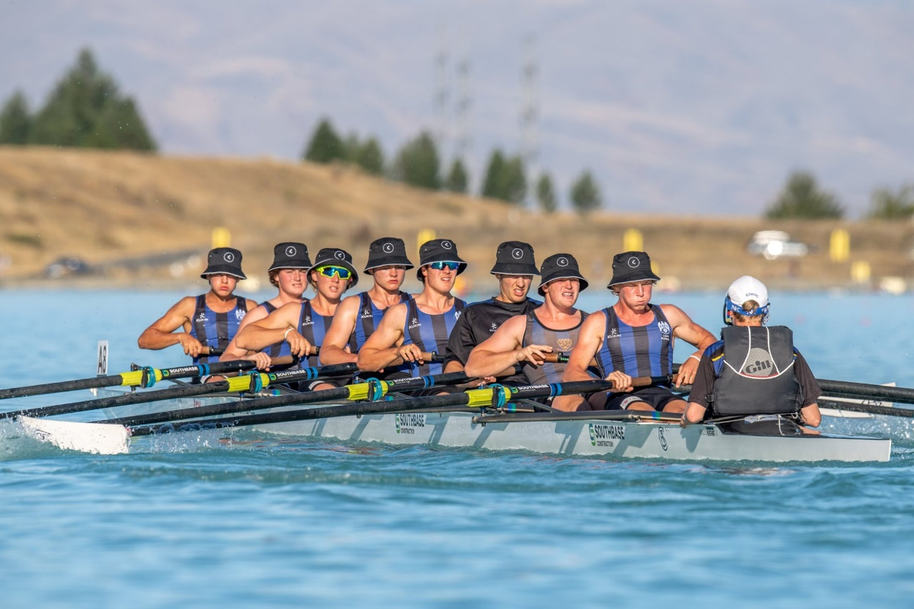
CBHS Sports Achievements
Andrew Lindsay
GOLD
U18 Coxed Four

Slide 9
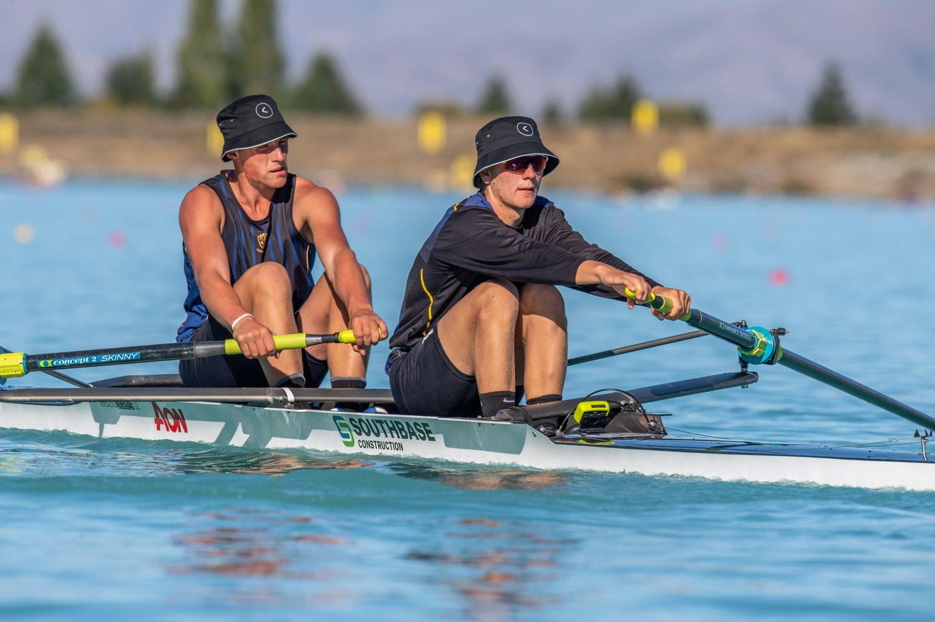
CBHS Sports Achievements
Henry Woelders
GOLD
U18 Coxed Four
U18 Coxed Quad Sculls
U18 Double Sculls

Slide 10
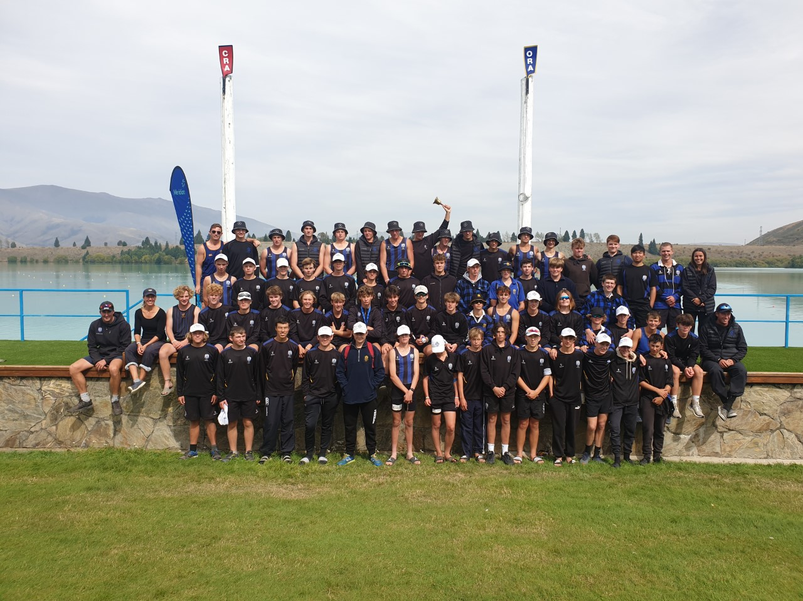
Medalists
Silver
U18 Coxless Pair
U16 Coxed Eight
U18 Coxed Eight
Bronze
U15 Coxed Octuple Sculls
U15 Coxed Eight
U15 Coxed Four

Slide 11
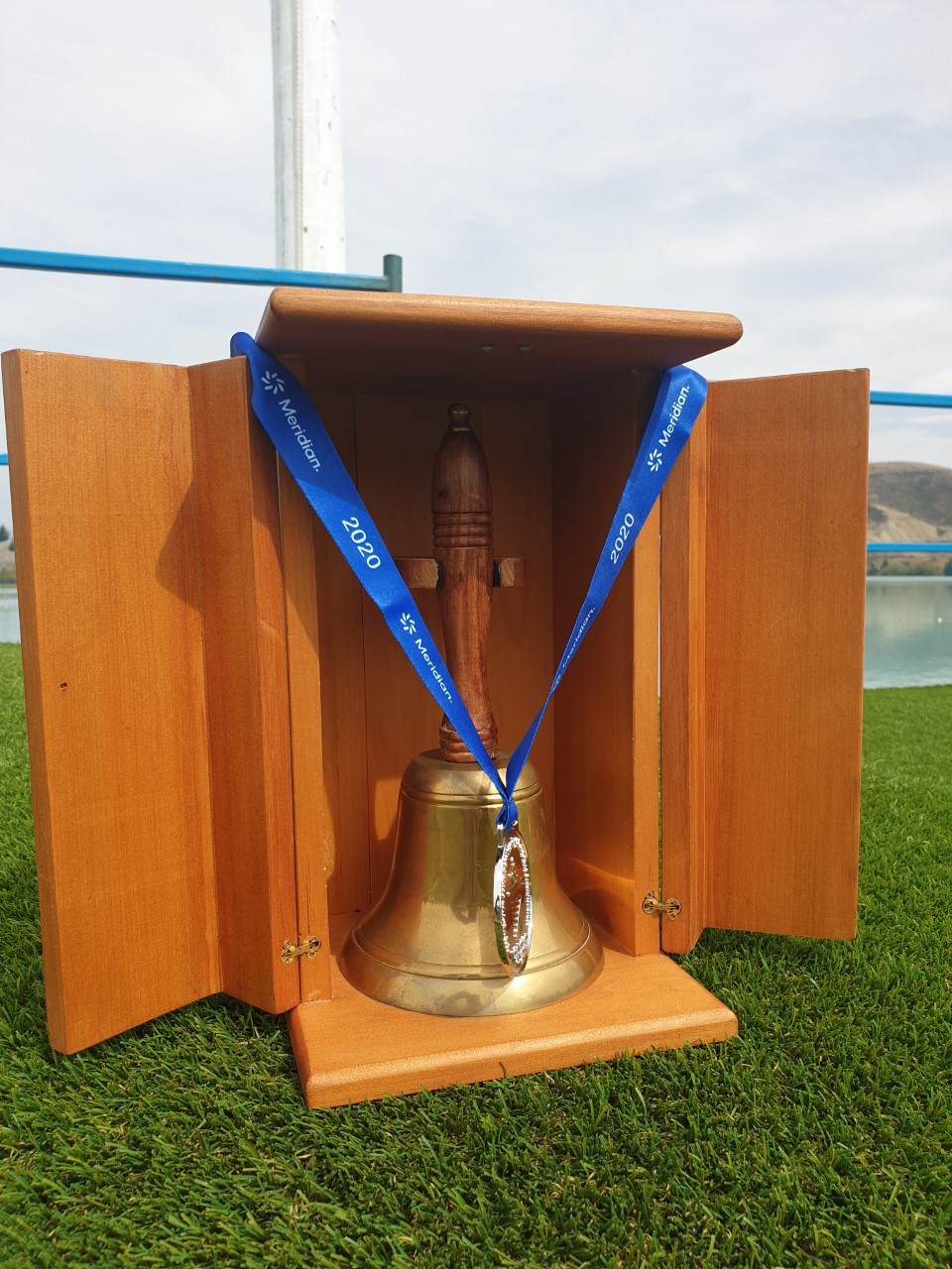
2020 Points Bell for Best South Island School

Slide 12
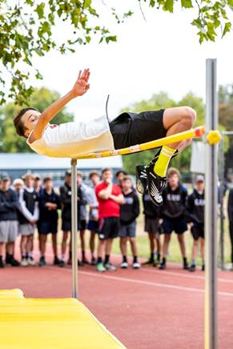
CBHS Sports Day - Records
Levi Murdoch
CBHS School Record Junior High Jump
1.81m (1.75m in 2005)

Slide 13
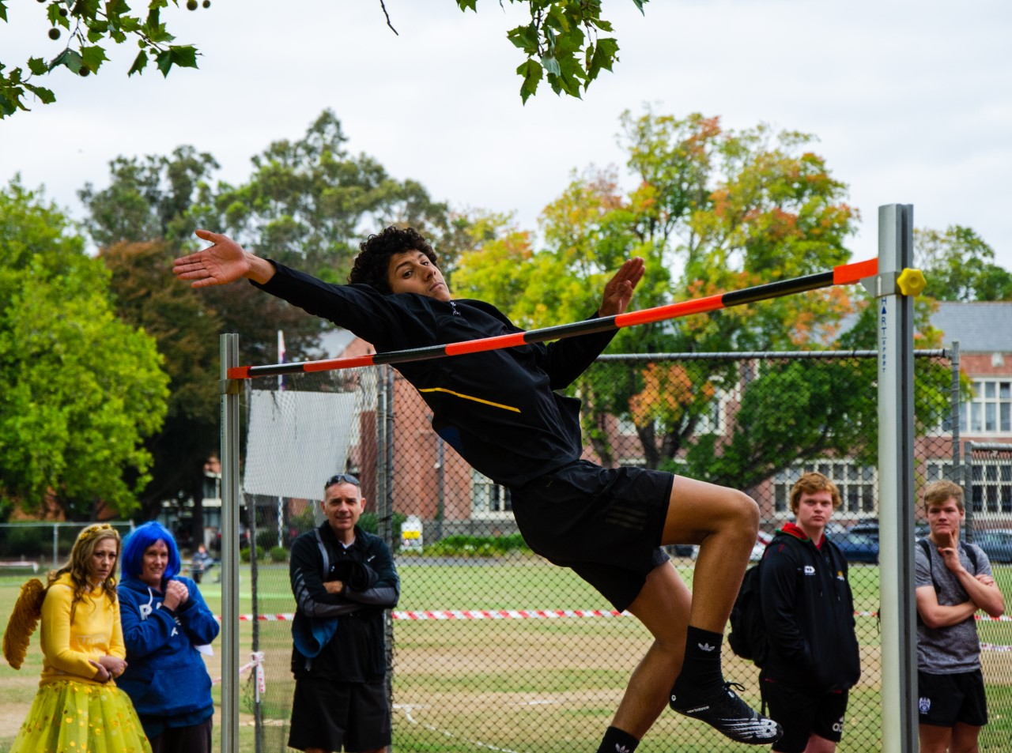
CBHS Sports Day - Records
Eli Leifi
CBHS School Record Senior High Jump
1.96m (1.95m in 2003)

