Slide 1
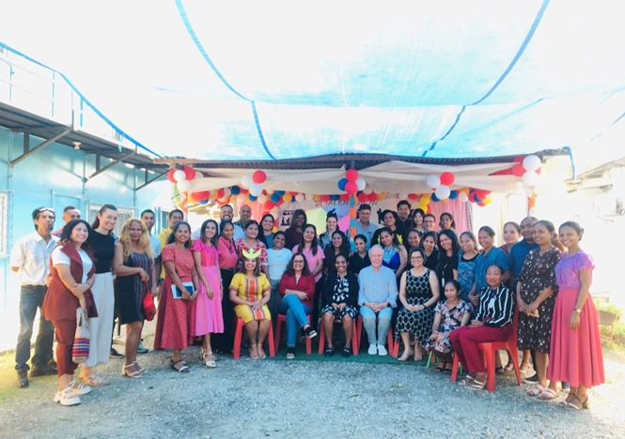
JANUARY to DECEMBER
CASA VIDA TIMOR-LESTE TRAINING PROGRAMS REPORT

Slide 2
Casa Vida
Vision and Mission
Casa Vida
“Casa Vida was founded in 2008 to provide child victims of abuse a safe place where they can find care for their physical, mental, social and spiritual needs”.
Vision
A civil society which upholds the national and international rights of children and women, protecting them in all circumstances against sexual abuse and gender-based violence
Mission
To provide child victims of sexual and physical abuse a place of safety and security where they receive child-centered care for their physical, emotional and spiritual needs.

Slide 3
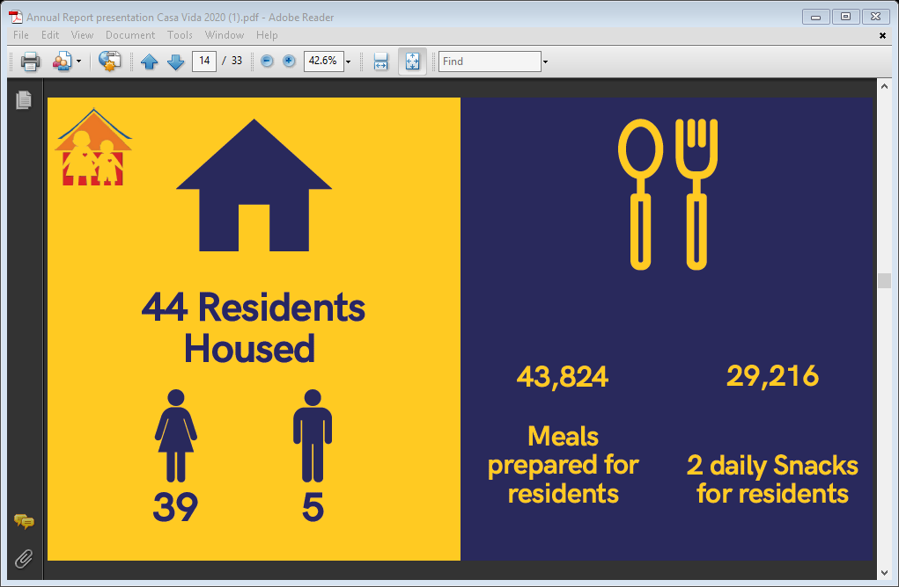
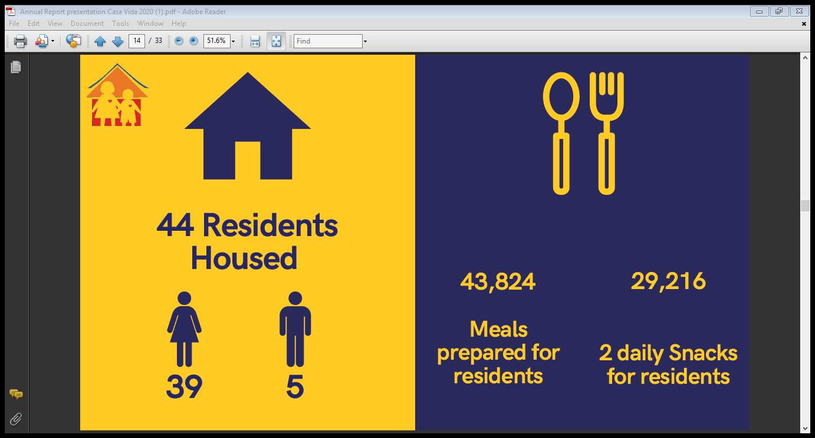
Client Overview
January – December 2023
Total Clients January-December
71
New Client
28
Reintegration
40
Exist in the Shelter
31
Female
30
Male
1

Slide 4
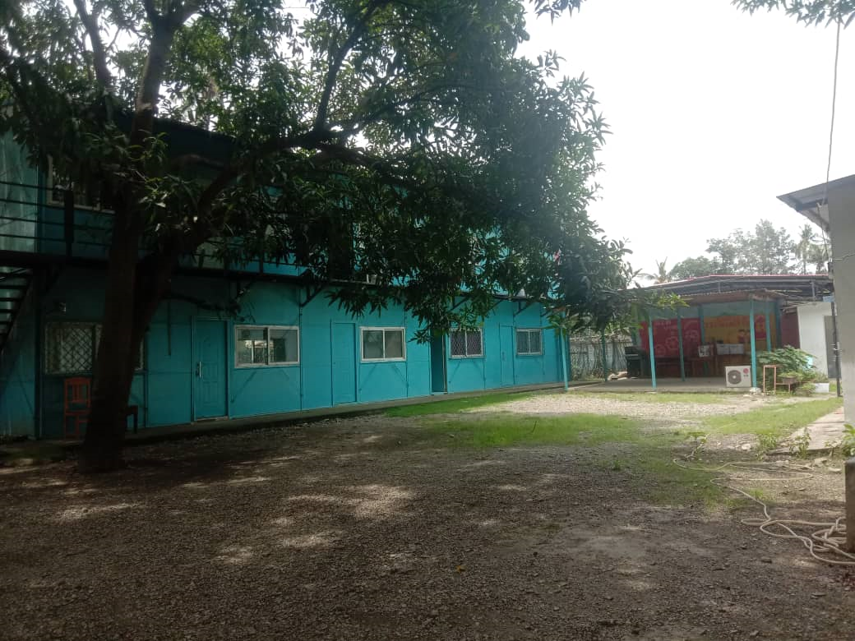
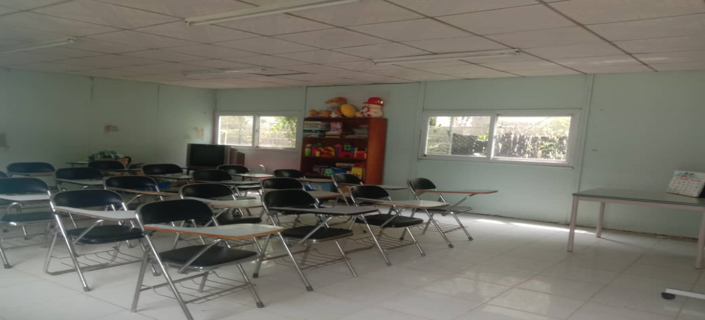
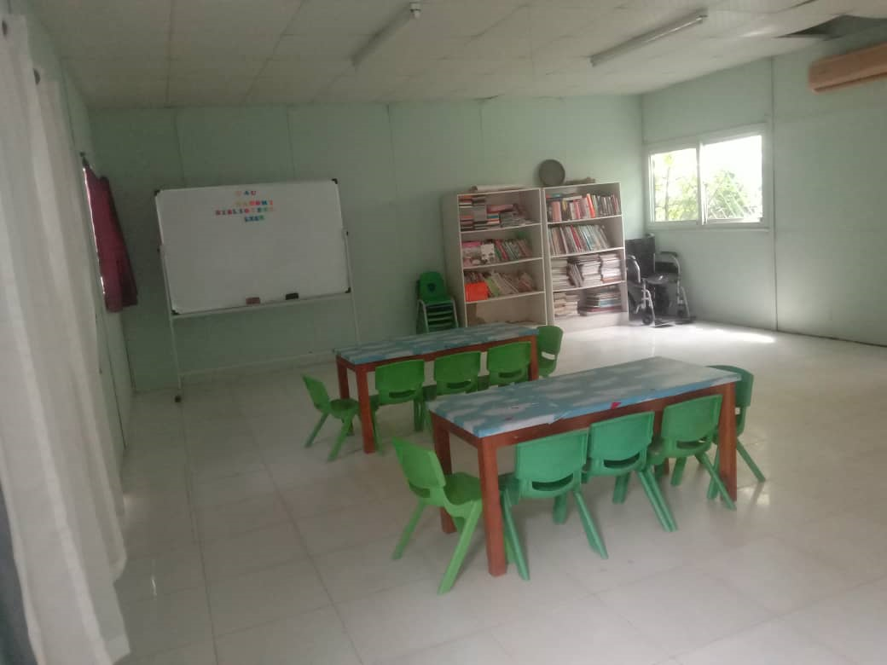
Casa Vida
Training Programs
About our training

Slide 5
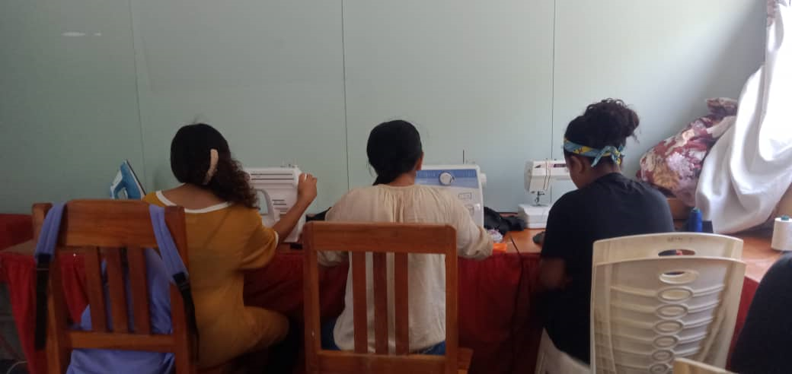
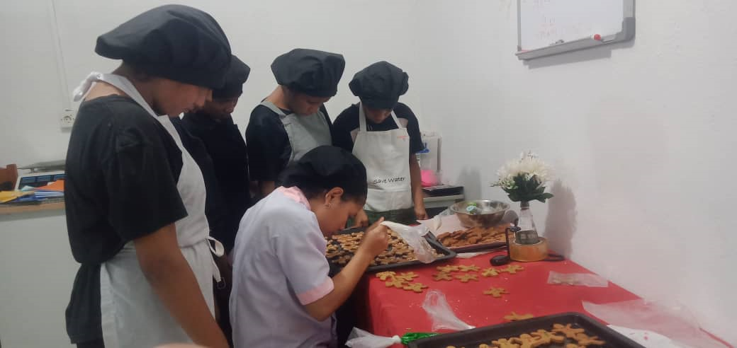
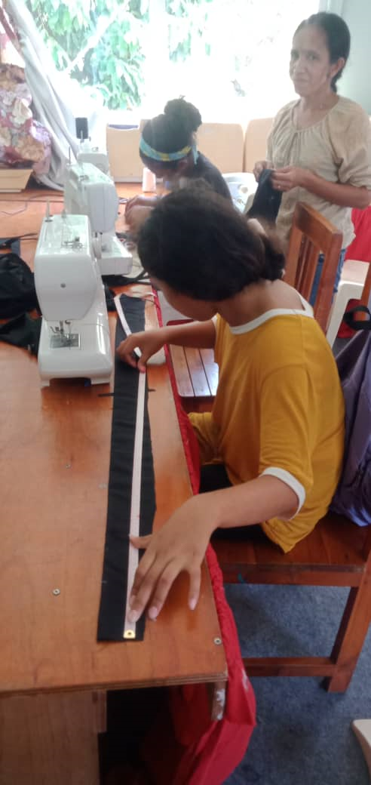
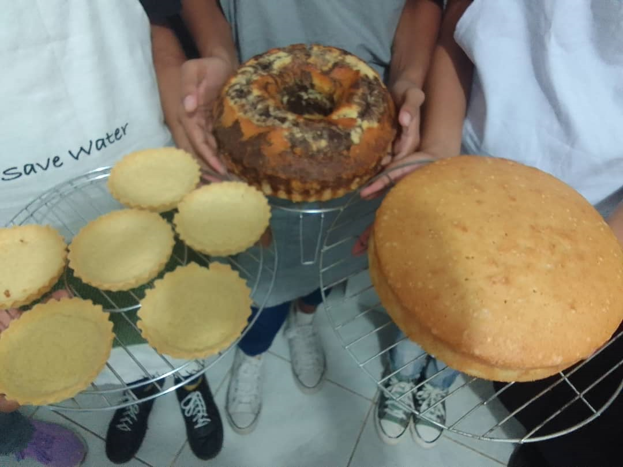
2. “Bakery Business” 14 were training last year & led to three clients receiving a contract to work in baking, providing goods for the Café(Glorias Jeans).
1. “Sewing” 17 clients were involved in this training. 3 are sewing independently.

Slide 6
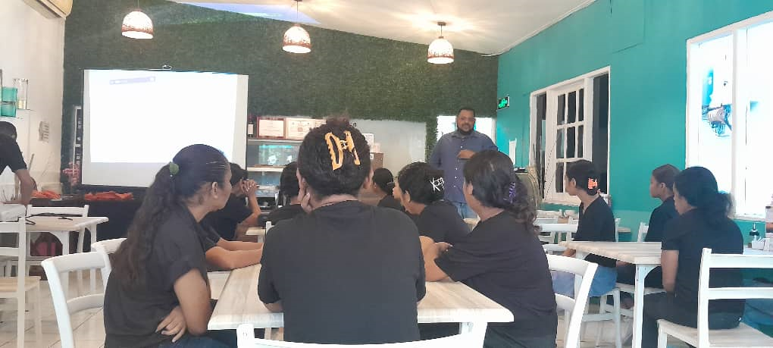
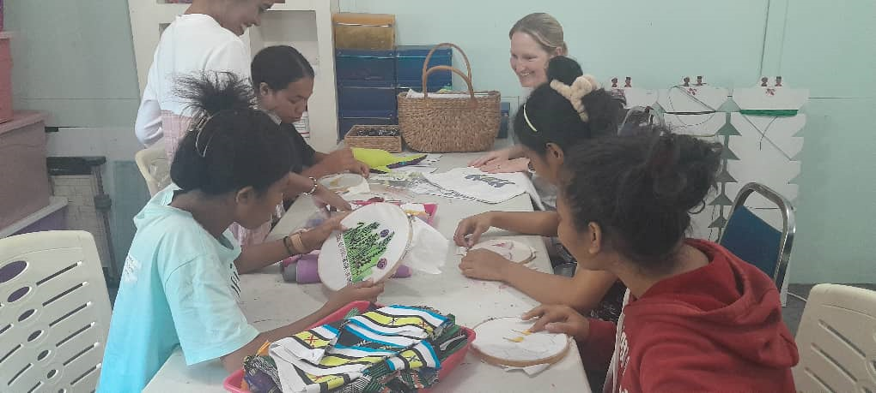
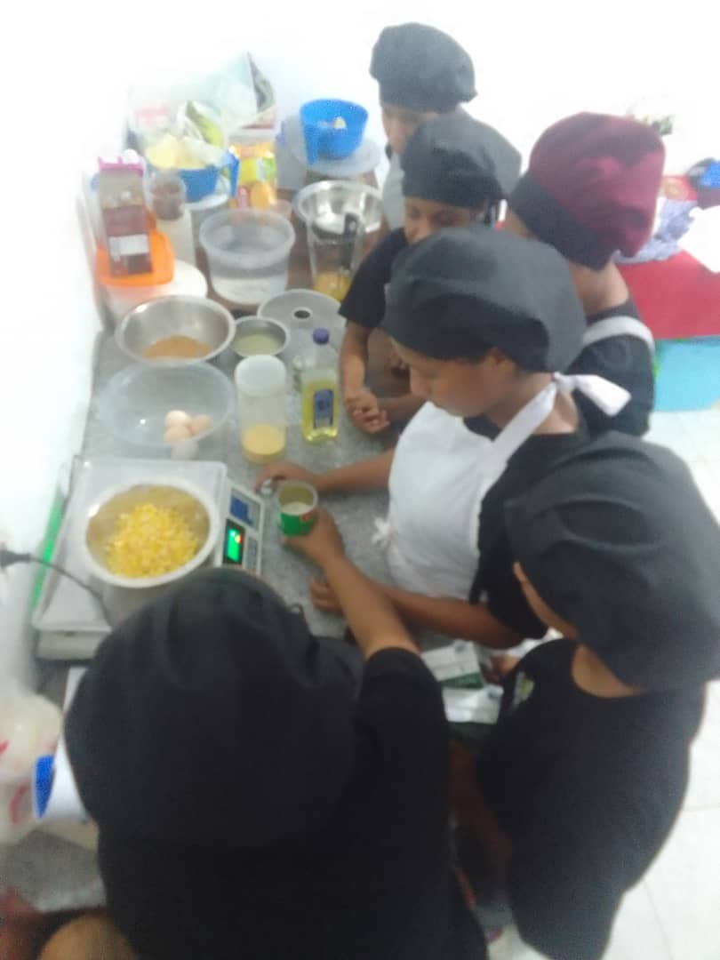
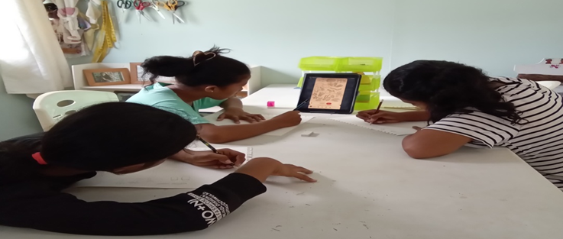
4. “Art-Craft” 22 clients participated in this training and from this training, 5 of these clients can now teach others and acquired a level of skill that will enable them to be able to get jobs when the time comes for reintegration.
3. “Gastronomy”: National and International foods. 20 clients participated in the training, and 3 of these client are now doing professional training and will be qualified to get jobs in a restaurant.

Slide 7
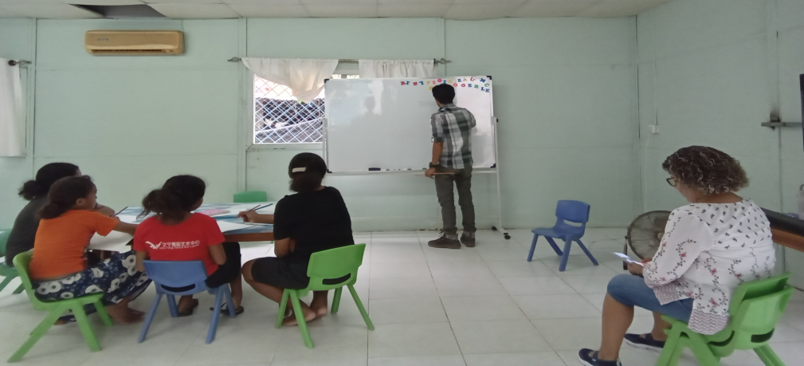
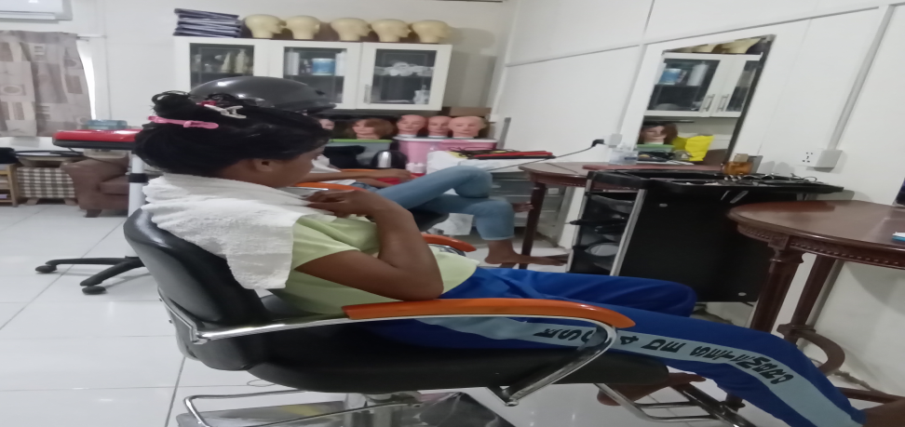
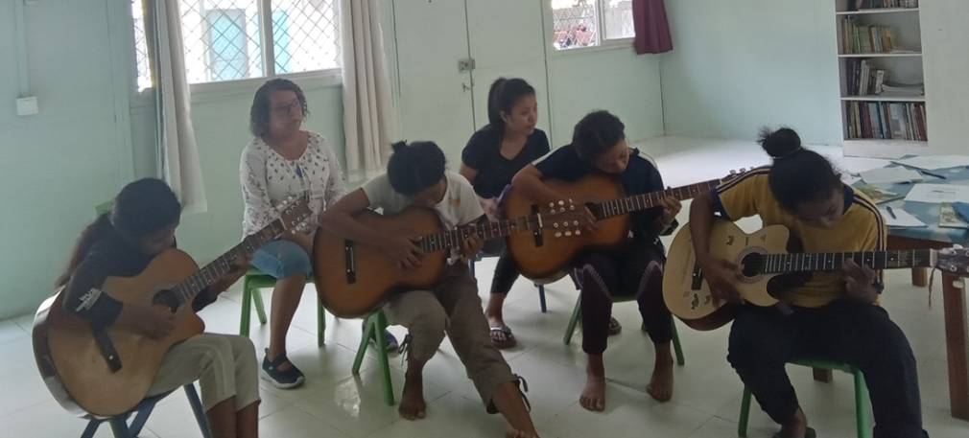
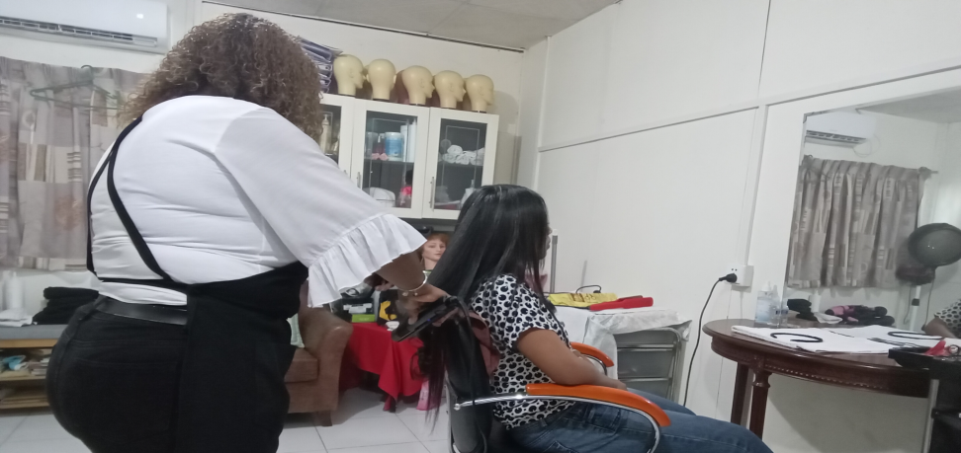
5. “Music (guitar)” 10 clients participated in the training and 4 of these clients are now able to teach others
6. “Salon” 9 clients participated in this training; 3 are able to teach others.

Slide 8
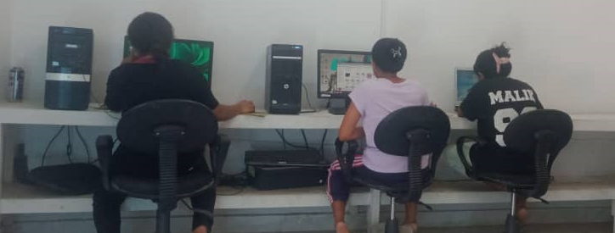
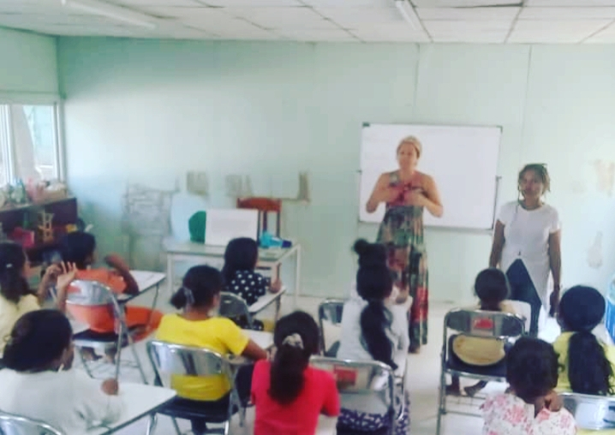
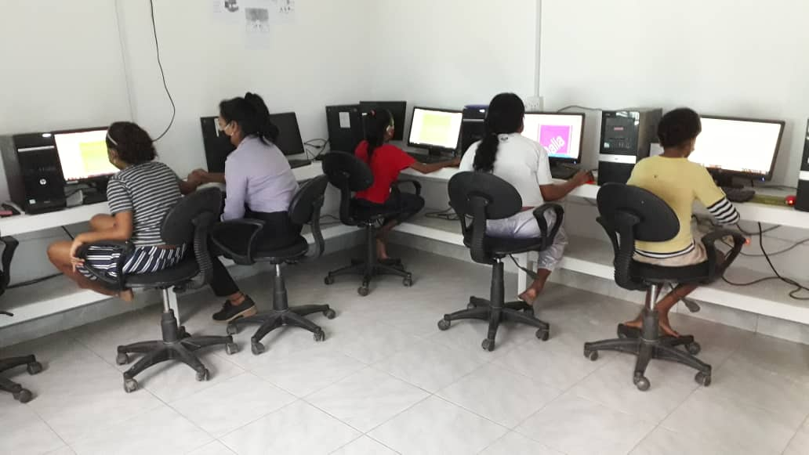
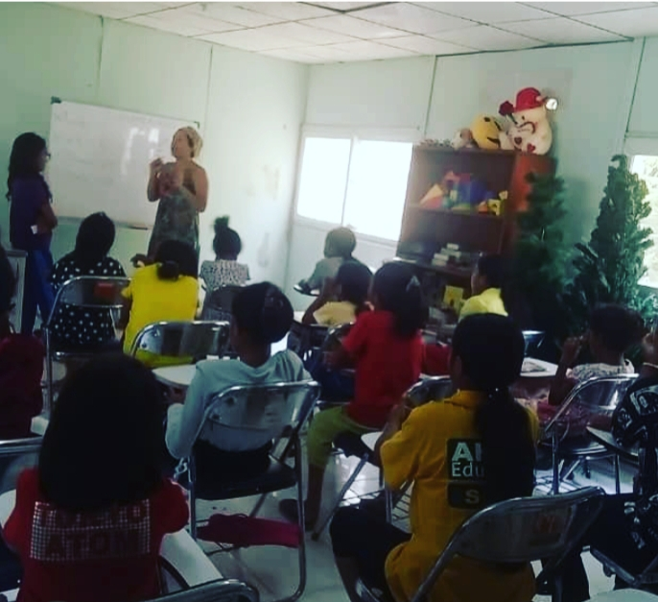
7. “Computer” 12 clients participated in the training. We are still having difficulties in this class because of a lack of well functioning computers since the 2020 flood that damaged some of the computers. At present there are just four computers that can be used for this training.
8. “Finance training” 44 clients were involved in basic budgeting and finances, teaching them to know about money & how to manage and how to save money.

Slide 9
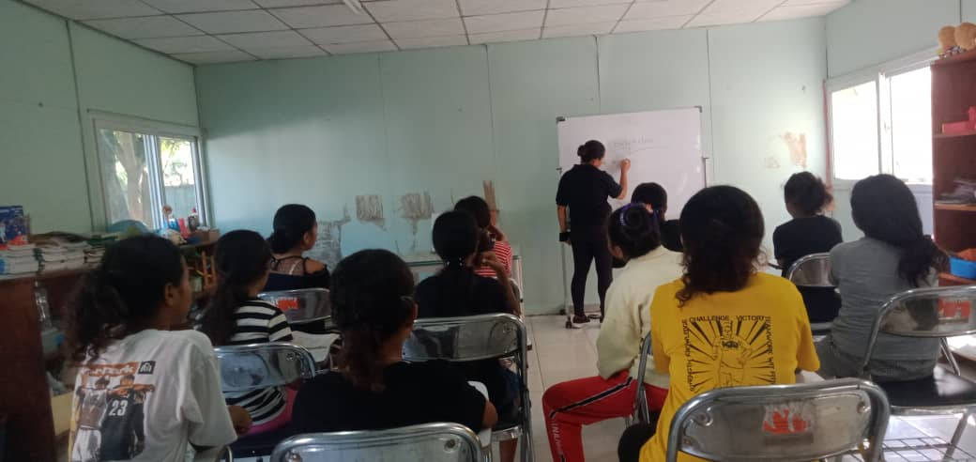
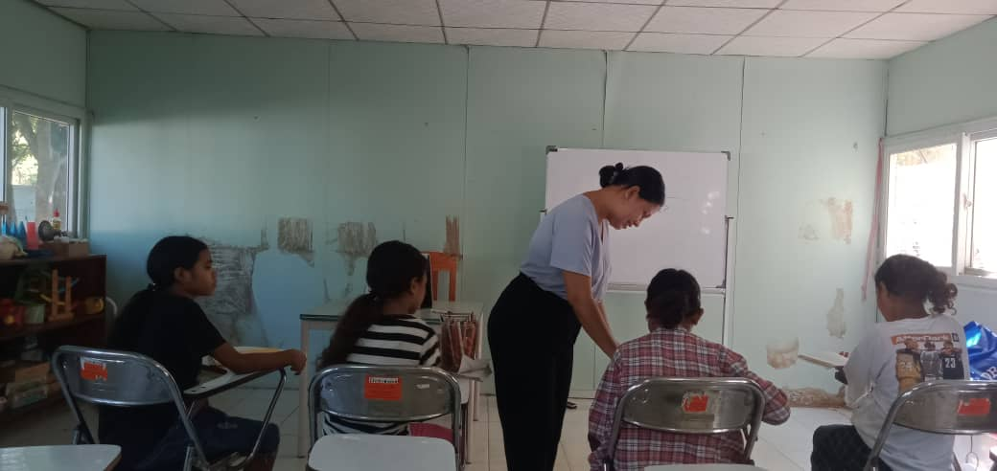
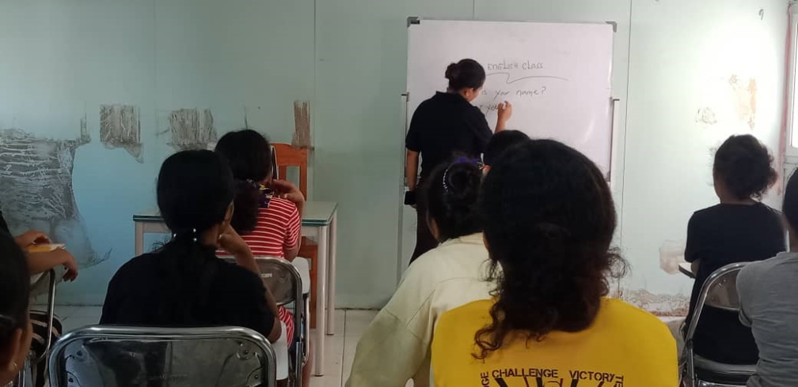
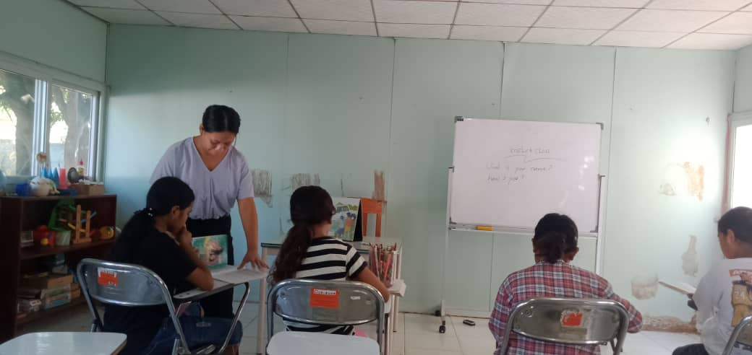
9. “Portuguese”: 8 clients participated in the training to improve their language skills and 7 received literacy training.
10. “English”: 14 clients participated in the training.

Slide 10
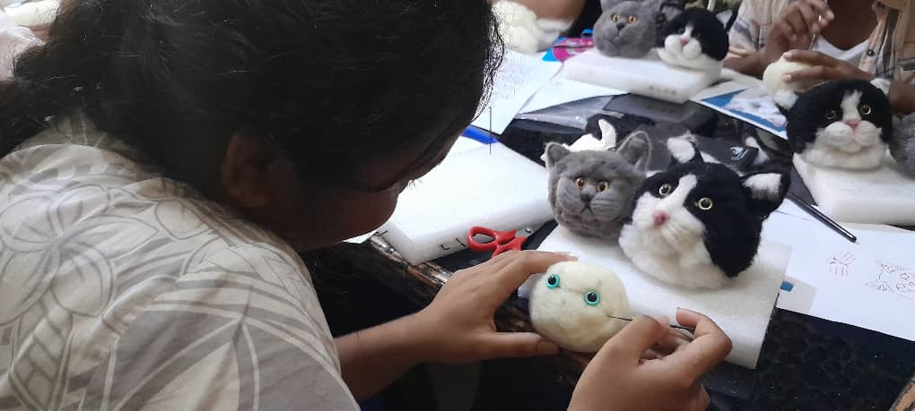
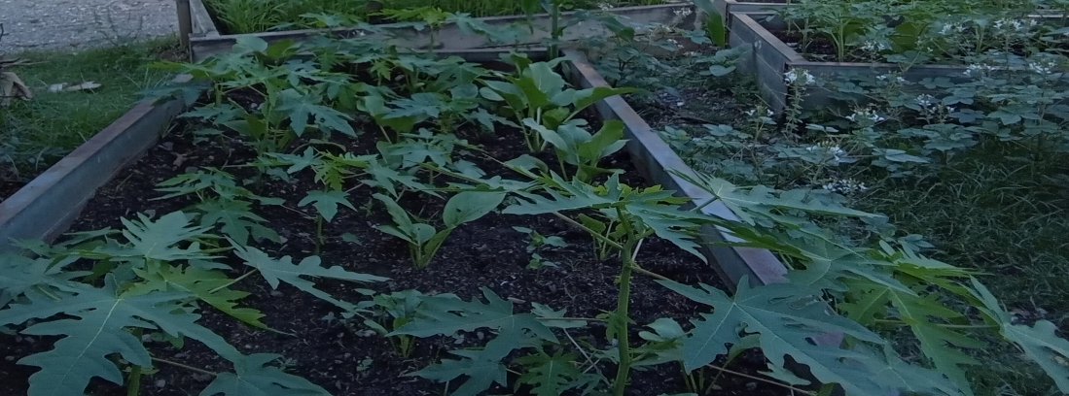
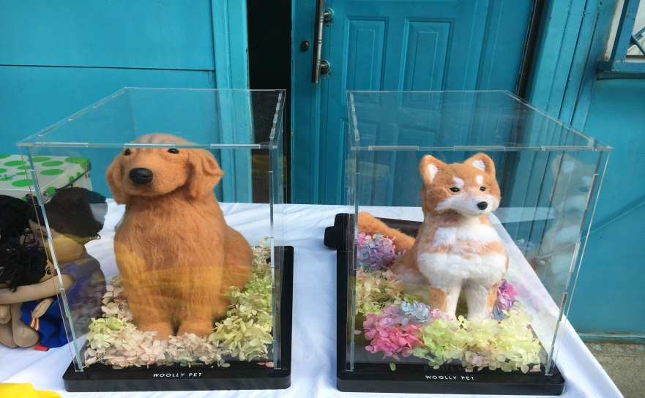
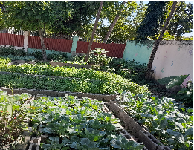
11. “Wooly-pet”: 16 clients participated in the training. Four of them are professional and able to teach others.
12. “Gardening: 9 clients participated in the training and all of these clients now know how to proficiently grow vegetables and teach others. This training has been a wonderful blessing to Casa Vida, because we do not need to spend so much money on vegetables.

Slide 11
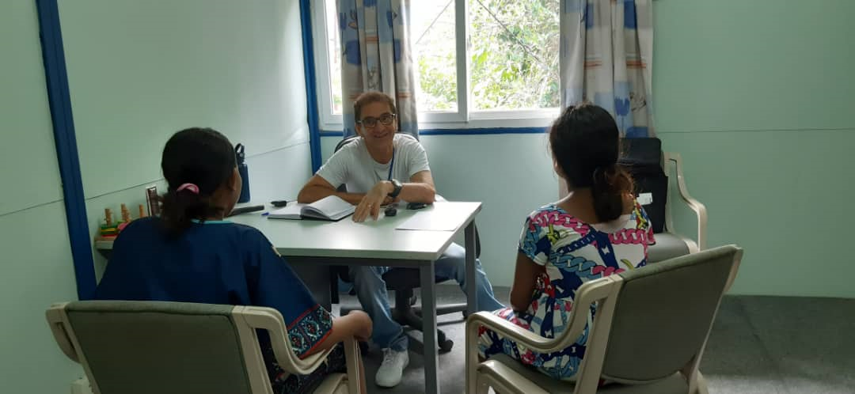
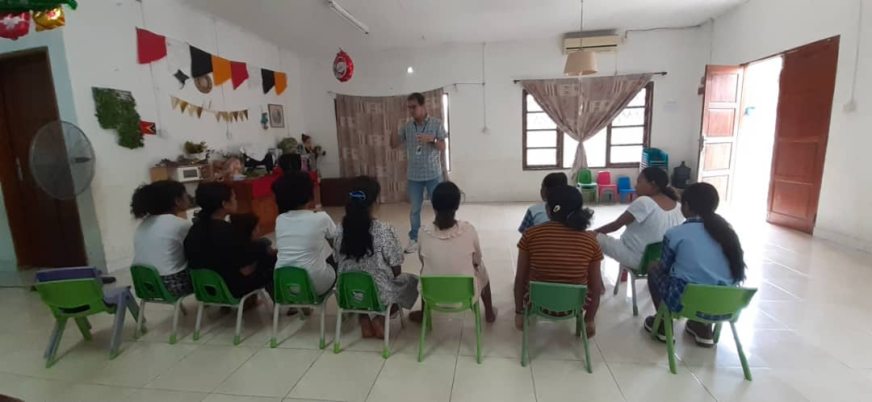
Health Program
The “Psychologist” consults clients both individually and in groups. This helps to ensure that our clients fully recover from their trauma, and are capable of volunteer group participation and social interaction, prior to reintegration. The staff of Casa Vida have an open opportunity to receive consultations with the psychologist and this is also available for the families of our clients.

Slide 12
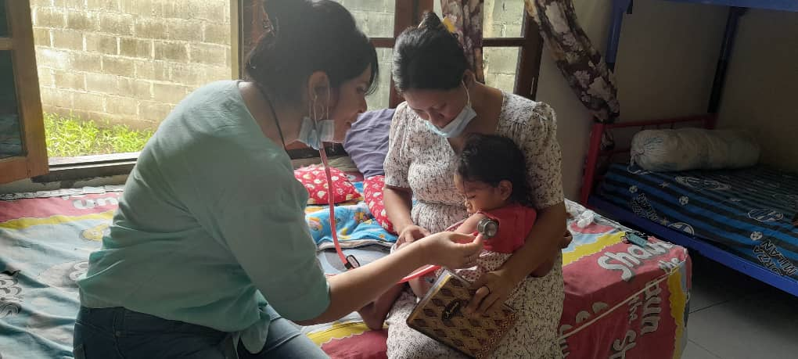
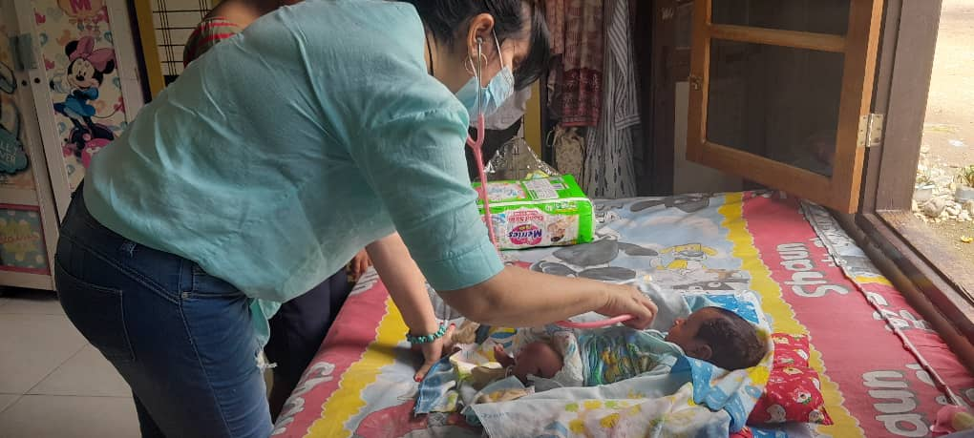
“Nurse & Volunteer Doctors”
Our clients have access to a registered nurse and midwife who provides individual check ups for each client monthly, attends to minor cases of sickness, and accompanies clients to specialist doctors who comes for a house visit and consultation and in specific cases refer to the hospital.

Slide 13
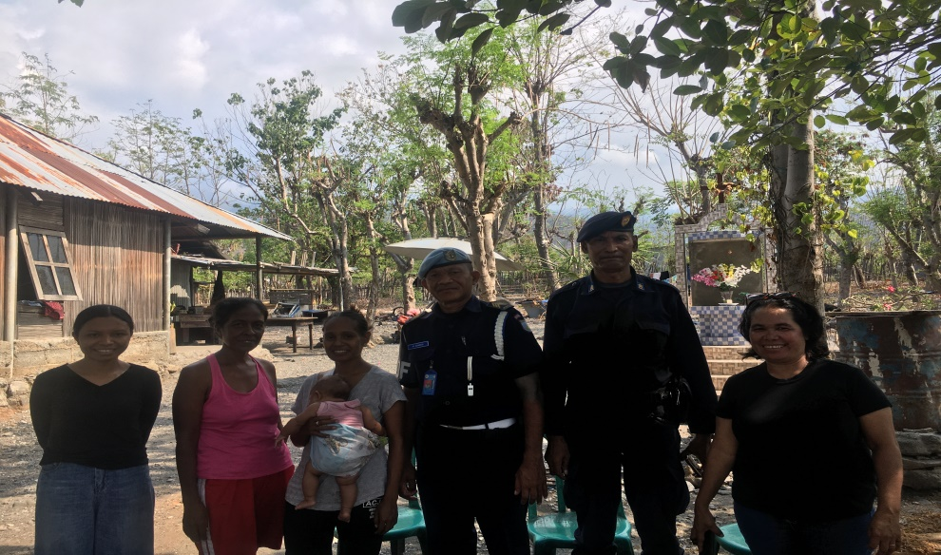
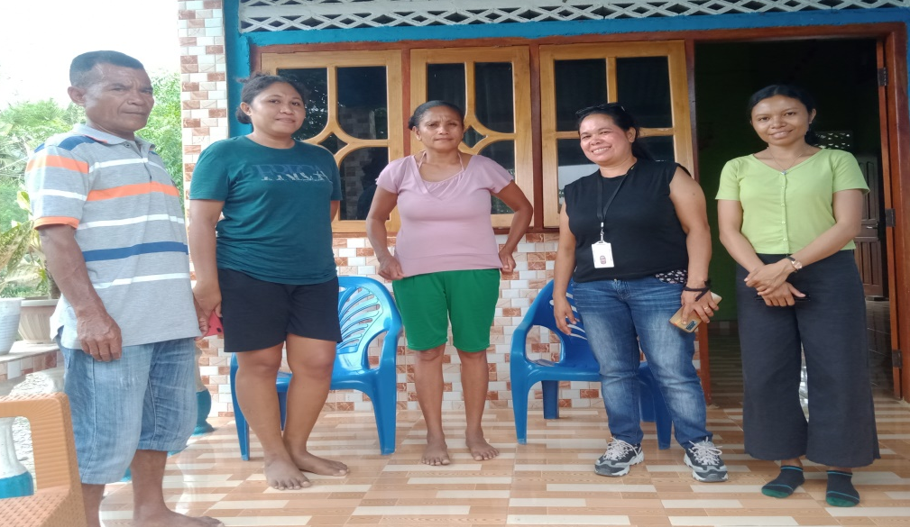
Reintegration Program
Reintegration is divided into three parts:
Assessment, Reintegration and Follow up.
These processes are very important because they help to ensure that the clients will be safe back home, and that their life will be able to continue in a non-threatening environment and be able to move forward with their futures.
1. Assessment – we were able to carry out 59 assessments. This part is done by the social worker who will visit the prospective home and check if the place is safe for the return of the client to their family.

Slide 14
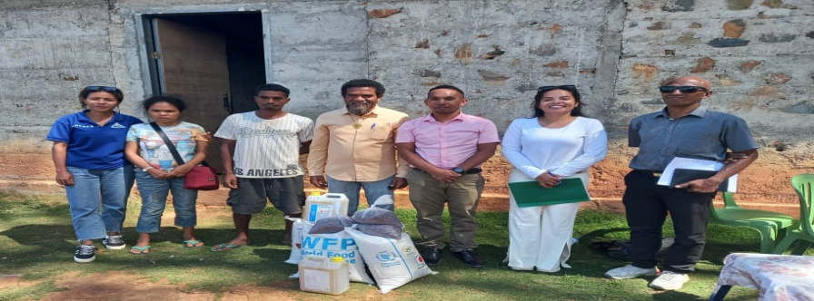
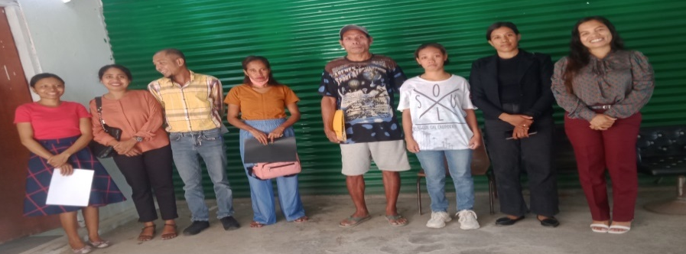
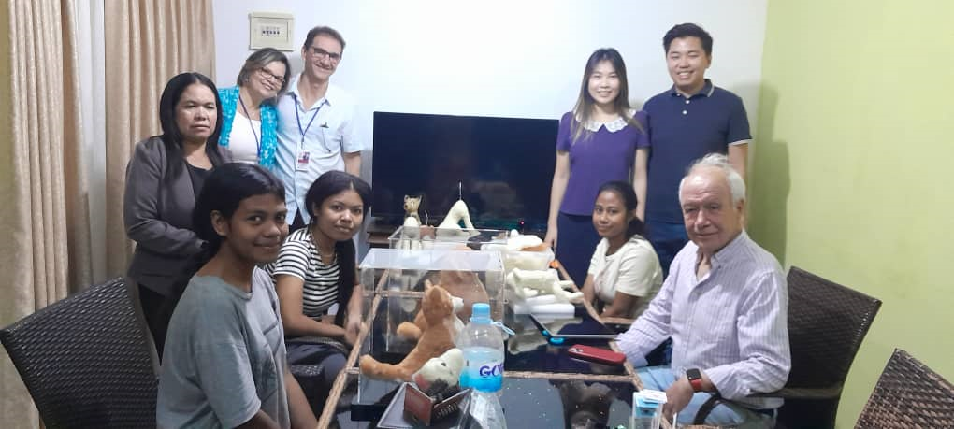
3. Follow Up we make 2 types of follow ups (40 direct and 61 by telephone contact). This part happens during the six months after reintegration with the objective of monitoring the adjustment of each client to her environment. Depending on the case, this period is flexible and if considered necessary, can be extended past six months.
2. Reintegration – We reintegrated 40 clients.
This is when the client is returned to the family, accompanied by our partners.

Slide 15
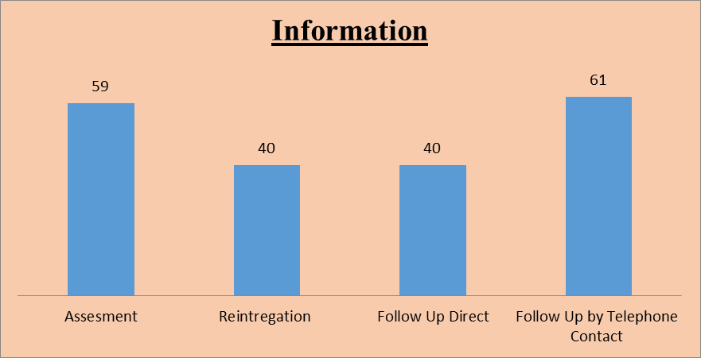
Information for Assessment, Reintegration and Follow up

Slide 16
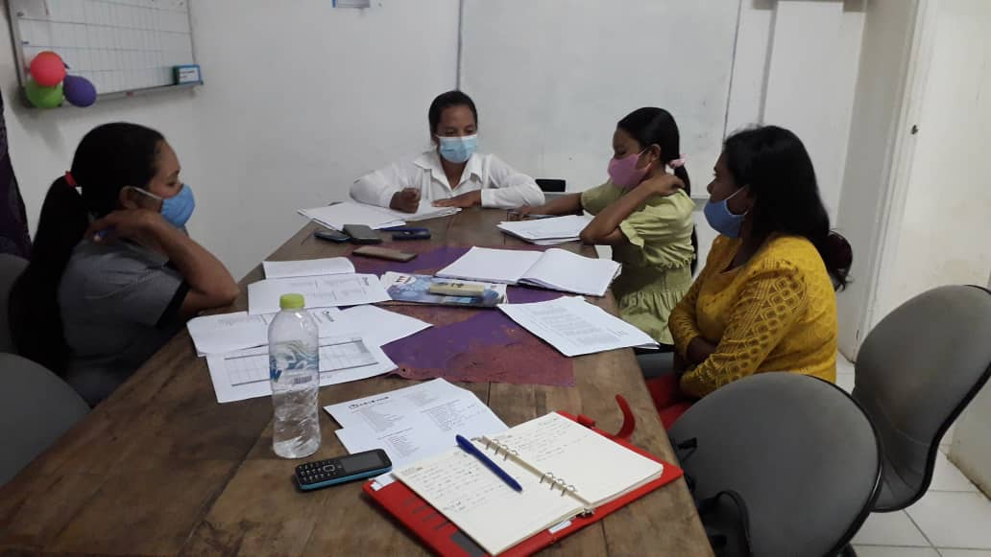
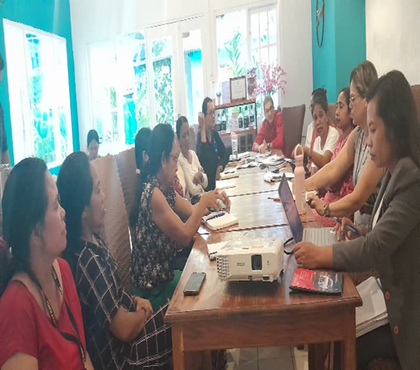
Case Management Meeting
Weekly Social Worker Meeting, Monthly Internal Meeting and Trimestral External Meeting with Partners .

Slide 17
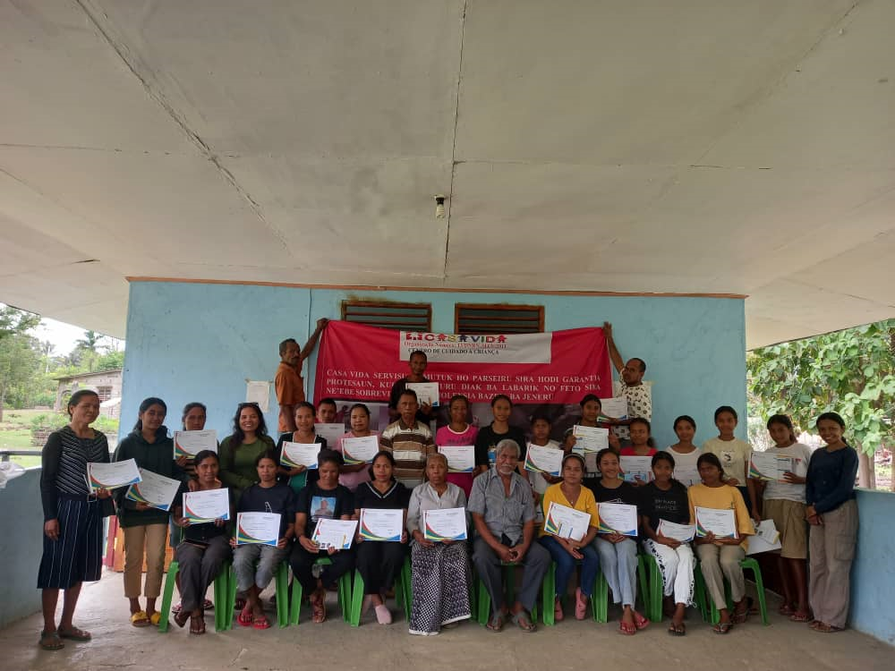
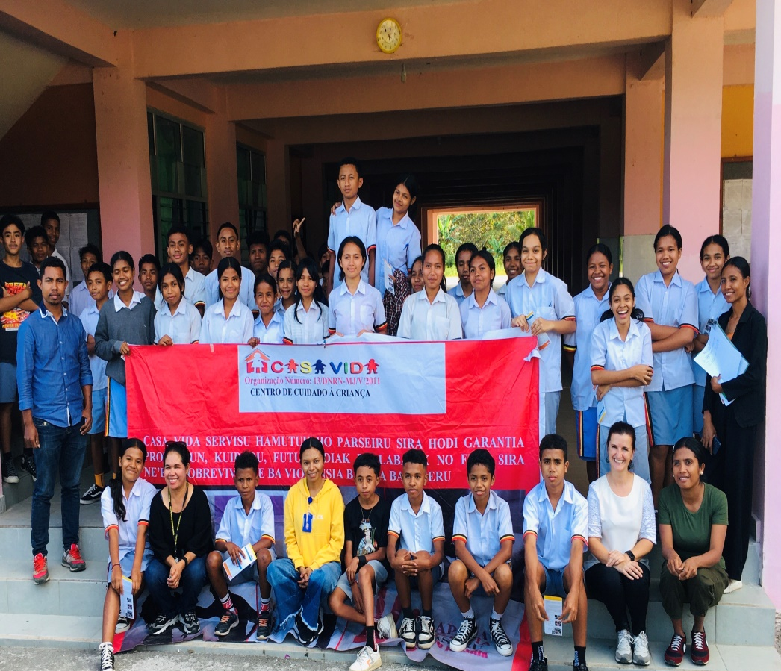
Prevention
We were able to provide our prevention program in 13 different districts. We offered 43 training sessions, including schools (1001 students and community settings 652 participants).

Slide 18
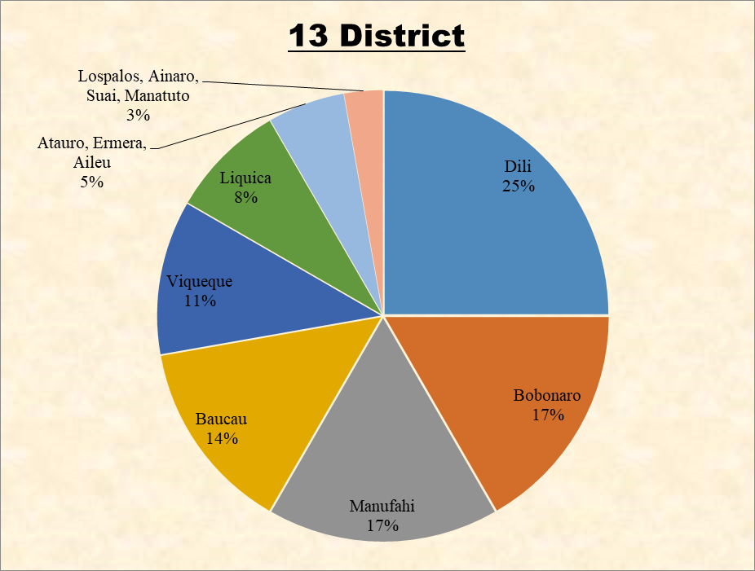
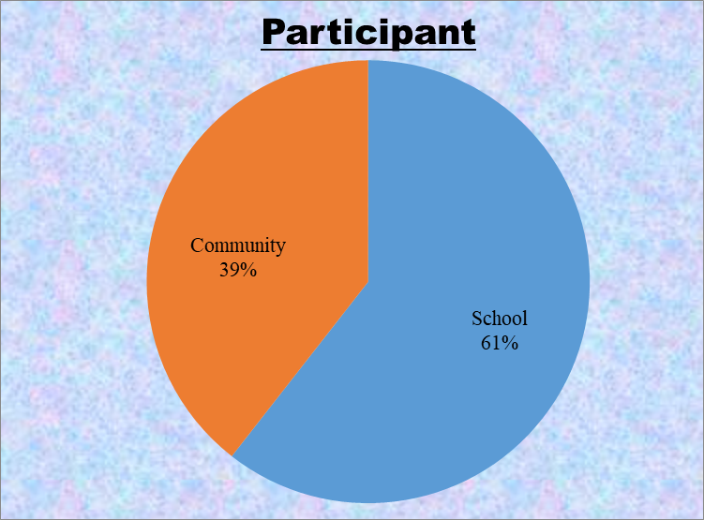
We have been able to cover 13 districts and hold 43 training sessions in communities and schools. There were 1653 participants.

Slide 19

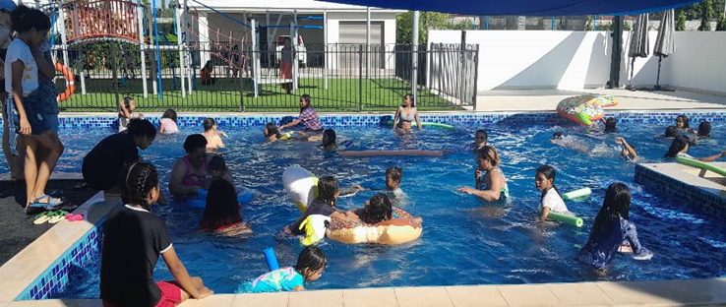
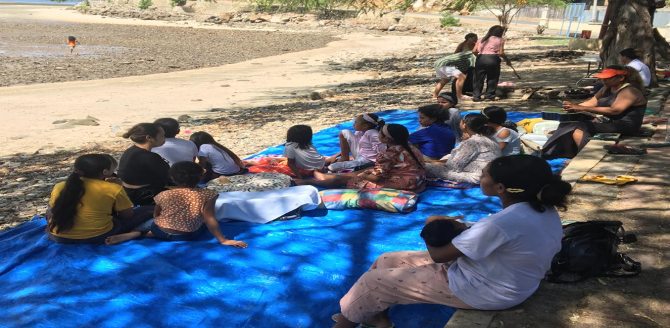
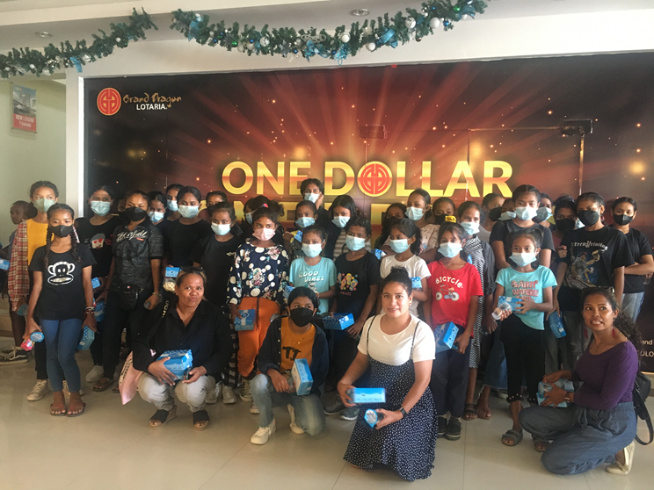
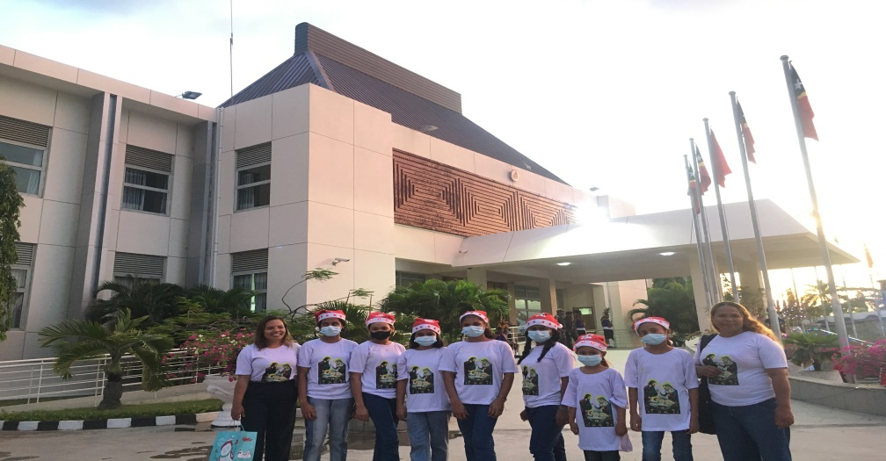
Swimming Pool, Watching a Movie, Sea and A Christmas Party

Slide 20


