Slide 1
LeaderShip, Mentor and communication
Lisa Sharman and Kaori Kobayashi
Notes:
Lisa and Kaori to briefly talk about the workshop we went on.

Slide 2
A bit about ourselves
Acting Assistant Head of School
Lisa responsible for West Auckland and North Shore Provisions (OVS, KPS, KIS, KGC, KBH)
Kaori responsible for South Auckland Provisions (OPS,OJC, OSC)
Notes:
Explain a little about our role, Our teaching experiences - how long teaching, how long in this role

Slide 3
LeaderShip
Notes:
Lisa and Kaori
Leadership - everyone brings their own unique values. As leaders is it our job to identify the unique values that people bring and bring out the good in people.
The value you bring to your community is not based on how many hours you do but based on your giftedness.

Slide 4

Be open and honest, people will trust you
Fail is not seeing as failure
Value people for their ‘who’ not their ‘what’
Isolation kills leaders
As leaders it is our job is to raise up other leaders
Notes:
LIsa
Be open honest, people will trust you
Fail - Ok to make mistake. Show them that you make mistake, it give people the confident it is ok to fail or make mistakes in a safe working environment. Learn from you fail or mistakes to grow
Value: meaning in workplace
Dependability and Responsibility. ...
Possessing a Positive Attitude. ...
Adaptability. ...
Honesty and Integrity. ...
Self – Motivated. ...
Motivated to Grow & Learn. ...
Strong Self – Confidence.
Appreciate Them. Notice your employees doing things that add value to the organization.
Be Interested – Show That You Care. ...
Openly Communicate. ...
Seek opinions. ...
Help them grow. ...
Trust Them. ...

Slide 5
GReat leadership and great communication are synonymous terms.
Notes:
Kaori = to have great leadership you need great communication, need both

Slide 6
Mentor
Notes:
Lisa

Slide 7

Mentor:
“ A Person’s mentor is someone who gives them help and advice over a period of time, especially help and advice related to their Job”
“Learning from someone who wants you to grow!”

Slide 8
There are four Valves of mentoring:

Slide 9

Four Valves are:
Staying close to culture
Eg: work environment, values, expectation and goals in a workplace.
Reminding yourself of a younger you
Reminding yourself of what you know
Hearing the rhythms of the drums
Notes:
Four hidden values of mentoring:
Culture shapes the way we interact at a workplace.
Positive culture encourage staff motivation,loyalty, healthy relationship, respect fairness, team work. Positive attitude in workplace.
when we mentor, we stay close to the culture of our organisation, and of culture in general it reminds you of a younger you
Reminding yourself of what you know
It is not what you give it what you share - share what you know and information
Be supportive/encouragement
Give time and be approachable
Explain the unwritten rules in
Hearing the rhythms of the drums
Open to see real things, see people
Open your eyes and look around you, what’s happening, be aware

Slide 10
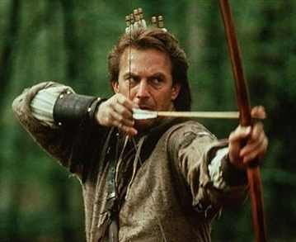
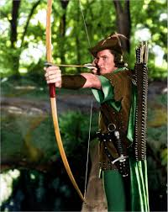
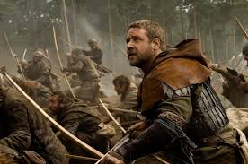
Robin Hood Methode
Notes:
Mentoring: the Robin Hood Method: steal from the rich and give to the poor Its our duty to get ideas from those people we know who are rich in Leadership experience, and pass this on to those who want to learn more
eg: Louise workshop in the holidays, had leaders on the panel sharing their experiences and knowledges.

Slide 11
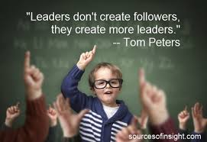
As a Leader your words and your time carry more power than others
Notes:
Your words and time are powerful tools use them wisely. People value when you spend your words and time on them. What people remember is how you treat them.
Get out there and talk to people, get to know them etc….
Meet in a cafe - away from work place
At staff meetings or email - acknowledge how well they did eg: I really appreciate your help yesterday or …...

Slide 12
People never walk away from organisation, they only ever walk away from people because people govern experiences
Notes:
Add more notes.

Slide 13
89% of managers believe employees leave their jobs
seeking a higher income. However, repetitive research shows in reality
only 12% of employees state that money was the primary factor in seeking work elsewhere.
The remaining 88% of employees state psychological
reasons for leaving,including not feeling trusted or
valued or that their contributions are not appreciated.

Slide 14
What do people want more than money?:
Openness Purpose/Cause Transparent Culture
Job Security Safe Be Valued
Be Fulfilled Fun/Enjoyment Integrity/Trust
Contribute Well Respected Connected
Thanked Encouraged Grow
Listened To Feel Care For Feeling Worthwhile
Balance Competent/Professional Time

Slide 15
communication
Notes:
Kaori

Slide 16

great leadership and great communication are synonymous terms.

Slide 17

It is almost impossible to disconnect leadership skills from communication skills as they are that intrinsically interwoven. If your Kete is not woven tightly, your kai will simply leak away.

Slide 18

By the way...

Slide 19
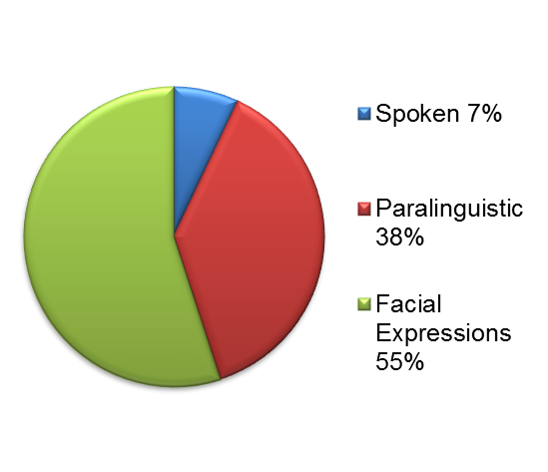
How do we communicate?
By Albert Mehrabian
Notes:
Explain a little about our role, Our teaching experiences - how long teaching, how long in this role

Slide 20
Poor communication results in air gaps.

Slide 21

When
communication
Is poor,
imagination
takes over

Slide 22

There is no border, no restriction, no limitation nor rule.

Slide 23

Tell your story.
Trust them.

Slide 24

Value people
for their ‘Who’
not their ‘What

Slide 25

What Unique Value do they bring to the team?
What goes away if they go away?

Slide 26

Trust what they bring
Value who they are
Appreciate what they givE

Slide 27

If we want better outcomes, leaders simply need time to rekindle their “Oooh”.
If we want better outcomes, leaders simply need time to identify the “Oooh” in others.

Slide 28
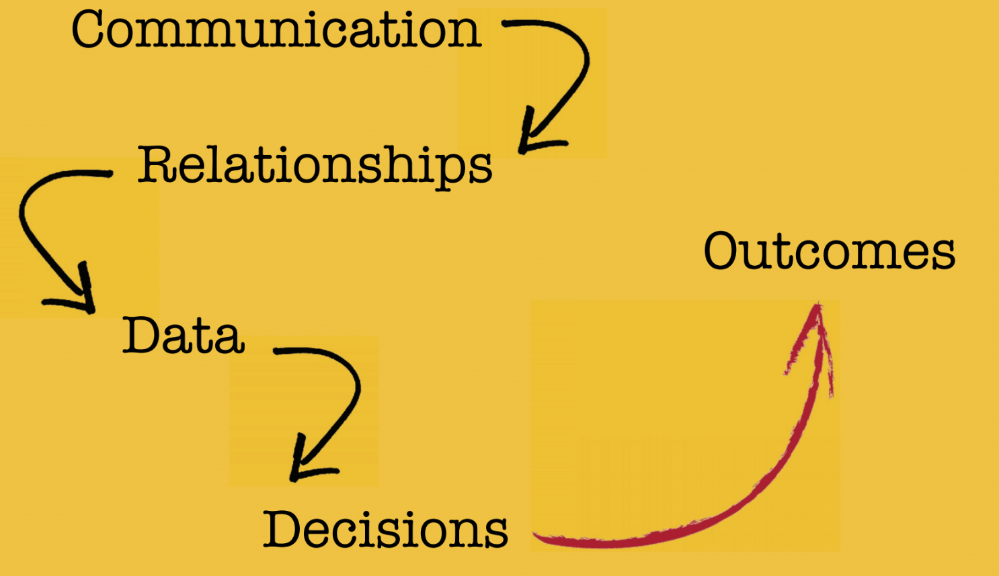
Quality outcomes are
the result of quality
communication

Slide 29
So...

Slide 30
great leadership and great communication are synonymous terms.

