Slide 1
RETAIL EVENT CATERING & COVID 19
Paul Marquardt – National Operations Support Manager – Spotless NZ

Slide 2
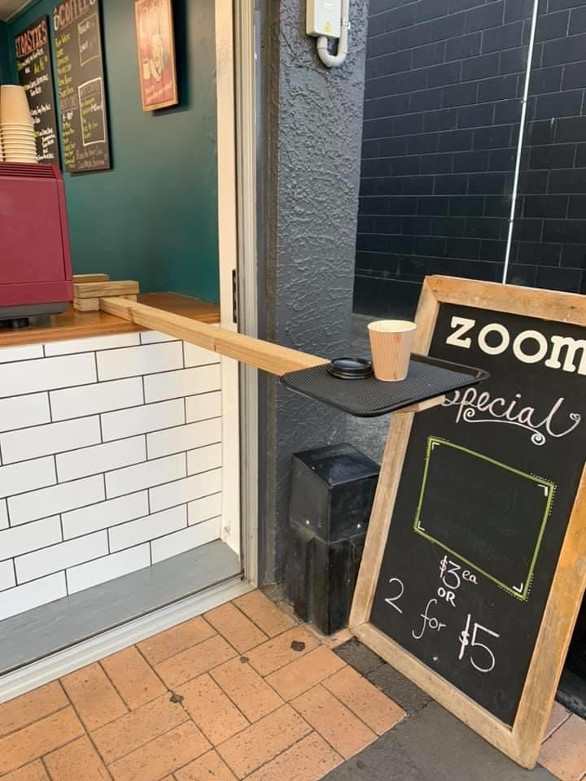
ITS TIME FOR INNOVATION
My local Café – Zoom Espresso in Green Bay
Problem:
How to serve customers who are 2 metres away?
Solution:
A piece of 2x4 plank with a tray screwed to the end of it that slides in and out.
Coffee and the mobile eftpos goes out to the customer on the tray when the product is ready.
Line on the ground with the appropriate social distance space.

Slide 3
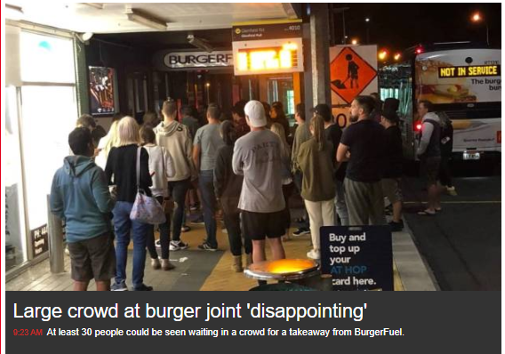
Lack of a management system causes risk

Slide 4
ITS TIME FOR INNOVATION
Solving problems on service flows is important to sustain business through this period.
It will give your guests reassurance that you have their health and safety as a top priority, and give them confidence to return to your venue.
It will provide legislative bodies with evidence that venue delivery can be de-risked to allow larger crowds to be in venues more quickly.

Slide 5
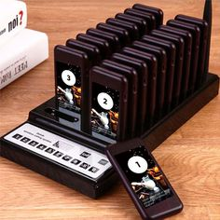
PHYSICAL ENVIRONMENT – Service Flows
Limit numbers in outlets / cafes / bars with appropriate distanced cues for entry. Floor markers at measured distances becoming very normal.
In some environments, Using buzzers for guests to collect product from a pick up station once their order is fulfilled.
Grab and go slides with patron flow monitored for distancing.
Think like Sushi Train! How can you get product out to customers
Cashless is the new norm

Slide 6
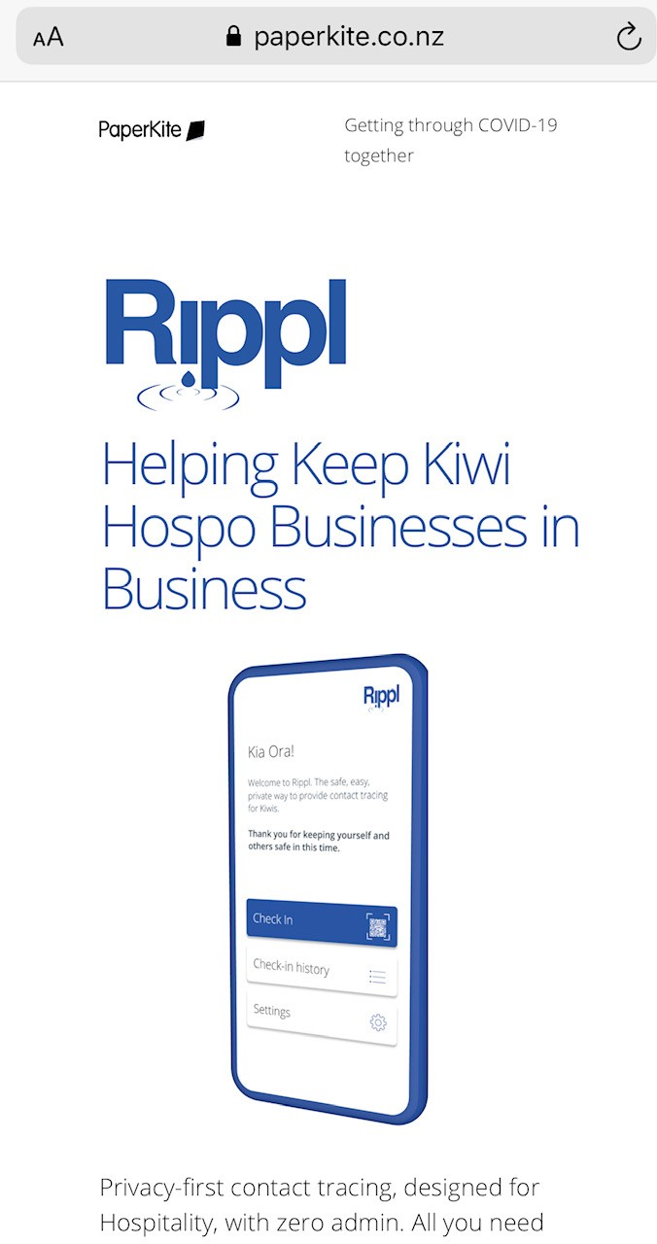
Rippl APP

Slide 7
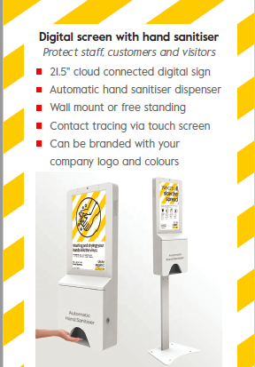
Digital signage with hand sanitiser at entry points

Slide 8
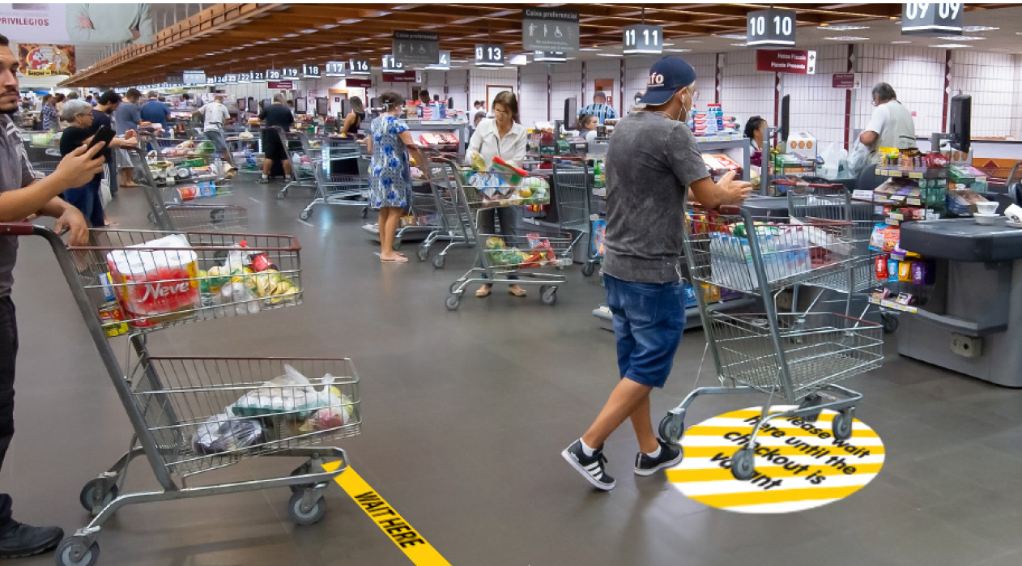
FLOOR VINYLS AND SIGNAGE

Slide 9
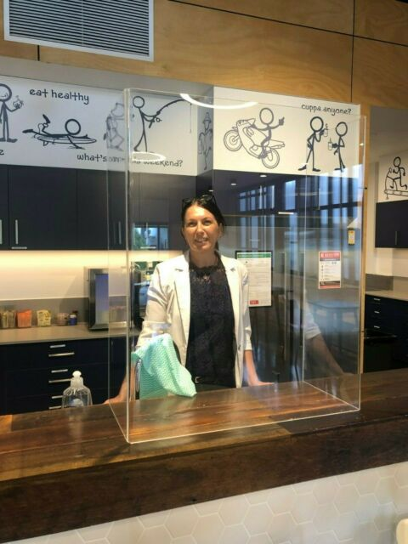
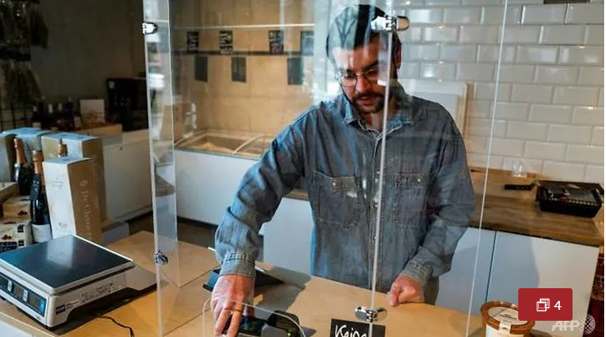
Sneeze Guard Barriers / Virus Shields

Slide 10
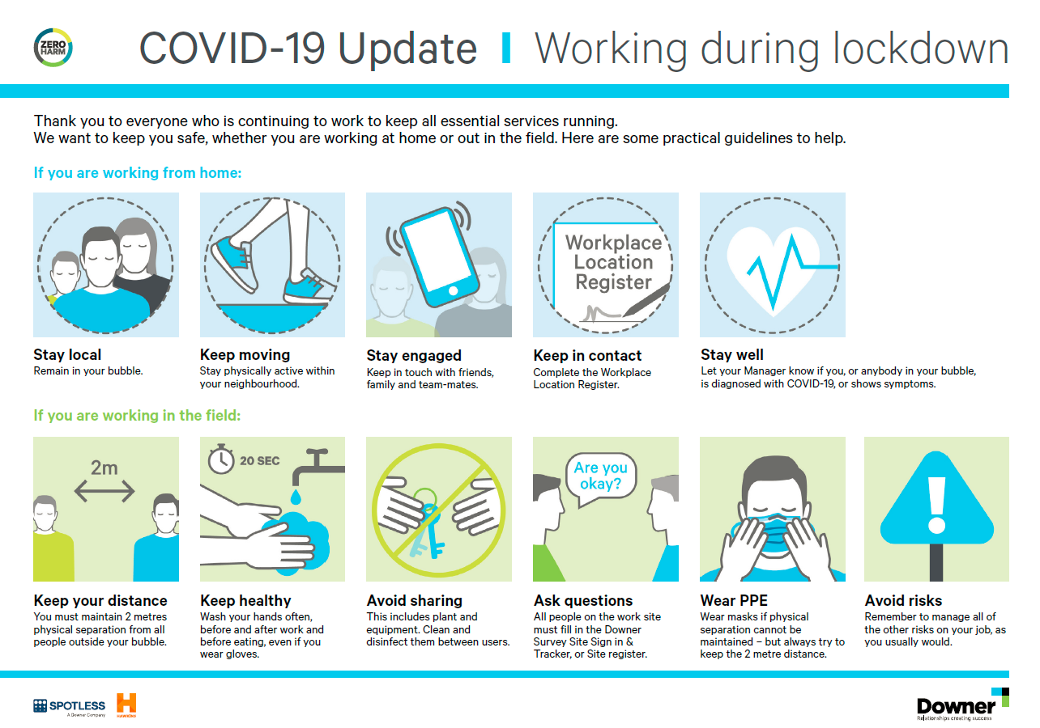
KEEP YOUR TEAM UP TO DATE
Make people feel comfortable coming to work by keeping them up to date and informed.

Slide 11
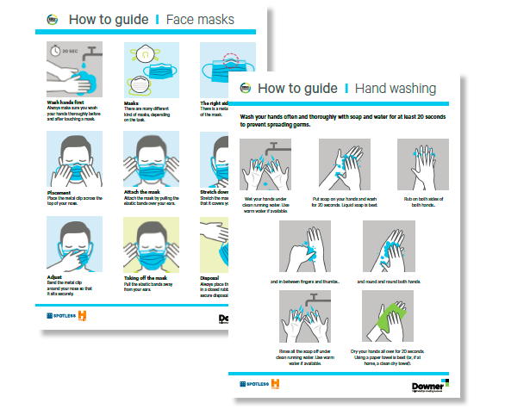
Make your team feel safe
Have the appropriate PPE available
Gloves, Masks, Hats etc
Ensure staff know what to do to keep themselves and their guests safe

Slide 12
PHYSICAL ENVIRONMENT - STAFF
Managing staff working where they would have been in close proximity to each other e.g. retail cooks on a fry line.
Lots of hand sanitising stations
Using similar virus shields like FOH cashier stations to segment work areas.
Designate work spaces with markings / tape
Tailor menu offerings so they can be safely produced – limited menus
Appropriate PPE available – gloves, masks.

Slide 13
NEW REVENUE STREAMS
What other catering options can you produce from your venue with idle capacity?
Precooked packaged meals delivered to local residents.
Local business lunch packs – offer a service so that staff can stay at work and get lunch delivered.
Partnerships with high street brands to help them increase production.
Using venues for alternate functions – Corporate suites become iso-offices.

