Slide 1
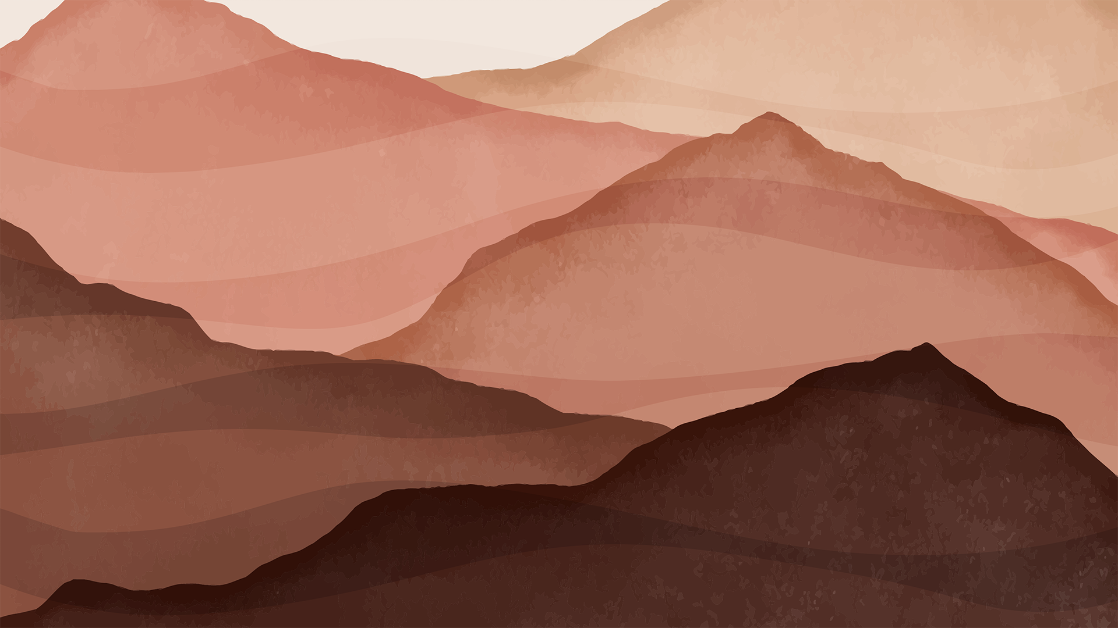
Maungatere
story & photographs
by Pūkeko class & Andy Scott

Slide 2

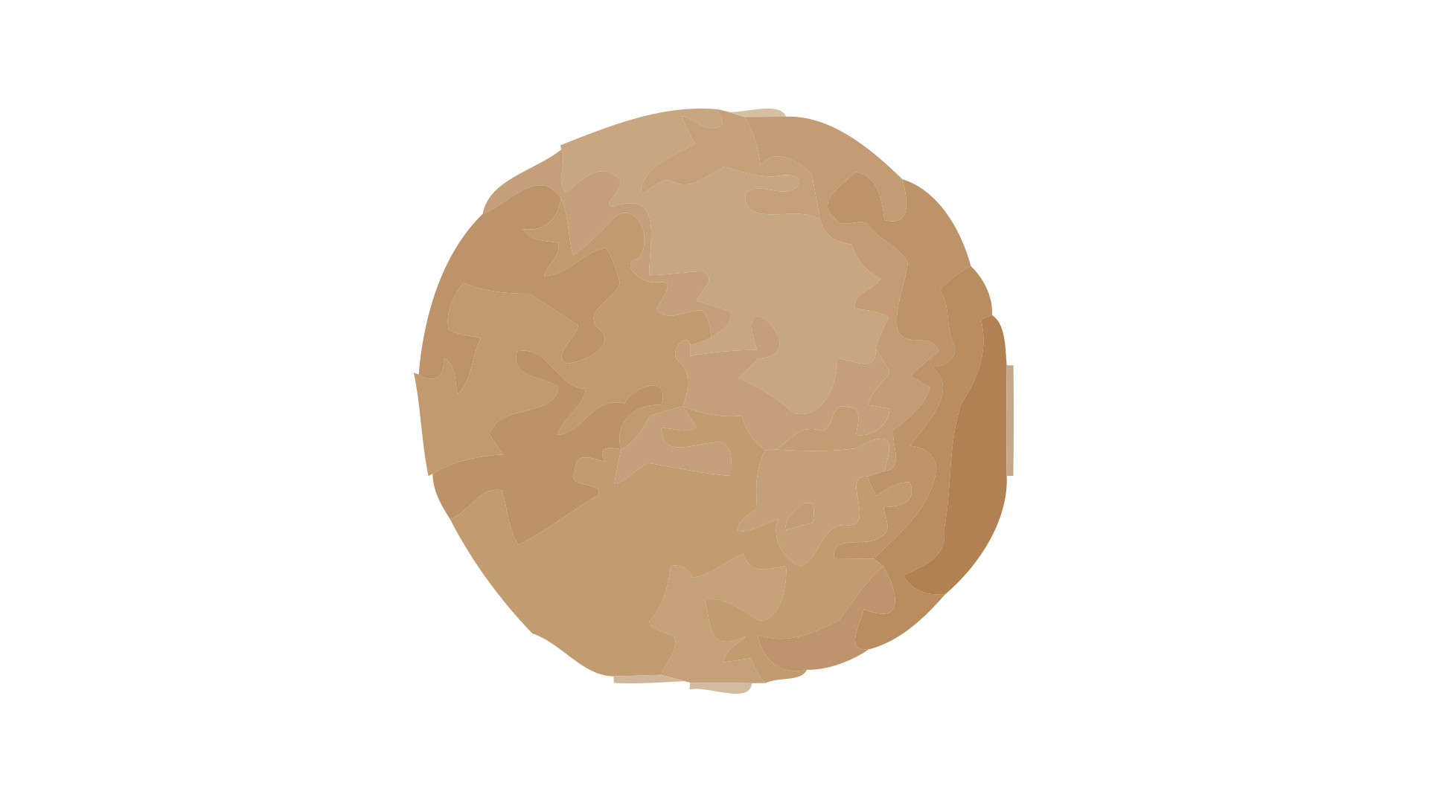
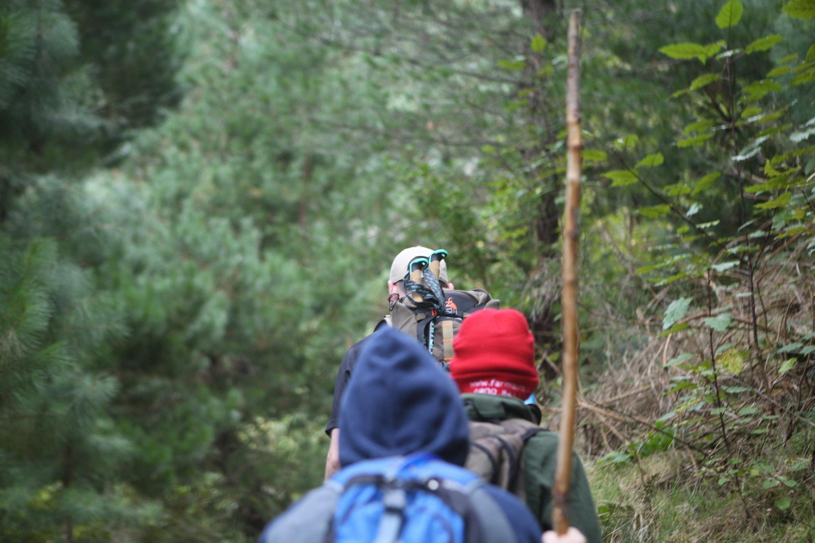
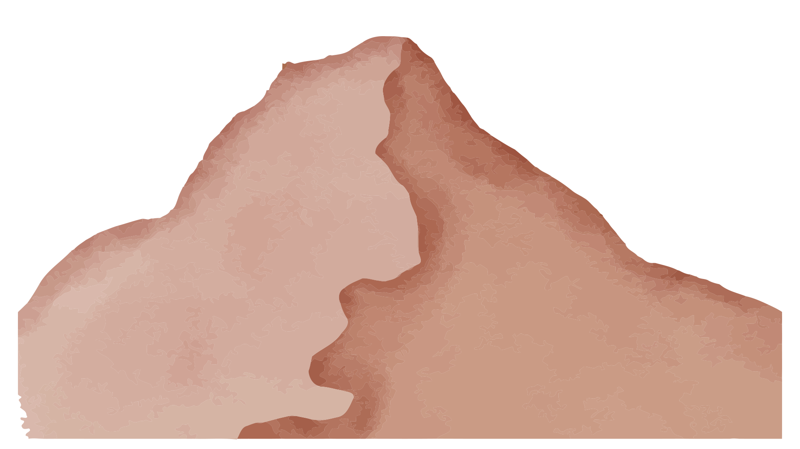
Kei te haere mātou ki Maungatere….
E te kaipānui, tēnā koe!
Kei te pānui koe i te pukapuka o te hīkoi Maungatere. Kei te whiti mai te ra, e hīkoi ana mātou kei runga i Maungatere.
In 2022, Our year 5-8 rōpū climbed Maungatere, led by Mr Scott (author) to support our kaupapa Tūrangawaewae

Slide 3
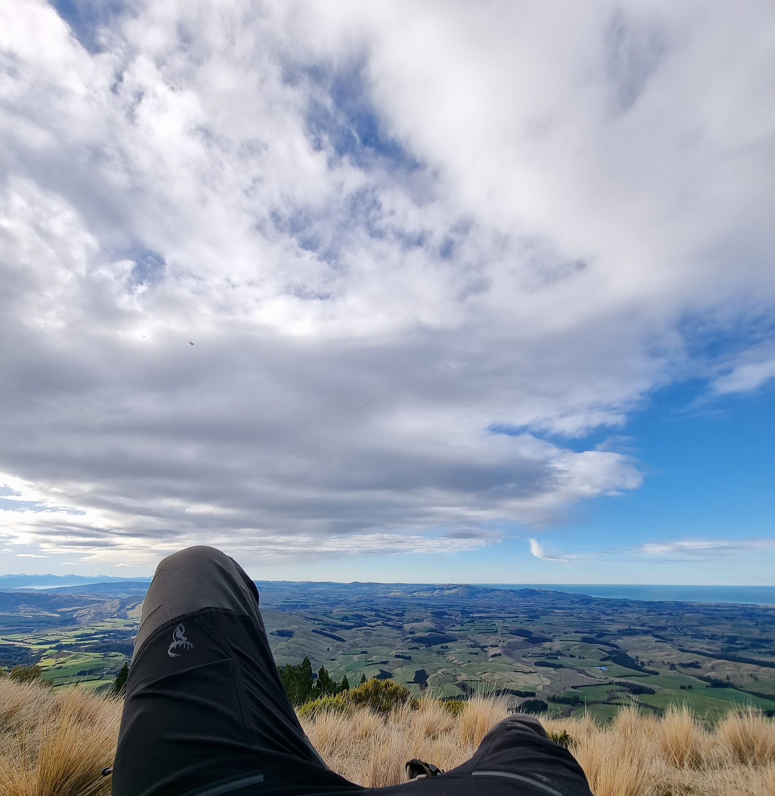
He aha? kei hea?
Maungatere is the maunga of mana whenua Ngāi Tūāhuriri & Te Kura o Kowai (Leithfield). It stands in North Waitaha, overlooking the whenua.
We learned when tāngata of this rohe pass on, their wairua float up Maungatere and along to Cape Reinga. It is a place where we stand proud, strong and invigorated.
Kia kaha te reo Māori. Kia kaha te ao Māori.

Slide 5
Rāmere, iwa karaka i te ata

Slide 6
Kei te whiti
mai te ra

Slide 7
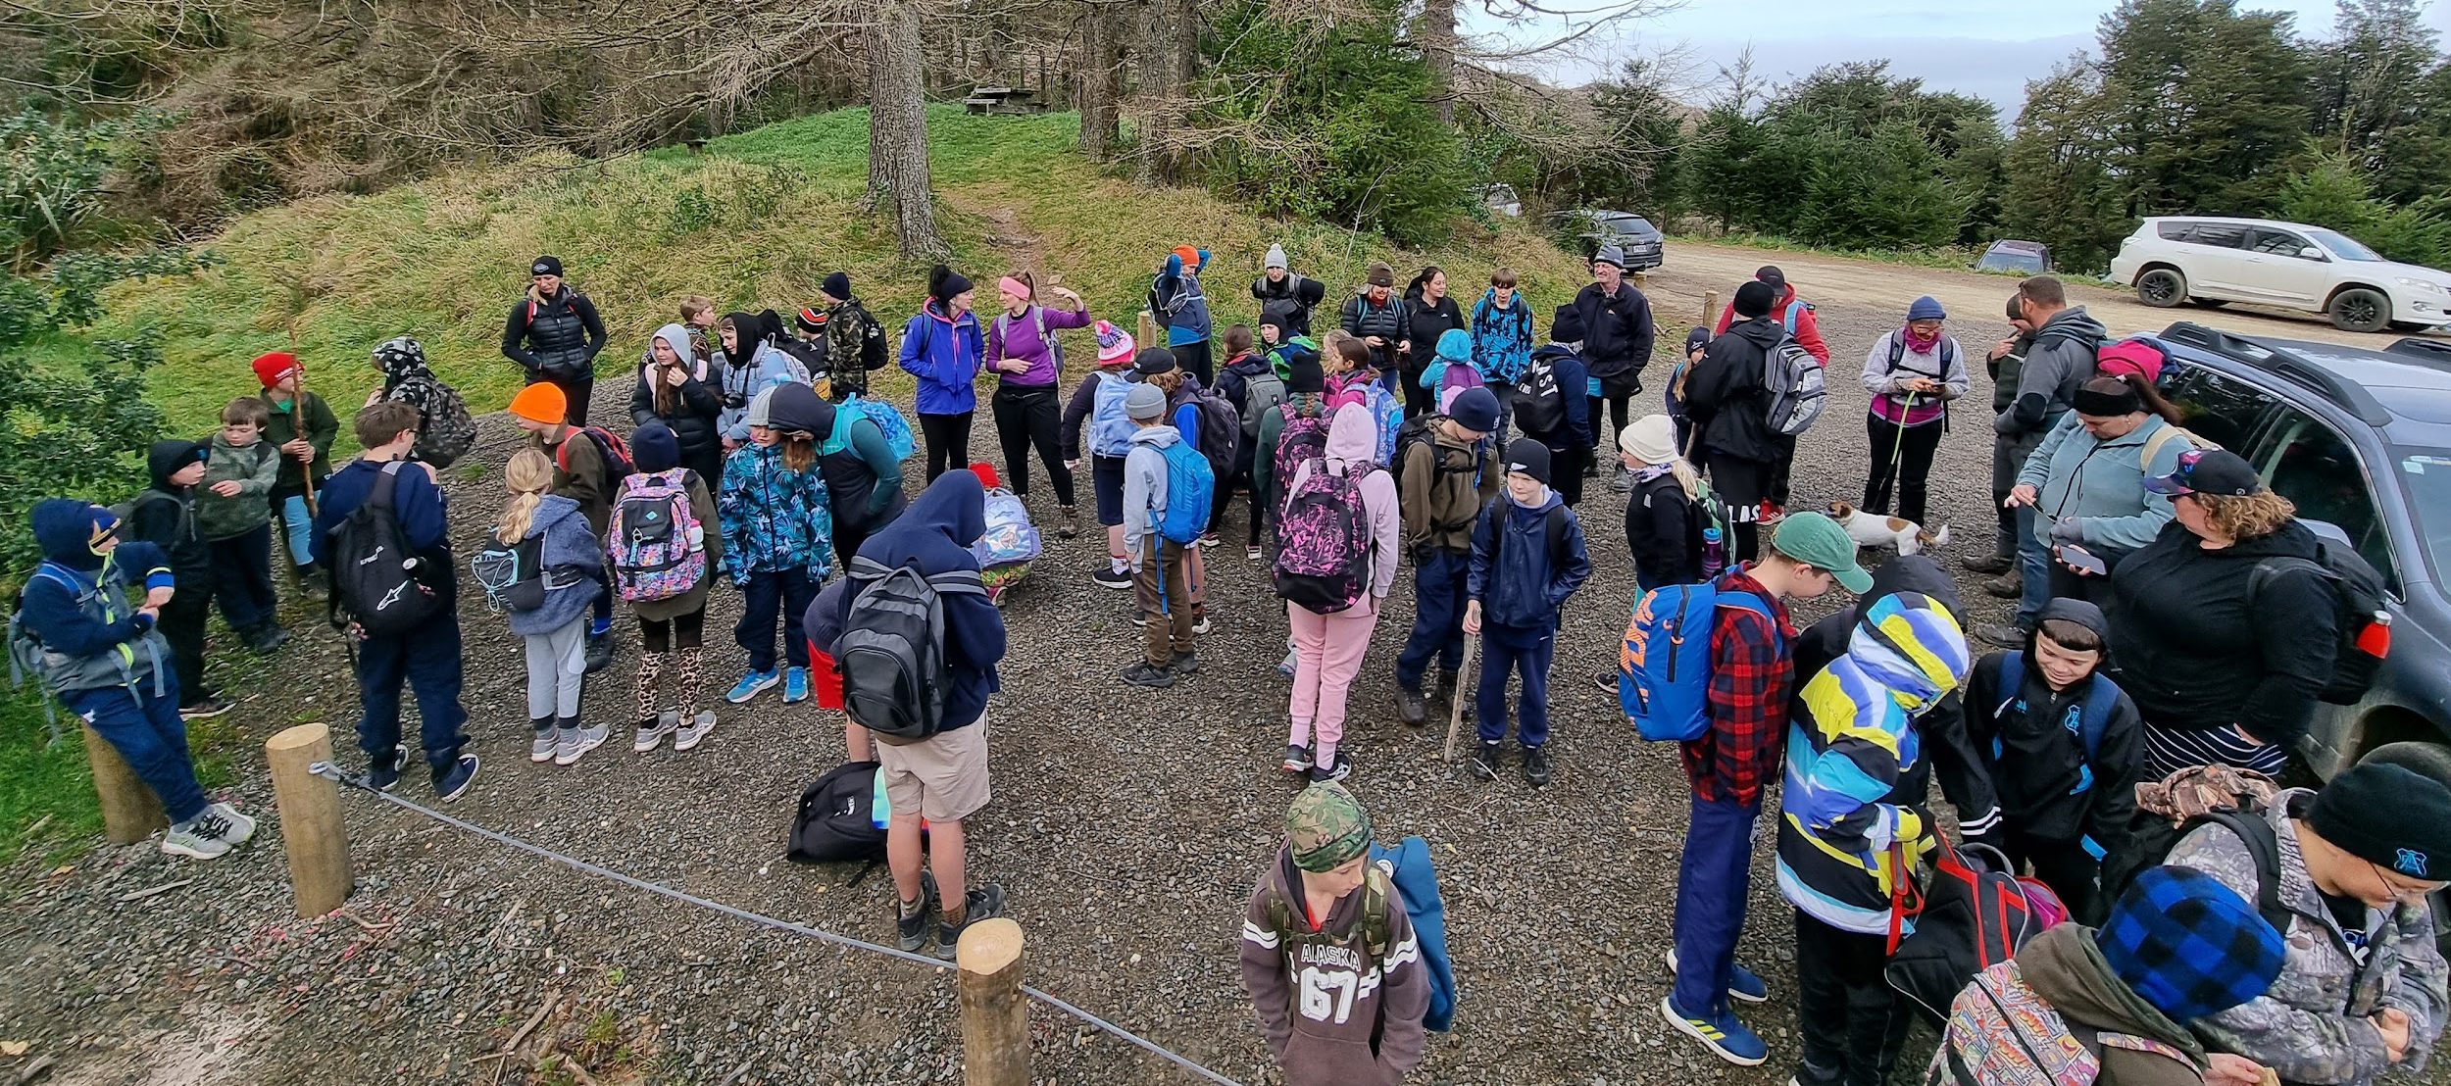
E rima tekau ngā ākonga hiamo

Slide 8
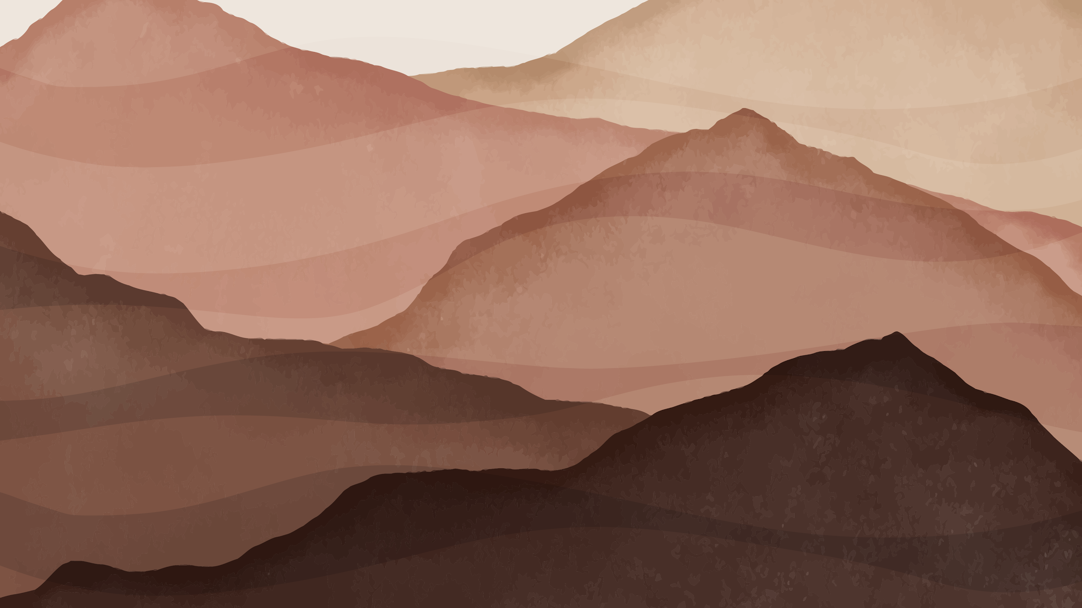
Kia rite…

Slide 9
E hīkoi ana mātou

Slide 10
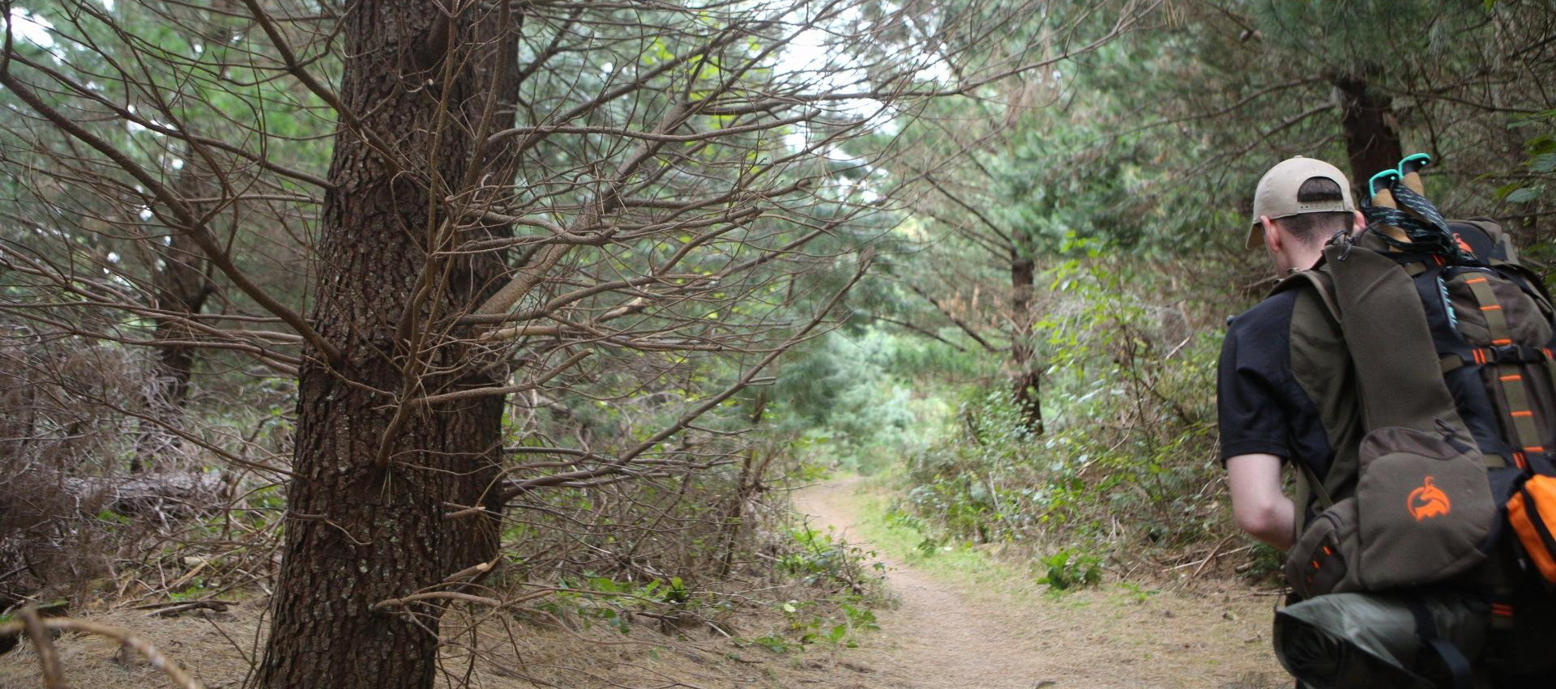
Kei roto mātou i te ngahere uriuri

Slide 11
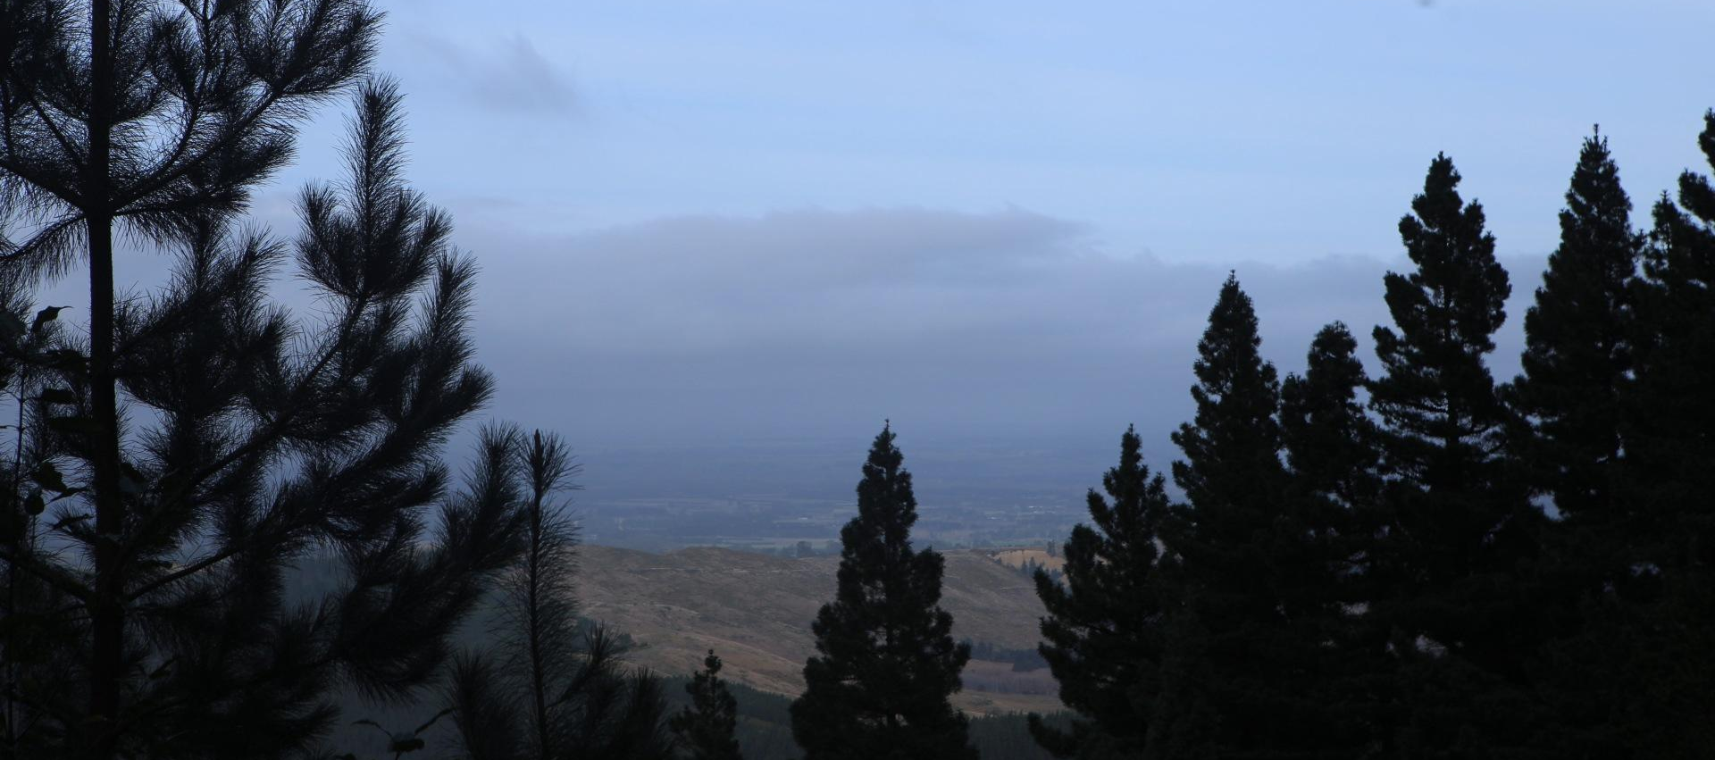
Te ātaahua hoki o te tahatū o te rangi!

Slide 12
Aue!

Slide 13
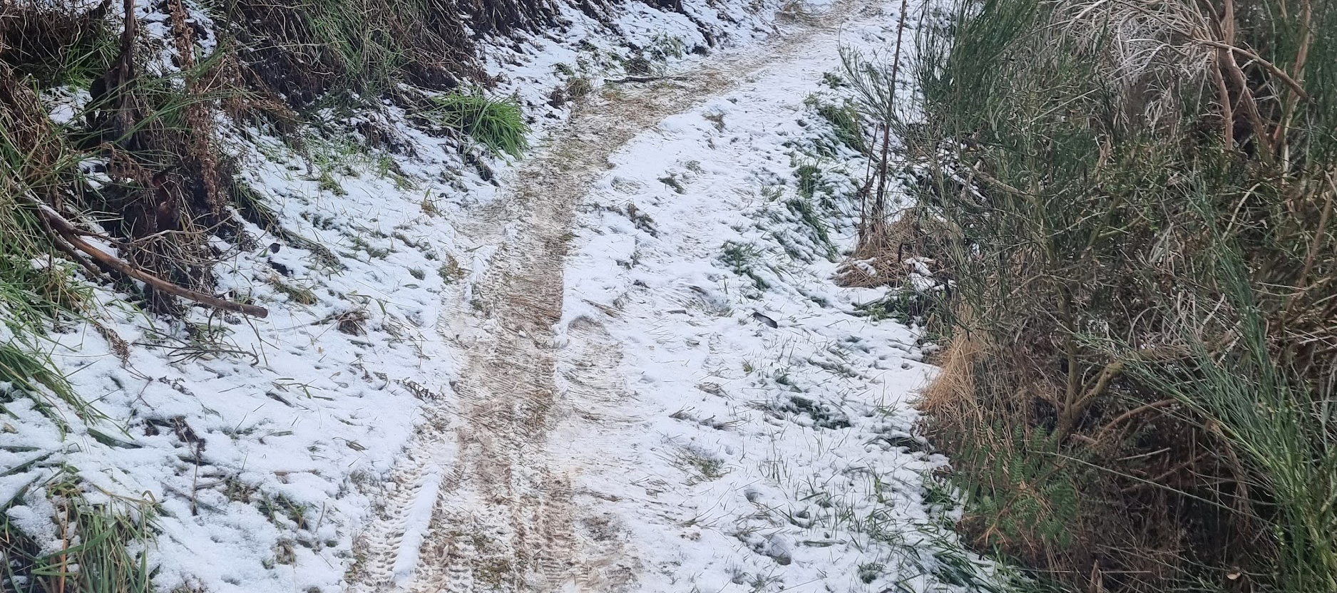
Kei te makariri mātou! I huka!

Slide 14
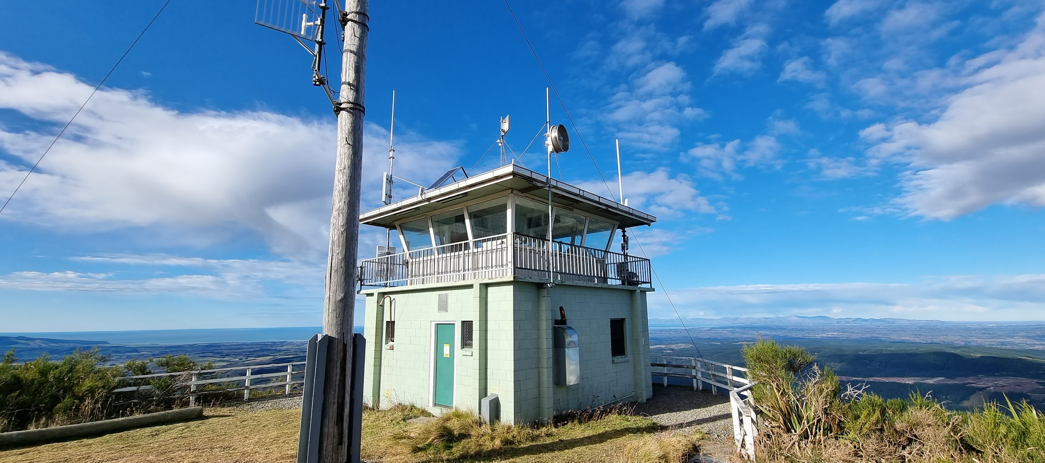
He whareahi tēnei!

Slide 15
Ka rawe!

Slide 16
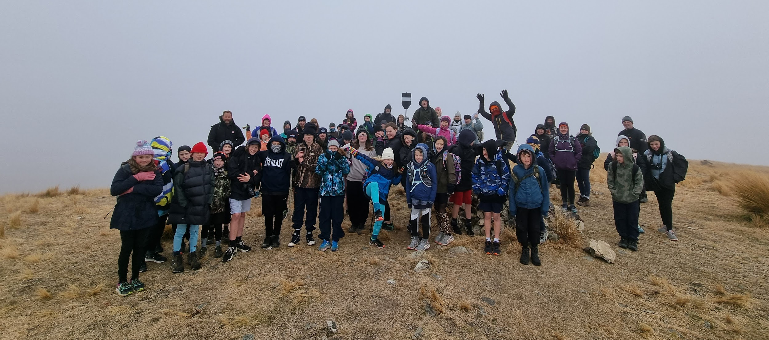
Kei runga mātou i Maungatere

Slide 17
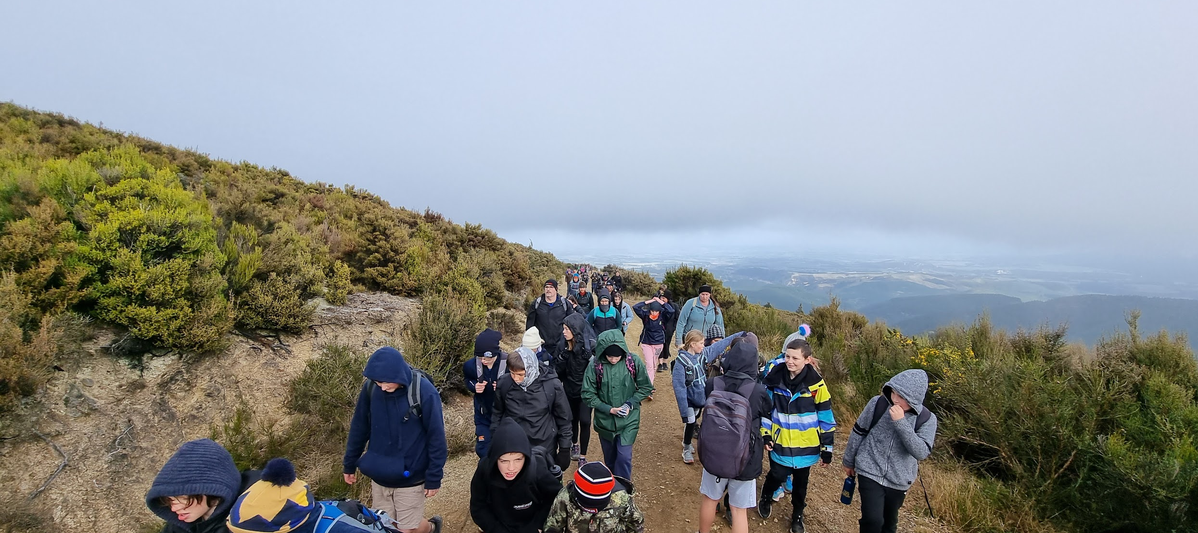
Kei te harikoa, ā, kei te ruha hoki mātou

Slide 18
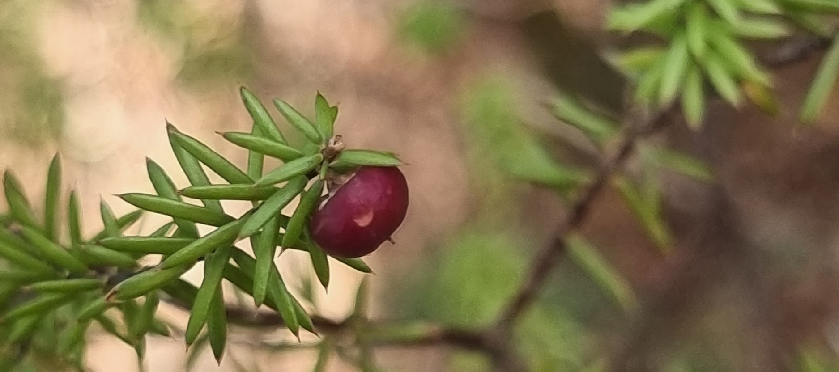
Ka kite Maungatere.
E haere ana mātou ki te kainga

Slide 20
Kaupapa
Our tamariki explored te pānui / te kōrero o Maungatere and the historical importance to mana whenua, Ngāi Tūāhuriri, & Te Kura o Kowai. Our tamariki followed on within our Tūrangawaewae celebration as kaikōrero and shared our hīkoi and kaupapa with whānau and wider community.
Tōku reo, tōku ohooho, tōku reo, tōku māpihi maurea, tōku reo, tōku whakakai marihi!

