Slide 1
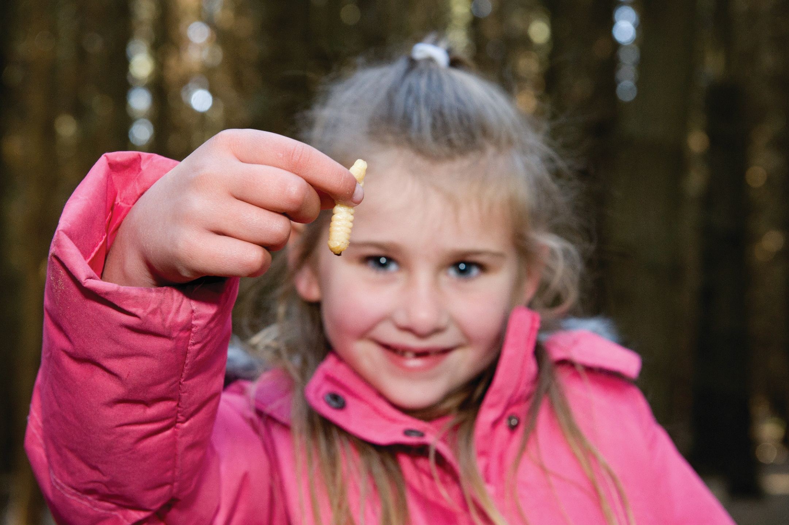
Notes:
WHAT DOES THIS IMAGE SAY TO YOU?

Slide 2
Christchurch City Council
Learning Through Action
Environmental Programmes
For Schools
“Learning through action. Engaging minds. Empowering citizenship.
Ko tō ao, Ko tōku ao”
Notes:
WHO ARE WE?

Slide 3
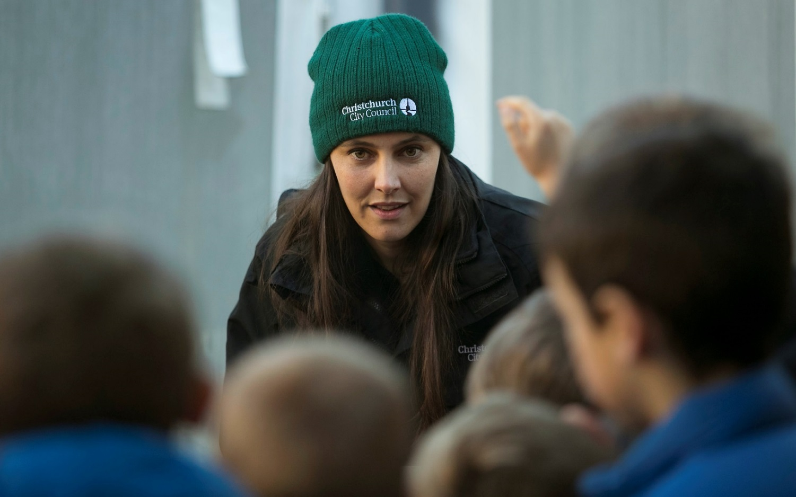
Our programmes are:
Free
Place-based, immersive learning for Yr 0-13
Linked to NZC
Easily accessible via website or booklet
Loads of fun!
Oh, and did I mention free?
Notes:
WHAT DO WE DO?

Slide 4
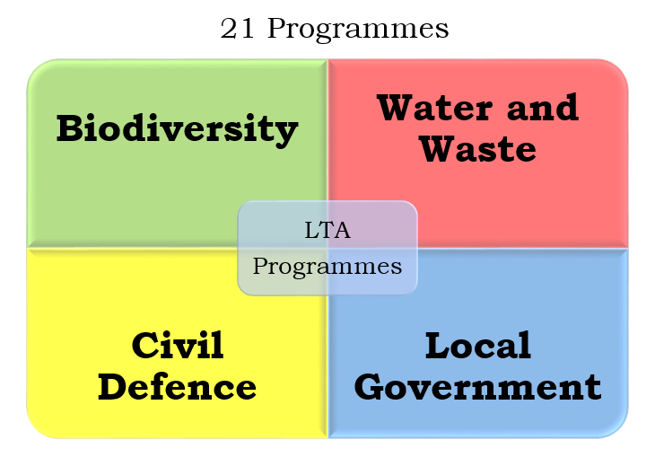
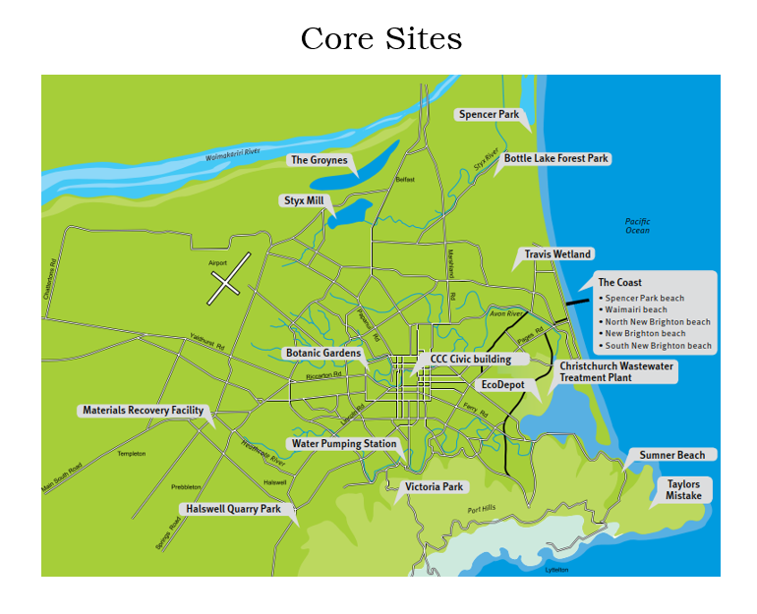

Slide 5
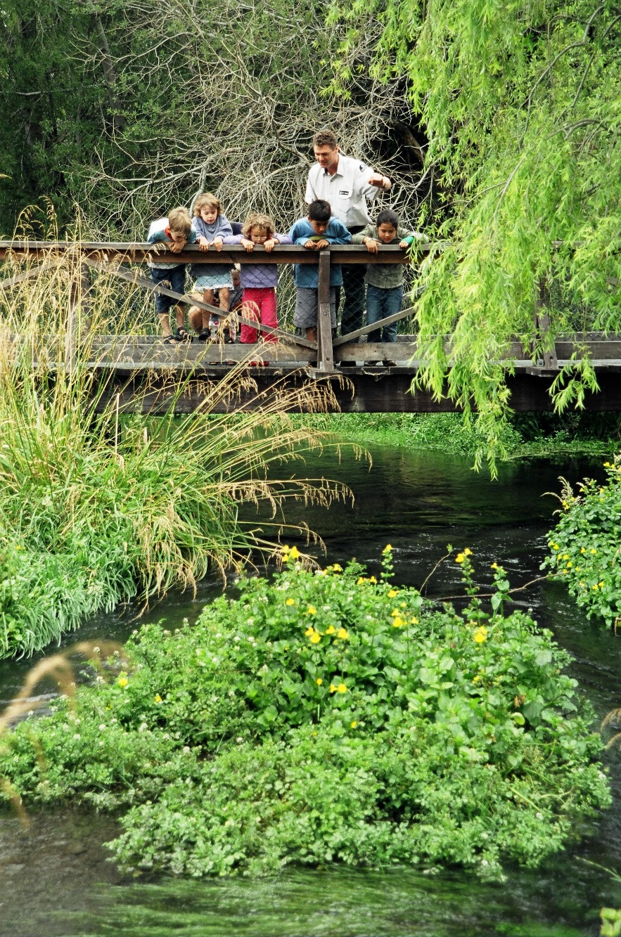
Why do schools use our programmes?
Kick-starter
for a programme of learning
Reinforcer
for knowledge already held
Connector
to a local space
Knowledge booster
to enable decision-making
Celebration
to close the inquiry
Notes:
WHY DO WE DO WHAT WE DO?

Slide 6
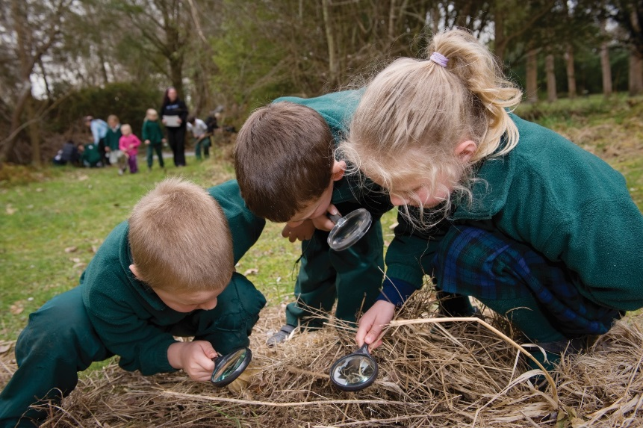
How are we doing?
200
99%
12,299
800
Notes:
HOW ARE WE DOING?

Slide 7
How are we doing?
In the last 5 years we have worked with over 200 schools in and around Ōtautahi Christchurch
We are currently tracking at 99% satisfaction with the programmes we deliver
Over the last 12 months we have shared our programmes with 12,299 participants
We have over 800 teachers on our
database

Slide 8
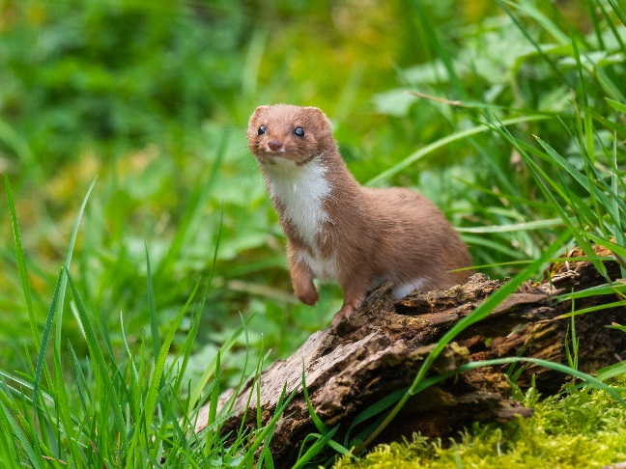

Time for some fun ☺
Notes:
SCAT AND TRAP ACTIVITY

Slide 9
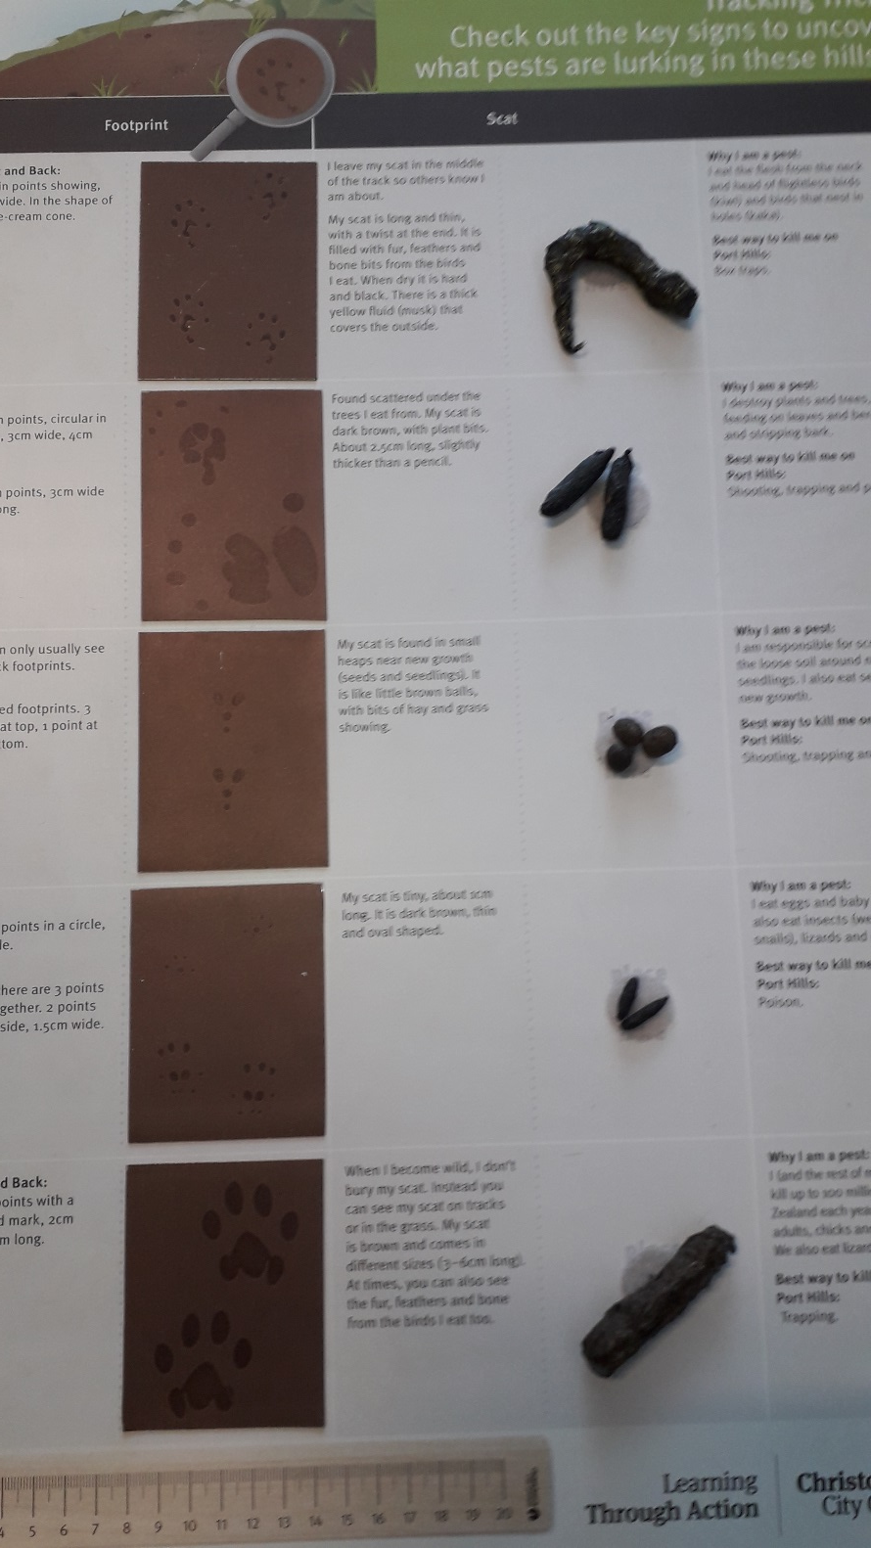
How did you get on??

Slide 10

What’s coming up?
Climate Change
Storm Water
Notes:
WHAT ARE WE DEVELOPING?

Slide 11
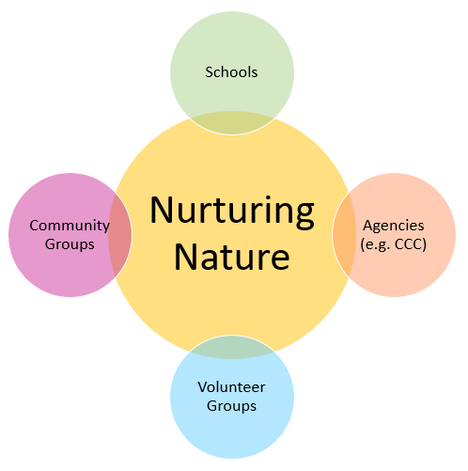
Hot off the press…
Nurturing Nature
Environmental Restoration
Kaitiakitanga

Slide 12
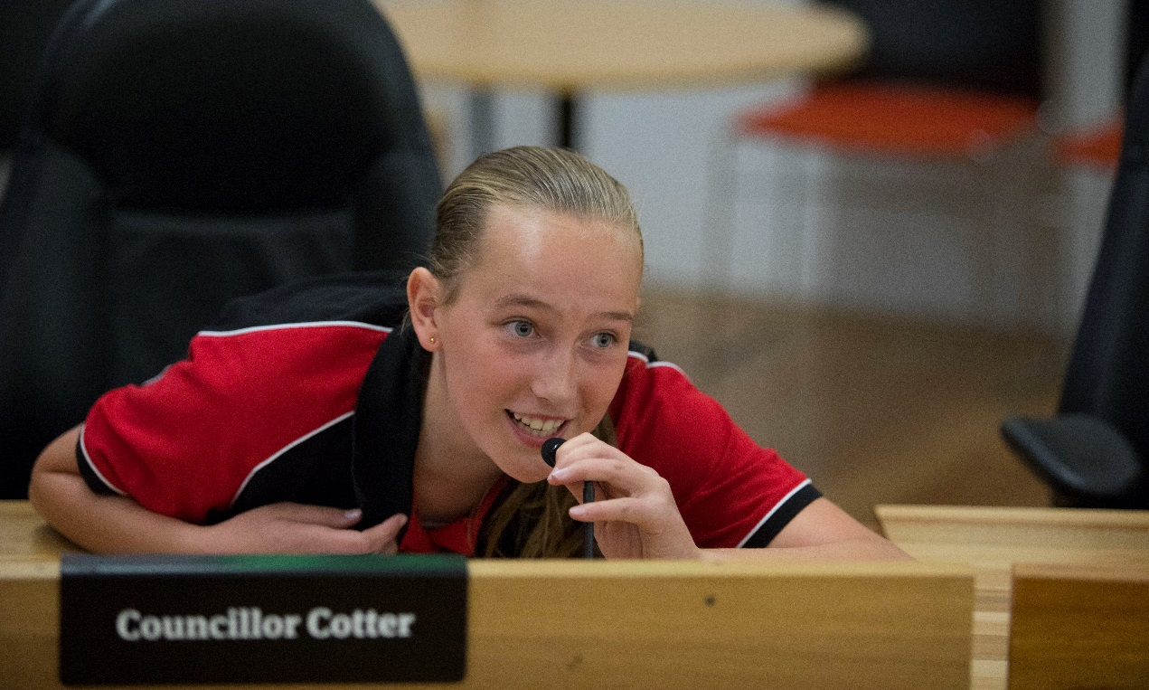
What the schools are saying…
“It strongly teaches the importance of sustainability, and the activities really make the pupils think.”
“To save water as much as I can and pass on the message to friends and family.”
“Reinforced learning in a real context.”
“I will make sure I put things in the right bin.”
“Fabulous hands-on experience for all children.”
Notes:
HOW DO LEARNERS FEEL ABOUT WHAT WE PROVIDE?
Peach = Teachers, Blue = Students

Slide 13


Learning Through Action
LTA@ccc.govt.nz
03 941 6389
Or search for “Learning Through Action” on the CCC Website
Nurturing Nature
Enquiry form
https://ccc.govt.nz/parks-and-gardens/volunteer-in-parks/register-to-volunteer-in-a-park/
Or email
parks.volunteers@ccc.govt.nz
Mā te taiao, kia whakapakari tōu oranga
Let nature in, strengthen your wellbeing

