Slide 1





Workshop 3:
Tuakana Teina
Created by CORE Education
for the Puketeraki Kahui Ako

Slide 2
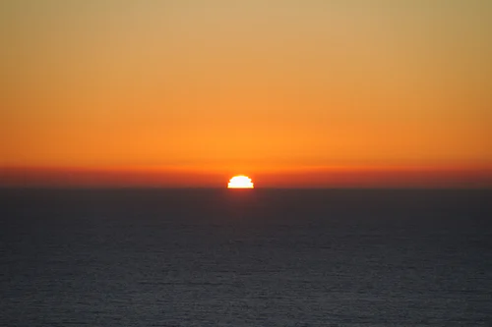
Dawn of change
Notes:
‘Te Kawa o Maiora’, is a karakia of sorts, which was written with the intention to bless the new post COVID-19 world in which we find ourselves living.
"A kawa ora in its earliest instance imbues life into a new house, or into a new situation, and this is a very new situation to us," he says.
It was in thinking about how he could help not only his own community but also the wider global community, that Lardelli was inspired to compose ‘Te Kawa o Maiora.’
"Great ideas come out of situations where people are thinking about others, not only themselves and their close relatives but the broader picture about what could help everybody," he says.
"Māori play a vital link as tangata whenua and who we are as mana whenua, but we also have an obligation to make sure that all human beings are okay in this situation because it’s a world pandemic."
"He aha te mea nui o te ao? He tangata, he tangata, he tangata."

Slide 3

“A kawa ora in its earliest instance imbues life into a new house, or into a new situation, and this is a very new situation to us," Derek Lardelli
Notes:
‘Te Kawa o Maiora’, is a karakia of sorts, which was written with the intention to bless the new post COVID-19 world in which we find ourselves living.
"A kawa ora in its earliest instance imbues life into a new house, or into a new situation, and this is a very new situation to us," he says.
It was in thinking about how he could help not only his own community but also the wider global community, that Lardelli was inspired to compose ‘Te Kawa o Maiora.’
"Great ideas come out of situations where people are thinking about others, not only themselves and their close relatives but the broader picture about what could help everybody," he says.
"Māori play a vital link as tangata whenua and who we are as mana whenua, but we also have an obligation to make sure that all human beings are okay in this situation because it’s a world pandemic."
"He aha te mea nui o te ao? He tangata, he tangata, he tangata."

Slide 4

Reflective practise
What changes have you made, new learning or wellbeing strategies?
What changes would you like to see?
Notes:
Our why!

Slide 5
He waka eke noa:
Goal of this workshop series:
Extend professional networks
Name | School | Contacts
Jo Woodrow | Rangiora High School | wdj@rangiorahigh.school.nz
Janel Painter | Amberley | janel.m@amberley.school.nz
Sacha Storer | Rangiora High School | srs@rangiorahigh.school.nz
Vicki Edwards | Te Matauru Primary | vicki.edwards@tematauru.school.nz
Averil Wells | Leithfield School | averil@leithfield.school.nz

Slide 6
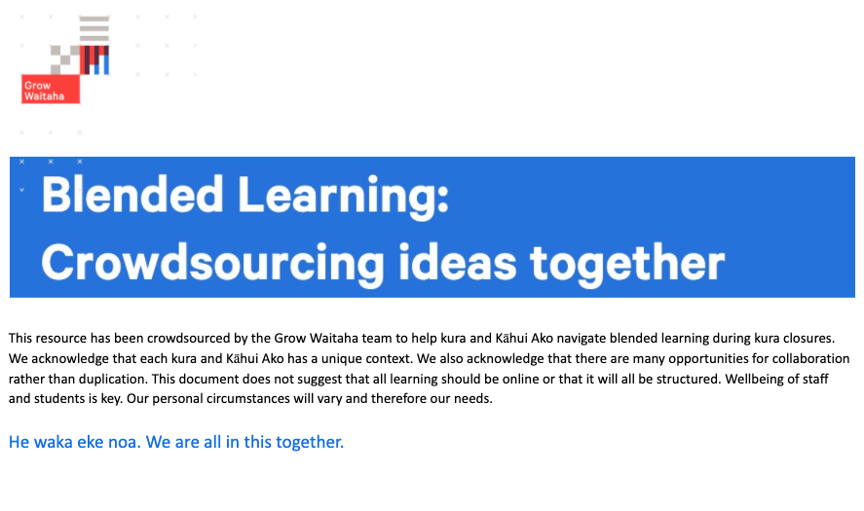
He waka eke noa:
Goal of this workshop series:
Further development skills and partnerships
Link to the resource

Slide 7
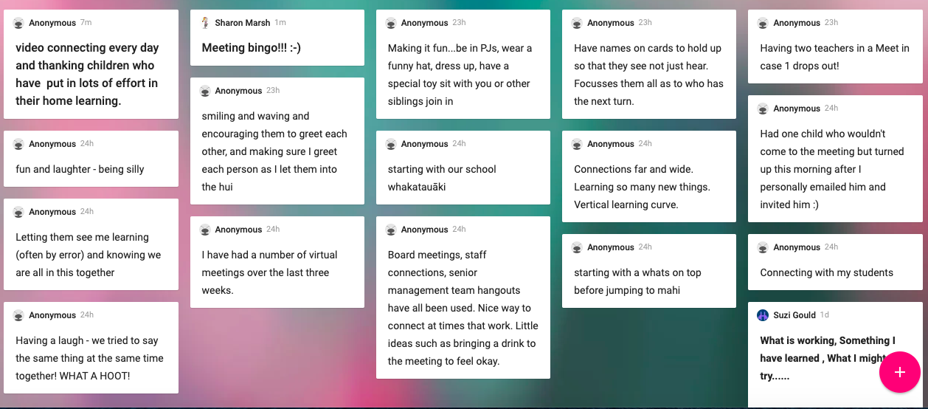

Manaakitanga Online
What does manaakitanga look like in a virtual hui?
https://padlet.com/suzi_gould/Feedback
https://padlet.com/suzi_gould/Feedback
Notes:
*** How do you manaaki others in your virtual hui ?
////https://padlet.com/suzi_gould/Feedback

Slide 8
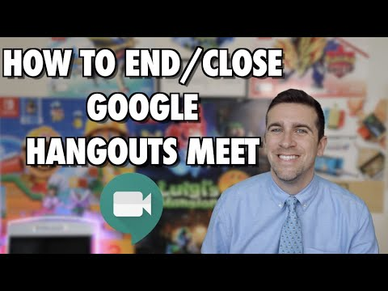
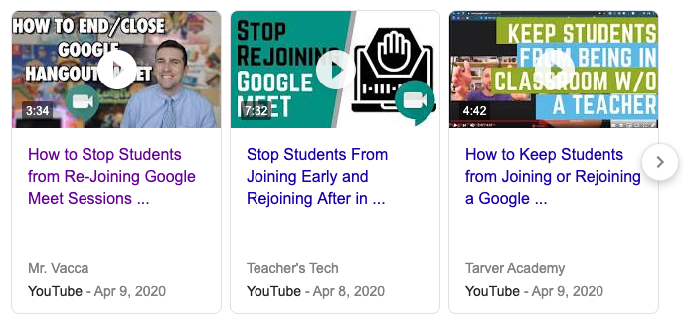
He waka eke noa:
Goal of this workshop series:
Confidence, safety and effective use of virtual hui tools

Slide 9
Crowdsource focus: anything, ways of working,
Taking videos of us doing things around home to share with our students so they can hear our voices and see our faces. To keep our students connected with us | Vicky Holt Rangiora High School
Creating Google Slides on almost anything which may interest our students with some easy questions they can answer | Vicky Holt Rangiora High School
Using Seesaw to stay connected | Vicky Holt Rangiora High School
Friday Fun day full group meetings with dressups and themes | Jo Woodrow Rangiora High School
Daily Google Hangouts with groups of students, teachers and Learning Assistants. Just to listen and share how we are all going | Vicky Holt Rangiora High School
We have PRIDE time at school Fridays and have carried this on teachers & Support staff have activities kids request a PRIDE activity & join in great connecting | Janel Painter Amberley School
Daily Google Meets (with different activities like quizzes, listening activities, memory activities etc) and weekly Hui’s with different themes and competitions for most creative. | Vicki Edwards Te Matauru Primary
Joining Learning Assistants with ORS funded students in Mainstream Learning via Google Classroom so LAs can assist those students to continue studies, especially those working towards NCEA credits | Jo Woodrow Rangiora High School
Weekly 1-1 catch up meetings with special needs children. We tell each other jokes and talk about our days. It’s been a great way to stay connected. :) | Vicki Edwards Te Matauru Primary
We use PB4L at Rang HS which is Positive Behaviours for Learning to acknowledge our students mahi with focus on core values | Jo Woodrow RHS
Notes:
Reaching out
1. Reaching Out
• Get the learners baking in the school’s Food Tech space to make treats [scones, muffins] that can be delivered to the police, medical centres, vets, supermarkets etc.
• Get the learners making ‘thank you’ cards to deliver to the local supermarkets, police etc.
• Get learners to write poems, and letters that can also be delivered.
• Get learners to make a ‘thank you’ video. This example is the work of a group of learners at Rolleston College responding to March 15.
• Get a group of learners to run a competition to design a T-shirt that can quickly be produced and sold with the profits being donated.

Slide 10
Teachers aides crowdsourcing
Crowdsource focus: Transitioning Back to School
1. Reaching Out | Daily Google Hangouts to let our students talk about how they feel and what they are doing today/tomorrow etc | Vicky Holt Rangiora High School
 | Get the learners making ‘thank you’ cards, poems, videos to deliver to essential workers the local supermarkets, police etc. | Suzi Gould CORE Education
2. Check and Connect | With our students looking for credits, letting them know we are here to help but also making them accountable so they can join classroom again and not feel left behind | Jo Woodrow RHS
 | Use a range of ways to ask how people are doing ? some useful question prompts | Suzi Gould CORE Education
3. Moving forward: goals; steps Pits and peaks | Hugs - if we’re allowed to! We are learning sign language as we have a hearing impaired student | Vicky Holt Rangiora High School
 | Special Welcome on first day back settling in feeling comfortable being back in school environment | Janel Painter Amberley
Notes:
Reaching out
1. Reaching Out
• Get the learners baking in the school’s Food Tech space to make treats [scones, muffins] that can be delivered to the police, medical centres, vets, supermarkets etc.
• Get the learners making ‘thank you’ cards to deliver to the local supermarkets, police etc.
• Get learners to write poems, and letters that can also be delivered.
• Get learners to make a ‘thank you’ video. This example is the work of a group of learners at Rolleston College responding to March 15.
• Get a group of learners to run a competition to design a T-shirt that can quickly be produced and sold with the profits being donated.
Check and Connect approach to your school’s version of tutor or form time.
This is where the class sits in a circle to share.
Thumbs up sideways
The names Pits and Peaks and Check and Connect are not important and should be personalised for each school context.

Slide 11
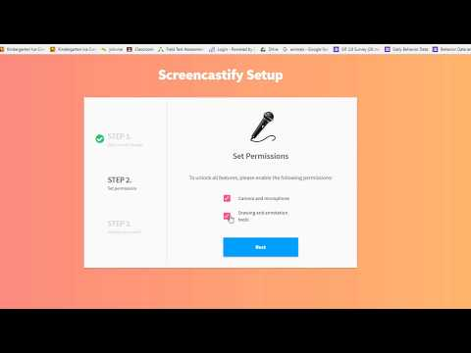
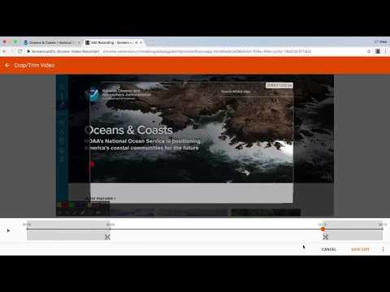
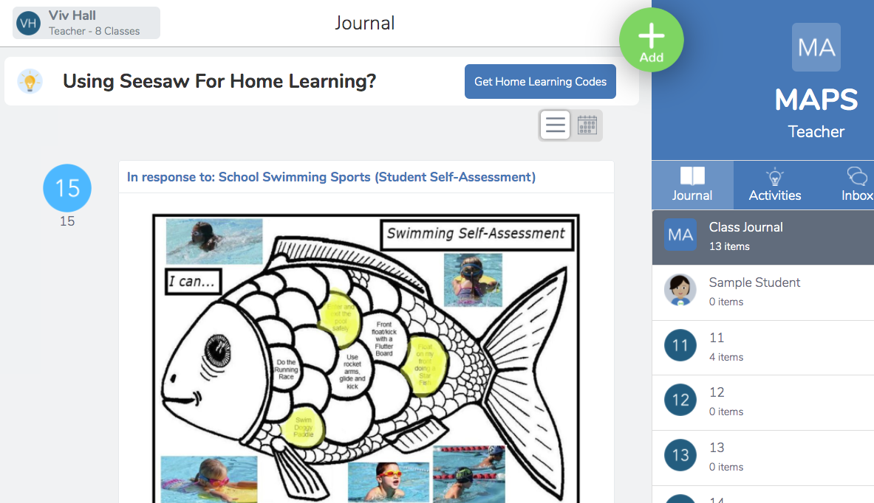
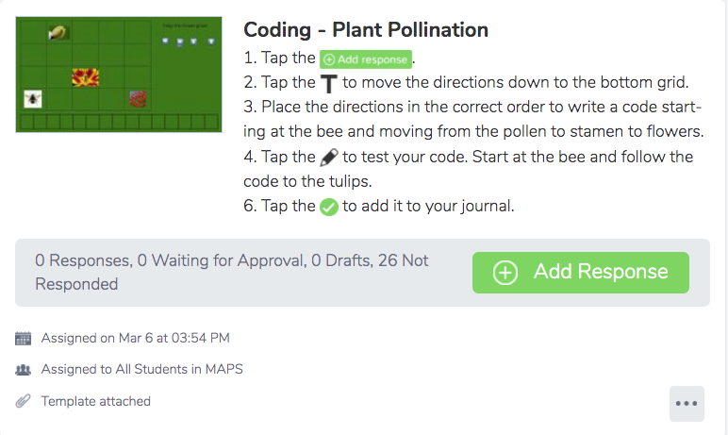
What about creating content…?
Seesaw & Activities
Activity Library

Slide 12
What about creating content…?
Flipgrid
Activity Library

Slide 13
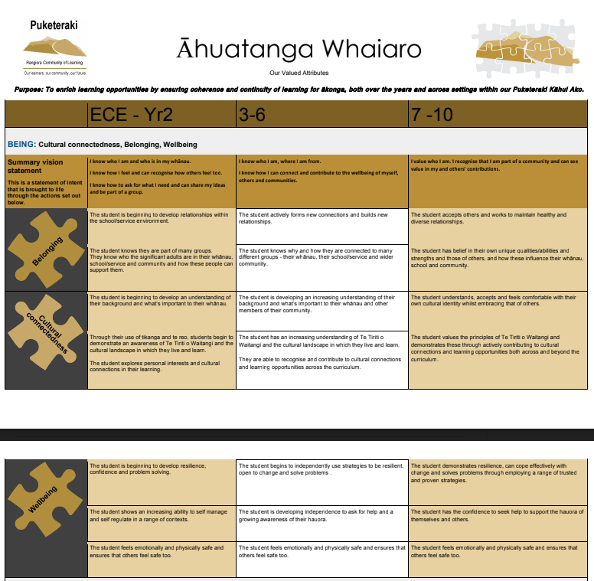


Through the lense of pedagogy, people and our Āhuatanga Whaiaro:
Well Being
Belonging
Cultural connectedness
Notes:
Our why!

Slide 14
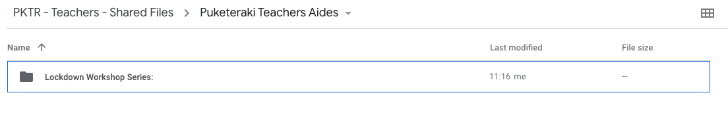
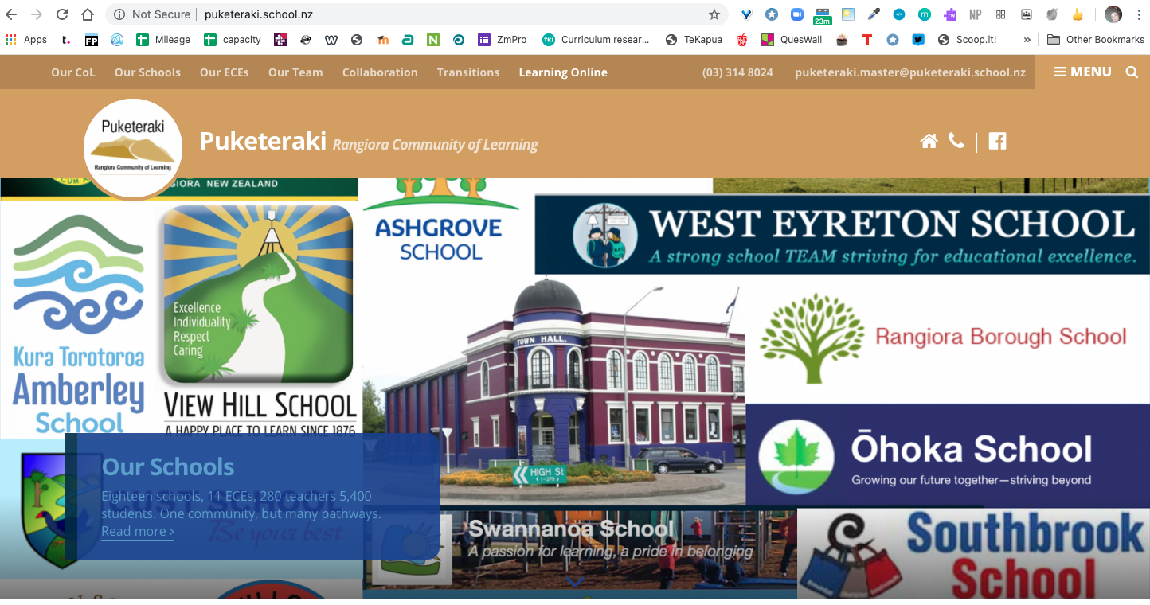
How do I access the files from this workshop series?
The files and recording will be placed in the Puketeraki teachers shared file on google drive.
The teachers aide series (plus other Puketeraki workshops) can be found on the Puketeraki website - Learning online tab.
Notes:
Sacha Storer11:13
The way we connect with students has changed.
Vicky Holt11:13
Learning how to use Google Hangouts
Rebecca Tayles11:13
My daughter hasn't wanted to do schooling at home this week. I have let her run with this. We always check in with the teacher sometime during the day but hopefully we will be back at school soon.
Averil Wells11:13
I have been getting fresh air everyday by walking
Jo Woodrow11:14
making my bed every morning so I feel like I have achieved something!
Melanie Wildermoth11:14
walking and bike riding with family
Nicky van Lent11:14
Staying connected to friends and family virtually.....important for kids too.
Kim Hassan11:14
learnt how to use google hangouts
Pip Wyatt11:14
Learnt to let go of things out of my control. More balance for us and need to continue this. I think I need some more technology lessons!
You11:14
The beach has never been more attractive
Averil Wells11:14
yes kim!
Elizabeth Buckley11:14
Hi guys, I have been trying to deal with things on a day to day basis, rather than looking too far ahead, which I find can be quite overwhelming.
Averil Wells11:15
yes Kim!
claire cameron11:15
accepting that not every day is going to be a good day.
Janel Painter11:15
Connecting more as a family changig habits you get into when your busy running around to activities!
Sarah Morris11:15
Challenged myself to be able to run 5km non stop and did it after not having run for 4 years. Needed the fresh air and exercise.
Kim Hassan11:15
walking every day with my dog, discovered more of the beautiful tracks of Leithfield and Amberley
Averil Wells11:15
learning patience
Vicki Edwards11:16
I have enjoyed adapting my literacy programmes via google meet in google classroom for students and find they are so engaged and it has helped keep our relationships strong.
Christine Morriss11:16
Are you still looking for extra attendees. We still have some colleagues trying to join
Robyn Norriss11:16
Knowing how famiies are getting onstaff and students online through staycation on google docs
You11:17
https://docs.google.com/presentation/d/1IGAtRUOz1EbrREn75WIZjBvFvJa_YHFQISdmCikio04/edit#slide=id.g776794a3cc_2_45
Rebecca Tayles11:17
How do we enter the details.
Nicky Lancaster11:18
Can more people join this meeting some colleagues still trying to get in.
Sarah Whiting11:19
Should be able to. Ask them to try again and I wlll see if the access links comes up
John Kaye11:20
are you still letting people in? Some of my colleagues are trying to come in
Sarah Whiting11:20
Should be able to still enter
Vicky Holt11:20
I can't edit the document - scrolling etc
Janel Painter11:21
I had trouble & had to go out & back in
Rebecca Tayles11:22
Is there somewhere with all the info from all the hangouts we have had.
Vicky Holt11:22
I tried that but still can't. Grrr!
Sarah Whiting11:22
meet.google.com/ebb-tvxc-hjz
Vicky Holt11:23
Can you enlarge it?
Sarah Whiting11:24
You might need to refresh the link Vicky
Sarah Whiting11:25
All will see all of this on the shared slides too.
We are organised a shared space for all these resources too
Rebecca Tayles11:25
Can you tell how to find the shared space?
Elizabeth Buckley11:26
Where will this information be available please?
Sarah Whiting11:26
I will check with Suzi for you.
Elizabeth Buckley11:26
Thanks Sarah!
Sarah Whiting11:27
https://docs.google.com/presentation/d/1IGAtRUOz1EbrREn75WIZjBvFvJa_YHFQISdmCikio04/edit#slide=id.g776794a3cc_2_107
Slide 10
Sarah Whiting11:29
Access on last slide
Vicky Holt11:31
I have put some things on the above link. I hope that's right
Sarah Whiting11:31
Thanks Vicky. :)
You11:35
Eleven questions for making a true connection or maintaining team cohesion
Here are some sample questions for getting beyond “How are you?”
How are you taking care of yourself today?
What part of your shelter-in-place residence have you come to appreciate the most?
What surprising thing have you been stocking up on (that isn’t toilet paper)?
What’s a story – from a book, a movie, an article, a conversation – that you’ve been gripped by recently? Why did it capture you?
What habit have you start
Sarah Whiting11:35
Love these Suzi
Nicky van Lent11:42
Sorry everyone, I need to leave a little earlier today.....Thank you for holding this virtual hui today! Have a great weekend!
Elizabeth Buckley11:45
Sarah Whiting, your baby is beautiful!
Elizabeth Buckley11:46
I have to go, thanks for these great resources. Have a great weekend!
Sarah Whiting11:46
Thank you Elizabeth!
Sue Gilbert11:47
some of us missed earlier sessions ,can we still resource these
Janel Painter11:48
It will be good just to go back read & let it set in my brain properly!!
Jo Woodrow11:48
This has been great and I definitely wish we had known about the first two sessions. However I will be looking up the previous two sessions online. :)
Vicky Holt11:48
Thank you everyone - it makes me feel that we have been on the right track through the lockdown
Pip Wyatt11:48
Absolutely....these meetings has reminded me of what an important job role we all have. Also this has made me want to do some more study
Vicki Edwards11:48
Thank you so much. These resources and great and really helpful. It's so nice to know that we're all in this together. :)
Rebecca Tayles11:49
I have enjoyed these sessions. Learning more about what is on offer for teacher aids. I will be going onto your website to acess this info and like Janell have it set in my brain.
Robyn Norriss11:49
Yes I will appreciate reading it back later as well
Pip Wyatt11:49
Thank you I missed that last catch up so I will look that up. Was it TKI?
Melanie Wildermoth11:49
Thanks Its a shame we didnt know about other sessions, interesting will look at other sessions . thanks again
Averil Wells11:50
Loving this rich conversation!

