Slide 1

In July 2018, a group of senior students at Isleworth School, joined a photography elective.
Inspired by the Christchurch Documentary Project: Bishopdale, 2017, a collaboration between UC Fine Arts and Christchurch City Libraries, the group was excited to get out in their community, armed with cameras. The children worked with a wonderful, local photographer, Jess McGiffin, to discover how to take great photos. Here is our version: ‘Bishopdale Project: Our Place’

Slide 2
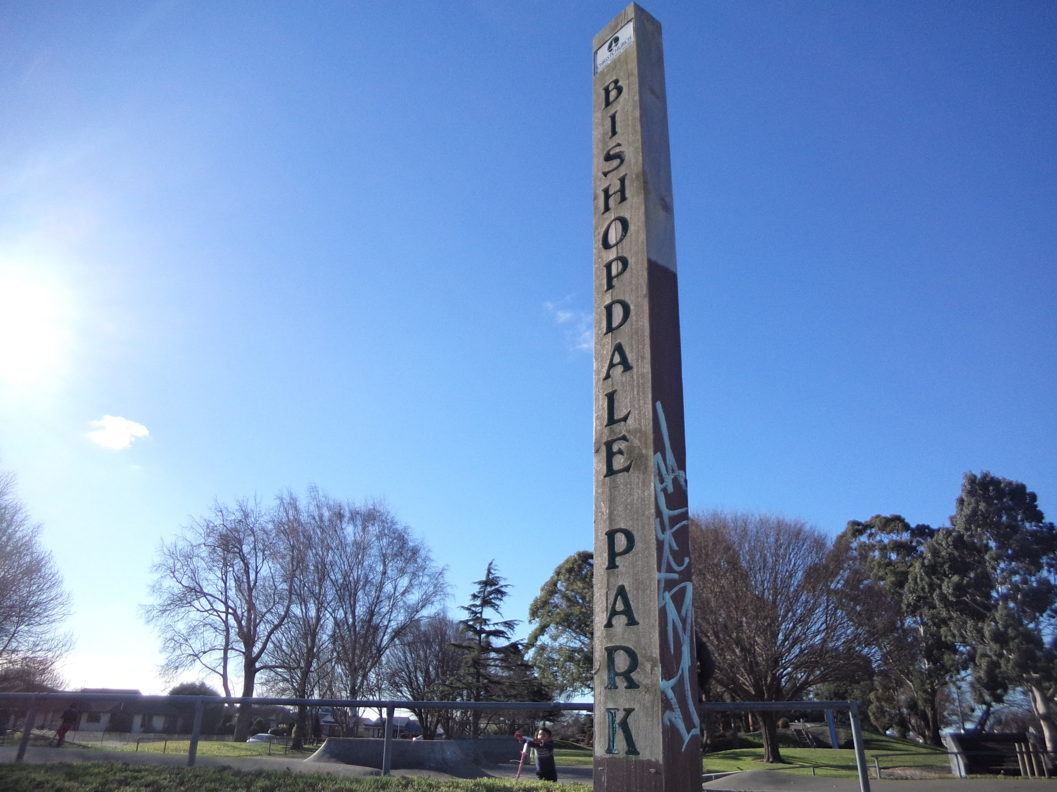
Leah took this shot at Bishopdale Park, down by the skate park.
Notes:
By Leah
Taken at Bishopdale Park by the skate park

Slide 3
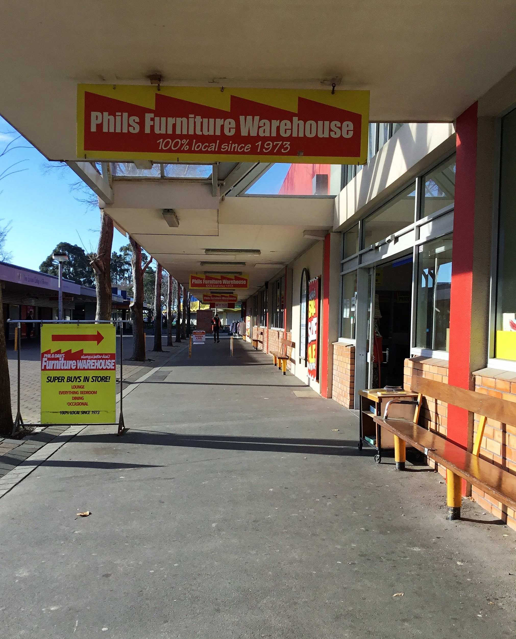
Shine captured this shot, looking down Bishopdale Mall.
Notes:
By Shine. Looking down Bishopdale Mall

Slide 4
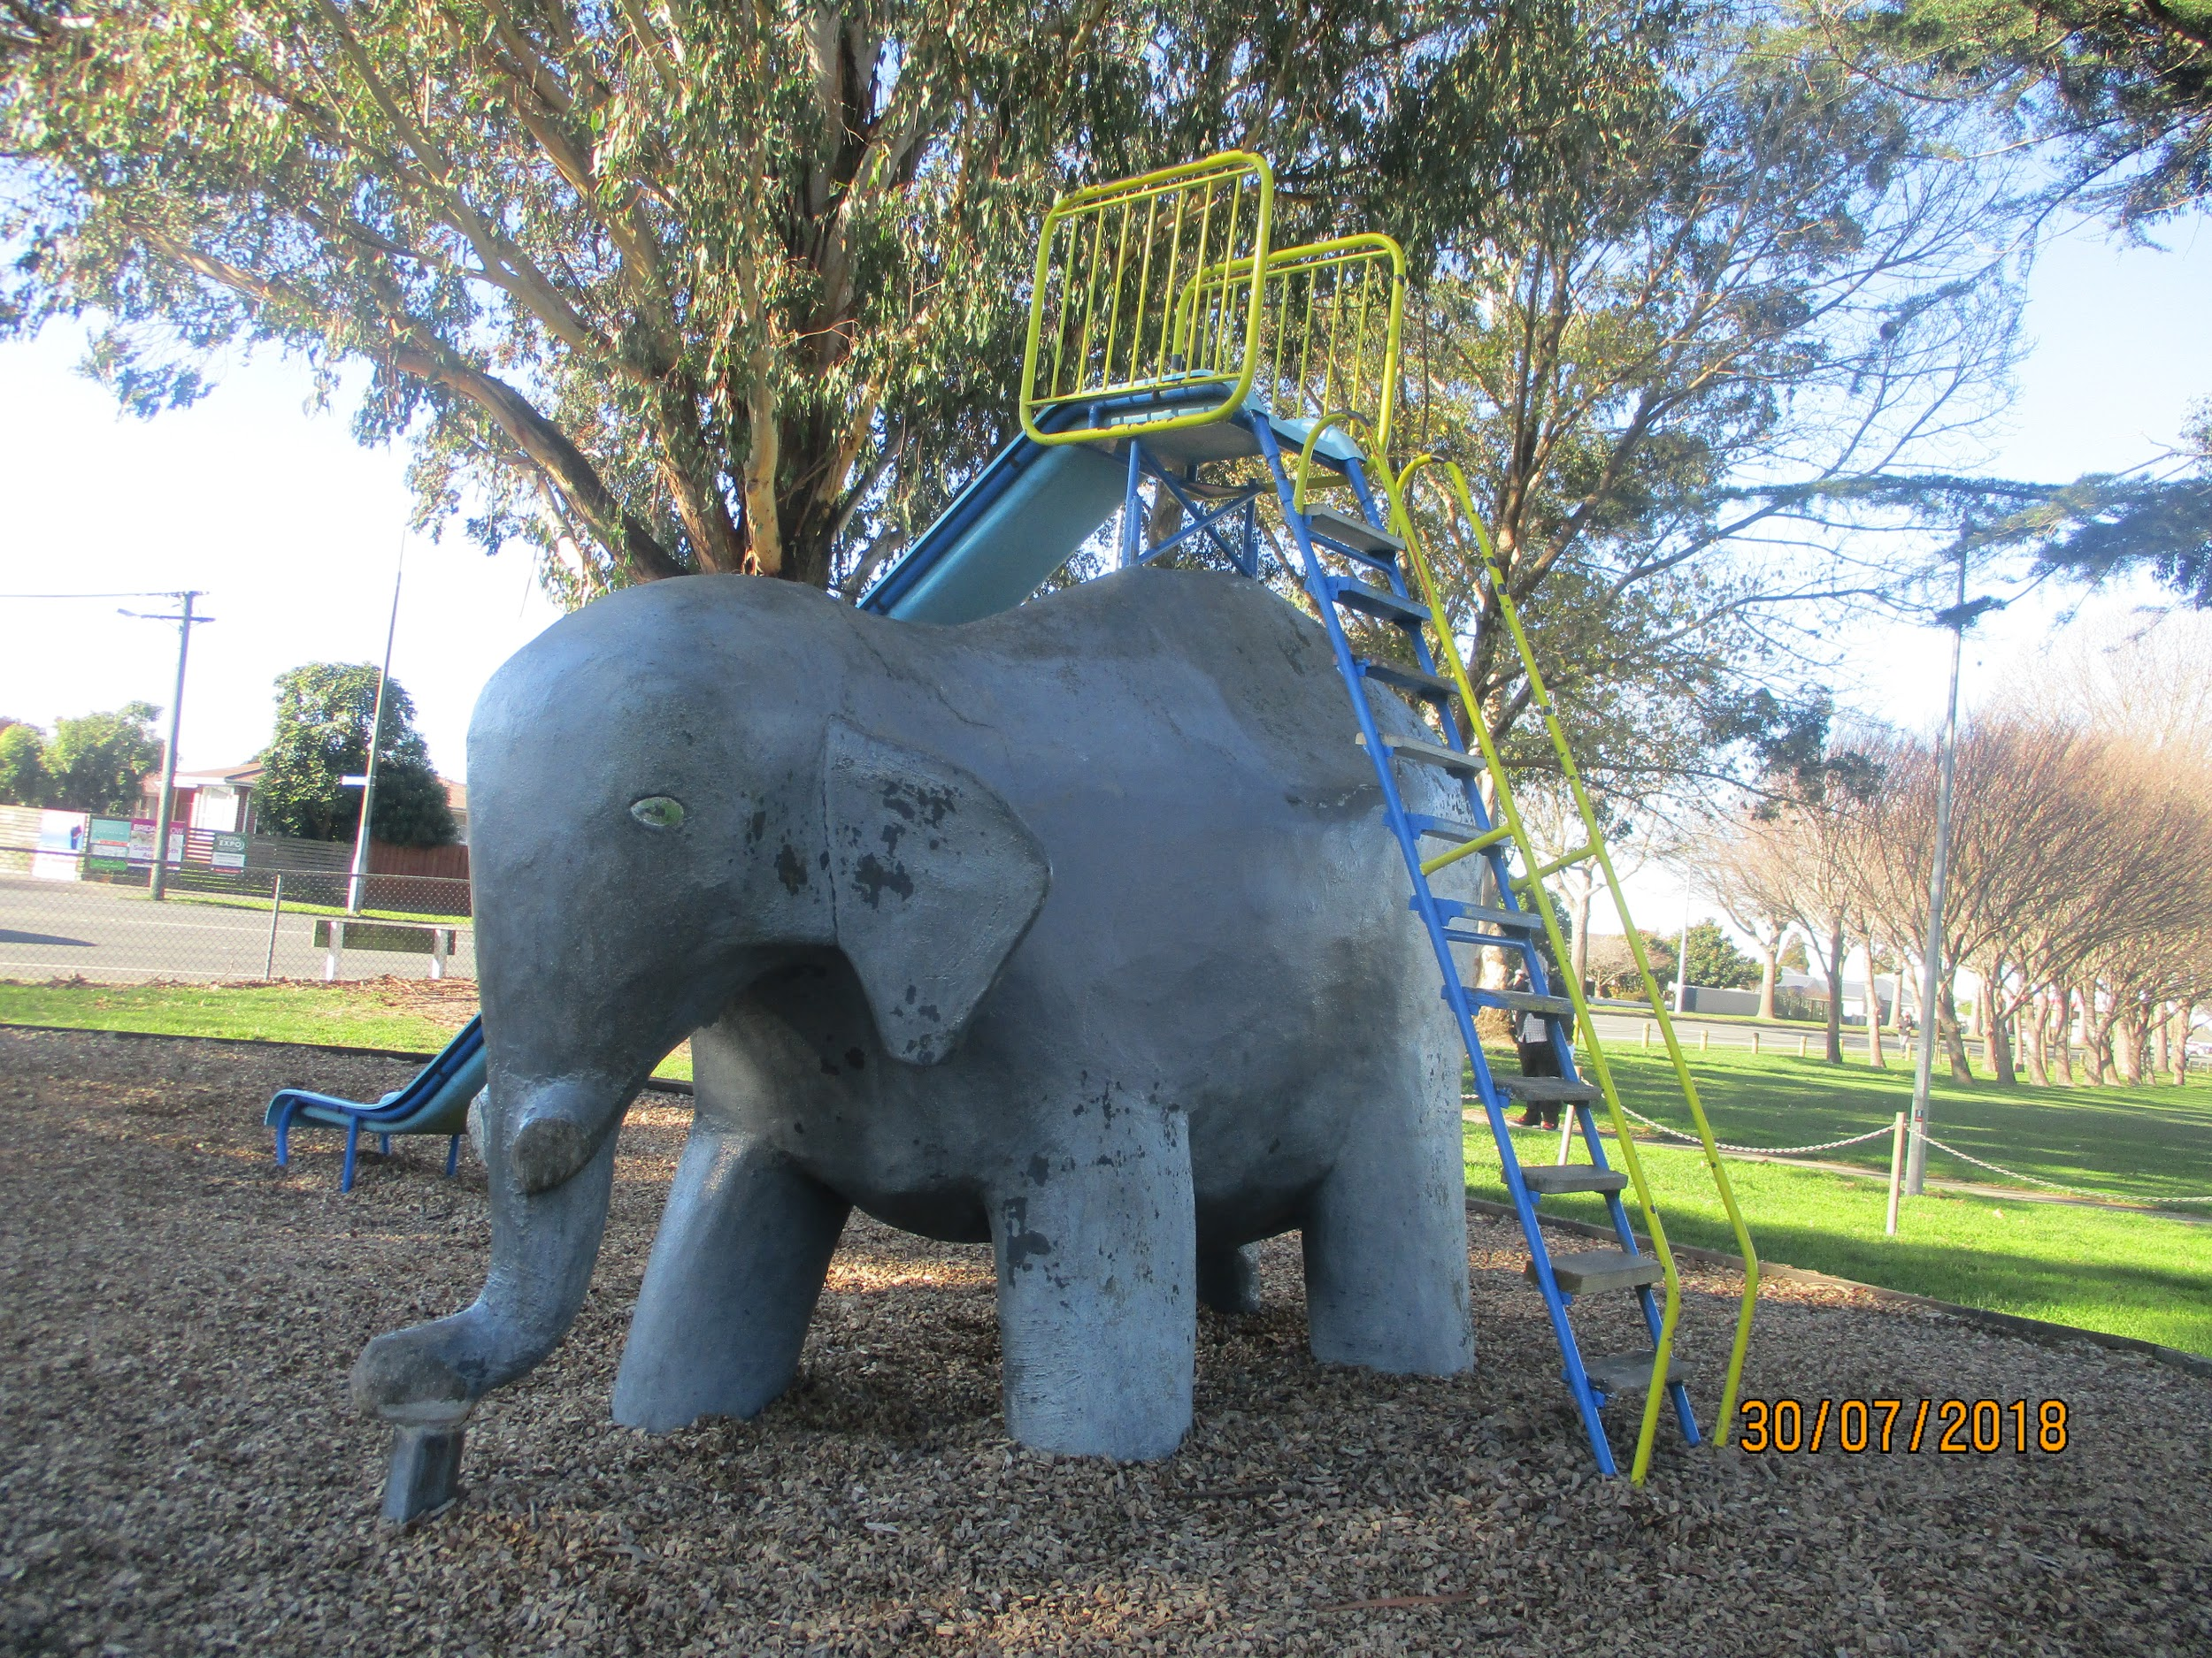
Jazmin took a shot of the iconic Bishopdale elephant slide.
Notes:
By Jazmin. The famous Bishopdale Park Elephant slide

Slide 5
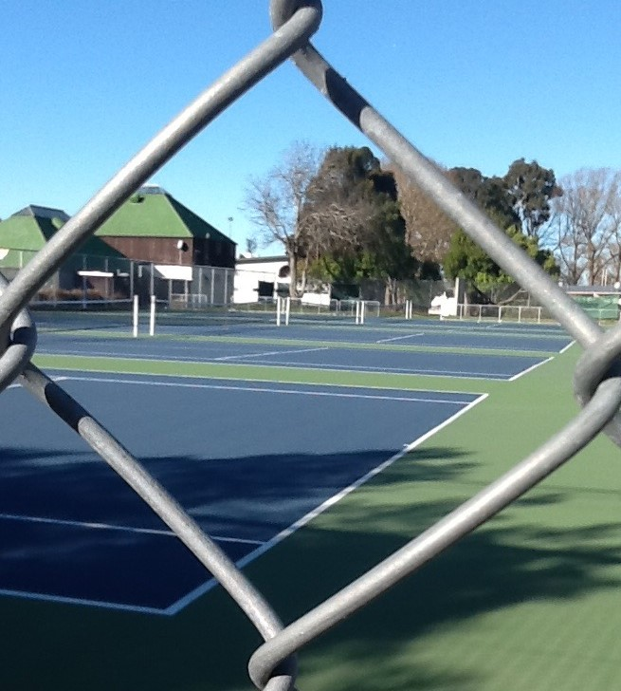
Mahdiya shot a glimpse of the Bishopdale Tennis Court through the netting.
Notes:
By Mahdiya. A glimpse of the Bishopdale tennis court

Slide 6
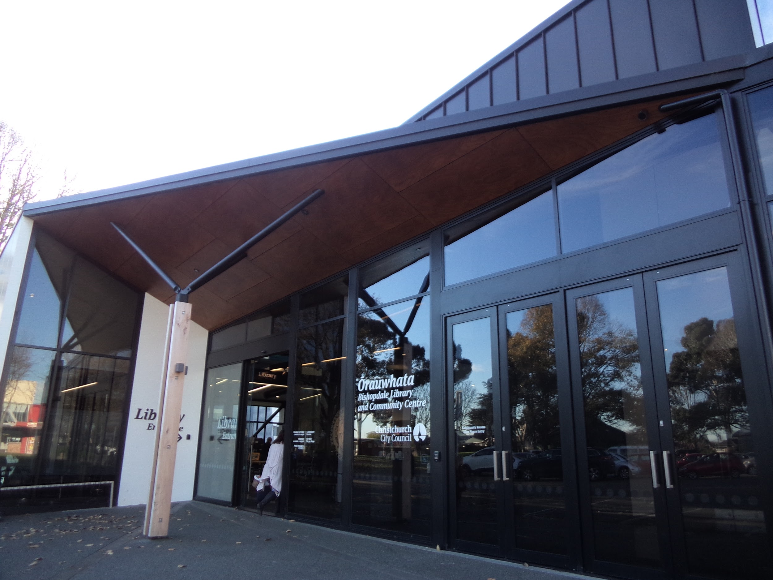
Rebecka photographed Ōrauwhāta Library.
Notes:
By Rebecka. Orauwhāta Library

Slide 7
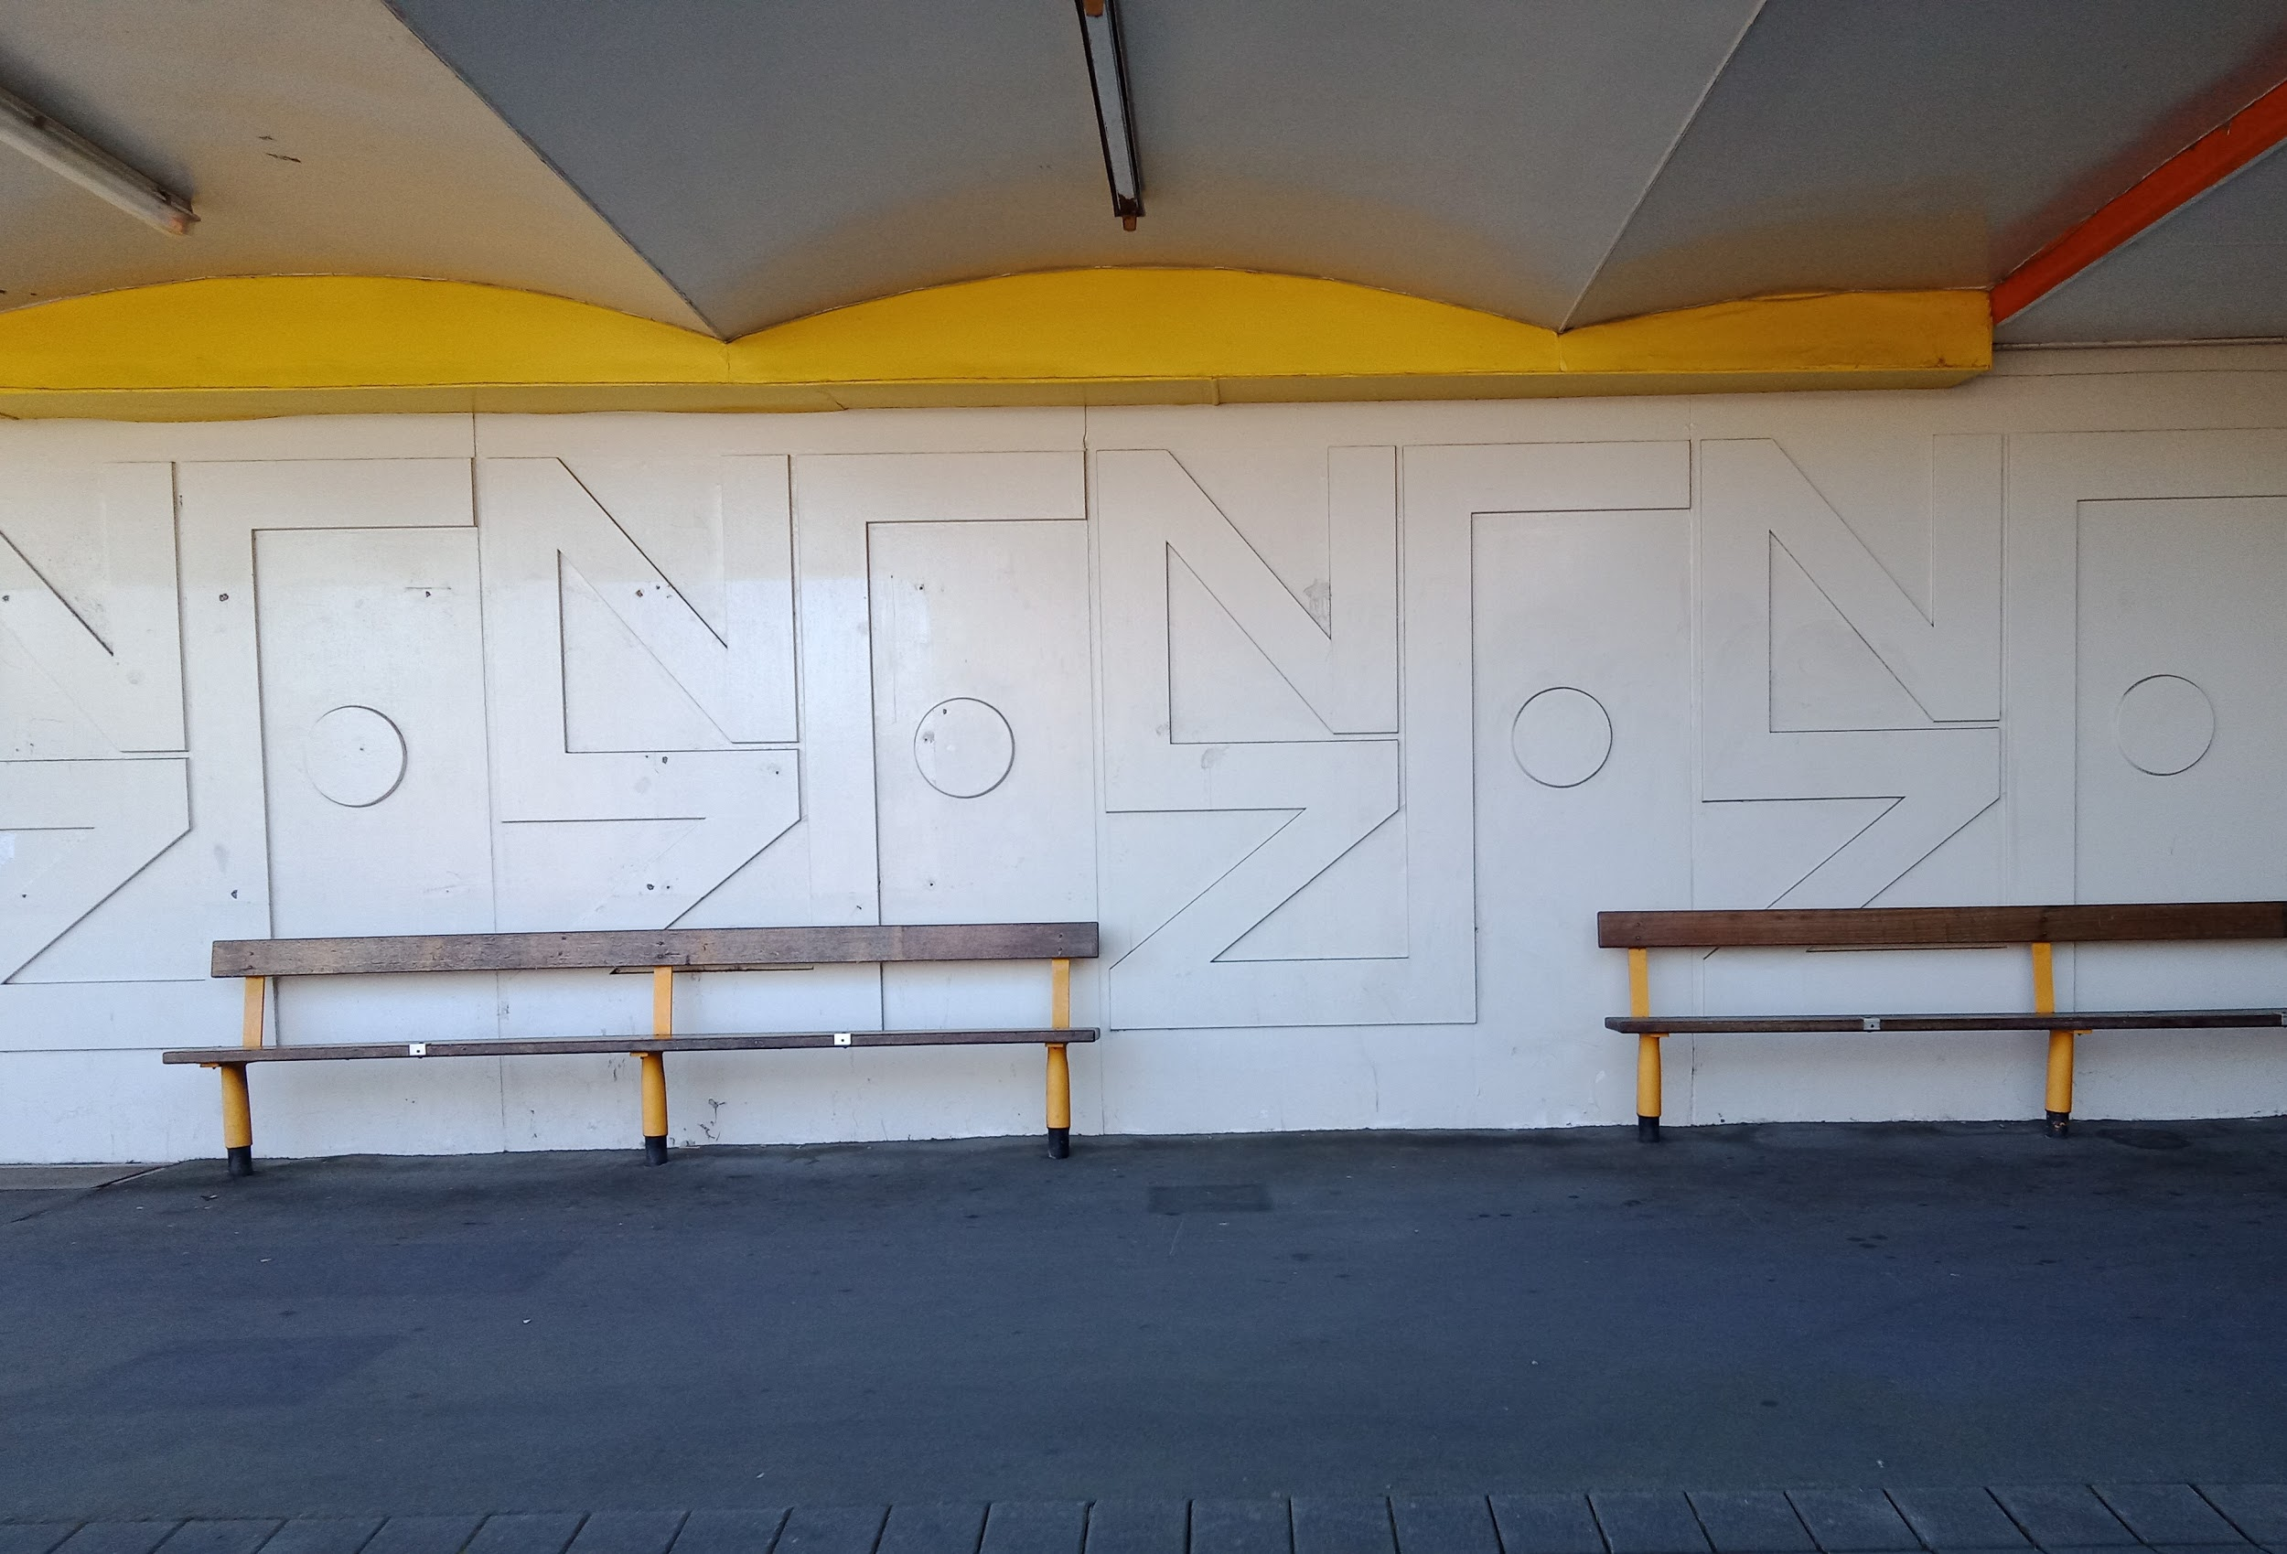
The NZ emblem is a feature of the side of the old Mitre 10 building. This photo was snapped by David.
Notes:
By David. NZ emblem on side of old Mitre 10 building.

Slide 8
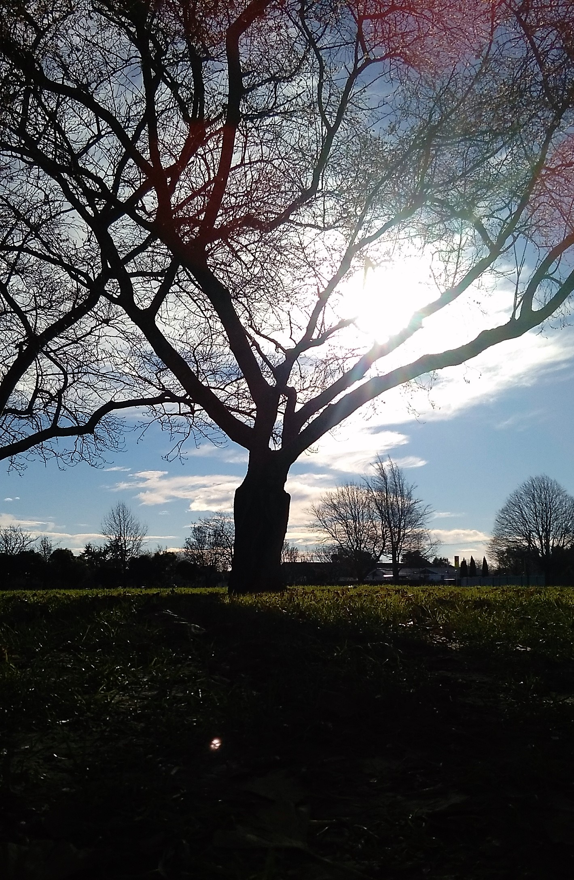
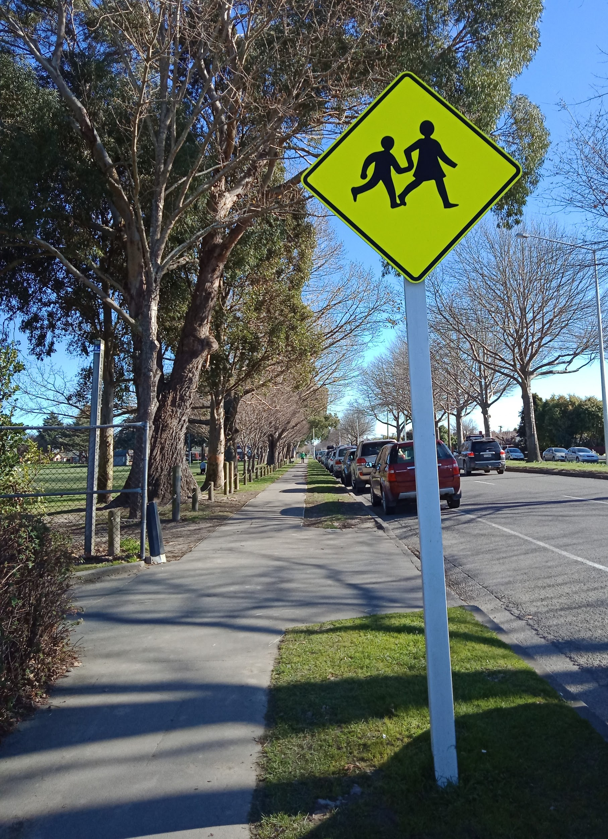
(Left) Layla’s shot of the sun peeking through the trees at Isleworth School.
(Right)
A car driving down Harewood Rd, past Bishopdale Park.
By David
Notes:
By Layla. The sun through the trees at Isleworth School
By David. Harewood Road, passing Bishopdale Park

Slide 9
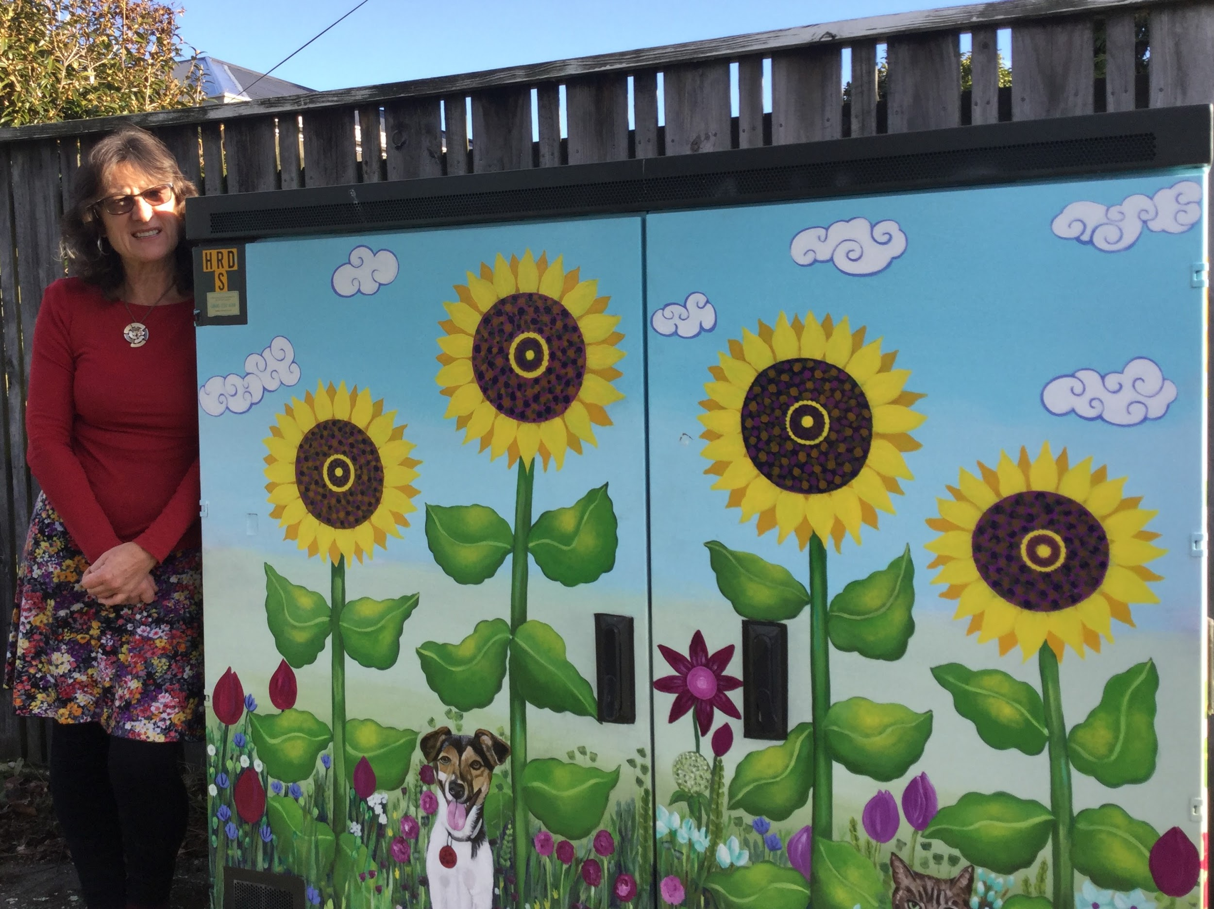
In Staines St, we came across this fabulous artwork, on an electricity cabinet.
The artist, Maxine Burney, met us and told us about her painting. The dog and cat lived in the neighbourhood. She is available for painting colourful commissions!
By Jasmine
Notes:
By Jasmine. Maxine Burney, artist in Staines Street, available for colourful commissions!

Slide 10
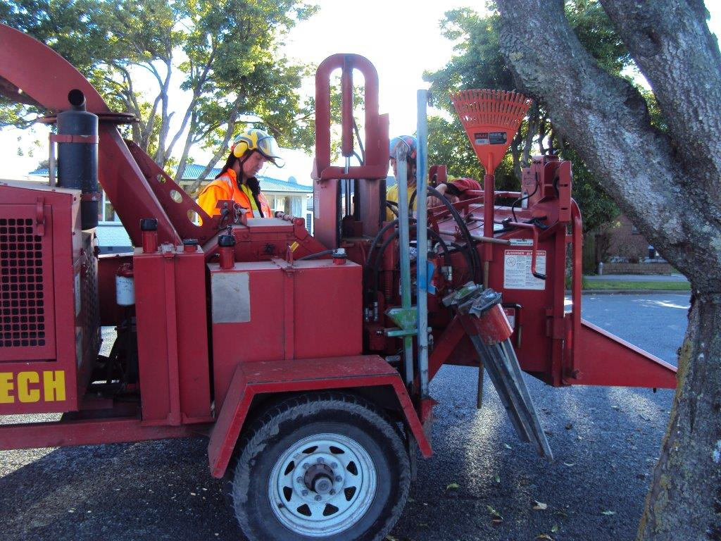
Danica found this worker from Tree Tech working hard in Leacroft St.
Notes:
By Danica. Tree Tech in Leacroft St

Slide 11
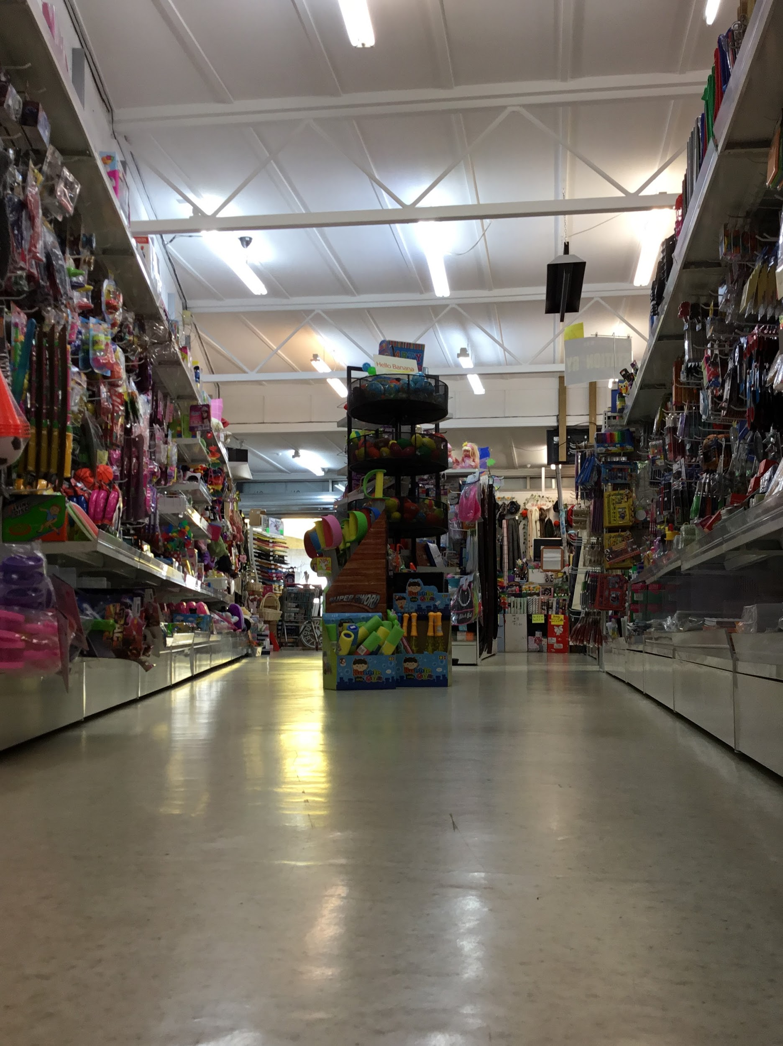
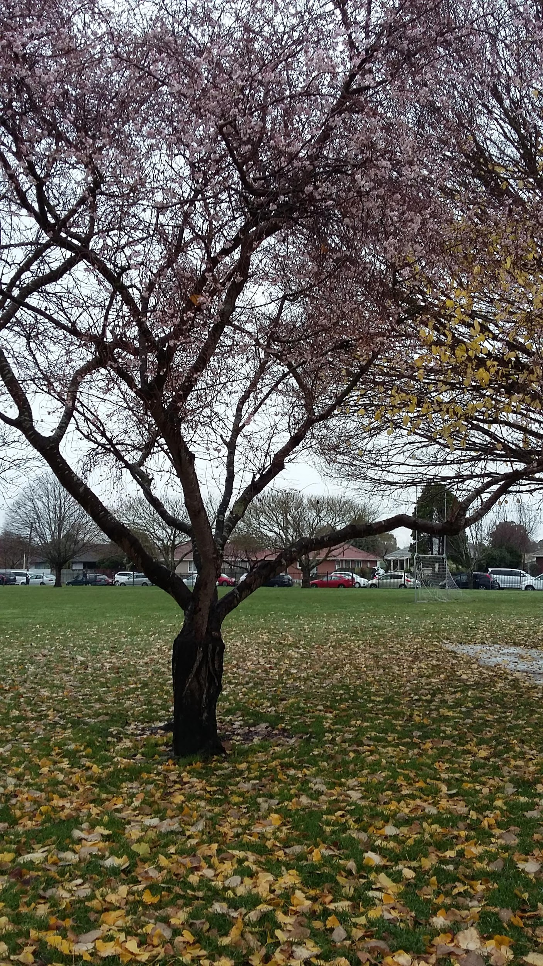
Maddi found this blossom tree, about to burst into flower in the Isleworth School grounds.
Shine snapped some action from the Bishopdale Mall $2 Store.
Notes:
By Shine. The Bishopdale $2 Store
By Maddi. Blossom tree about to flower in the Isleworth School grounds.

Slide 12
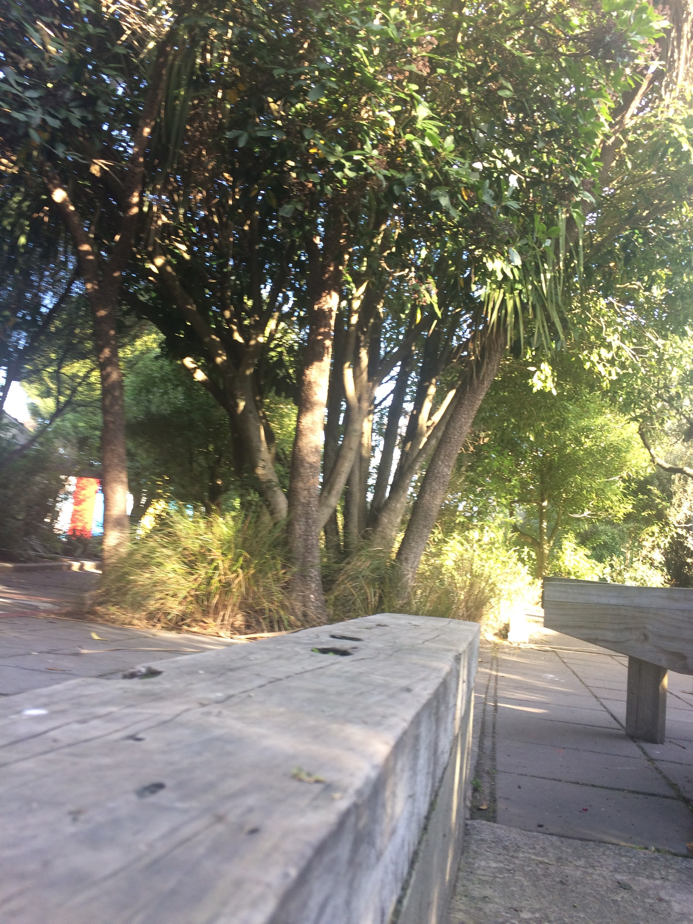
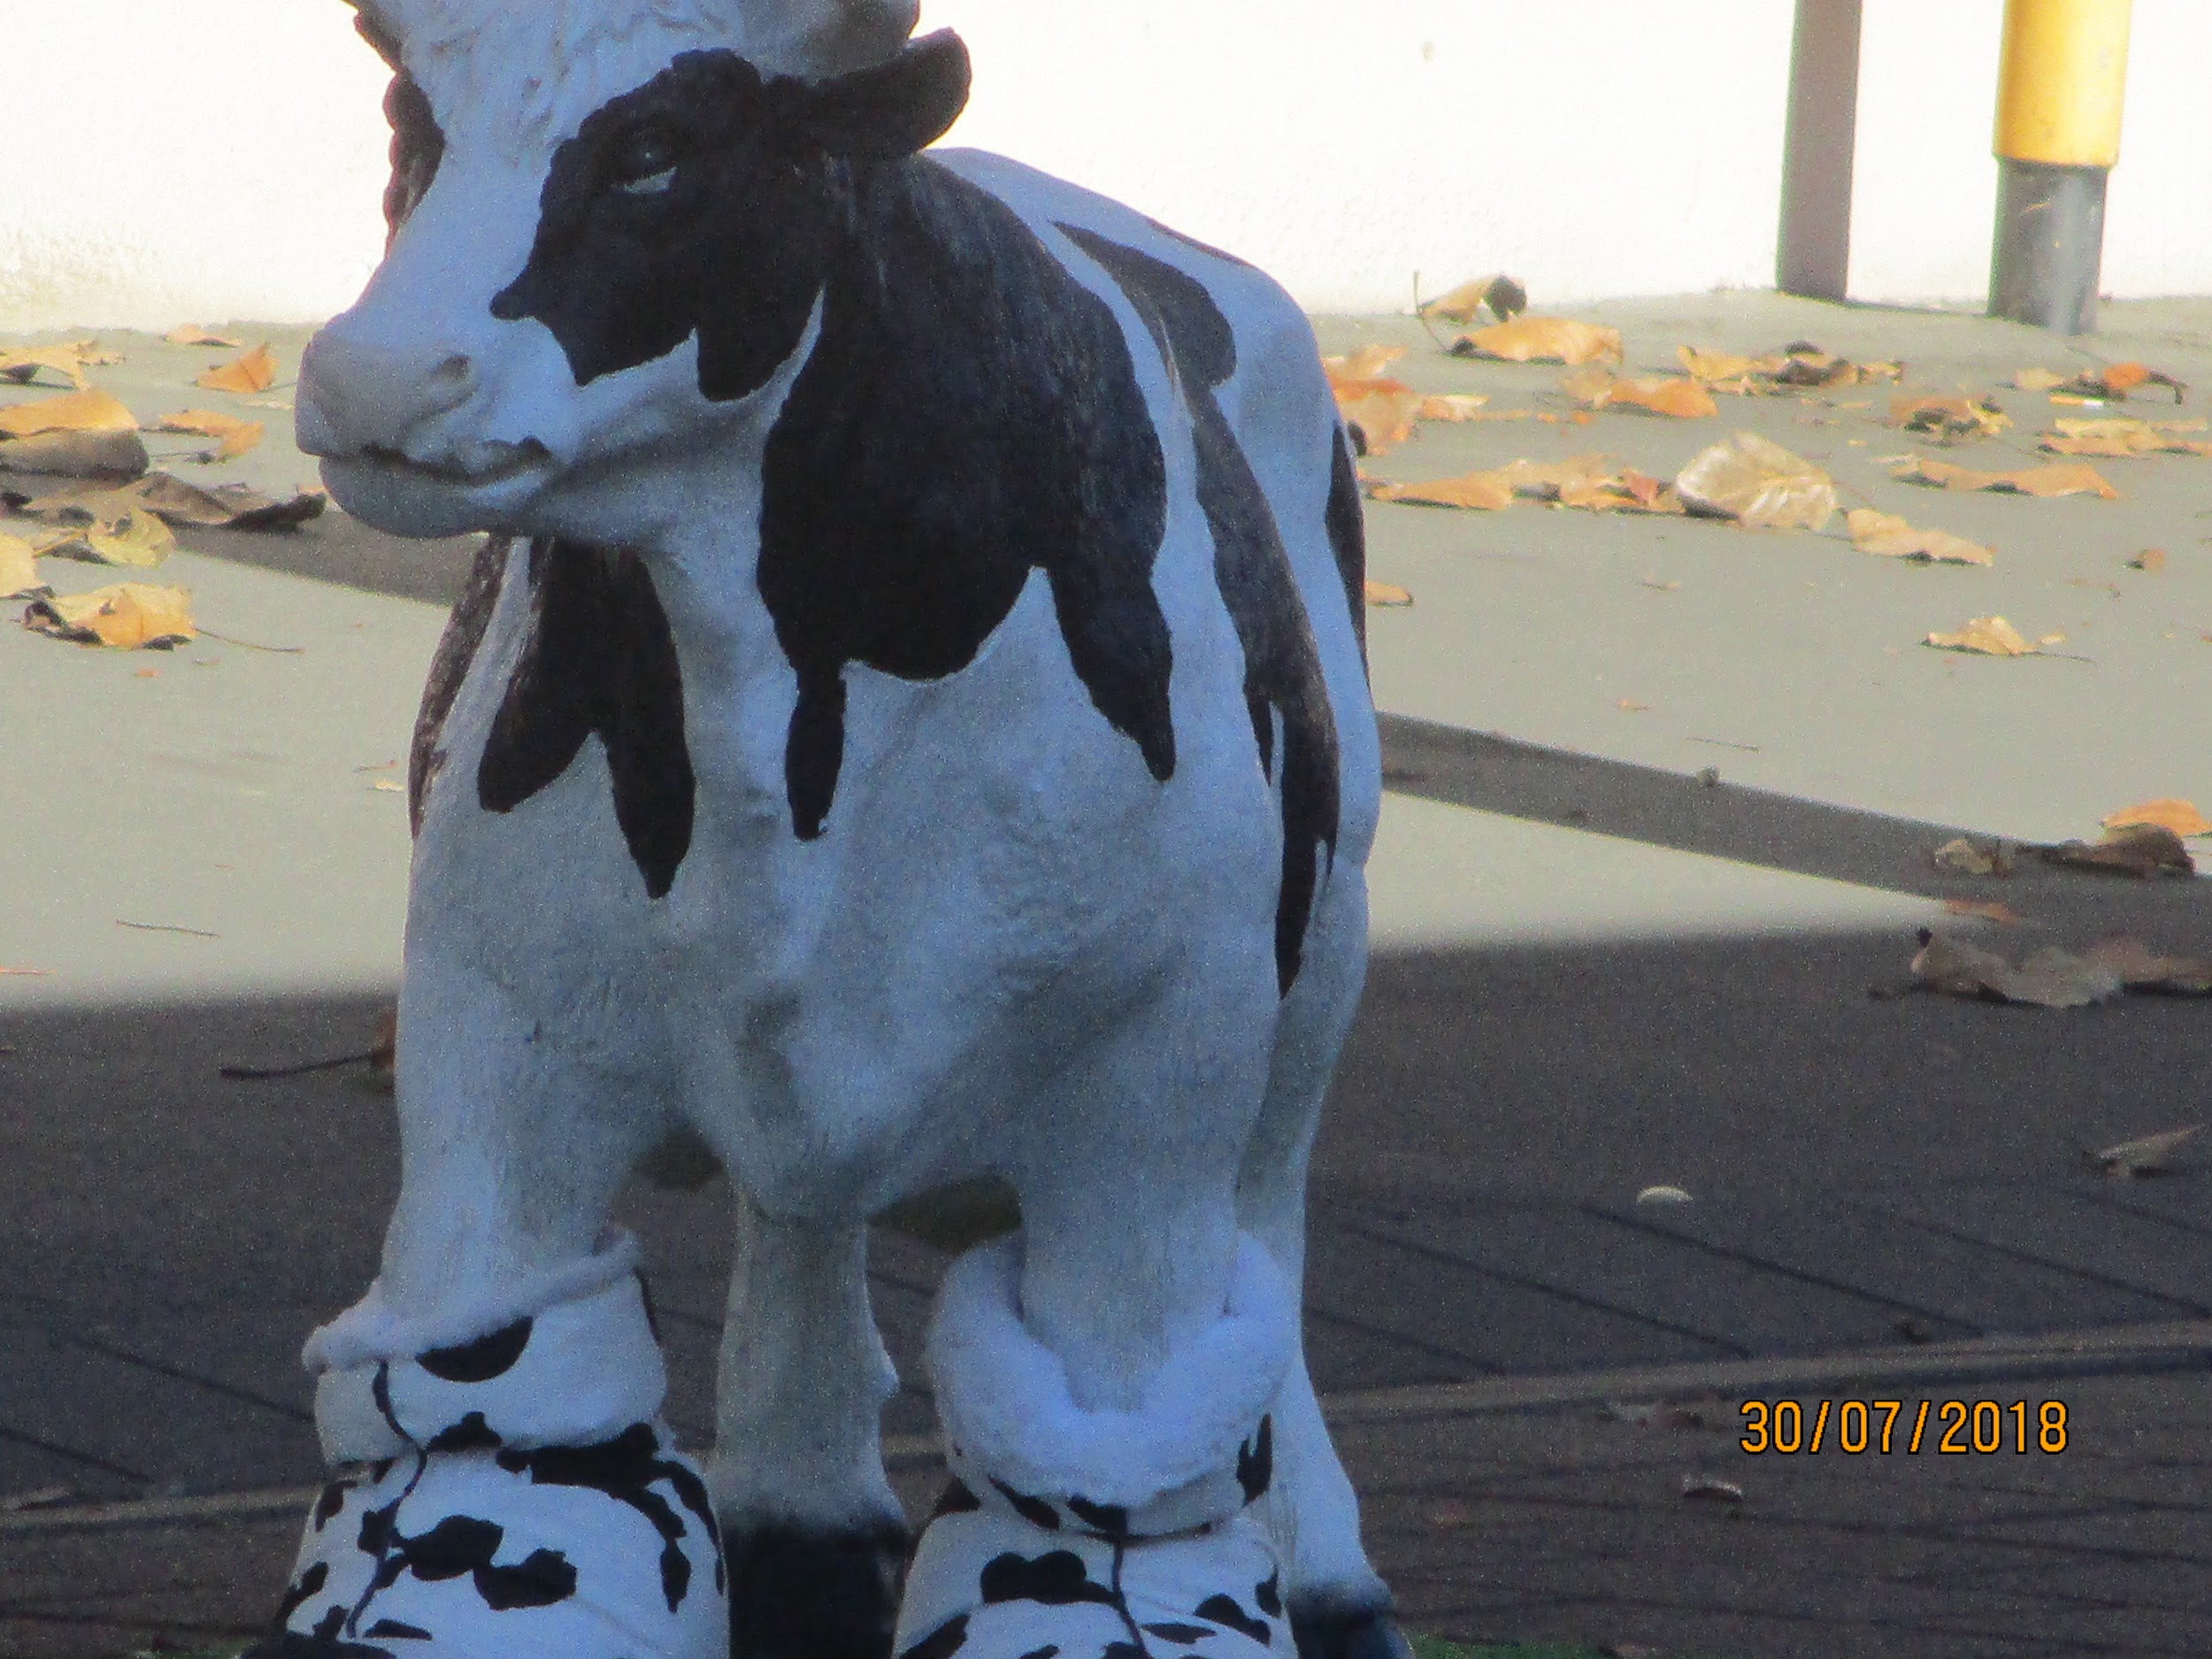
Maiya found a peaceful nook down at Breens Interme-diate.
Jazmin captured a shot of this friesian cow down at Bishopdale Mall playground.
Notes:
By Maiya. Peaceful foliage at Breens Intermediate
By Jazmin. Freesian cow down at Bishopdale Mall.

Slide 13
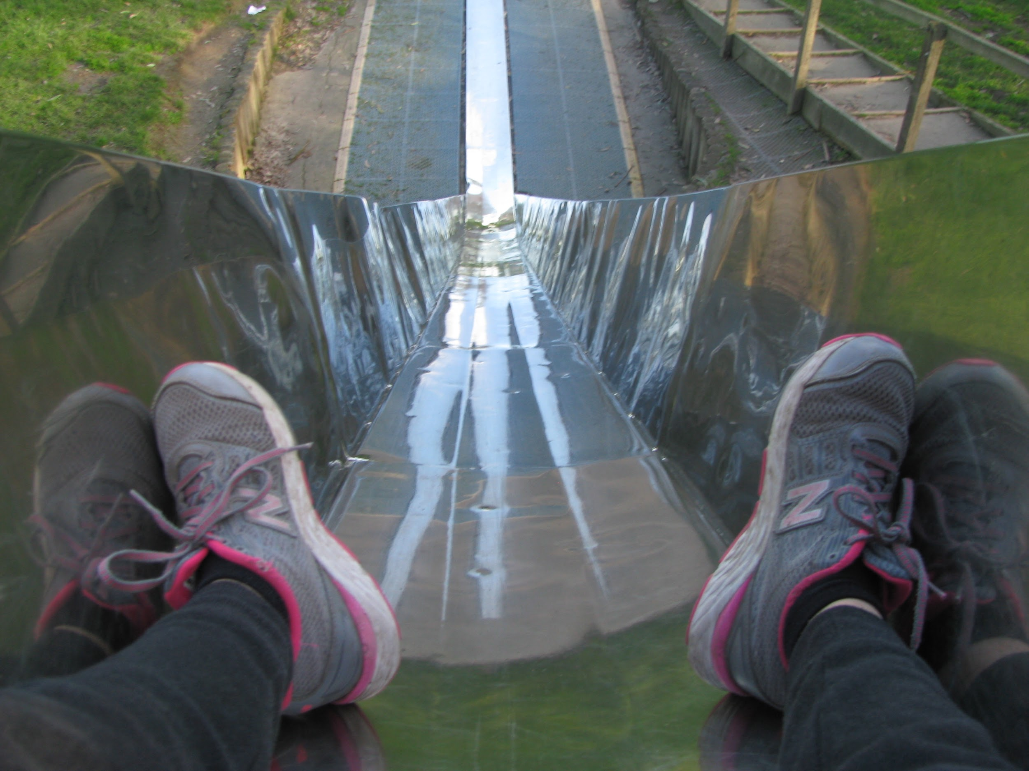
Emily took this photo just before she whizzed down the slide at Bishopdale Park.
Notes:
By Emily. Action down the slide

Slide 14
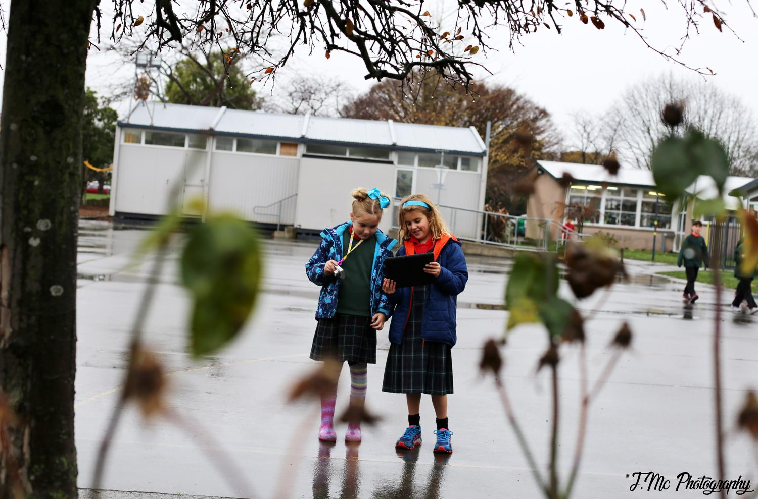
Our photograhy tutor, Jess McGiffen, took this lovely shot of Leah and Sofia through the roses at Isleworth School.
Notes:
By Jess. Isleworth students at work

Slide 15
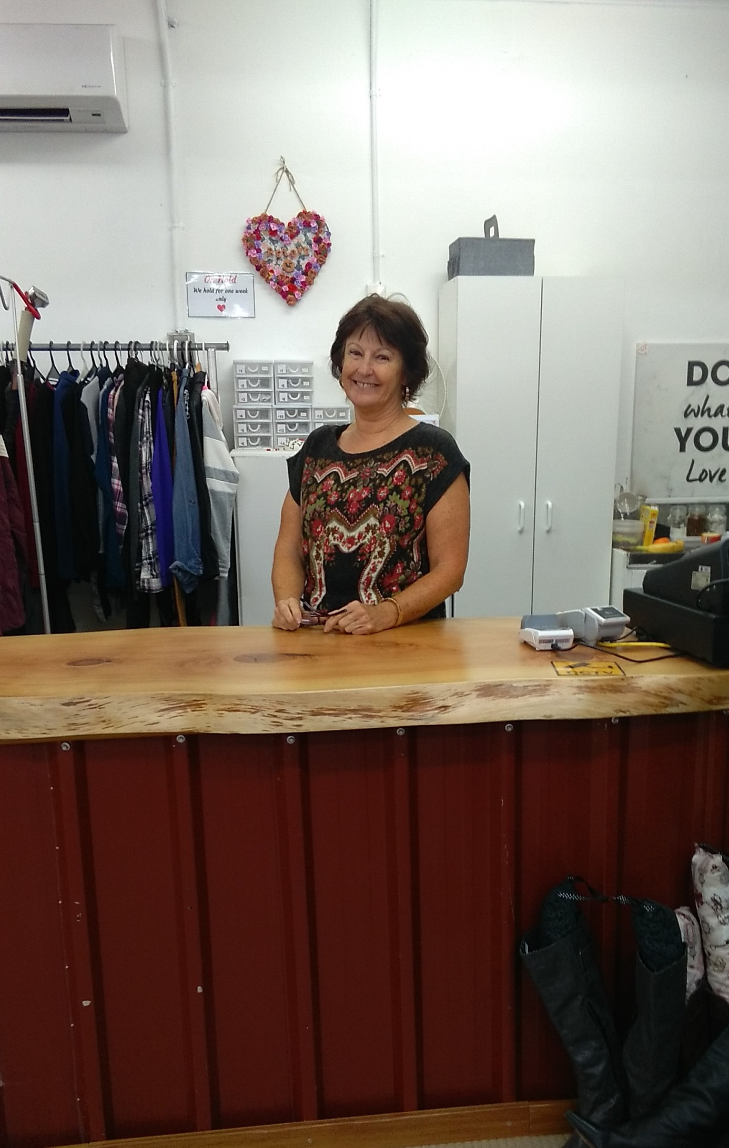
Layla found Chris Robinson, working hard in the second hand clothing shop, Relove in Leacroft Street.
Notes:
By Layla. Chris Robinson working at Relove in Leacroft St

Slide 16
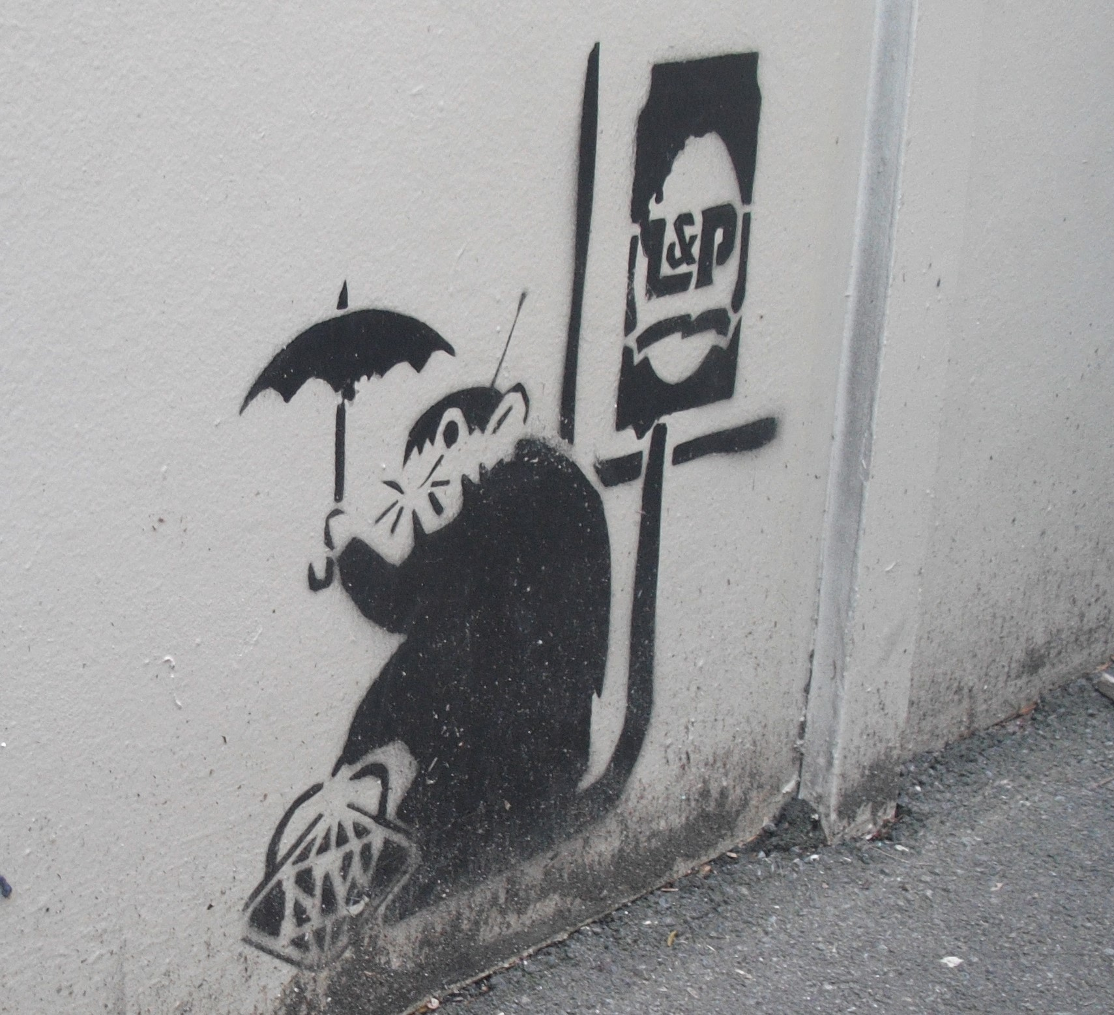
Maiya found this stencil on the wall down at Breens.
Notes:
By Maiya A stencil from Breens

Slide 17
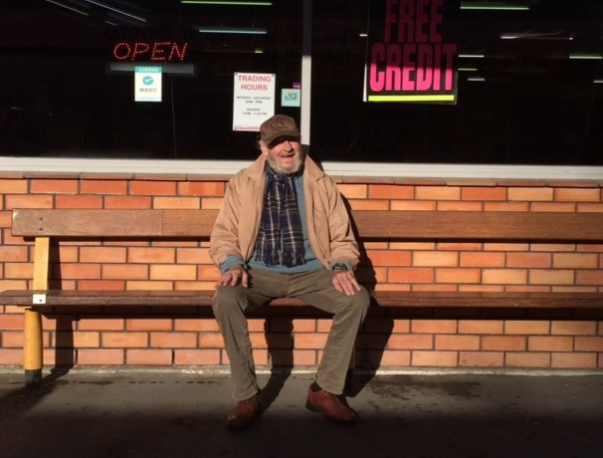
Shopper, Michael, taking a break at Bishopdale Mall. By Greer
Notes:
By Greer. Michael takes a rest at Bishopdale Mall

Slide 18
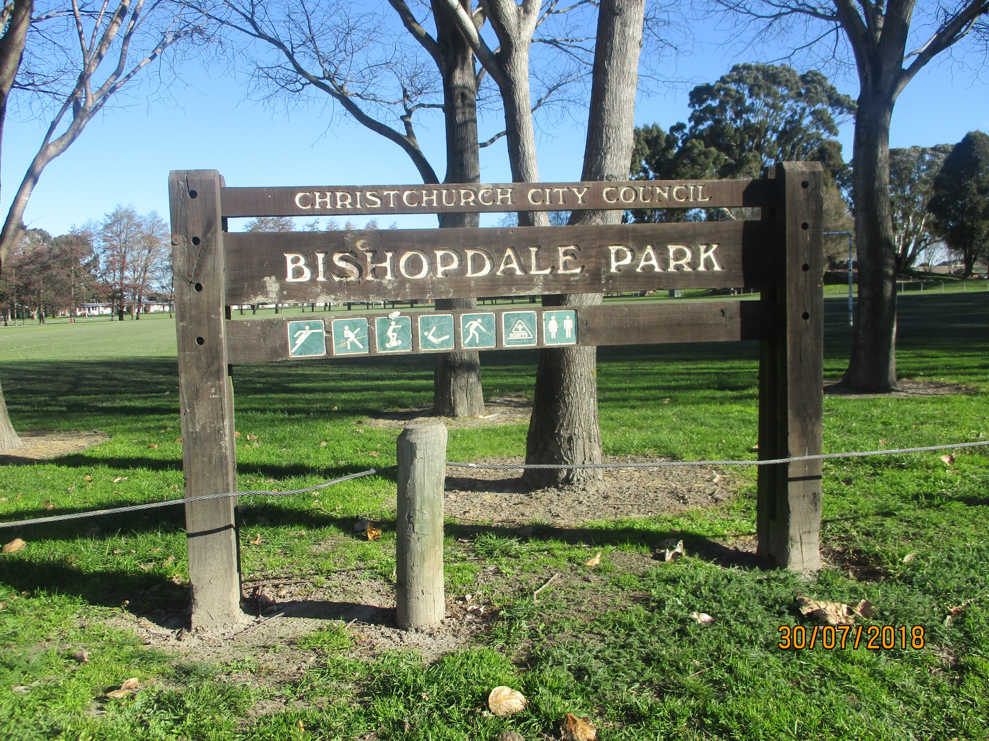
Jazmin took this photo of the signage at Bishopdale Park.
Notes:
By Jazmin. Signage

Slide 19
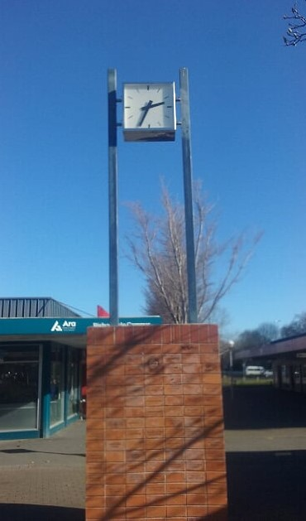
The clock tower at Bishopdale Shopping Mall, taken by Olive.
Notes:
By Olive W-P. Bishopdale Clock Tower

Slide 20
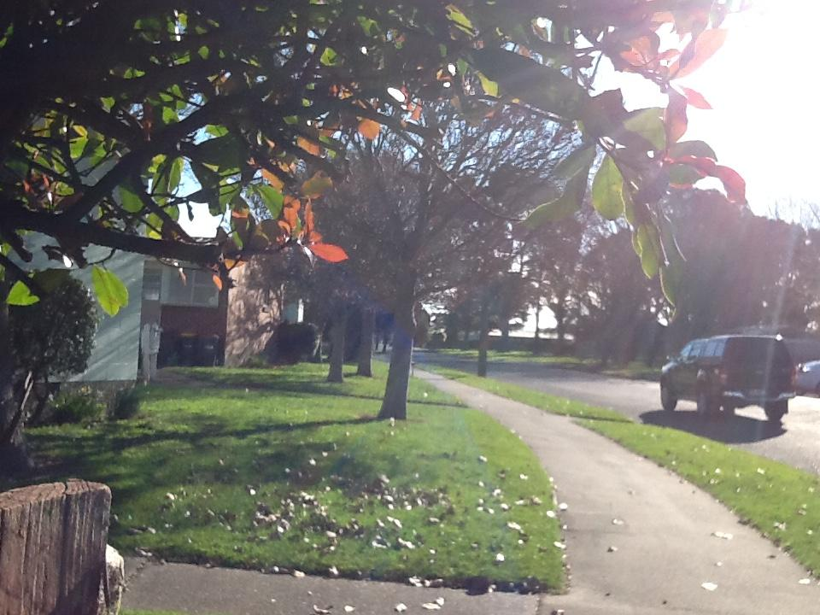
Mahdiya captured the winter sun filtering through leaves in Raleigh Street.
Notes:
By Mahdiya. View of Raleigh St

Slide 21
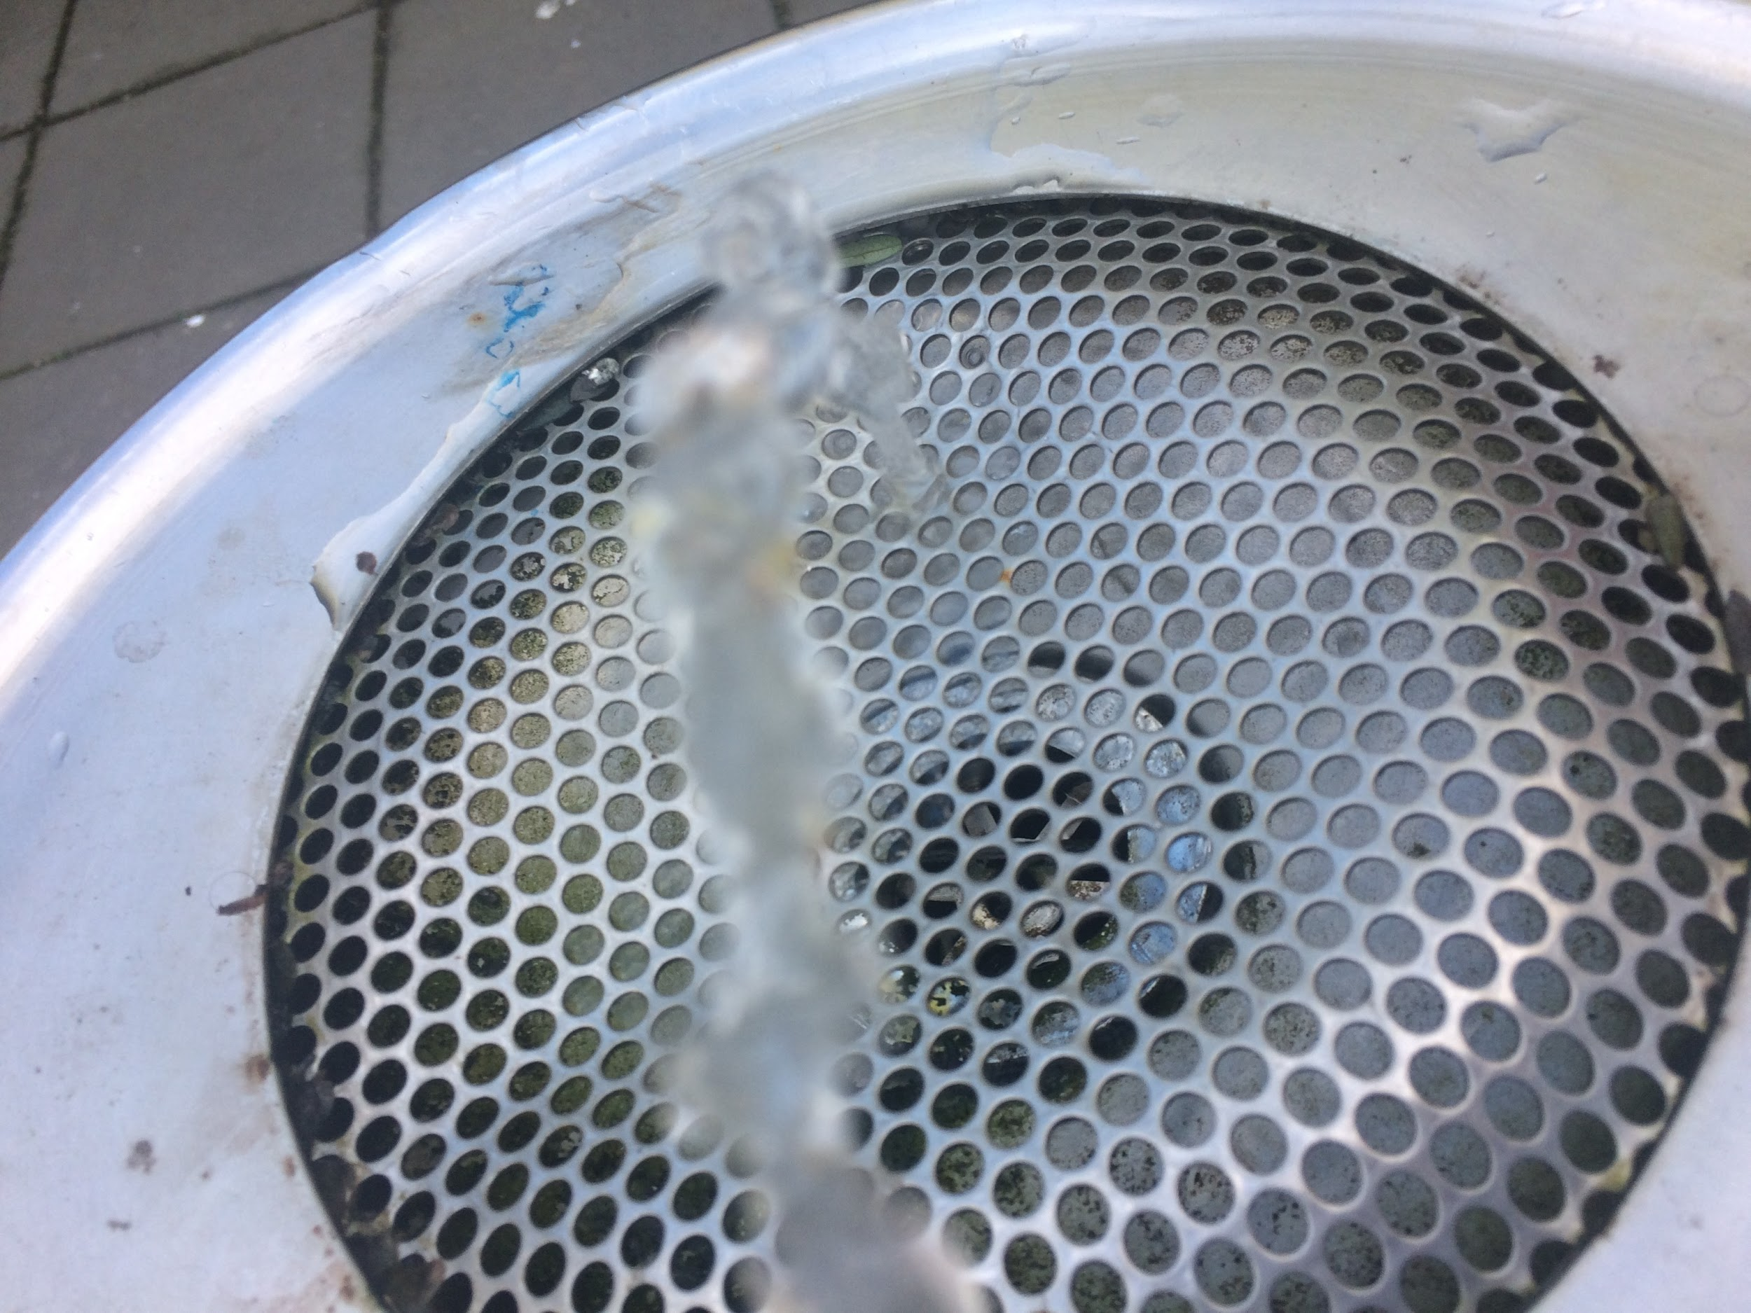
Maiya snapped this action shot of water squirting in a Bishopdale fountain
Notes:
By Maiya Water in Bishopdale

Slide 22
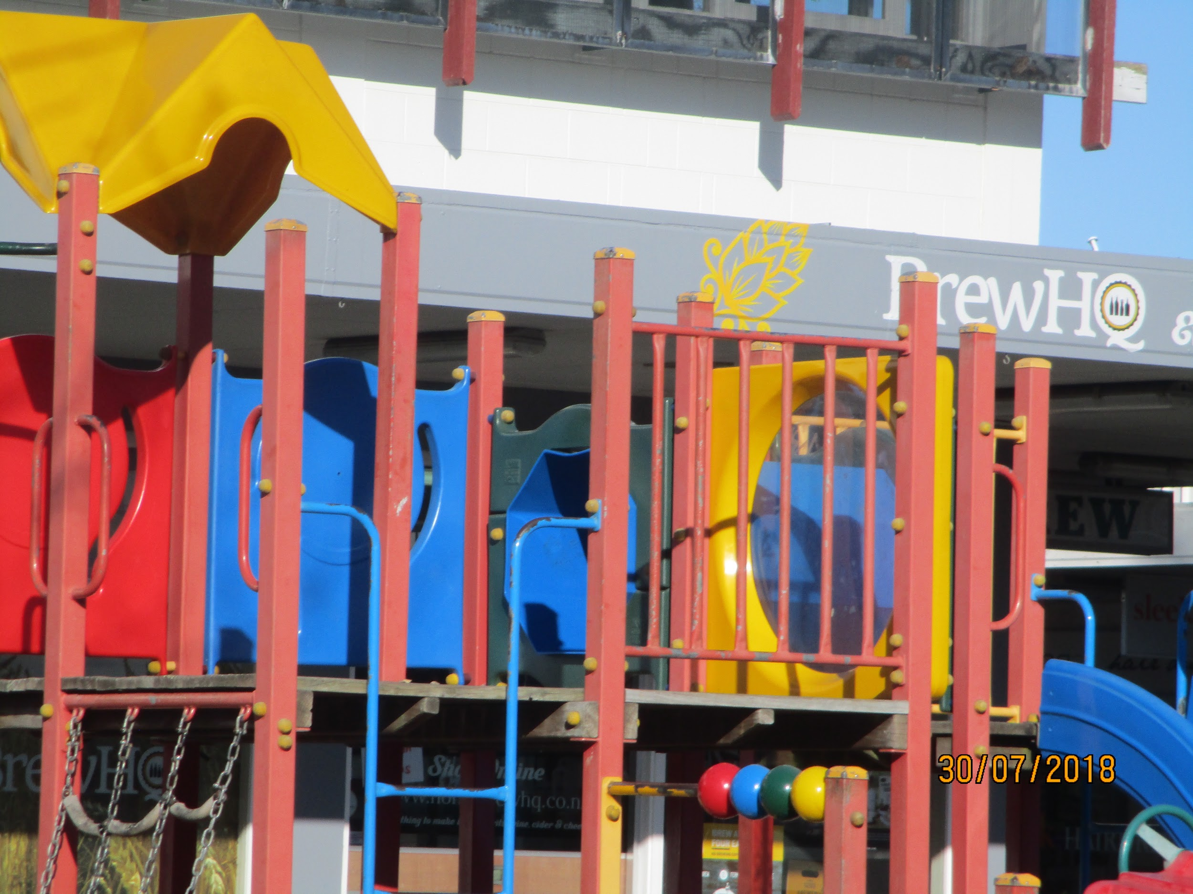
Jazmin took this shot of the fun playground in Bishopdale Mall.
Notes:
By Jazmin. Fun playground in Bishopdale Mall

Slide 23
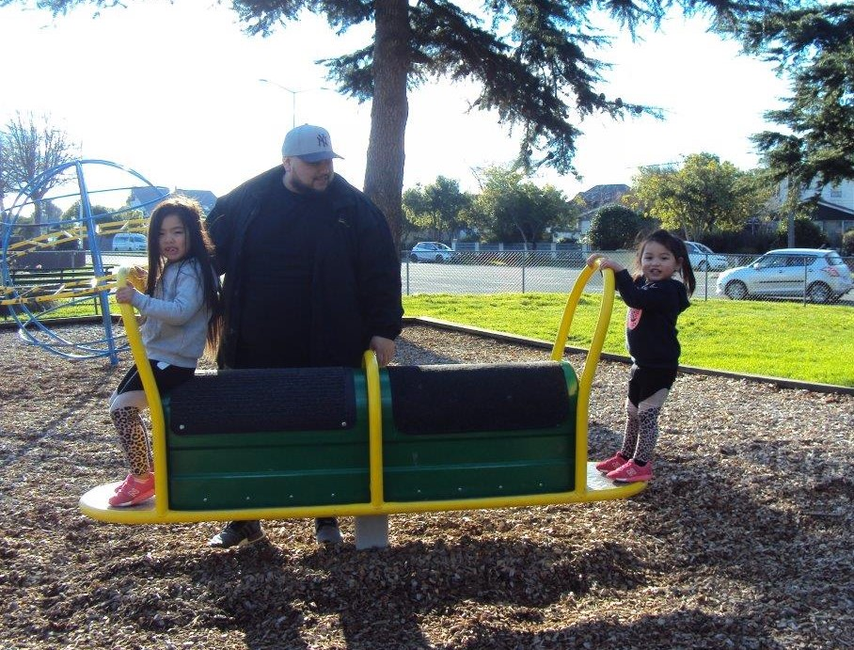
Danica came across this whānau enjoying the rocking horse and other play equipment at Bishopdale Park.
Notes:
By Danica. Rocking horse enjoyed by a whānau

Slide 24
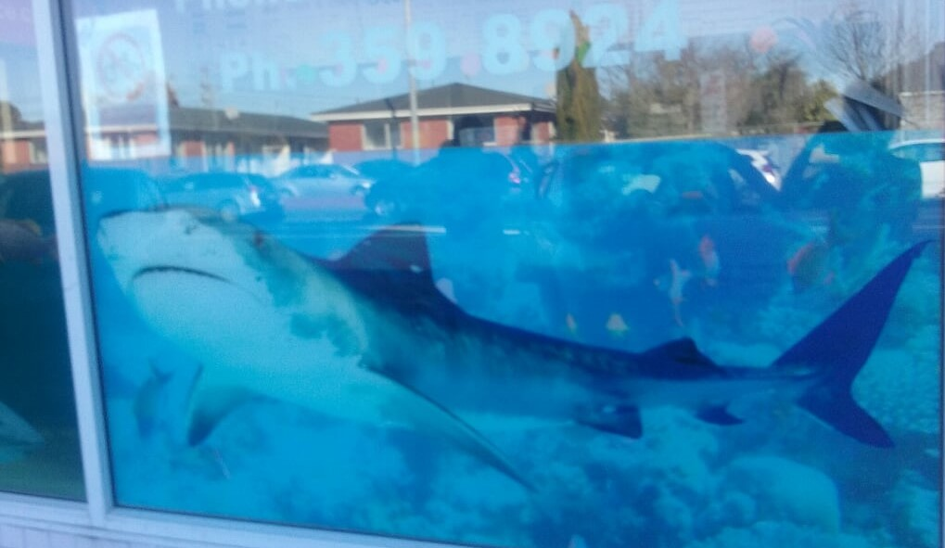
Shark attack! Leah snapped this photo at the Bishopdale fish and chip shop.
Notes:
By Leah. Shark attack at the chippie

Slide 25
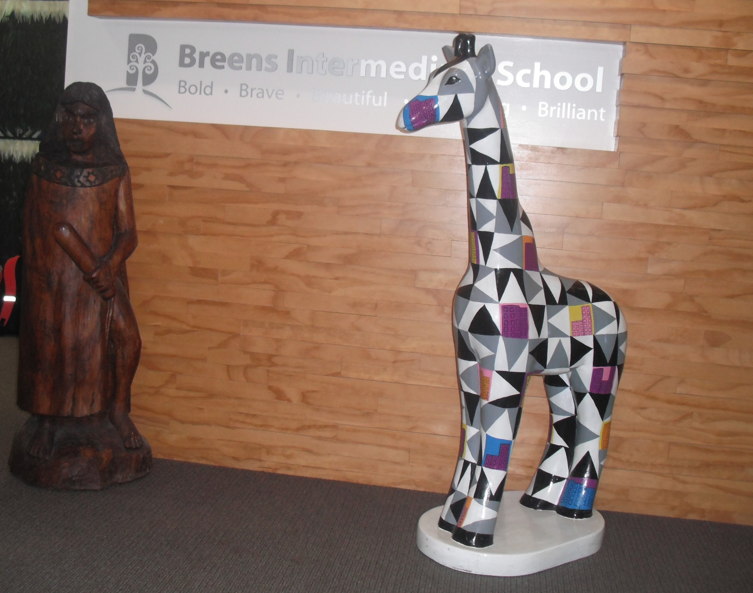
When you pop into the office at Breens, you are greeted by this cute giraffe… and a lovely office lady!
By Jessica
Notes:
By Jessica. Breens Intermediate foyer

Slide 26
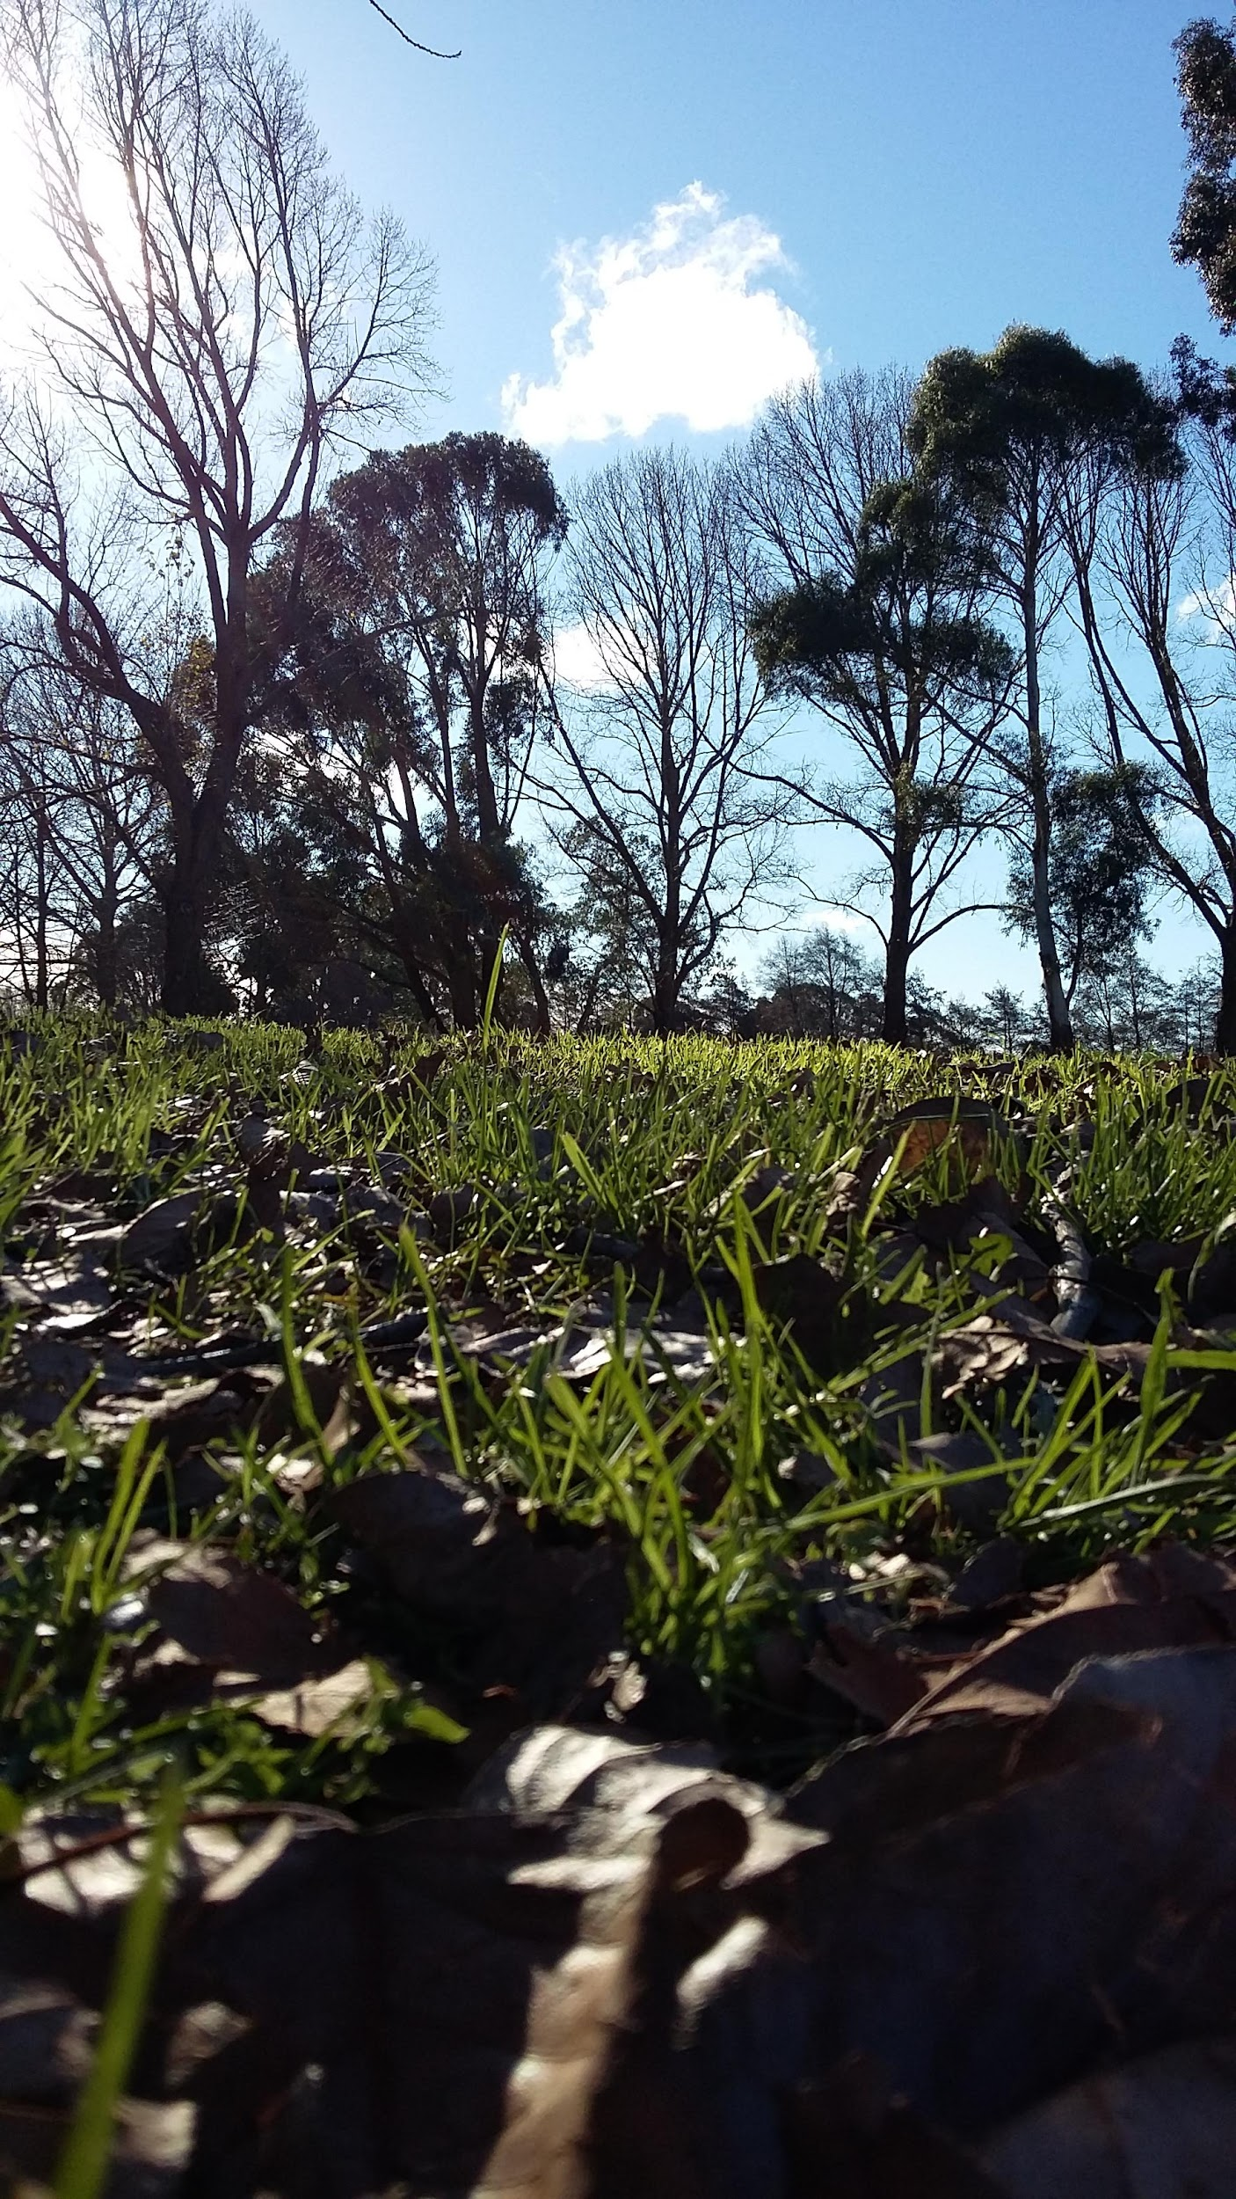
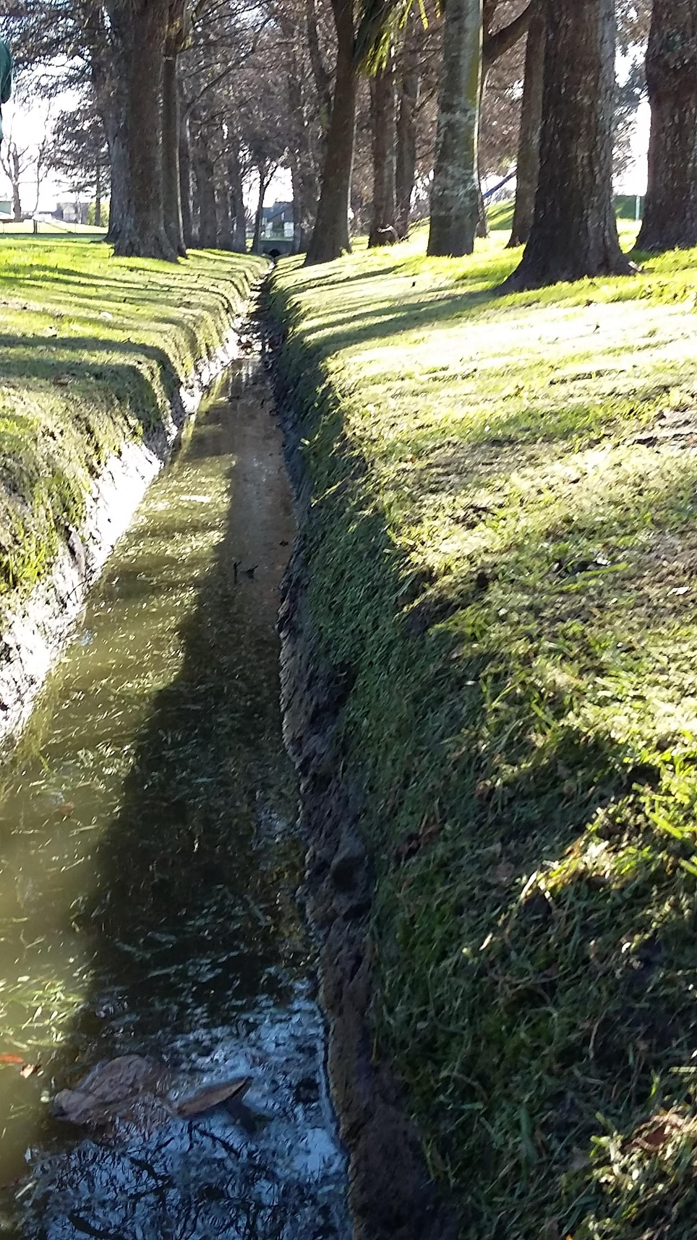
Maddi took these shots at Bishopdale Park.
Notes:
By Maddi. Both taken at Bishopdale Park.

Slide 27
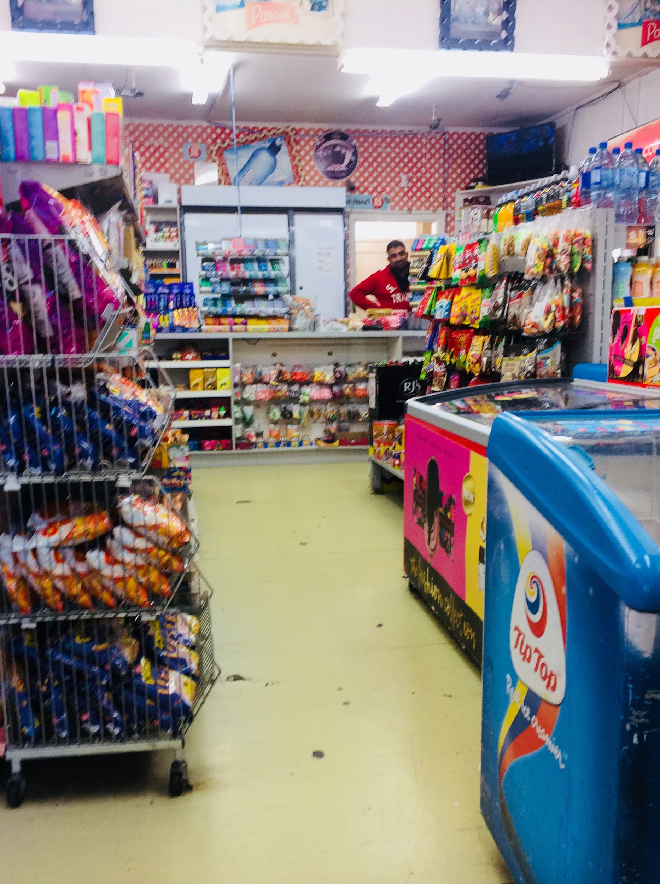
The shopkeeper at work in the Leacroft Street dairy.
By Georgia
Notes:
By Georgia. Leacroft St Dairy

Slide 28
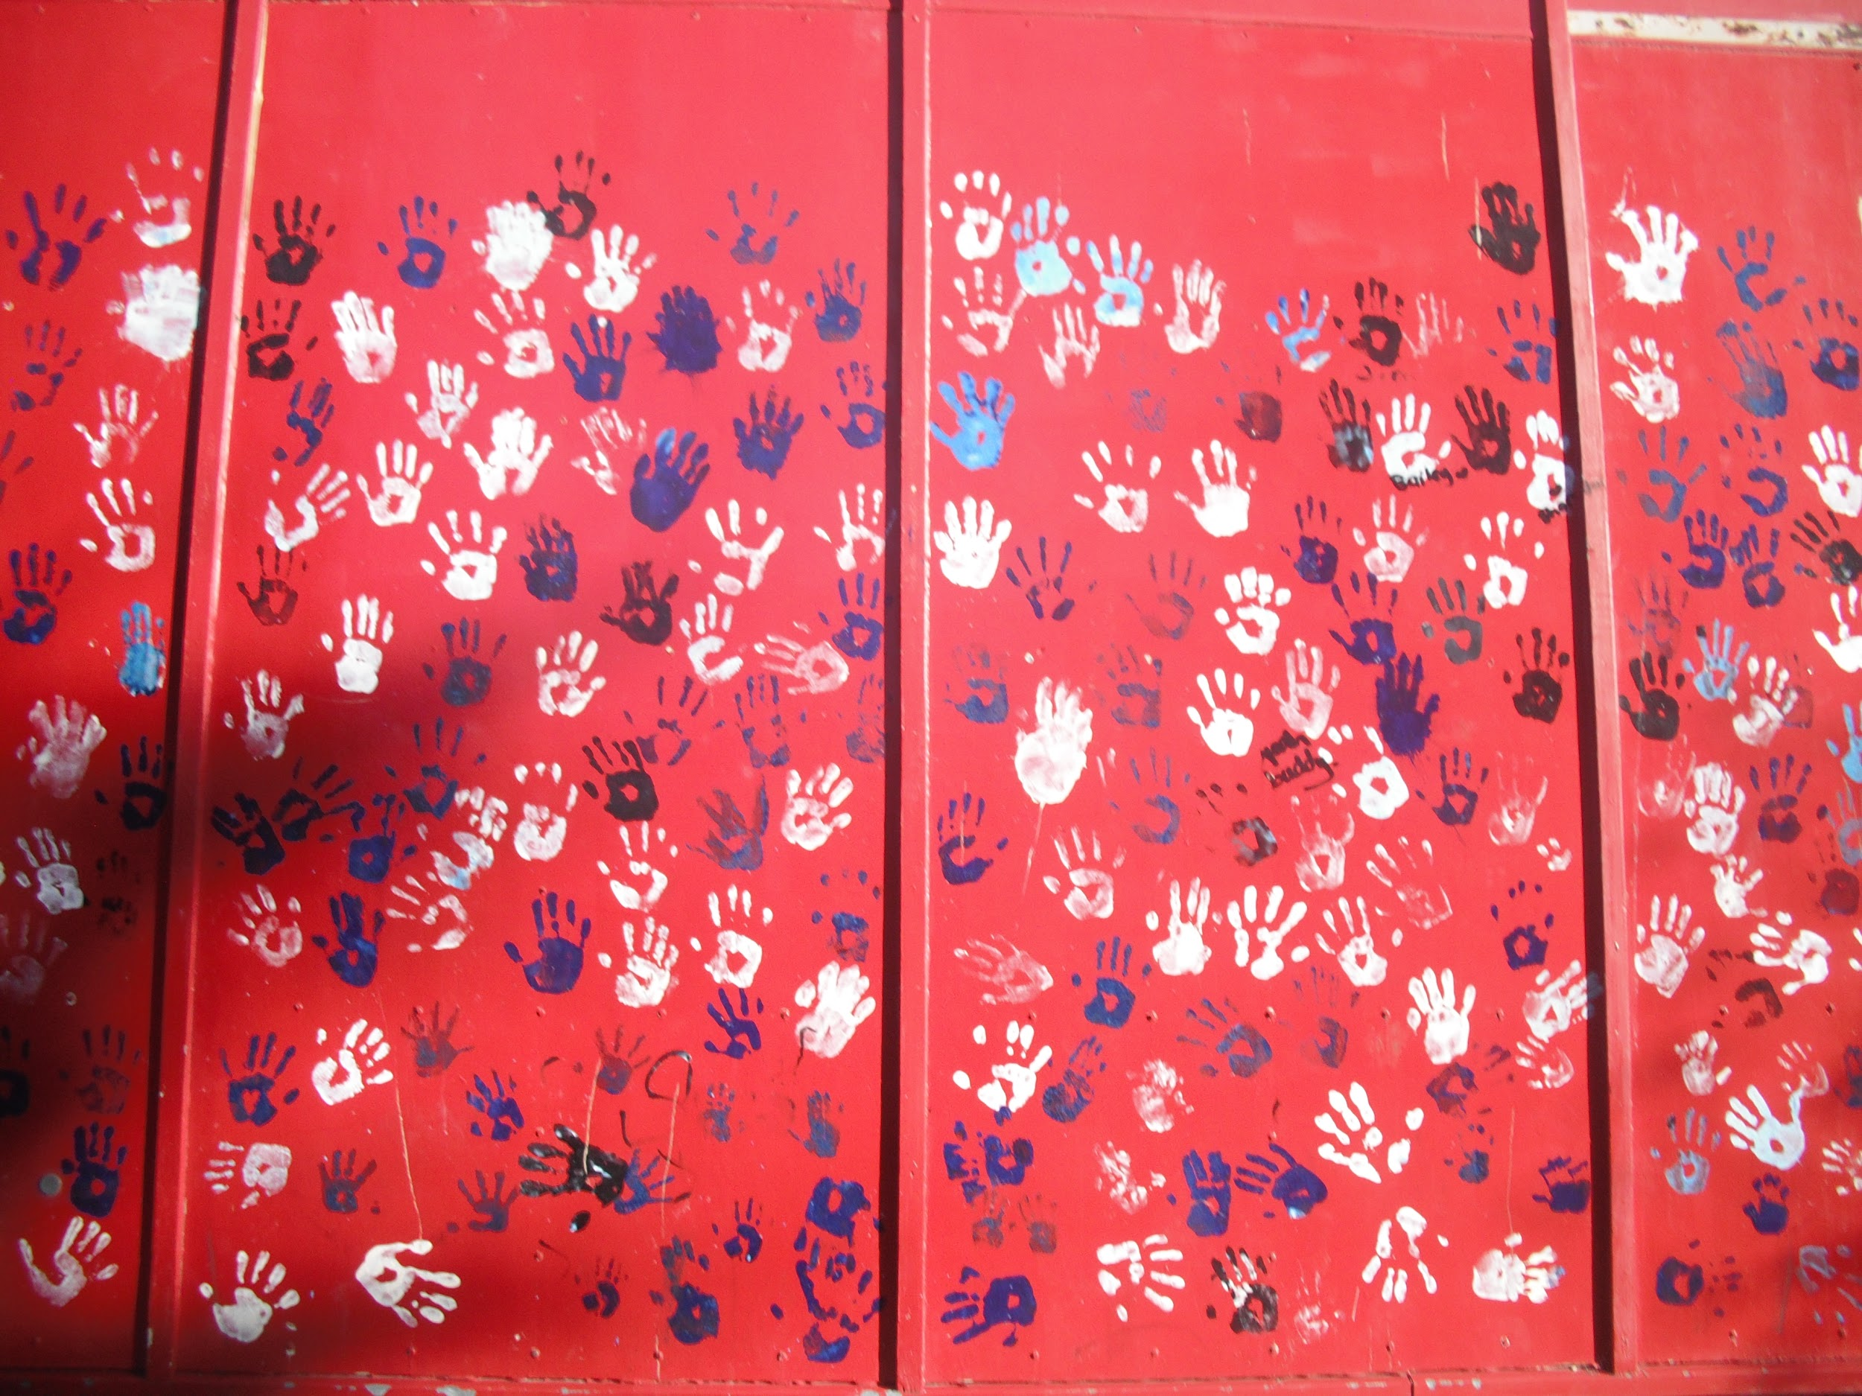
Sofia found a wall covered in handprints on Breens’s science room.
Notes:
By Sofia. By the Breens science room

Slide 29
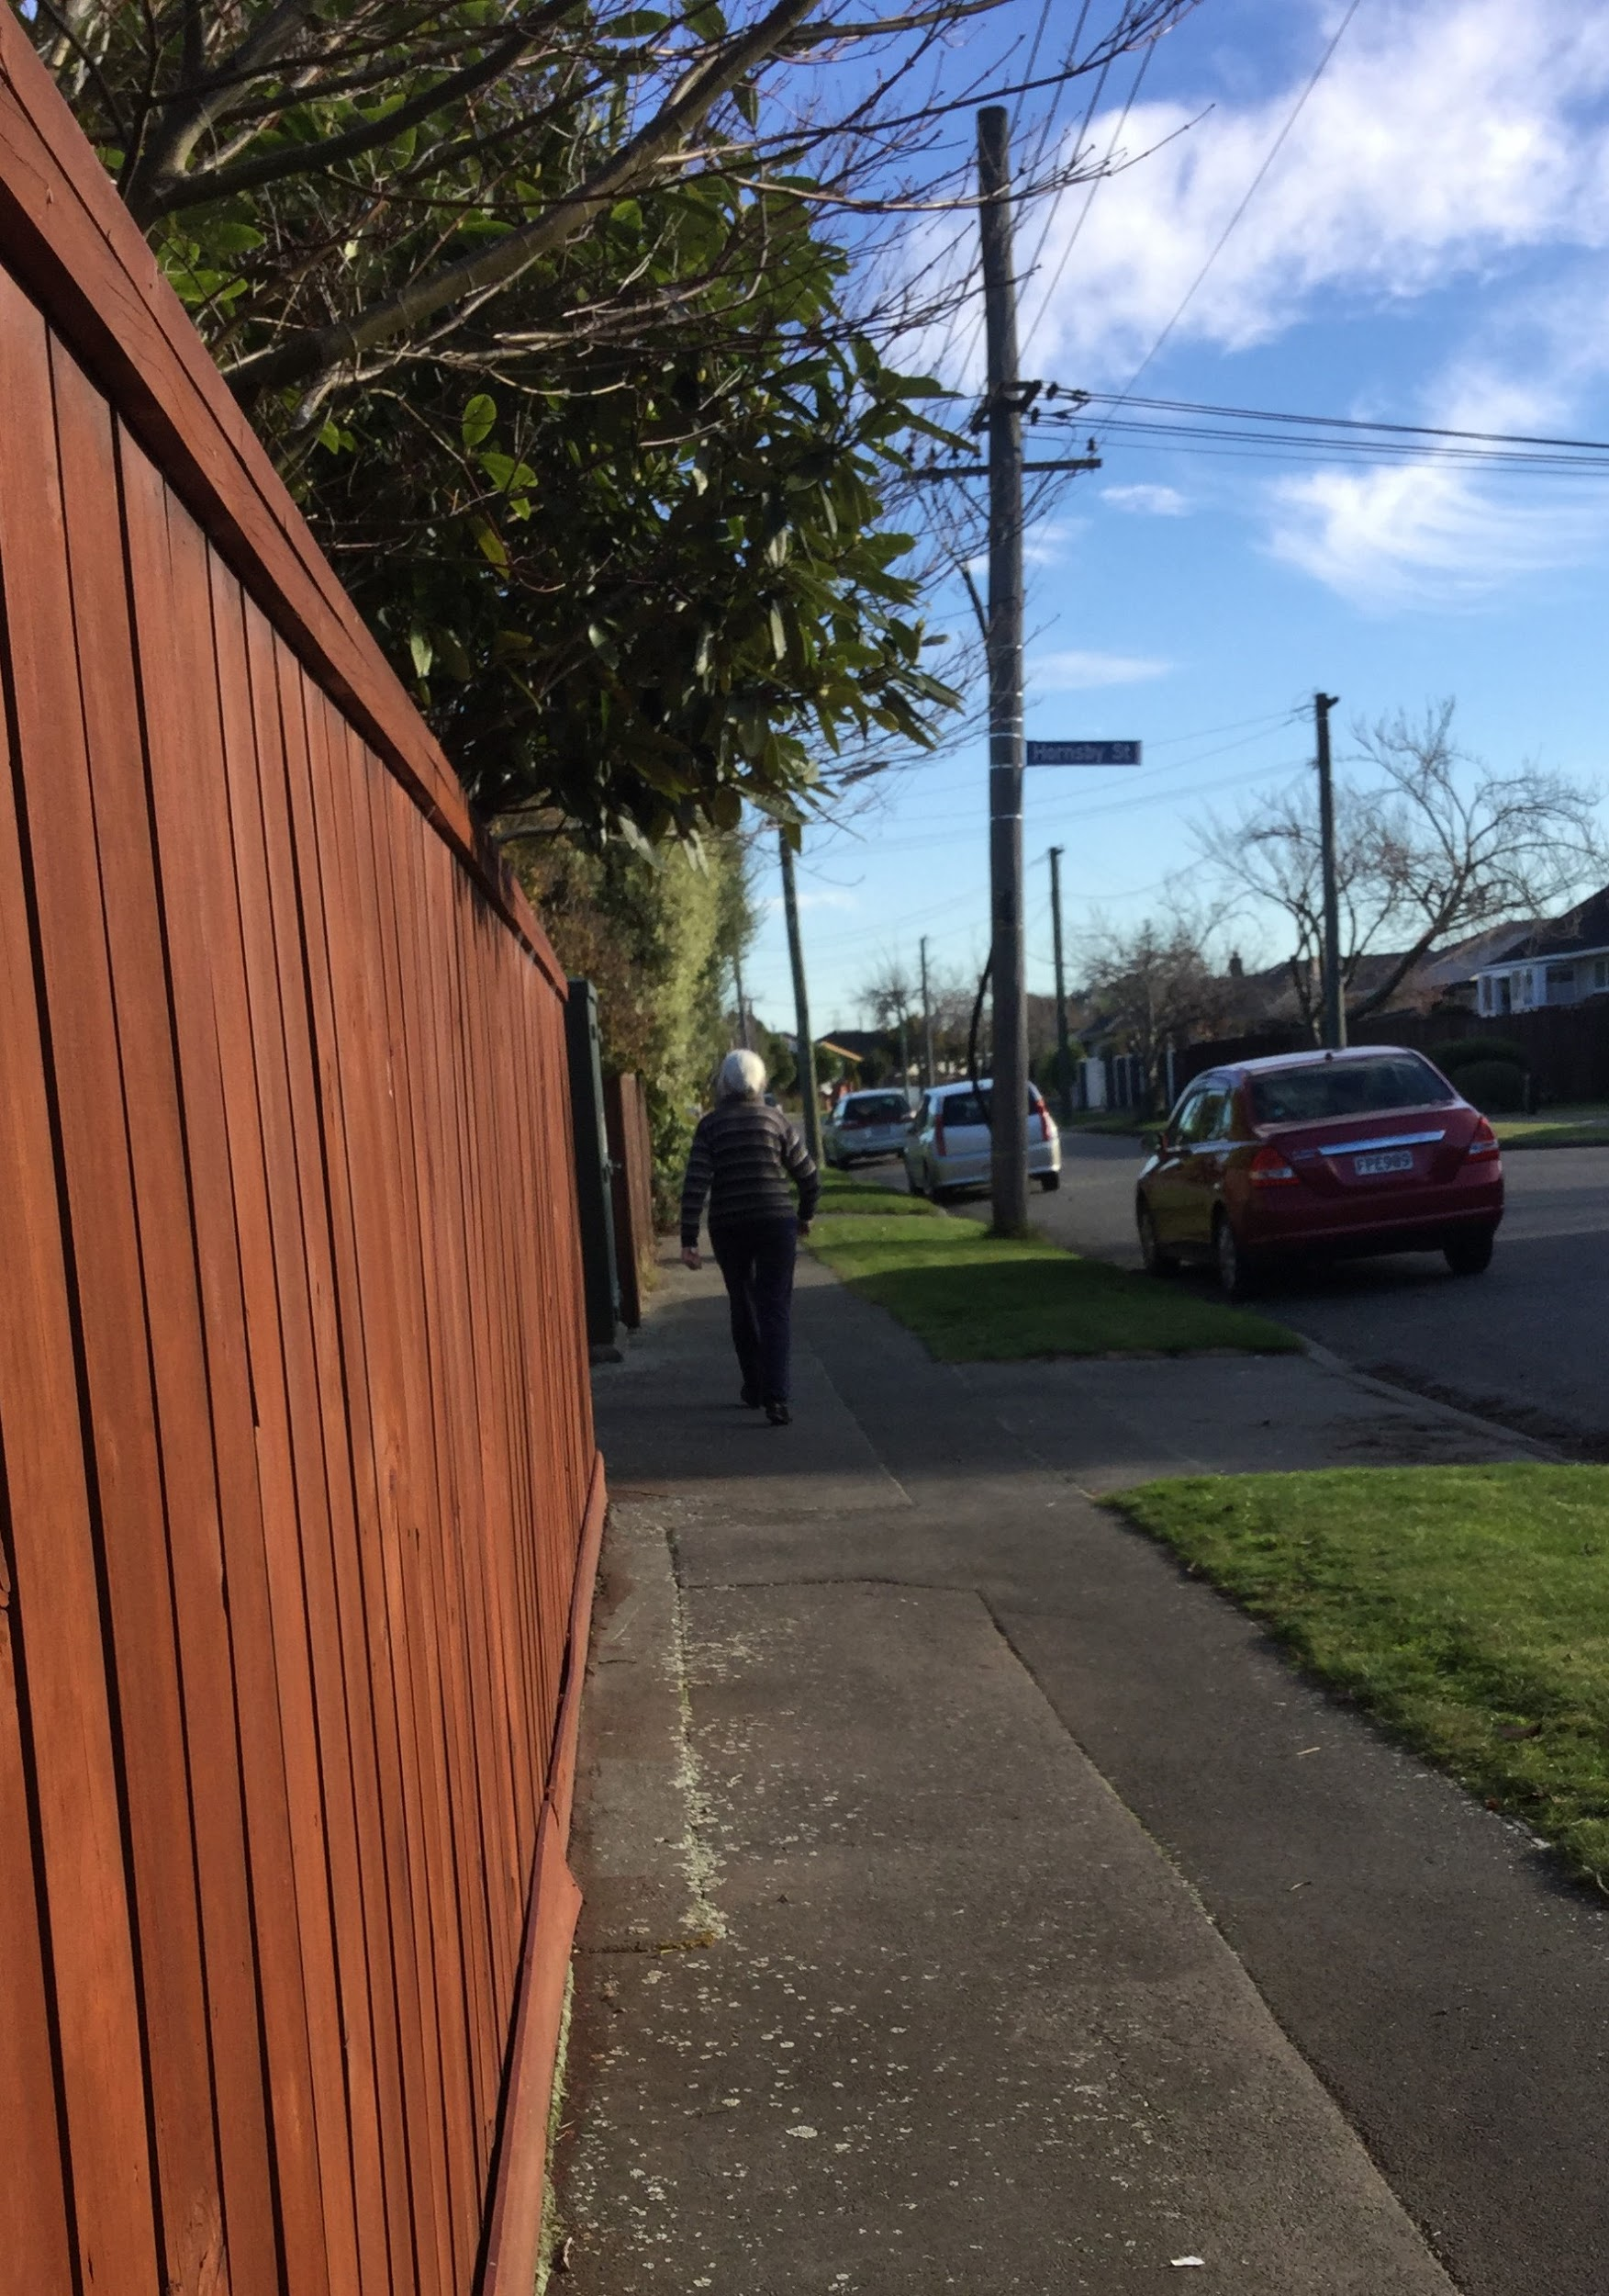
Bishopdale resident, Joan, does a lot of walking around the area.
Jazz has captured her disappearing down Mooray Ave.
Notes:
By Jazz. Joan walks down Mooray Ave on a sunny winter’s afternoon.

Slide 30
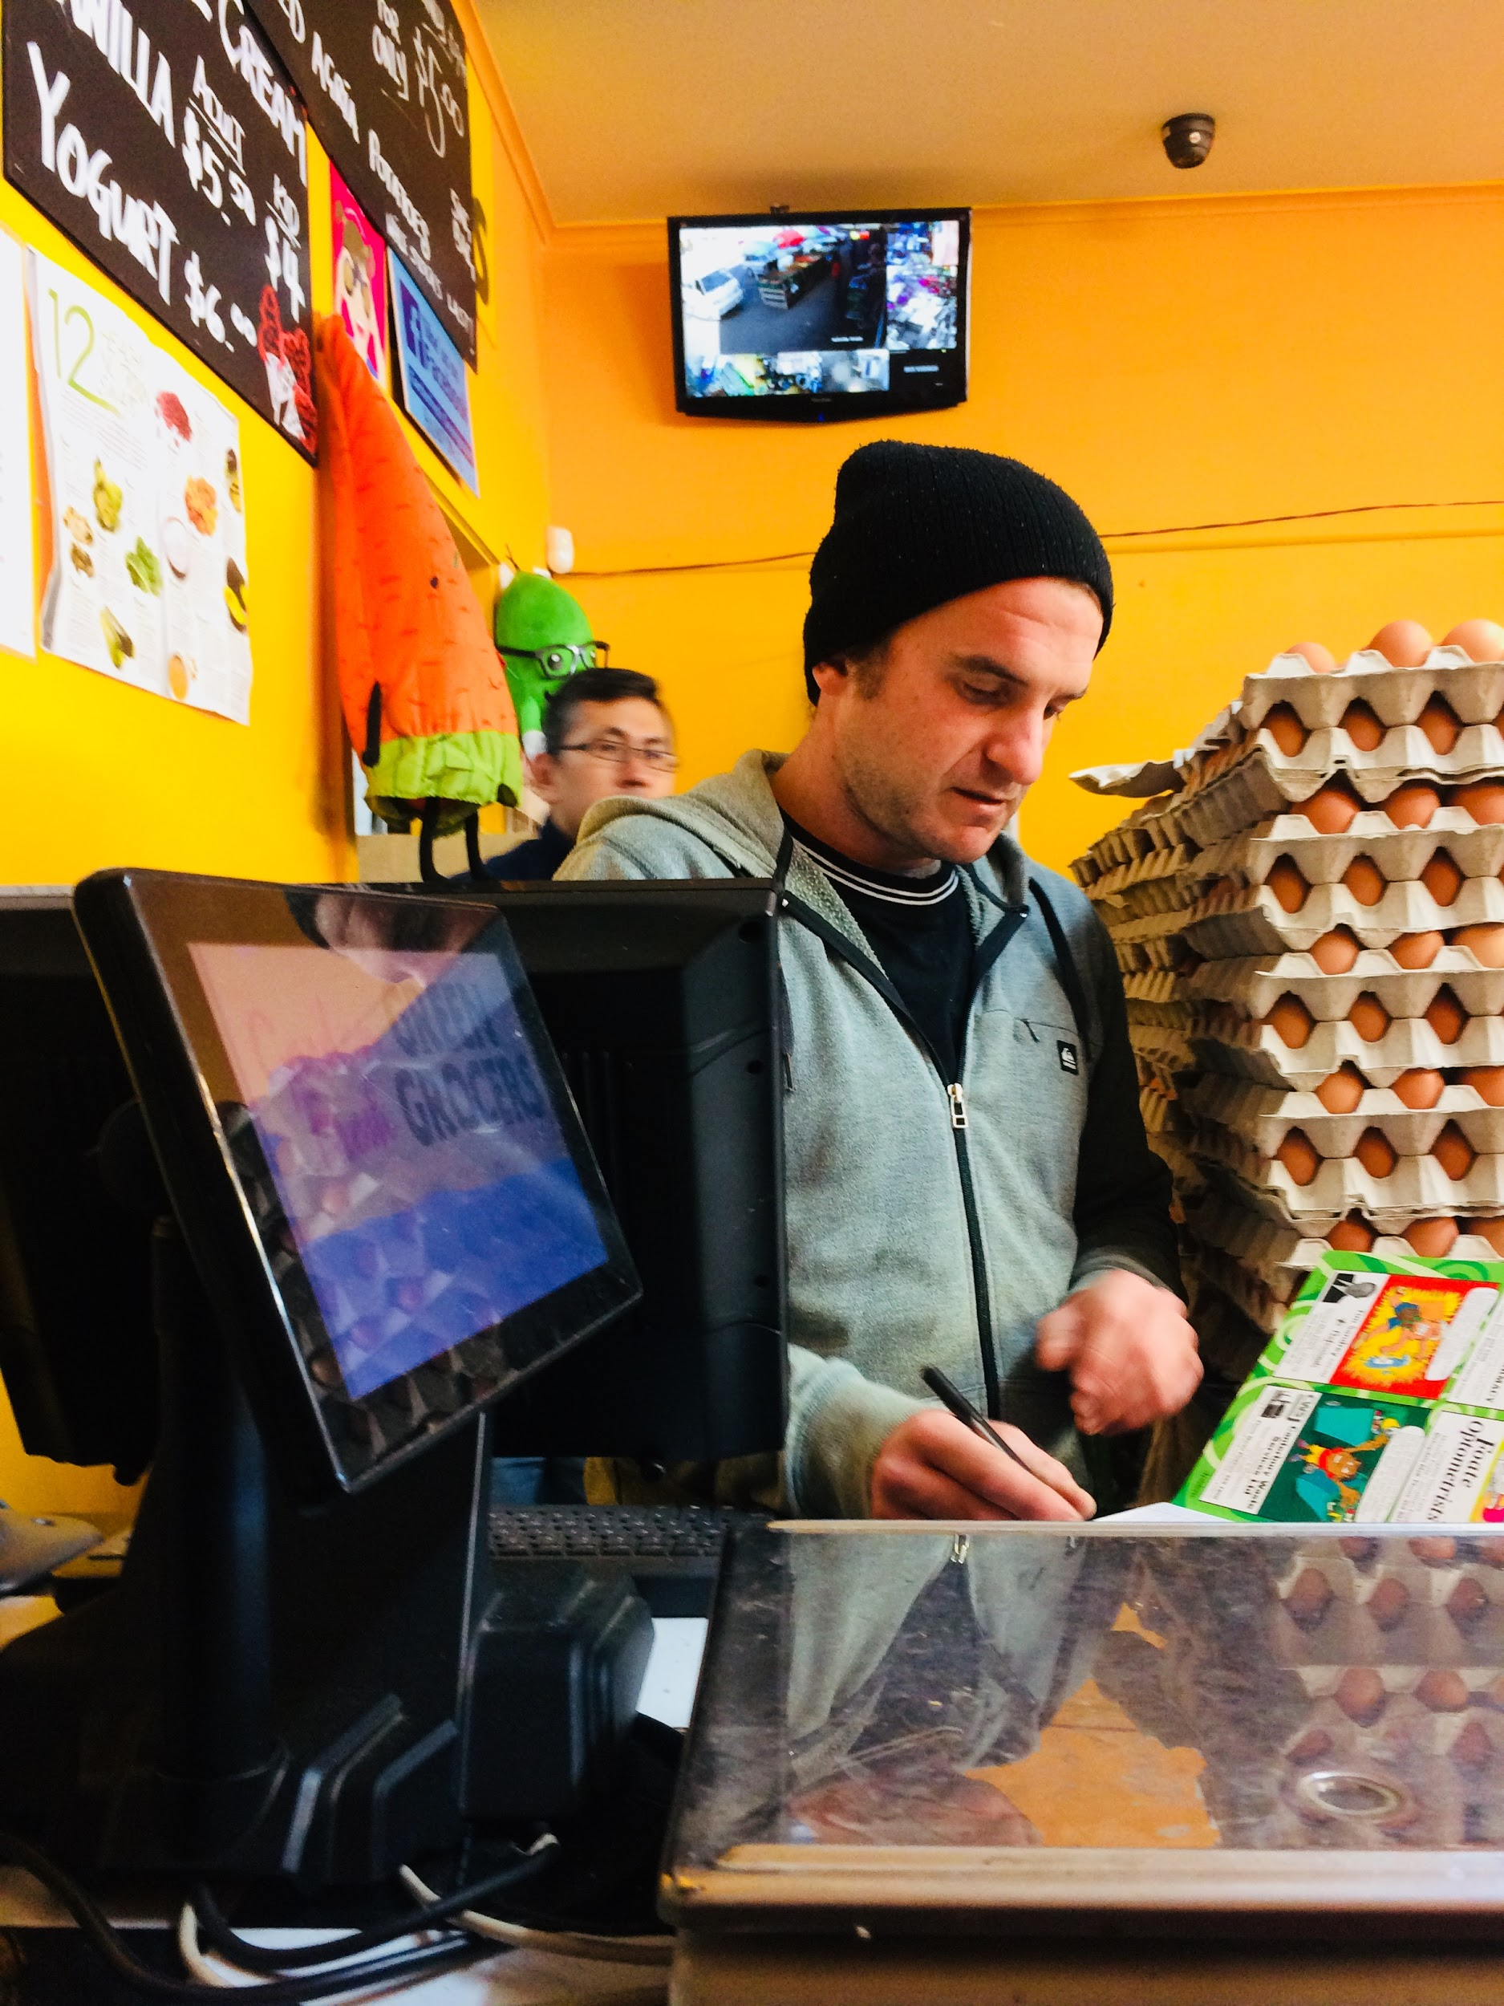
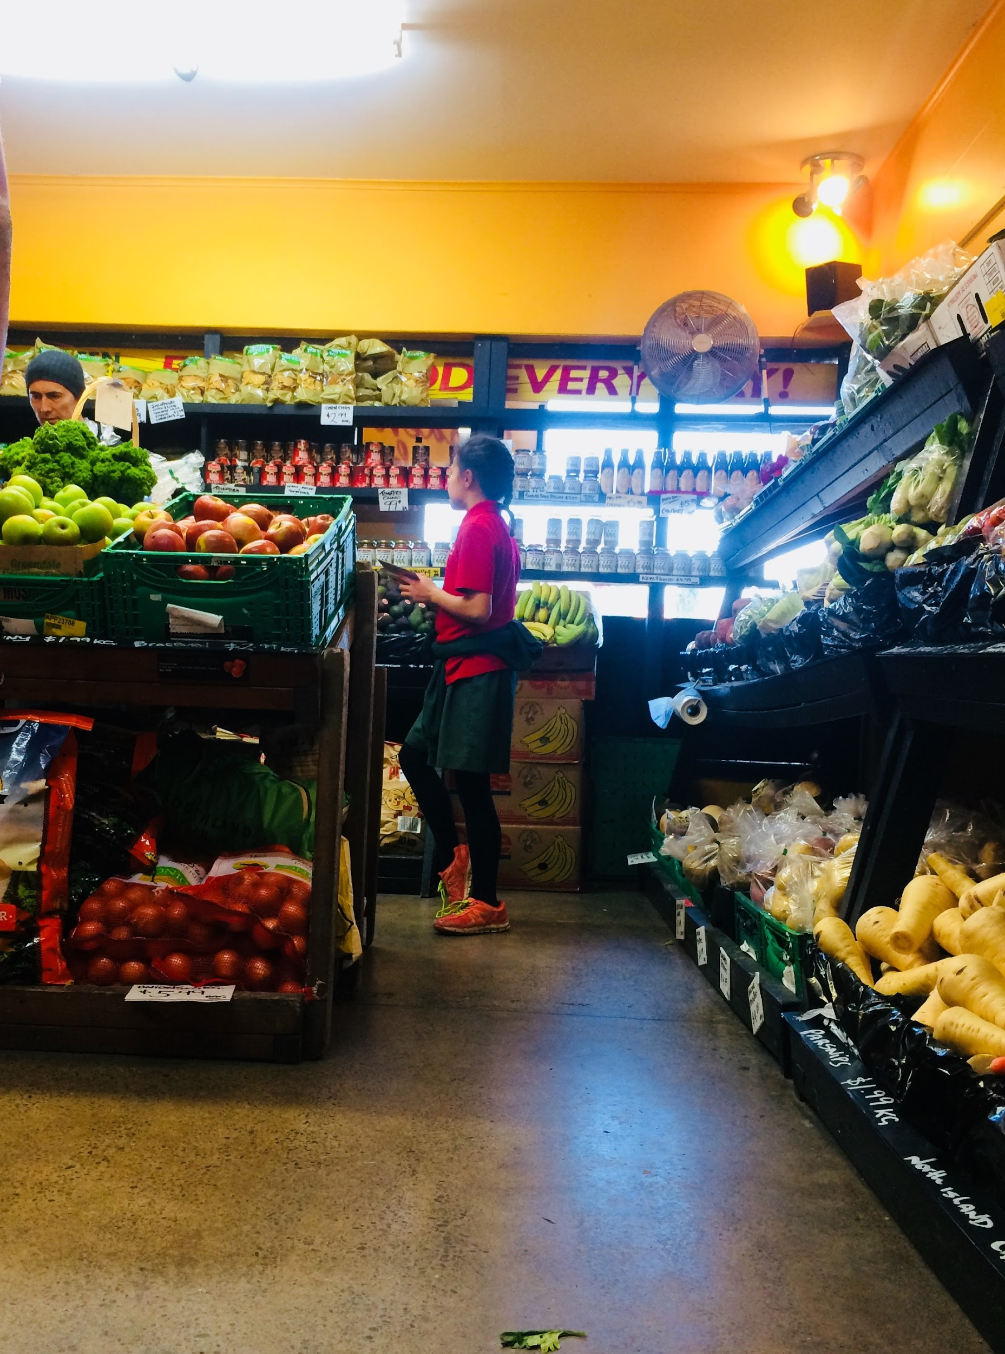
Georgia snapped these two shots at the Green- grocer’s in Leacroft Street.
Notes:
By Georgia. Leacroft St Fruit and Veg shop.

Slide 31
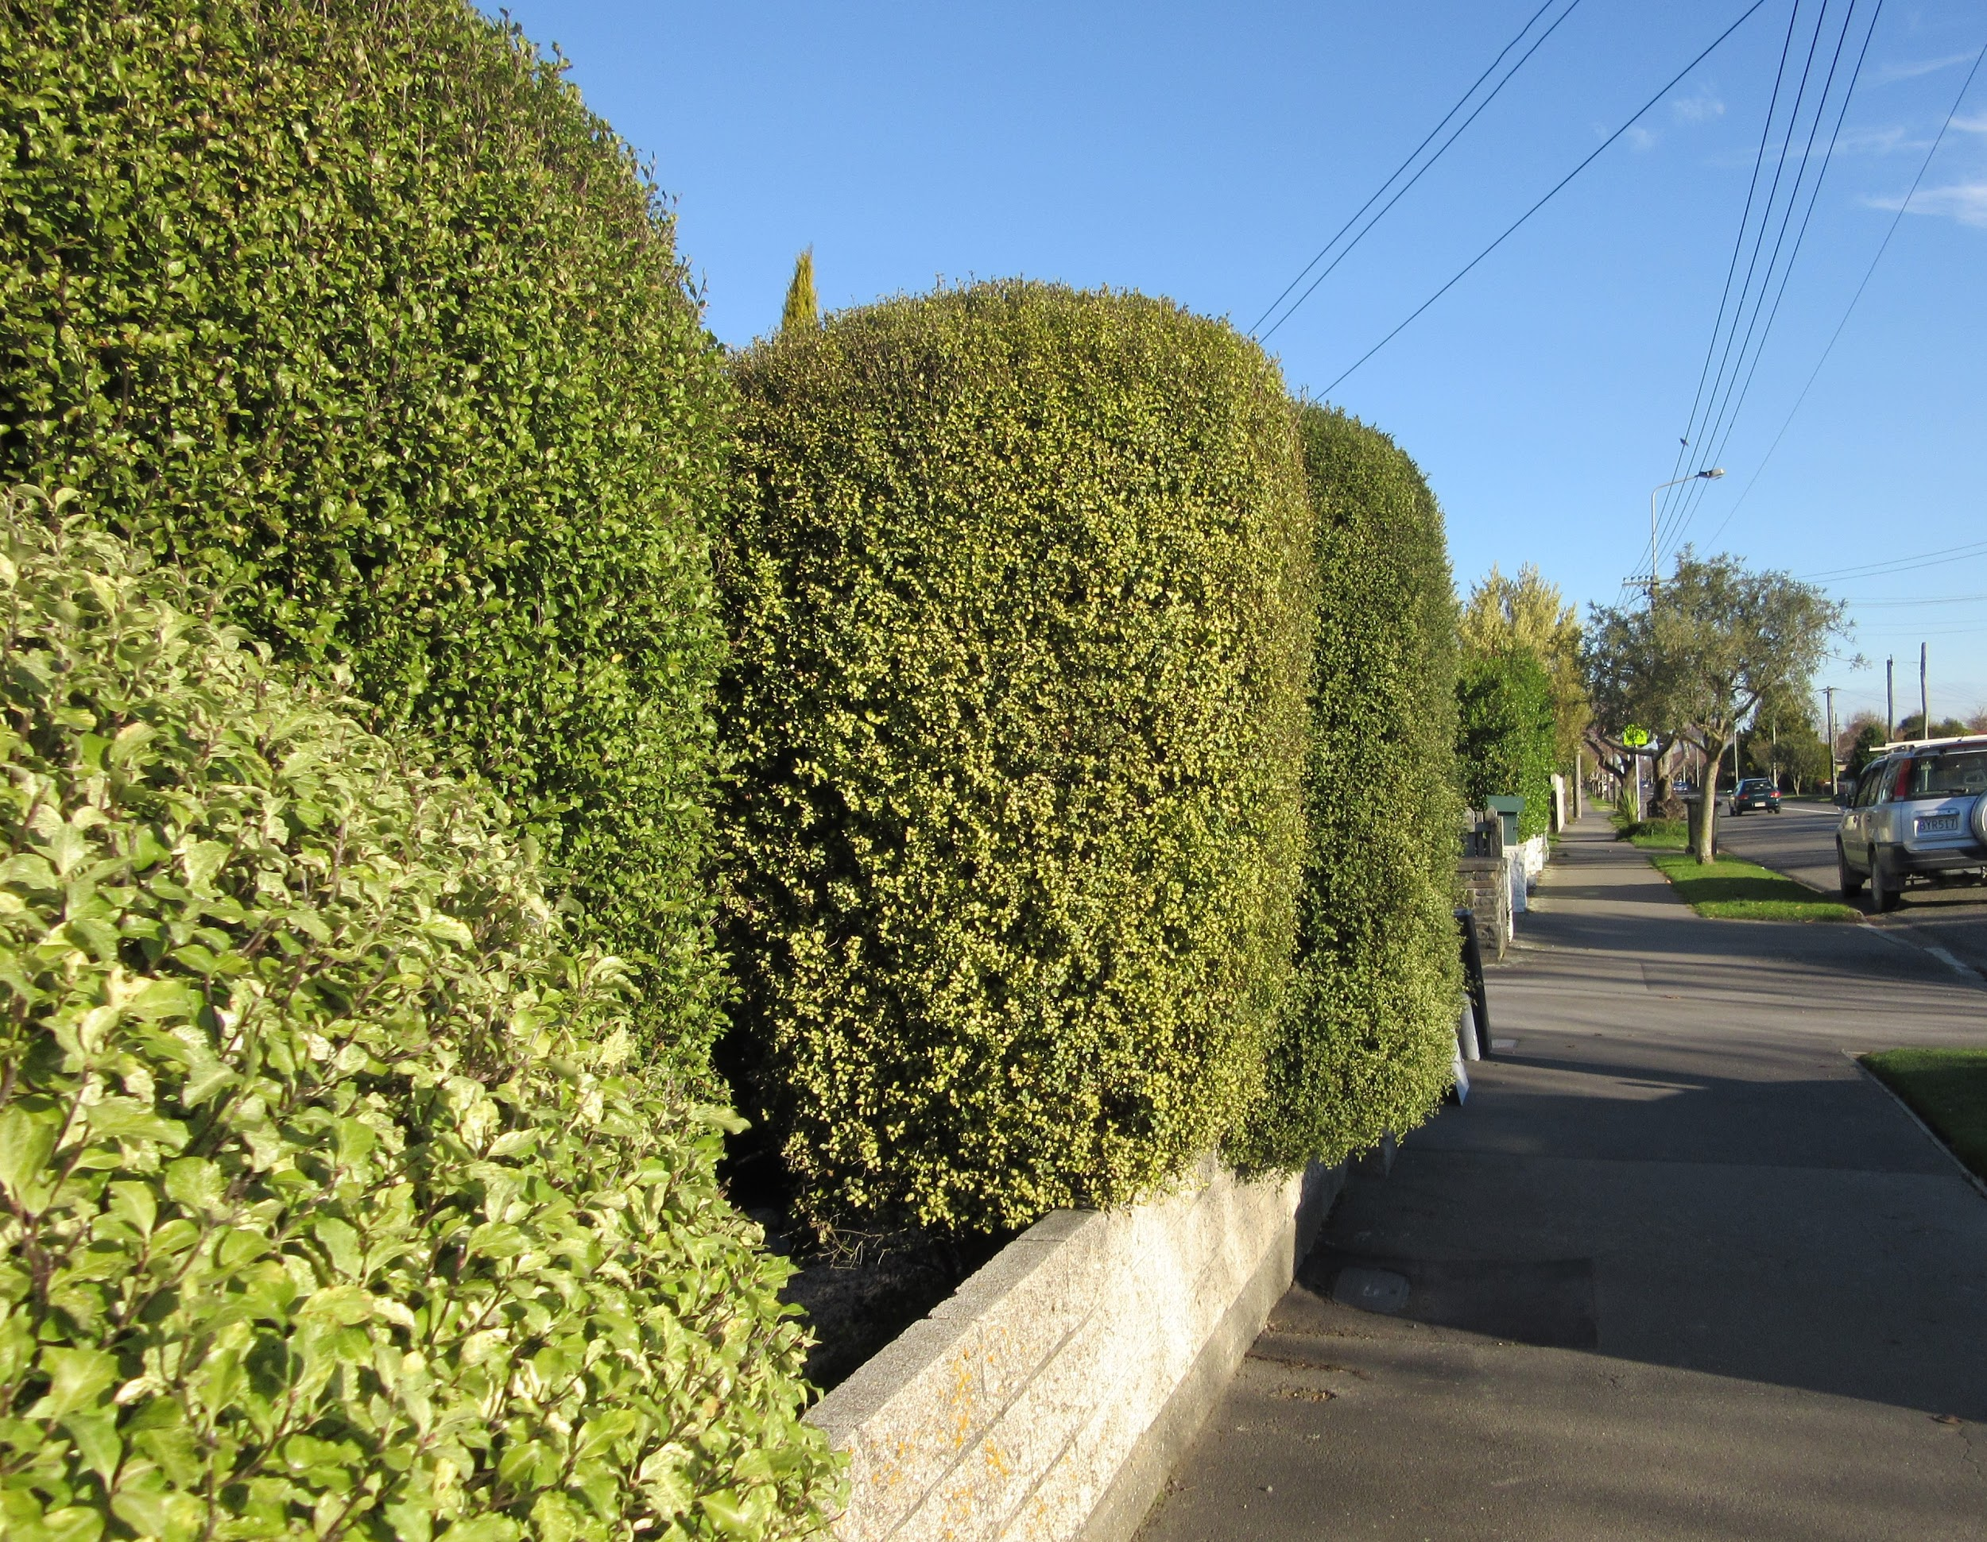
These interestingly curvy bushes caught Sofia’s attention.
Notes:
By Sofia. Interesting bush designs

Slide 32
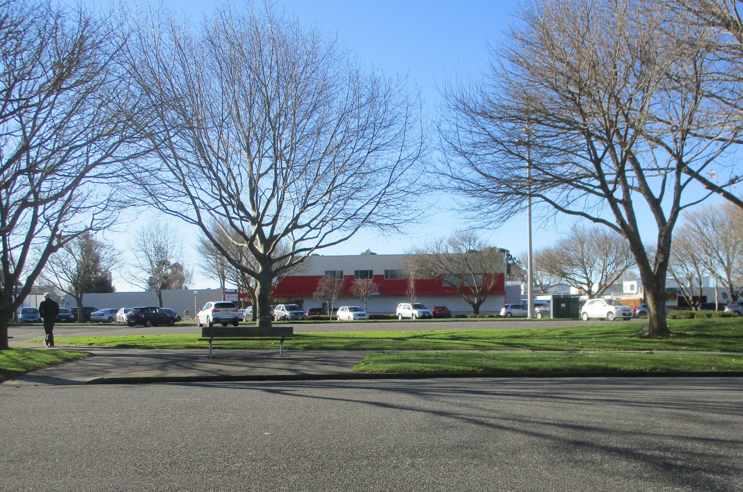
Looking across the Bishopdale Mall carpark.
By Jazmin
Notes:
By Jazmin. Across the Bishopdale carpark

Slide 33
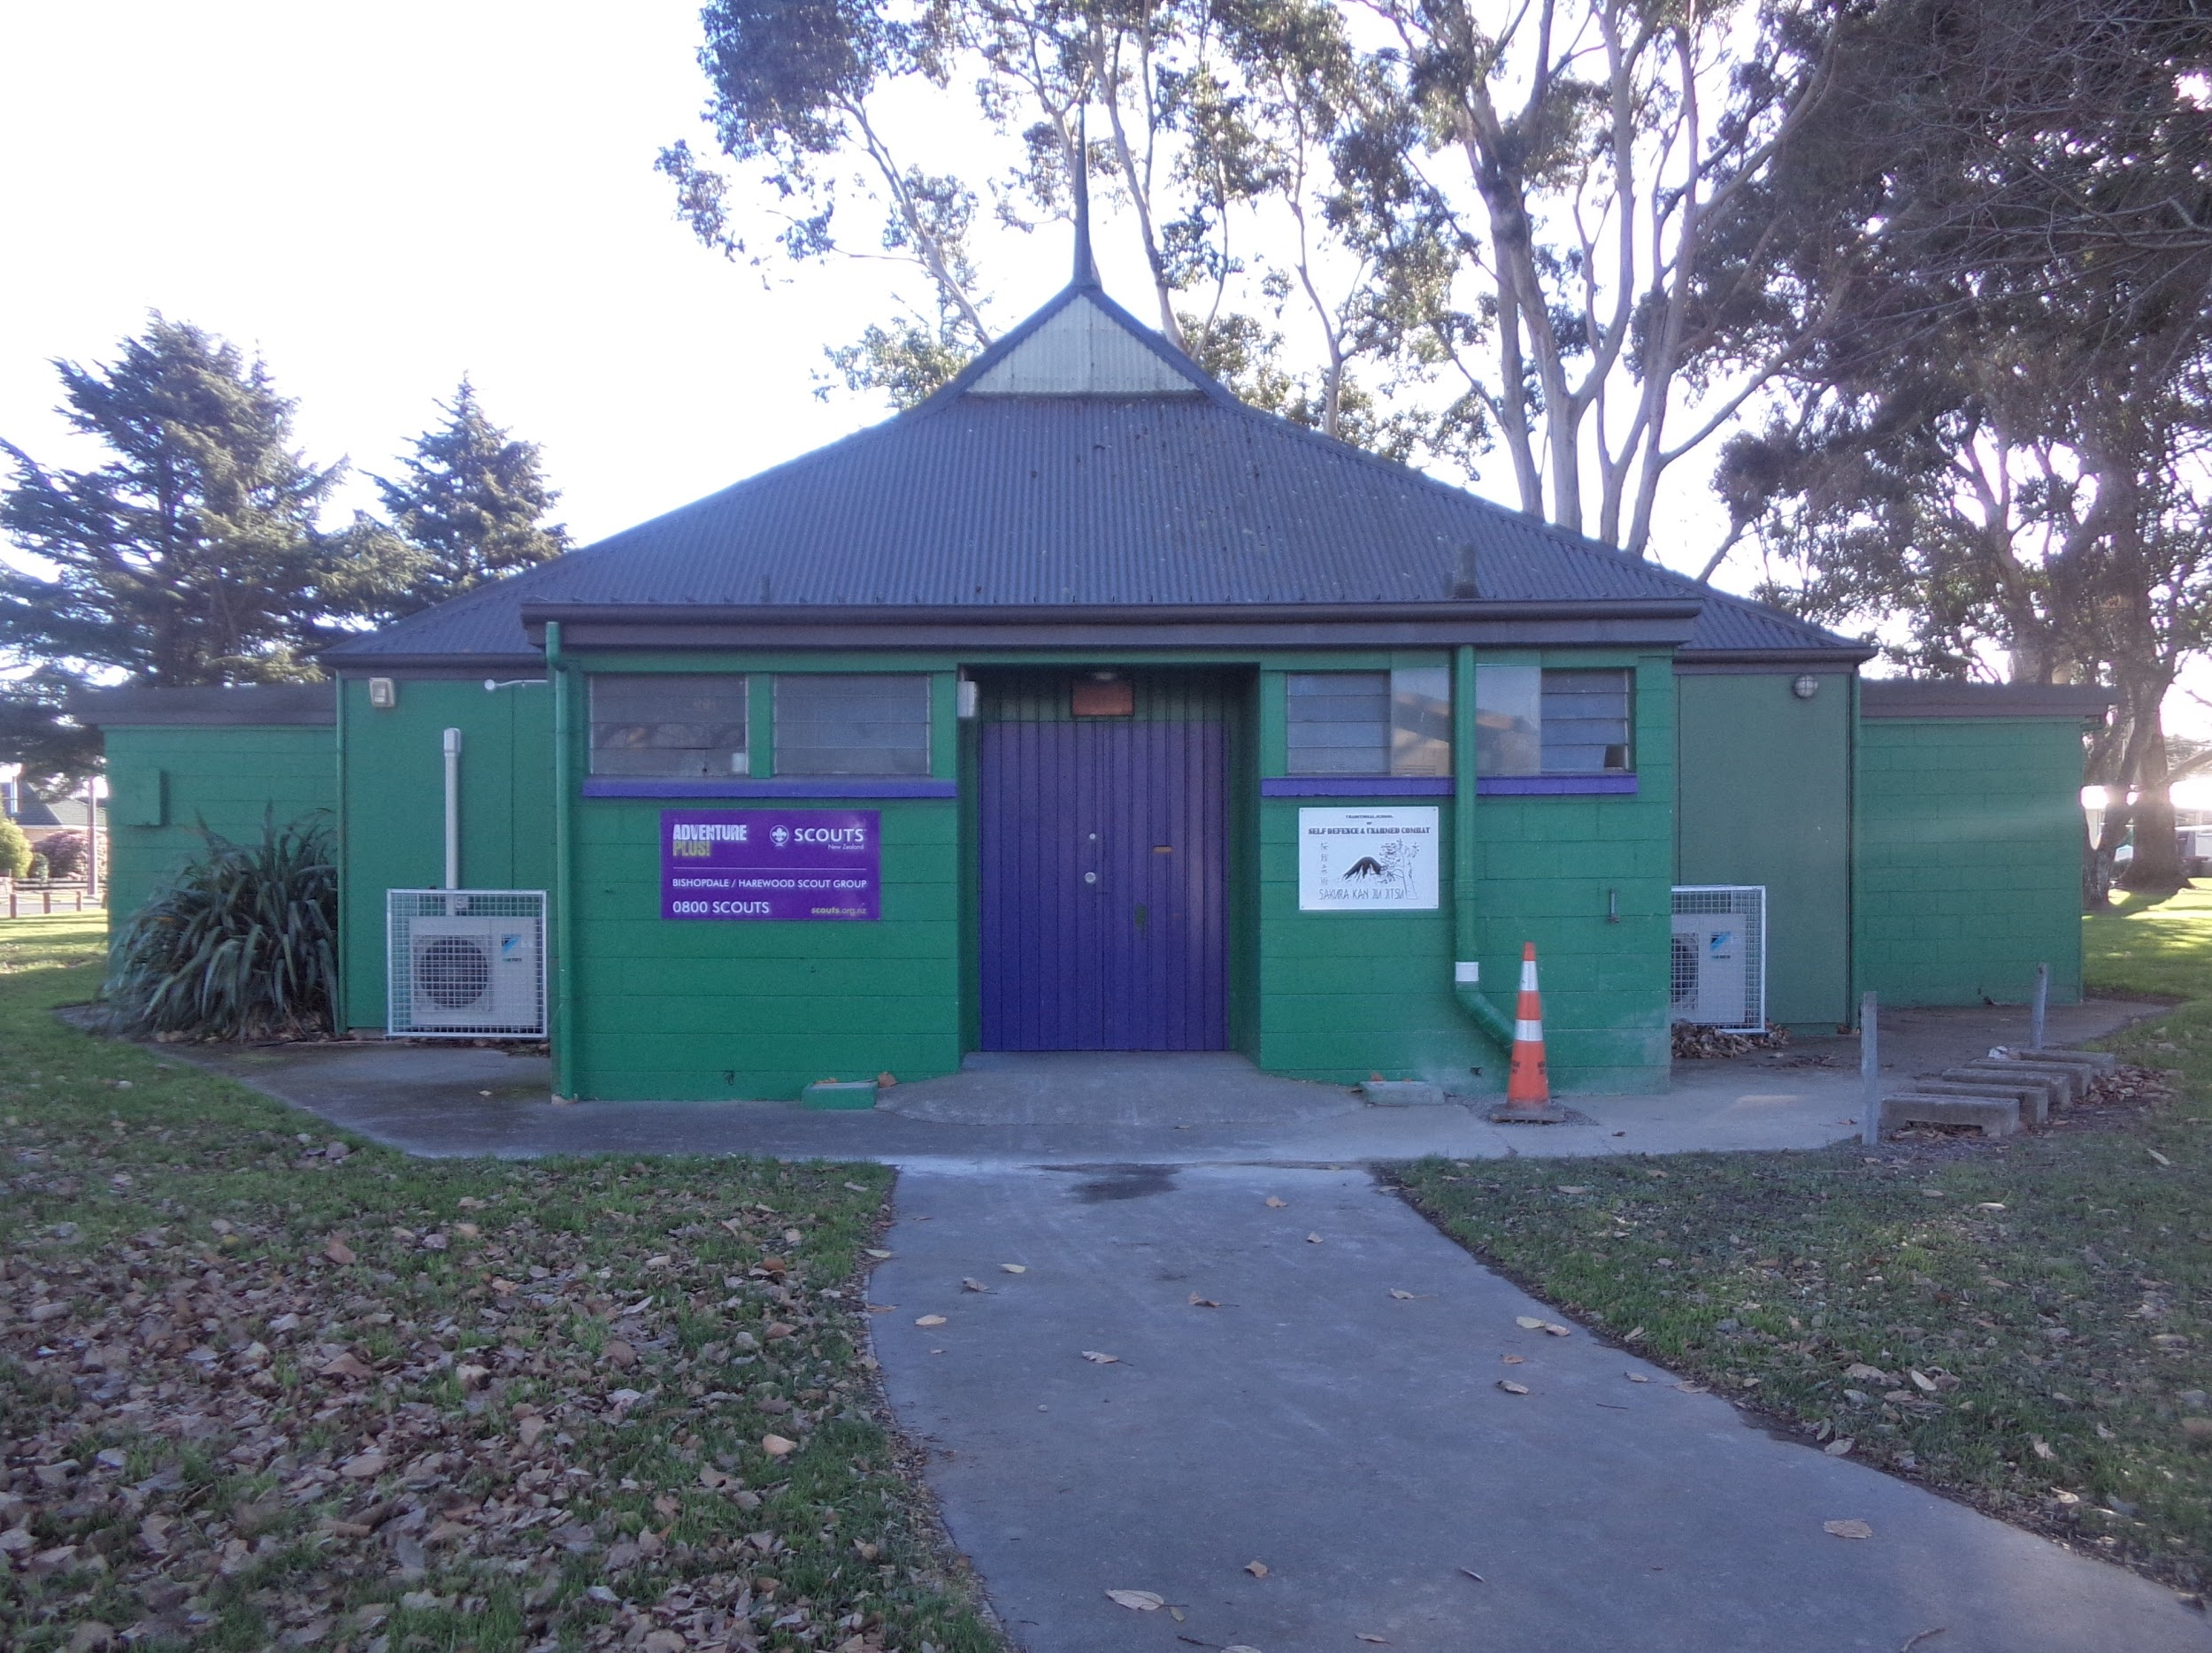
The Bishopdale Scout Den has a distinctive paint job.
By Rebecka
Notes:
By Rebecka. Bishopdale Scouts Den

Slide 34
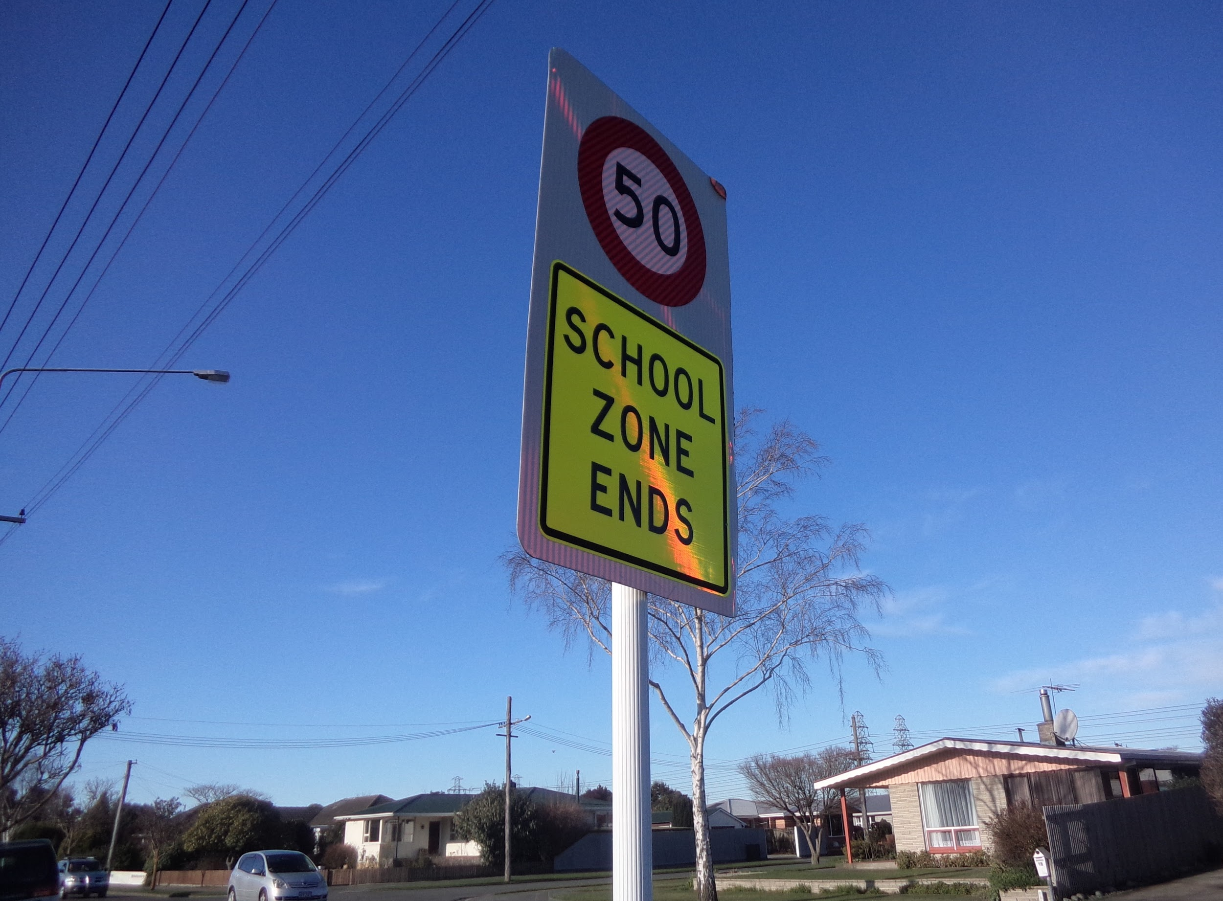
Greer took this photo of the Isleworth school zone, down Farrington Ave.
Notes:
By Greer. School zone, Farrington Ave

Slide 35
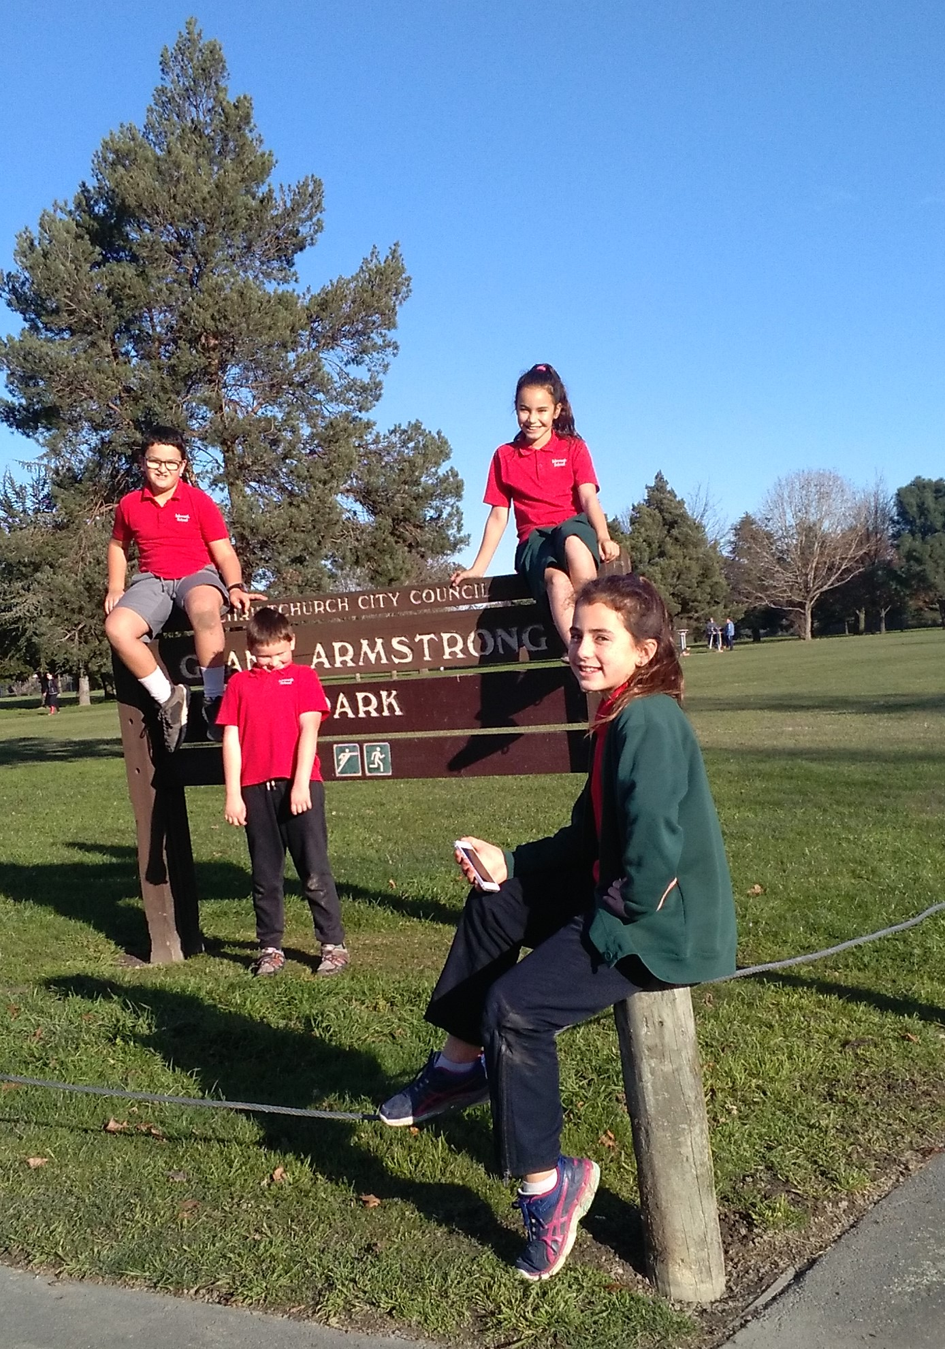
Olive had some of her school friends perch on the sign for Grant Armstrong Park.
Notes:
By Olive W-P. Zombie in Grant Armstrong Park

Slide 36
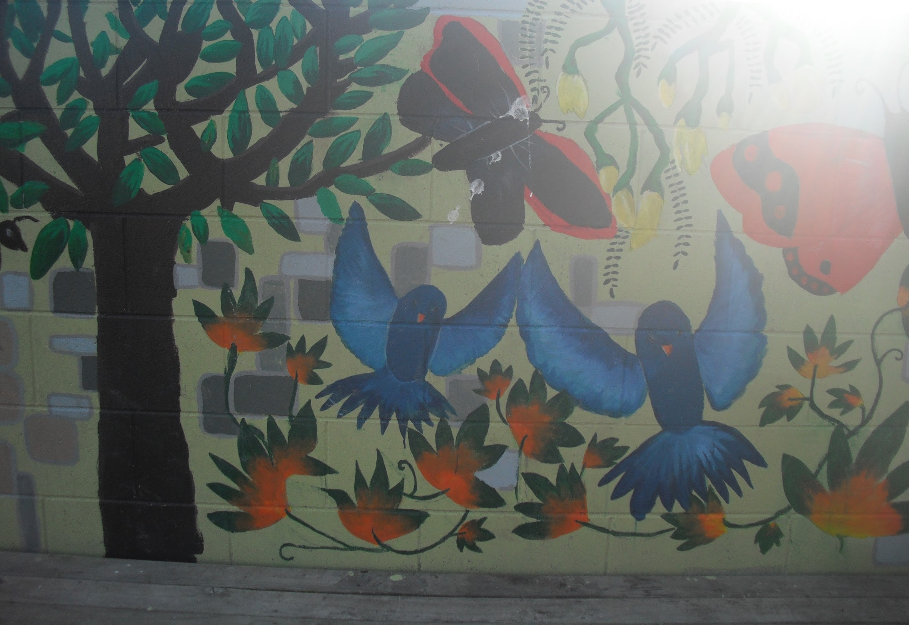
Jessica and
Sofia loved this artistic mural at Breens.
Notes:
By Jessica and Sofia. Art installation at Breens

Slide 37
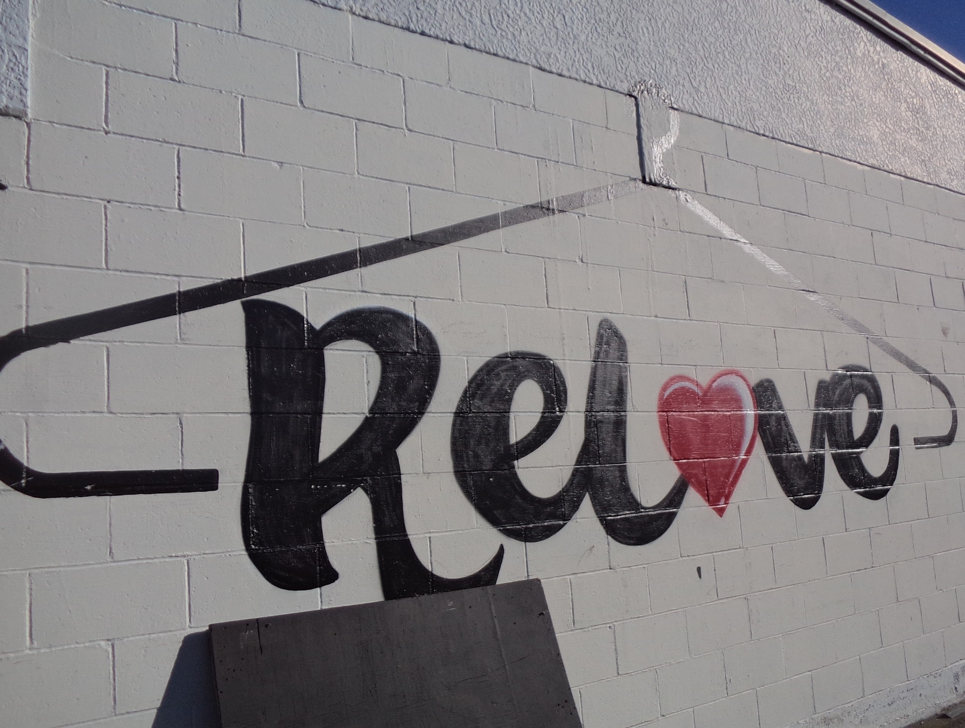
The sign advertising Relove second hand clothes store in Leacroft Street.
By Rebecka
Notes:
By Rebecka. Relove on Leacroft St. Second hand clothing

Slide 38
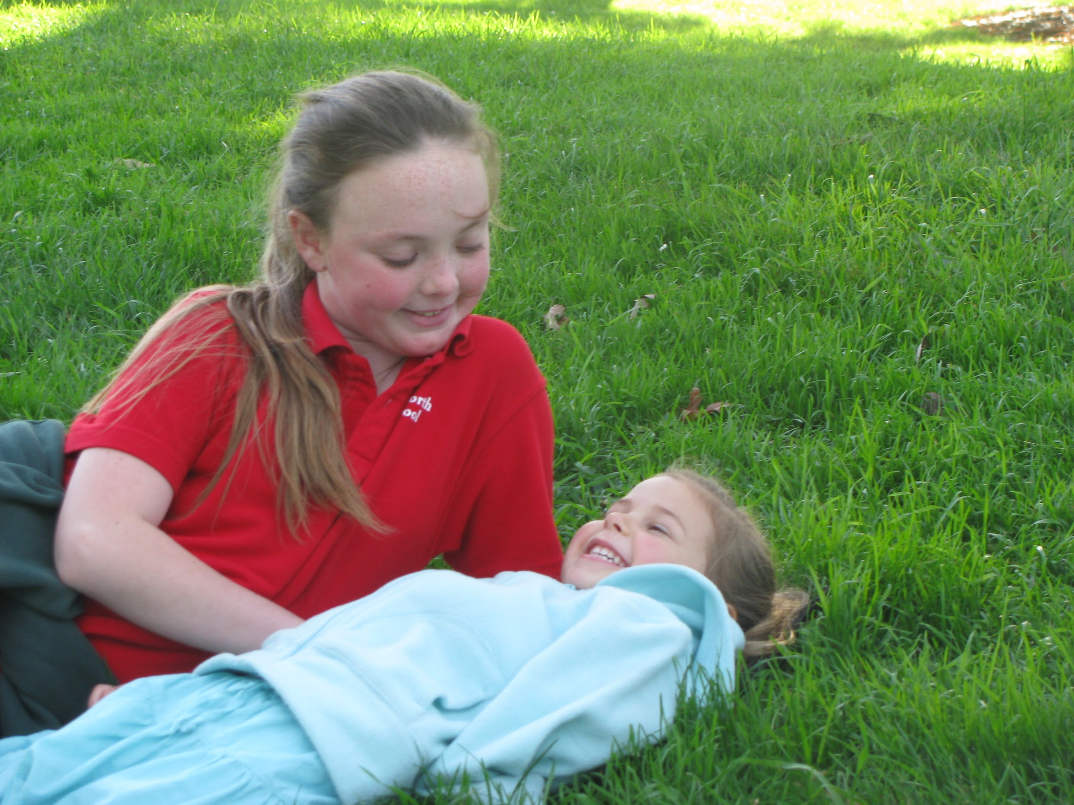
Olivia and Lydia play together at Bishopdale Park.
By Emily
Notes:
By Emily. Olivia and Lydia play at Bishopdale Park

Slide 39
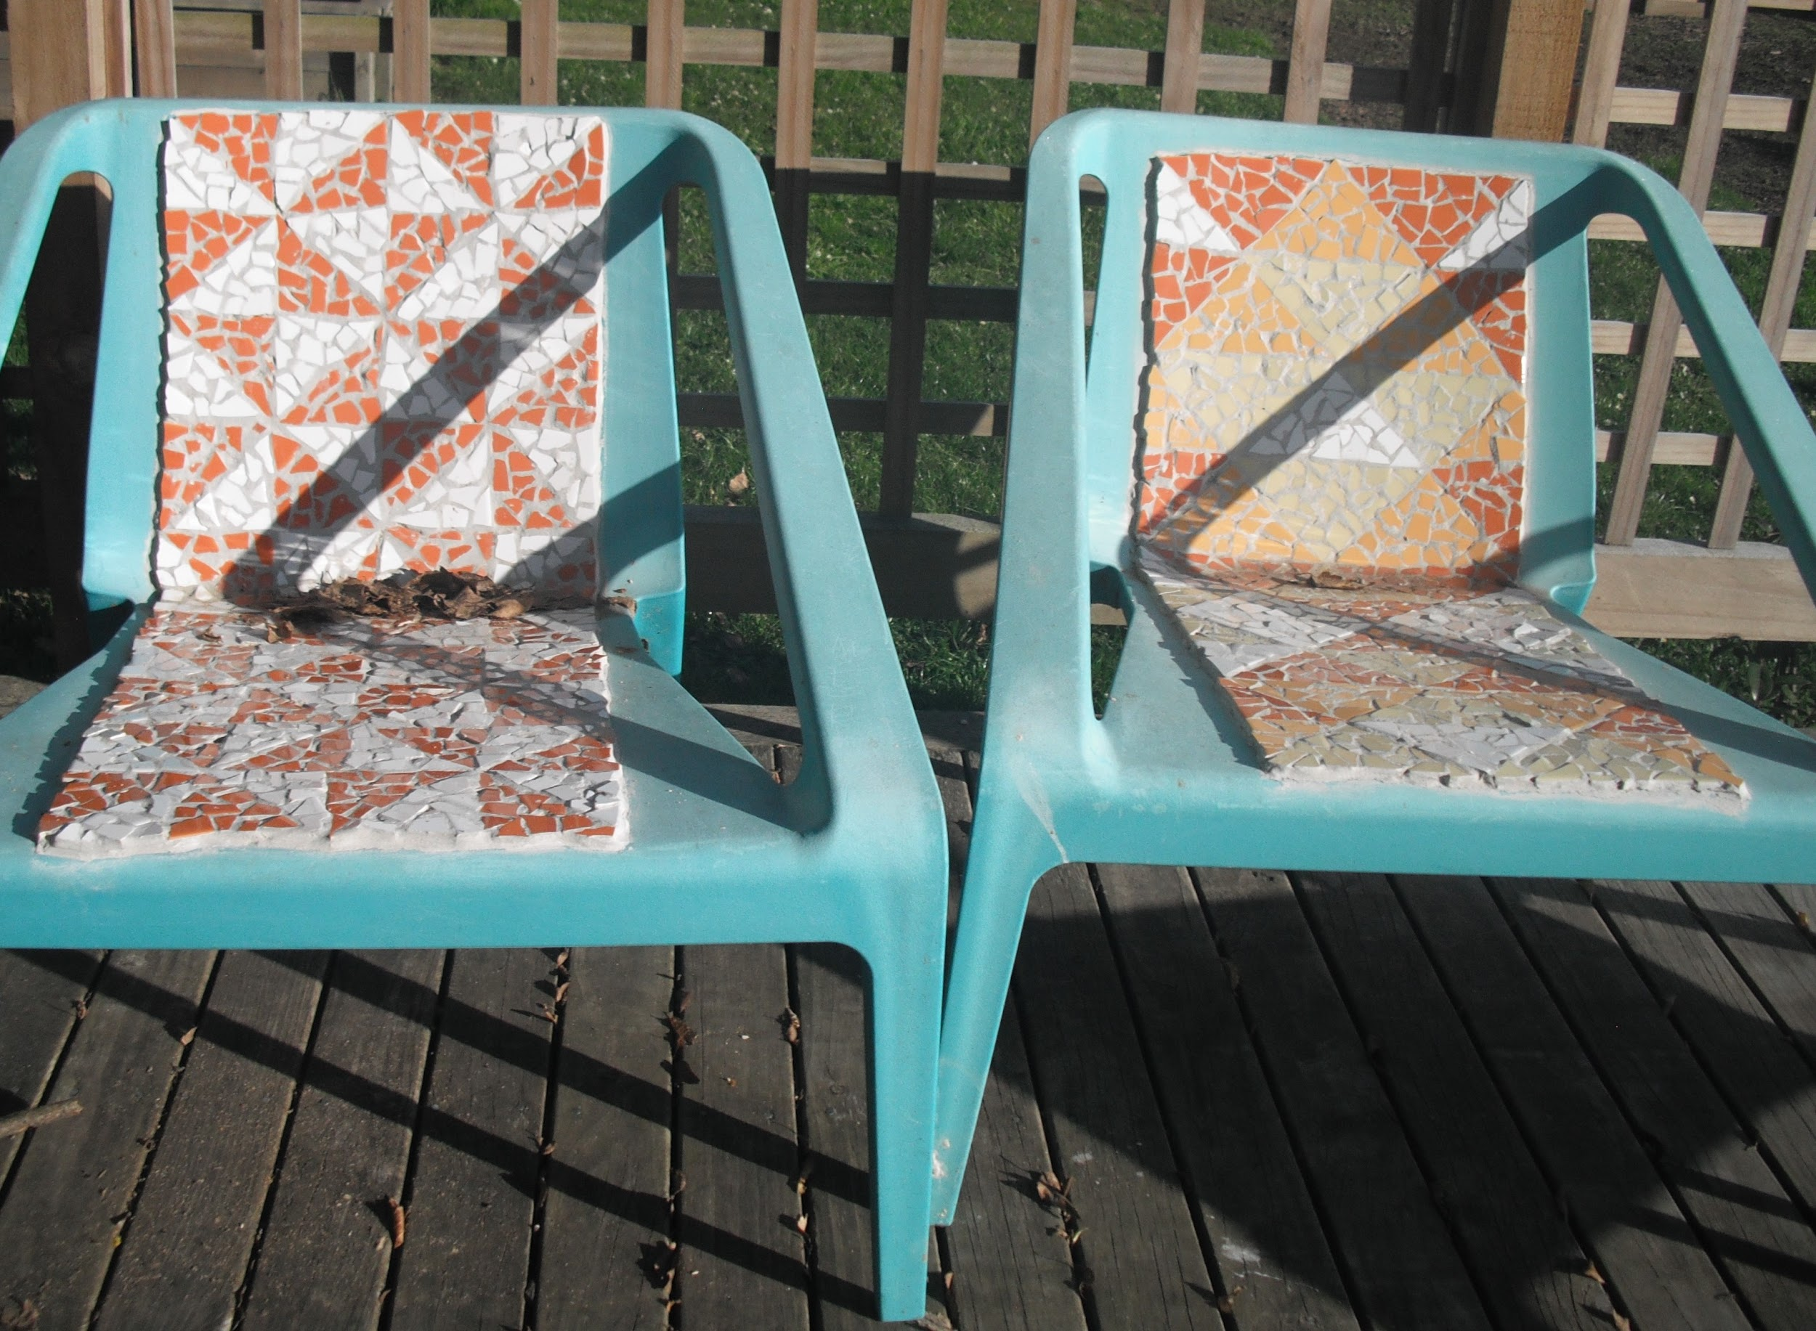
A couple of arty mosaic chairs down at Breens.
Notes:
By Jessica Mosiac chairs at Breens

Slide 40
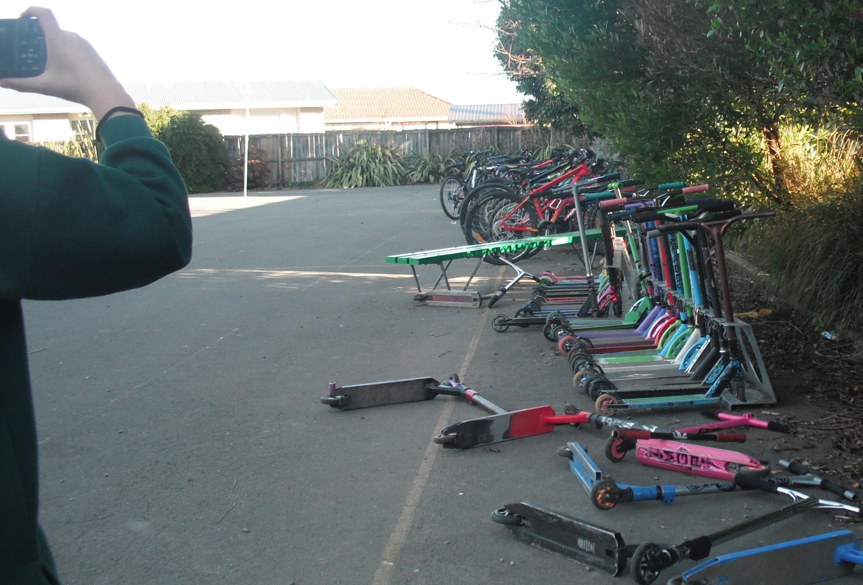
Busy school day…. Bikes and scooters parked up, waiting for the hometime bell.

Slide 41
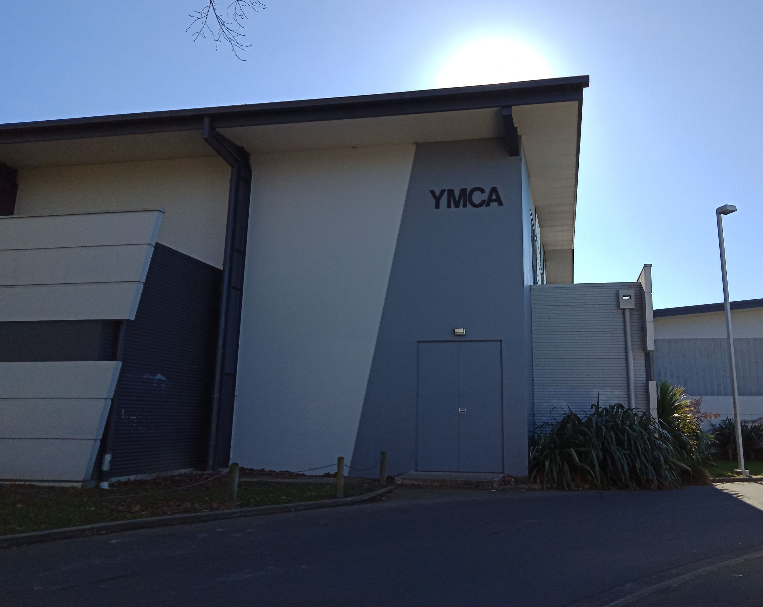
David took a photo of the side of the busy Bishopdale YMCA building.

Slide 42
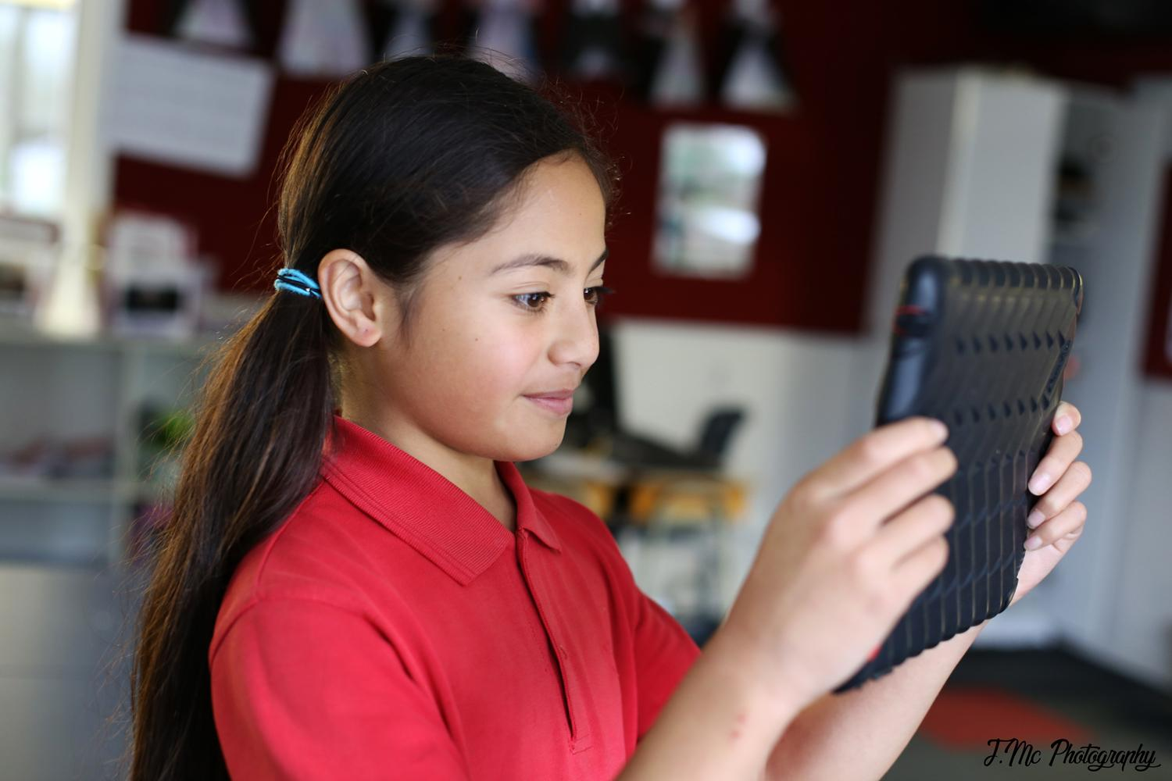
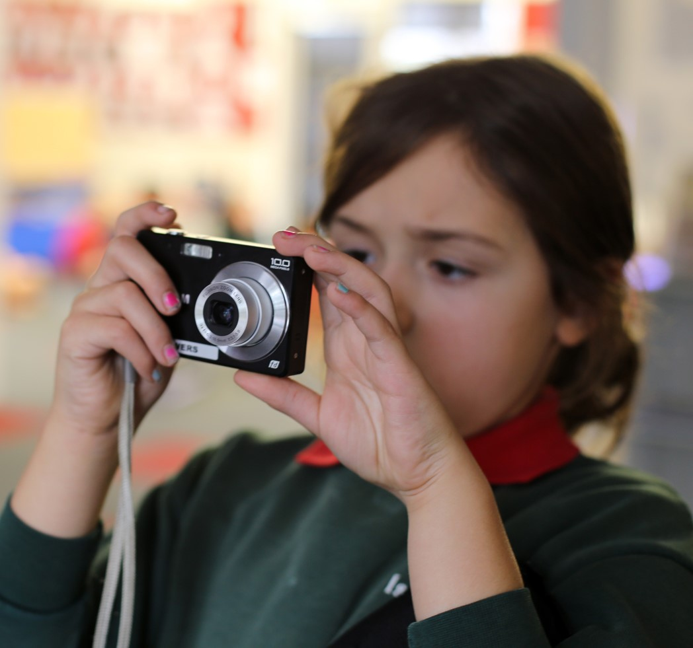
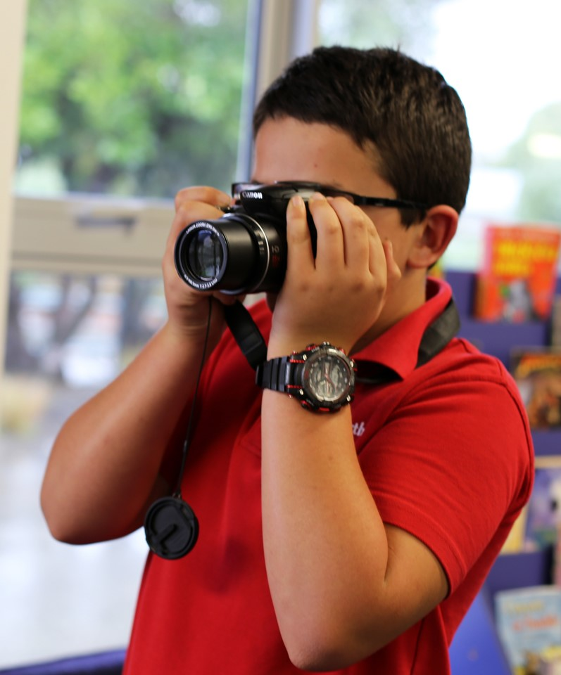
Thanks for watching our photo compilation of reasons why Bishopdale is ‘Our Place’. We hope you made some connections.
We acknowledge and appreciate:
Jess McGiffin for teaching us about taking photos
UC Fine Arts team/Christchurch City Libraries for the inspiration
All the wonderful Bishopdale people who let us take photos for our project
Our adult helpers: Jan, Sara, Leah, Rachael, Katherine, Fiona, and Jess

