Slide 1
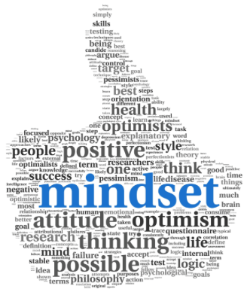
Growth Mindset
Parent Information Meeting - August 2015
Notes:
Kia ora koutou ngau mai haere mai. Hello, welcome and thank you for coming to our parent information meeting on Growth Mindsets. Our teachers have been learning about the impact of having a growth mindset on learning opportunities and we are now looking forward to sharing this information with you. Team leaders Tania Reid and Felicity Fahey and I will share information, we have spared no expense with international speakers also presenting! You will also get a chance to do some thinking, have a chance to ask some questions and you will have the opportunity to take home some further information to read and try at home at your leisure.

Slide 2
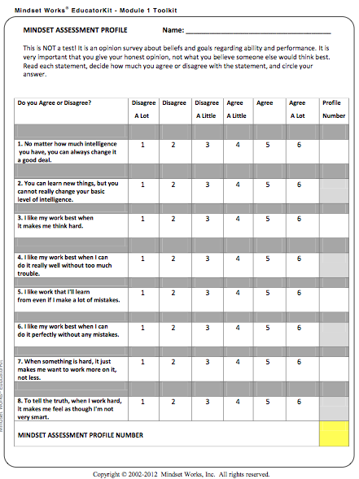
Growth Mindset Quiz
What sort of mindset are you starting with? On your seat is a quiz, complete the questions, then we will score, you don’t need to share with others!
Notes:
To start though you are going to take a very quick survey to help you gauge where your thinking is currently at, dont worry we wont be asking you to share this information, it is for your eyes only. Please take a few minutes to complete this form and then we will let you know how to score it.

Slide 3
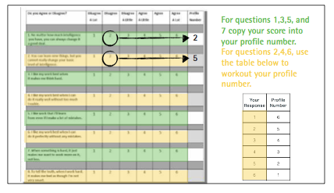
How is your mindset?

Slide 4
WHAT IS GROWTH MINDSET?!
FIXED MINDSET Basic abilities, intelligence, talents are fixed traits - have a set amount and that is that Goal is to look smart all the time and never look dumb or like you cannot do something straight away | GROWTH MINDSET Understand talents and abilities can be developed through effort, good teaching and persistence Don’t necessarily think everyone’s the same or anyone can be like Einstein, but believe everyone can get smarter if they work at it
Carol Dweck’s research, which focuses on what makes people seek challenging tasks, persist through difficulty and do well over time, has shown that many children believe their abilities are fixed, that individuals are born with gifts and can’t change. This fixed mindset thinking can be challenged by teaching children about growth midsets.
Notes:
Jason

Slide 5
Values and Beliefs
Where will Growth Mindset fit in?
Respect Responsibility Opportunity
Arohanui Community Quality
Notes:
Jason - our KNS values and beliefs are living in our school culture, they are spoken about, referred to and celebrated each day. With new learning and research comes and opportunity to consider whether we need to review and update our language to fit what we now know. We would like to embed our growth mindset learning within our already living values and beliefs - make them visual and part of our daily language - not an add on. When looking at our values and beliefs we have initially identified our quality and responsibility values and beliefs as areas where a belief about growth mindsets to help you learn may best fit to compliment our social and personal values and beliefs. We would like to get your input into this as parents and caregivers which we will start to do late tonight.

Slide 6
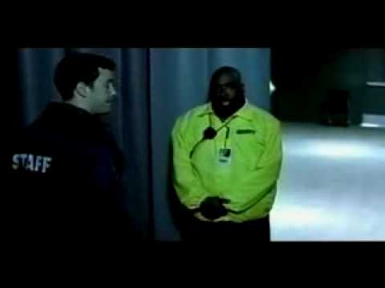
A Favourite Failure?!
Notes:
Jason - one of my idols growing up in the 1980’s was Michael Jordan who is widely known as one of the best basketball players ever. He could do it all - dribble, shoot, slamdunk taking off from the free-throw line,, shoot the game winning shot and the Chicago Bulls won lots of NBA titles. Then a few years later this comercial was produced …….watch……. this really hit home to me the importance of experiencing and learning from failure and mistakes. Michael Jordan who is widely known for his success valued learned from failure - what a great message for us all!

Slide 7
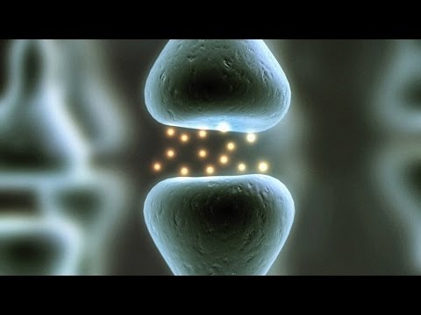
What is a Growth Mindset
Notes:
Carol Dweck - widelty regarded as one of the world’s leading researchers in the fields of personality, social pyschology and developmental psychology. Here she is talking about what she has learnt about growth mindset.
Stop at 6:36

Slide 8
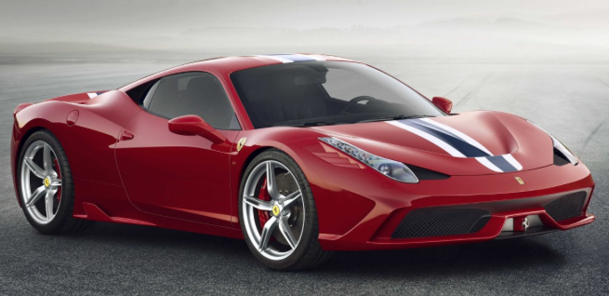
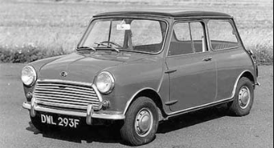


Ferrari vs Mini
Notes:
Tania

Slide 9
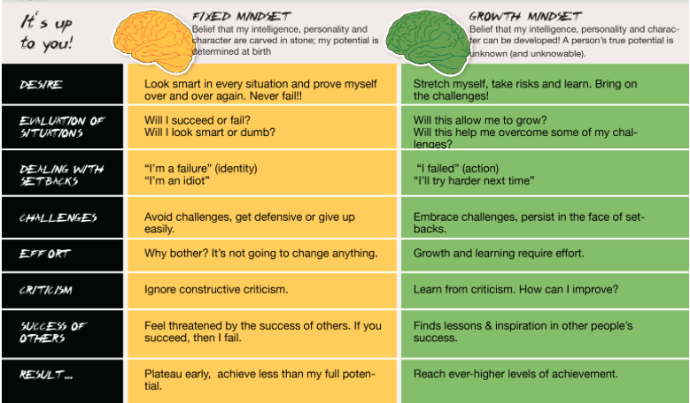
Fixed Mindset vs Growth Mindset
Notes:
Felicity have as a handout too

Slide 10
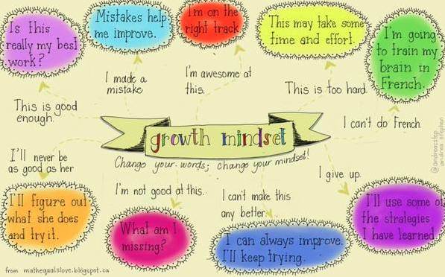
What children can say….
Notes:
Felicity print too

Slide 11
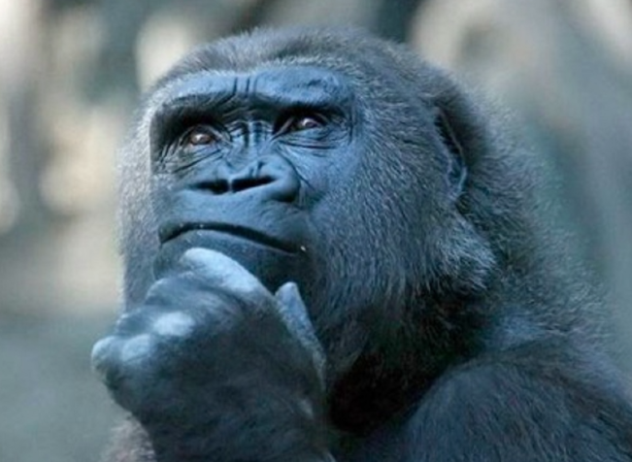

Time for Reflection….
Consider aspects that you can think of a struggle in the past and what you might do differently.
Think of messages you have been giving your children around what you are “not so good at”
Notes:
Tania : two different thoughts, from their own experience and from something from their children
thenStikcy note in the groups they are sitting in - Tania

Slide 12
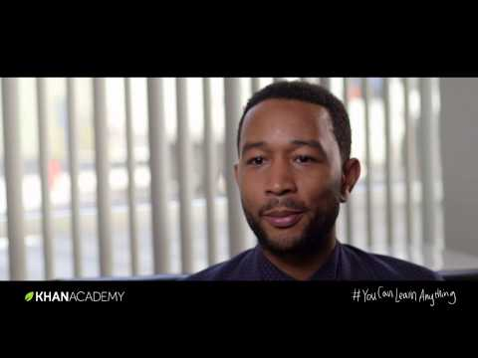
From failure to success
Notes:
Tania

Slide 13
Growth Mindset Praise….
Process Praise: “The wrong kind of praise creates self-defeating behaviour. The right kind motivates students to learn.” Carol Dweck.
Process Praise Focuses on:
effort and struggle
strategies and choices
choosing difficult over easy
persistence
resilience
improving
learning
Process praise sounds like…..
“ You really studied for you English test, and your improvement shows it. You read the material over several times. outlined it and tested yourself on it. That really worked!”
“I like the way you tried all kinds of strategies on that math problem until you finally got it.”
“It was a long, hard assignment, but you stuck to it and got it done. You stayed at your desk, kept your concentration and kept working. That’s great!”
“I like that you took on that challenging project for your science class. It will take a lot of work doing the research, designing it. You’re going to learn a lot of things.”
Notes:
Felicity

Slide 14
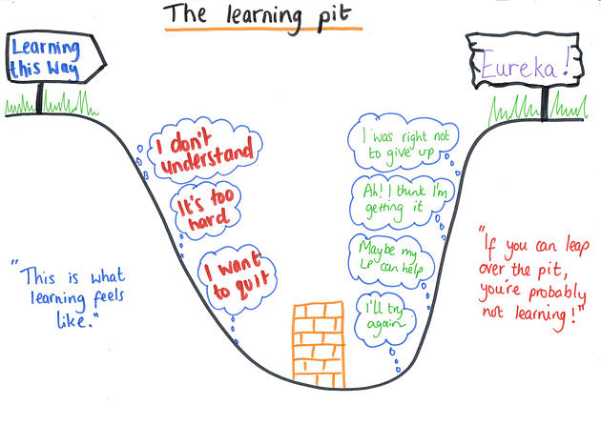
Learning Pit...
Notes:
Felicity to organise some students to do this

Slide 15
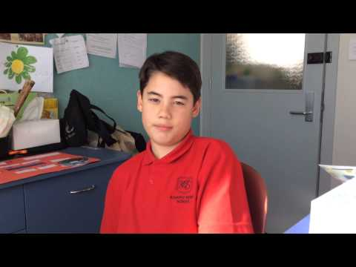
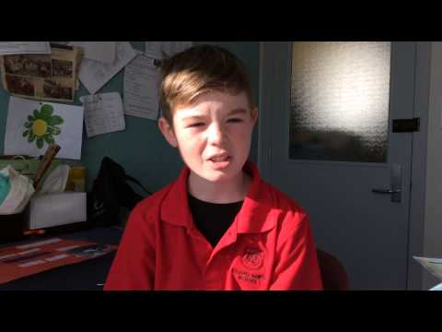
What the students think about the learning pit...

Slide 16
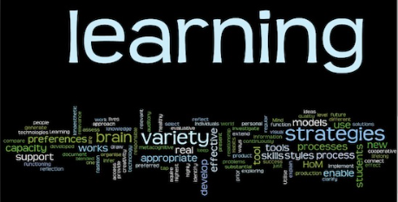

Mindset Suggestions for Parents
“If parents want to give their children a gift, the best thing they can do is to teach their children to love challenges, be intrigued by mistakes, enjoy effort, and keep on learning.” – Carol Dweck -
Notes:
More detailed suggestions follow for if we have time - things parents can take away with them - I will print these out and shrink on to a handout!!

Slide 17
Have Daily Learning Discussions
“What did you learn today?” “What mistake did you make that taught you something? “What did you try hard at today?”
It’s really important that you share what you have learned, too.
This models for kids that you learn new things every day, even learning from failures.
When children share, you can reply like this:
“You certainly did get smarter today.”
“I like the way you tried all kinds of strategies on that math problem until you finally got it right.”
“We all have different learning curves. It may take more time for you to catch on to this and be comfortable with this material, but I you keep at it like this you will.”
“Everyone learns in a different way. Let’s keep trying to find the way that works for you.”
(These are direct quotes from Mindset by Carol S. Dweck, Ph.D.)

Slide 18
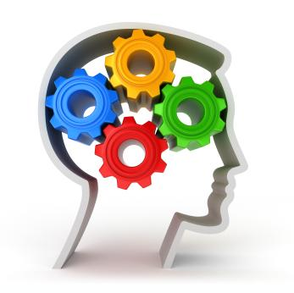
Parent/caregiver voice
I can grow my brain…….
Be:
CHALLENGED CURIOUS
INSPIRED RESILIENT
BRAVE PERSISTENT
DETERMINED POSITIVE
ENCOURAGED UNIQUE
COURAGEOUS ____________?
Strive for Personal Excellence
DREAM BIG!
Notes:
Jason

Slide 19
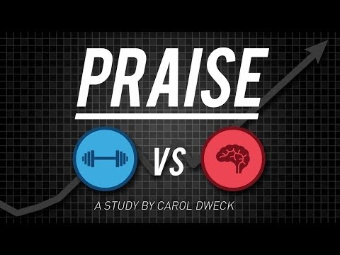
Give Feedback on Process Only
Praise effort, persistence, strategies, seeking challenges, setting goals, planning, or using creative strategies.
Don’t praise personal abilities like being smart, pretty, or artistic. This kind of praise actually can lead to a loss of confidence since kids won’t be smart at everything. They’ll doubt their ability to be good at something that is difficult initially.
Salman Khan recently wrote that he will never tell his son
he’s smart for this very reason.
He shares, “Between the deep body of research on
the field of learning mindsets and this personal experience
with my son, I am more convinced than ever that mindsets
toward learning could matter more than anything else we teach.”

Slide 20

Teach Them About Growing Brains
Explain to kids how the brain can grow stronger and that
intelligence can improve throughout your life.
Intelligence is not fixed. It’s changeable.
This is called brain plasticity.
What’s more, learning CHANGES our brains.
Kids need to know this is possible.

Slide 21
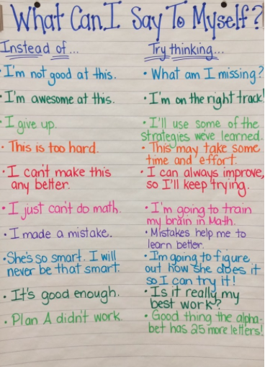
Encourage and Model Positive Self Talk
Self Talk is where it all starts...

Slide 22
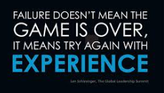
Encourage Risk, Failing and Learning from Mistakes
Failure teaches our kids important life lessons. For one, it’s how they learn resiliency
But we often want to prevent our kids from failing, from feeling upset or sad. Don’t.
We must let our kids fail now so that they can strengthen their growth mindset muscles.
If we don’t, they will be adults with no perseverance, with no belief in their abilities to work hard and succeed.
And if when your child fails, celebrate the lessons in the failure.
Tell them about all the famous people who failed and didn’t give up.

Slide 23
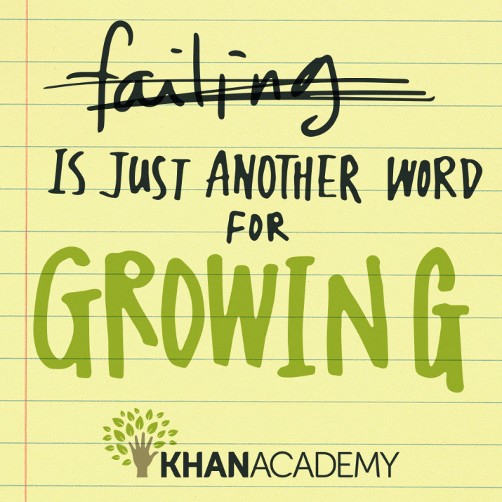
Conquering the “F” Word

Slide 24
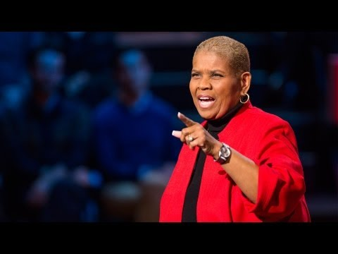
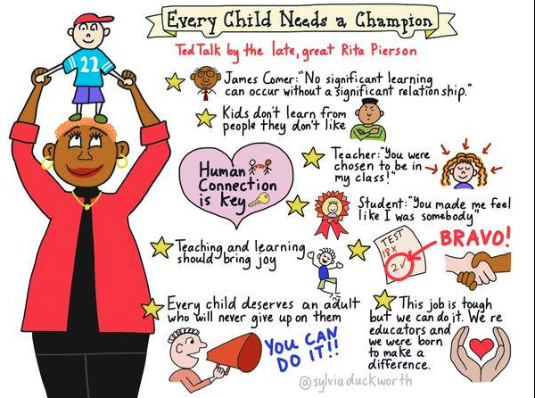
Every Child Needs a Champion!
Notes:
put pic and ted talk (incase we have extra time)

