Slide 1
2016
Colours Assembly

Slide 2
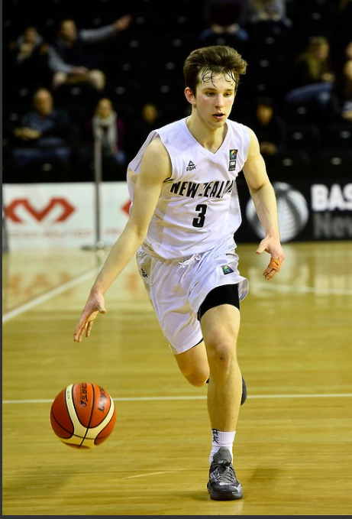
Quinn Clinton
Basketball

Slide 3
Quinn Clinton
School / Club:
Captain CBHS Senior Basketball team
Winner pre-season Dowson tournament
Winner Thompson trophy cup, winter season 2016
Winner Secondary School South Island Premiership
7th NZ Secondary School’s tournament
Mainland Eagles, 1 December to current, competed in Tarkanian Classic (13 points, 6 rebounds, 3 assists)
Regional
Under 19 Canterbury Selected Representative

Slide 4
Quinn Clinton
National
Canterbury Rams, Point Guard, 2nd season, debuted winter 2015
Under 19 Junior Tall Blacks Development Squad, 9 October to current, competed in U23 Nationals tournament, Tauranga
Competing in Under 19 FIBA World Championship Qualifying Round, Fiji, December 2016
Recognised as Tall Black Legend
International
Invited, Nike All Asia tournament, Beijing, June 2016
Invited, Basketball Without Borders, Melbourne, July 2016, MVP All Star final game
Invited, LivOn team, Adidas Global Nations tournament, Long Beach, California, August 2016

Slide 5
Quinn Clinton
Basketball

Slide 6
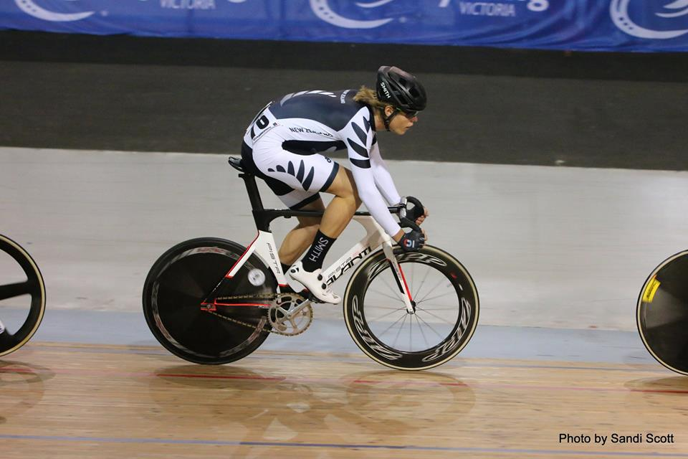
Hugo Jones
Cycling

Slide 7
Hugo Jones
School/Club
South Island Schools Road Champs U20
1st team Time Trial
1st Individual Time Trial (Course Record)
Cuddon Schools Tour U20
1st place General Classification
1st place Sprint
1st place Hill Climb
1st Canterbury Schools Cycling 8km Individual Time Trial Course Record.
Regional
Canterbury Club Road Championships
1st Place Road Race (U19 and Open Men)
1st Place 25km Individual Time Trial (Course Record) (U19 and Open Men)

Slide 8
Hugo Jones
National
NZ Secondary School’s Road Nationals
3rd place U20 Team Time Trial
International
Selected in the U19 NZ Track Cycling Team
Represented NZ at the International Track Series in Melbourne
2nd Place Reverse Elimination
6th Place Scratch Race
3rd Place Team Pursuit

Slide 9
Hugo Jones
Cycling

Slide 10
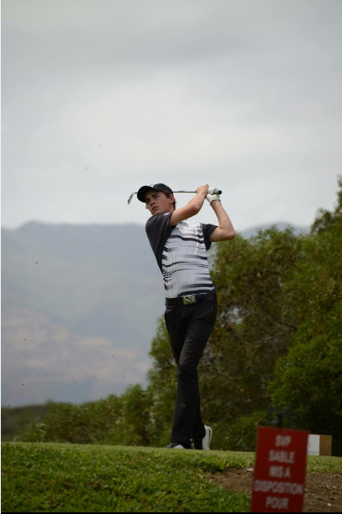
Tom Parker
Golf

Slide 11
Tom Parker
School / Club
CBHS School Golf Champion (holder of the Hope Salvour)
CBHS Golf Team (Captain)
Member of the Christchurch Golf Club Men’s Woodward Cup Team (Men’s interclub team)
Regional
1st Canterbury Golf U19 Order of Merit (OOM)
3rd Canterbury Golf Men’s OOM
3rd in Vardon Trophy (for lowest stroke average over all Canterbury Golf Men’s OOM events)
1st Canterbury Golf Men’s 4 Ball Best Ball
Canterbury Golf Junior Male Golfer of the Year
Canterbury U19 representative

Slide 12
Tom Parker
National
1st Faldo Series New Zealand Championship (u17)
2nd Lydia Ko North Harbour Age Group Championships (u19)
5th North Island Age Group Championships (u19) (2nd u17)
2nd South Island Age Group Championships (u19) (2nd u17)
6th New Zealand Age Group Championships (u19)
(2nd u17) 14th New Zealand Men’s Stoke Play Championships
Reached final qualifying for BMW NZ Men’s Open
Qualified for the NZ Amateur golf tournament in Wellington.

Slide 13
Tom Parker
International
New Zealand Junior Development Team representative for South Pacific Junior Open (Aug ’16)
New Zealand Junior Team representative for Srixon Junior International (Oct’ 16)- 8th overall (u18) and 2nd u17. The event included 145 boys, including Australia's top ranked juniors, as well as players from NZ, China, Japan, Thailand and a few other countries.
1st South Pacific Junior Open, New Caledonia (u18)*
3rd Faldo Series Asia Grand Final, Mission Hills, China (u17)
42nd IMG Junior Worlds, San Diego, USA (u18)
6th Worlds Stars of Junior Golf, Las Vegas, USA (u17) * and received an exemption (invitation) to play South Pacific Men’s Open, an Australian PGA Tour (professional) event, in New Caledonia from Sept 21-24
South Pacific Men’s Open rounds of 73 and 74 and missed the cut by one, ending up tied for 58th and 4th best amateur.

Slide 14
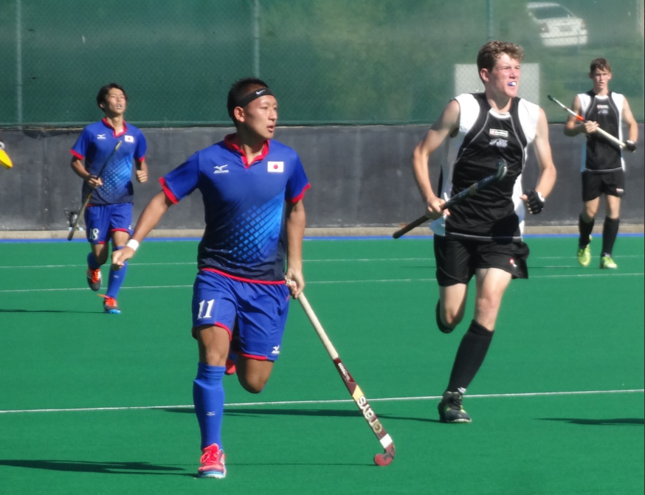
Moss Jackson
Hockey

Slide 15
Moss Jackson
School / Club
Co-captain of CBHS 1st XI
Member of HSOB/Burnside Premier Men’s Team
Regional
CBHS 1st XI – 1st in Canterbury Super Six Secondary School Competition, 3rd in Canterbury Secondary Premier League
HSOB/Burnside Premier Men’s Team: 3rd in Canterbury Premier Men’s Competition
Umpiring – Canterbury Hockey Most Improved Open Male Umpire

Slide 16
Moss Jackson
National
Member of Canterbury U21 Regional Men – 1st at National U21 Regional Men’s Tournament
Member of Canterbury U18 Regional Men – 8th at National U18 Regional Men’s Tournament
Co-Captain of CBHS 1st XI – 8th at National Secondary School Boys Tournament, Top field goal scorer of entire tournament (11)
International
Member of New Zealand U19 Junior Black Sticks Squad – Played against Australia and Japan in QLD, Australia

Slide 17
Moss Jackson
Hockey

Slide 18
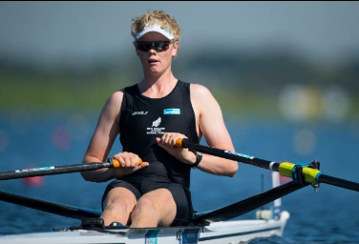
Angus Foster
Rowing

Slide 19
Angus Foster
Regional
Meridian South Island Rowing Champs (Club), 30 Jan 2016
Silver, Open Men’s Double
Silver, Open Men’s Eight
Meridian South Island Secondary Schools Champs, 19 March 2016
Gold, U18 Quad
Gold, U18 Double
Silver, U18 Eight

Slide 20
Angus Foster
National
Bankstream NZ Rowing Champs (Club), 1 Feb 2016
Gold, U19 Men’s Double
Aon Maadi Cup (Schools), 4 April 2016
Gold, Boys U18 Quad
Gold, Boys U18 Double
Bronze, Boys U18 Eight
International
Competed at Junior World Champs, Rotterdam, Netherlands
Placed 19th out of 30, winning the D-final in the single skulls

Slide 21
Angus Foster
Rowing

Slide 22
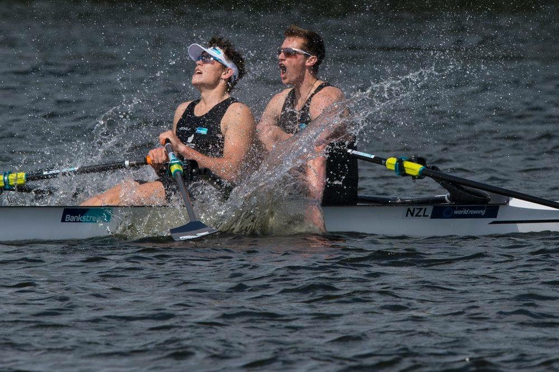
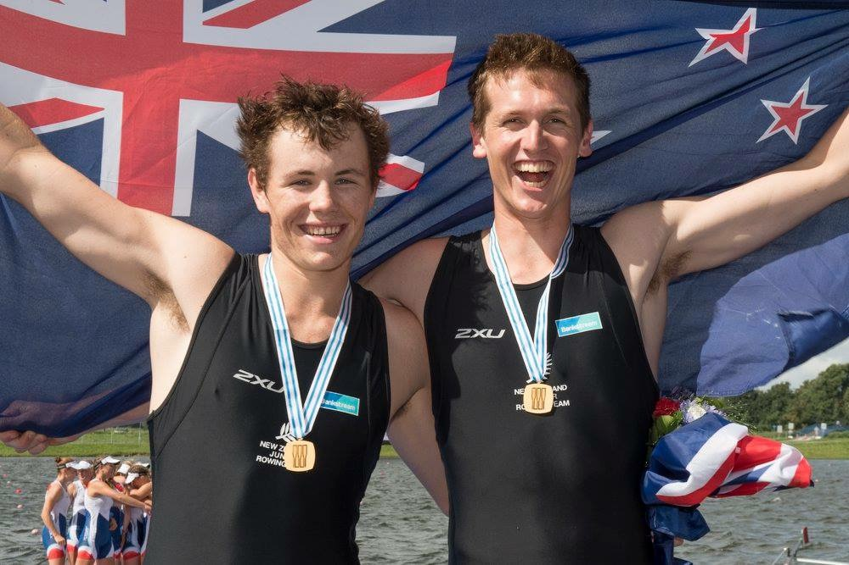
Jack Lopas
Rowing

Slide 23
Jack Lopas
School / Club
Awards
Senior Rower of the Year, Christchurch Boys’ High School
Junior Rower of the Year, Canterbury Rowing Association
Regional
Meridian South Island Rowing Champs (Club), 30 Jan 2016
Silver, Open Men’s Double
Silver, Open Men’s Eight
Meridian South Island Secondary Schools Champs, 19 March 2016
Gold, U18 Quad
Gold, U18 Double
Gold, U18 Single
Silver, U18 Eight

Slide 24
Jack Lopas
National
Bankstream NZ Rowing Champs (Club), 1 Feb 2016
Gold, U19 Men’s Double
Aon Maadi Cup (Schools), 4 April 2016
Gold, Boys U18 Quad
Gold, Boys U18 Double
Gold, Boys U18 Single
Bronze, Boys U18 Eight
International
Competed at World Junior Rowing Championships, Rotterdam, 28 August 2016
Gold in the Junior Men’s Double Sculls

Slide 25
Jack Lopas
Rowing

Slide 26
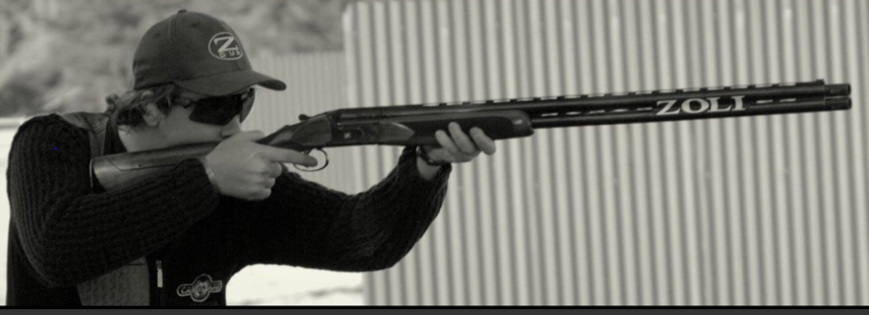
Harry Denton
Shooting

Slide 27
Harry Denton
School/Club
2nd Boys Single Rise Canterbury Circuit
9th Boys Single Rise NZ Champs
Regional
1st AA grade (2nd overall) & 1st Junior North Island South Zone
1st AA grade (2nd overall) & 1st Junior South Island North Zone

Slide 28
Harry Denton
National
1st Junior South Island Compak Champs
2nd Junior (1st New Zealander) North Island Sporting Champs
2nd Junior (1st New Zealander) NZ Sporting Champs
Currently ranked 3rd to qualify for the NZ elite men's team and 1st for the NZ Junior (under 21) team
International
Top qualifier for NZ Junior team for Oceania Championships
NZ were the 2nd Junior team Oceania Championships

Slide 29
Harry Denton
Shooting

Slide 30
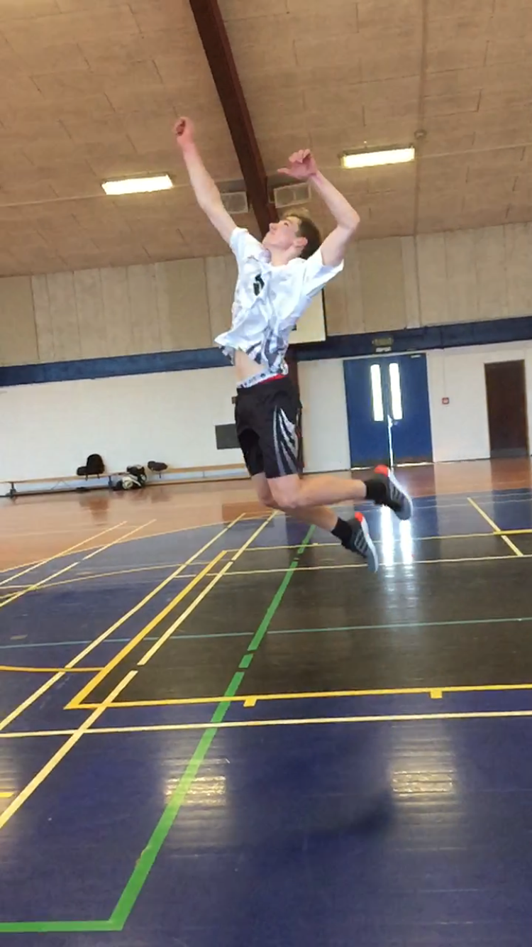
Fraser Canning
Volleyball

Slide 31
Fraser Canning
Canterbury Secondary School’s tournament team.
Member of Shirlley men’s A team for the NZ club Volleyball Nationals in Wellington.
Canterbury U19 volleyball team.
NZ U19 development team for a second year and travelled to an Australian state tournament on the Gold Coast. Started every game.

Slide 32
Fraser Canning
Volleyball

Slide 33
Special Awards
Service to Sport

Slide 34
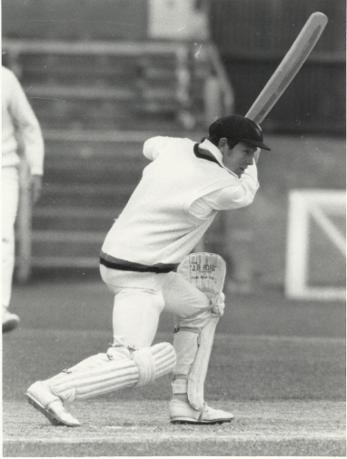
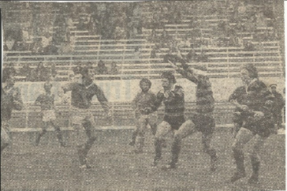

Slide 35
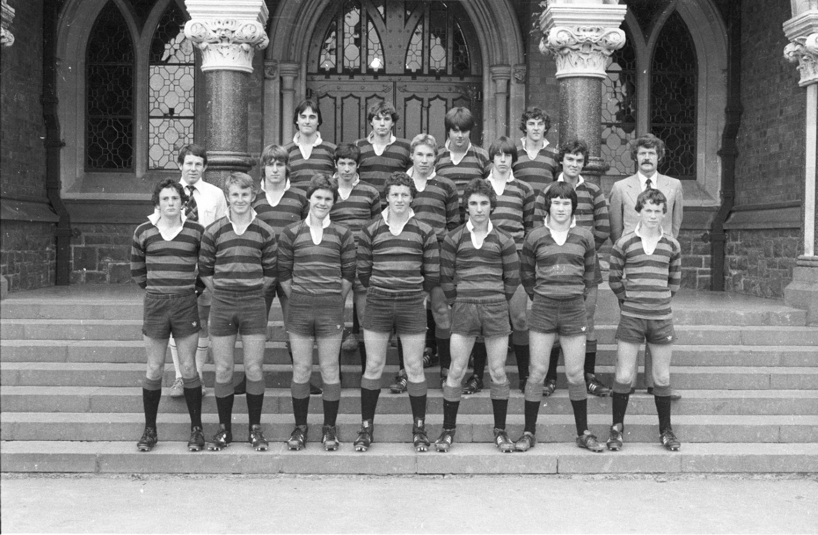

Slide 36
Mr Thomas
Sports Coordinator for 1990 and from 1993 to 1997 inclusive
Coaching involvement.
1. Cricket
Took 1st X1 for 3 years: 1985, 1986 and 1987.
Took junior cricket teams 1979 -1984 and 1988 - 2001
2. Rugby
Took 1st XV for 3 years: 1988, 1989 and 1990.
Took 1st XV on tour to Australia in 1988.
Took 2nd XV 1985, 1986 and 1987.
Took 3rd XV 1981, 1982, 1983 and 1984.
Took junior team 1979, 1980, 1991 and 1992.

Slide 37
Mr Thomas
3. Trap Shooting
TIC Trap Shooting from 2004 to 2013.
Still involved but in a limited roll in 2014 and 2015.
4. Small Bore Shooting
Was TIC for about 2 years 2002 and 2003.
5. Tennis
Looked after teams on Wednesday afternoons for about 12 years . About 2002 to 2014.

Slide 38
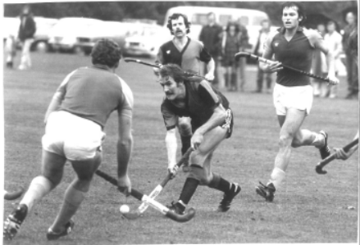
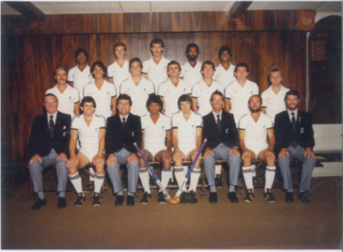

Slide 39
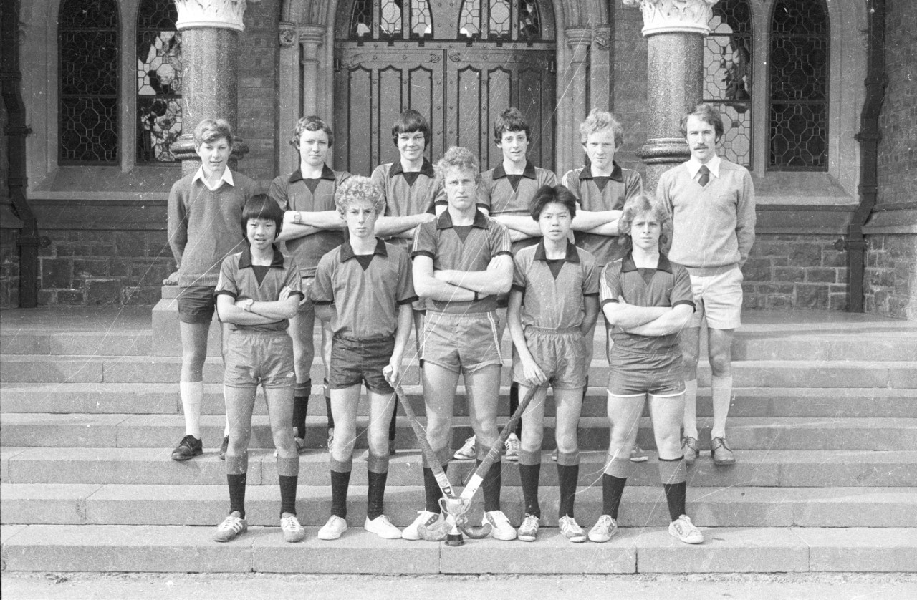

Slide 40
BURTTY
Student 1968-1972:
First XI Hockey 1969-1972
First XI Cricket 1970-1972
Staff: 1978 to PRESENT
Cricket:
NZ Under 20 Cricket Rep 1974
Coached and/or managed teams from 1978 to circa 2002
Coached Canterbury Cricket U14 Teams throughout the 1980’s that included Black Caps Nathan Astle, Stephen Fleming, Blair Hartland, Chris Harris, and Gary Stead.
Master in Charge 1982-1988
First XI Coach 1987-1992 and 2001-2002
Helped setup the Cricket Club along with Lindsay Thorn and is a Life Member of the Chch Boys’ High School Cricket Club

Slide 41
BURTTY
Rowing: Master in Charge 2004-2006
Hockey:
Has coached and/or managed teams from 1978 to 2015. CBHS have won Rankin Cup in 2010, 2000,1983, 1980 and 1978 since he has been involved in hockey.
Whilst a member of staff he also played 18 Hockey Tests for New Zealand beginning in 1978
First XI Coach: 1982 to 1988 then 1994 to 1996
Master in Charge of Hockey: 1992 to 1998 and then 2000 to 2015
Set up the CBHS Hockey Club in 1998.

Slide 42
BURTTY
Hockey Continued:
Organised 3 Rankin Cup Tournaments in Christchurch including the draw for 1989 Tournament, which was the first played entirely on artificial turf.
Was a member of the NZ Hockey Review Committee with Barry Maister old boy and Gold Medal winner and Glenn Turner (famous cricketer) that wrote the junior and youth hockey programmes in 1988. This is still the driver of hockey development today

Slide 43
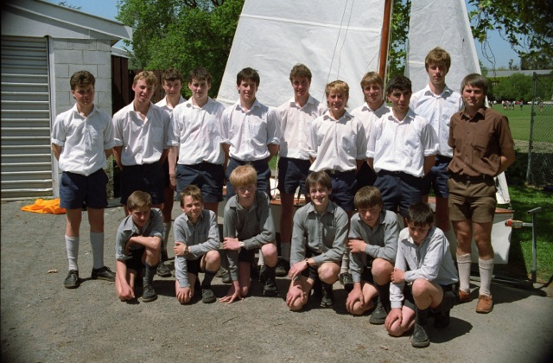
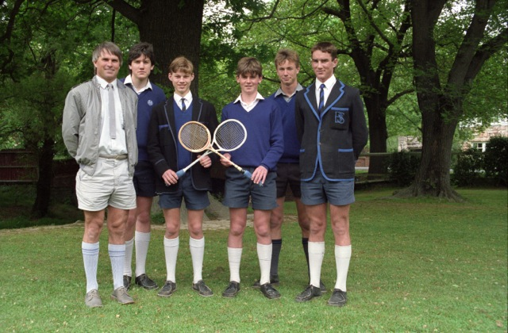

Slide 44
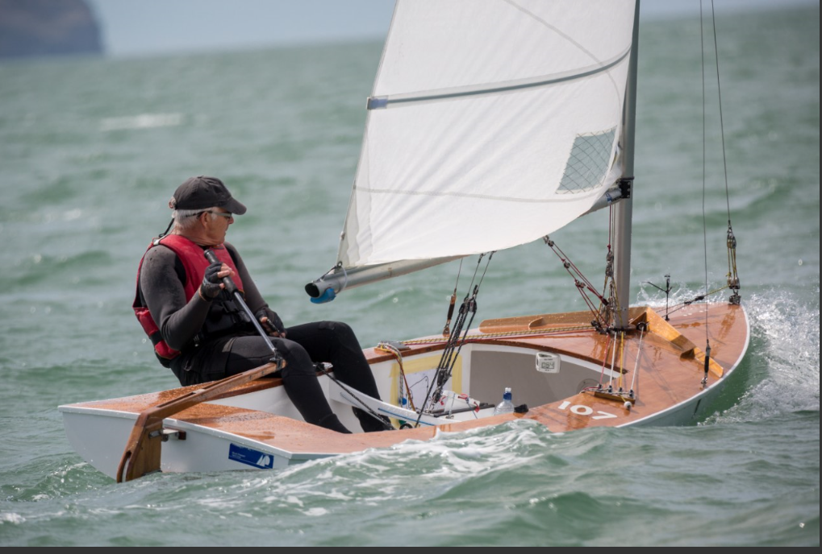

Slide 45
Mr Bird
Rowing
Coach of the U17 rowing team at Kerr’s Reach 1980
Coach of A rowing team 1980-1981
1980-1982
Maintained rowing shells
Organised fundraised for equipment during the winter months including collecting recycling material in the Hoon Hay area.

Slide 46
Mr Bird
Yachting (1984 -1990) & (1997-2001)
Master in Charge yachting (1985-1990, 1997-2001)
Maintained the school yachts during the winter months
Assisted with yachting (1994-1996)

Slide 47
Mr Bird
Master in Charge of Squash (1997-2003)& (2005-2011)
Won 7 Canterbury titles 2005-2011
2009, 2010, 2011 National Squash Champions
2009 – 2010 – Toured US/UK
2012 – Toured Malaysia
Chaired fundraising committees 2008 – 2012 – raised $7,000 per pupil during this time
2005-2011 – won 7 South Island titles consecutively
2012 -2013 Organiser of summer and winter social squash.

