Slide 1

Thought for the day
So far today I’ve done all
right. I haven’t gossiped, I
haven’t lost my temper, I
haven’t criticised or moaned.
I haven’t been snappy, grumpy, nasty, selfish, or
over indulgent. I’m very
thankful for that.
But in a few minutes, I’m
going to get out of bed, and
from then on I’m probably
going to need a lot more
help!
Adapted from an original anonymous source
Notes:
Before we go further we might need to give a brief overview of who we are and our recent roles.

Slide 2

Polar Bear
Notes:
Show clip

Slide 3

Penguins
https://www.youtube.com/watch?v=c7SuIkt1k70
Notes:
Show clip

Slide 4
We plan to cover
Staff wellbeing
Student wellbeing
The importance of relationships
Learning and focus

Slide 5
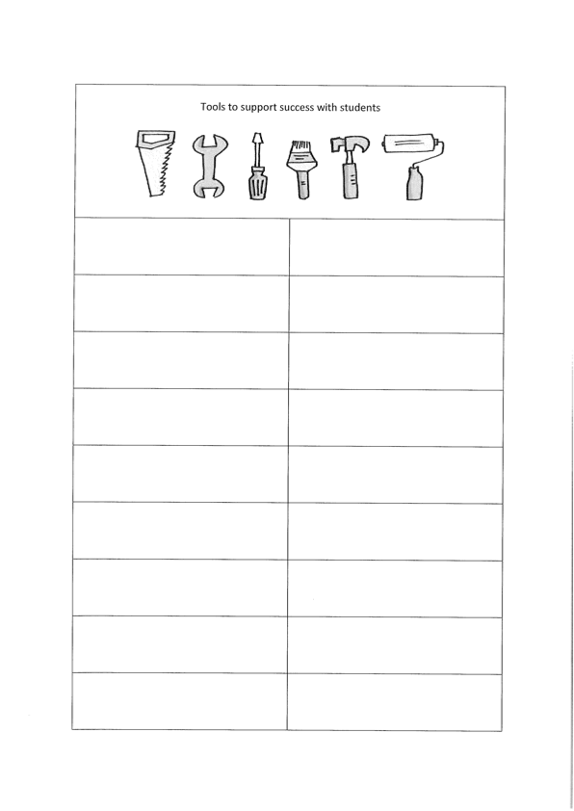
Your Toolbox
Notes:
Sandra

Slide 6
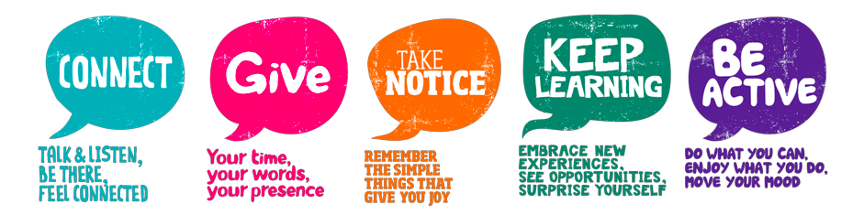
The Five Ways to Wellbeing
Notes:
Nick + notes

Slide 7
Why the Five Ways?
Like physical health, we can all benefit from looking after our mental health.
Research has identified five simple things we can do – the Five Ways*.
When practised regularly, they build resilience, boost wellbeing and offer some protection from developing mental health problems.
They’re beneficial for everyone, whether you have a mental health problem or not.
*Developed by the New Economics Foundation (UK) and adapted for New Zealand by the Mental Health Foundation.

Slide 8
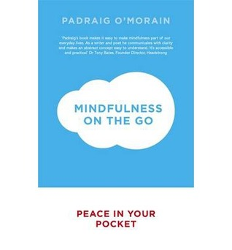
Mindfulness on the Go
Notes:
Sandra

Slide 9
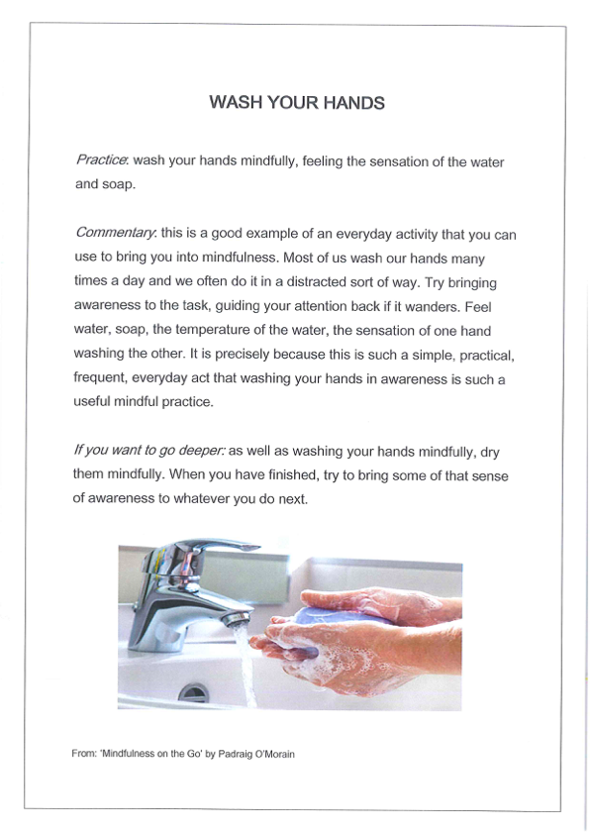

Slide 10
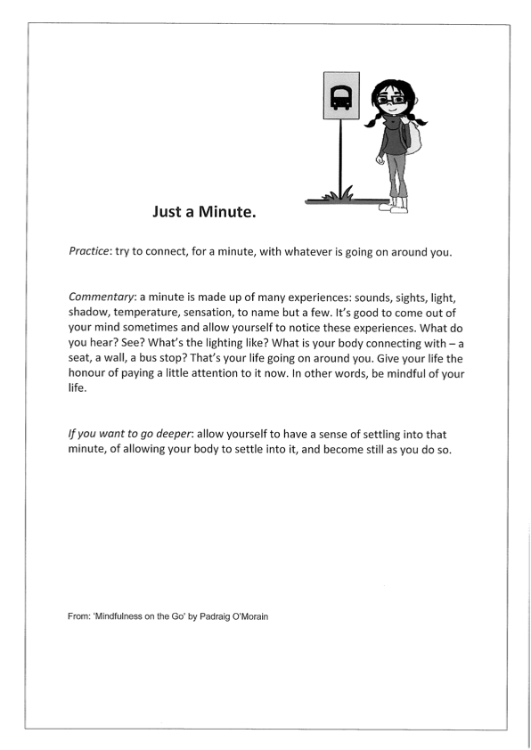

Slide 11
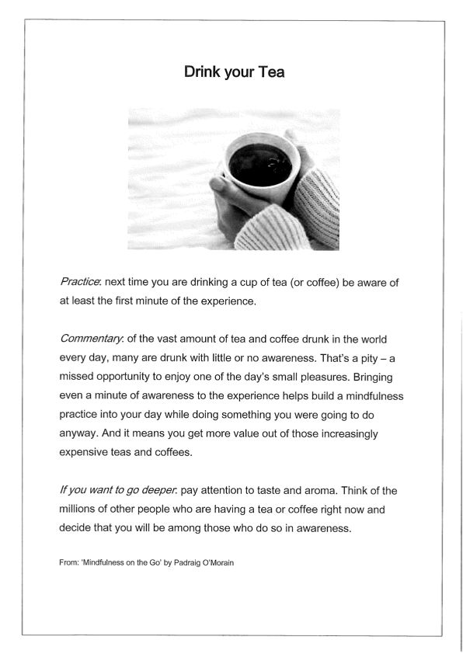

Slide 12
The Daily Gratitude Habit
The habit is super simple. Here it is…
When I sit down to eat dinner, I say one thing that I am grateful for happening today.
Each night before I go to sleep I write one good thing about my day.
Notes:
Sandra - ask group to think about something that they are grateful for. Maybe some people to share?

Slide 13
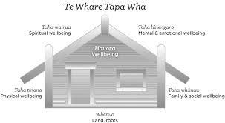
Student Wellbeing
Notes:
Sandra

Slide 14
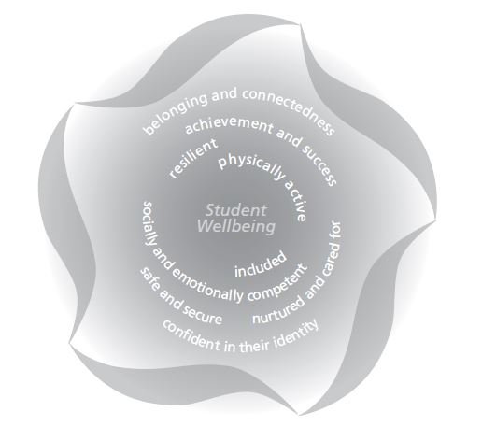
Notes:
Nick

Slide 15
About Leading Lights
Leading Lights provides guidance pathways to help teachers and other school staff in Canterbury recognise and respond to the needs of individual children in Years 1 to 8 in the following key areas:
Behaviour
Health
Learning
Safety
Wellbeing and Belonging
The pathways include clear, concise, locally-agreed information on interventions and strategies to use at school, as well as when to seek further support, who can provide it, and how to make requests.
The pathways and support pages are developed collaboratively by educators, support agencies, general practitioners, hospital clinicians, and a wide range of other education and health professionals working with specialist writers. Subscribe to Leading Lights updates to be notified when new pathways become available.
You can help us make the content even better by using the Send Feedback button (on every page) to tell us what you think, ask questions, and make suggestions.

Slide 16
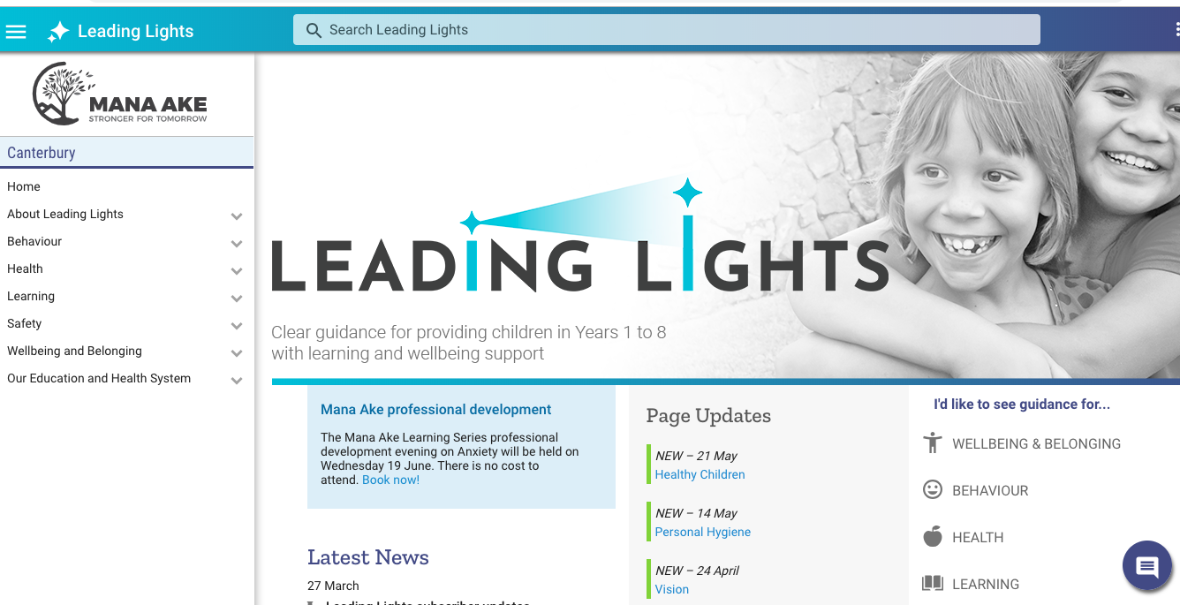
https://canterbury.leadinglights.org.nz/307.htm
Notes:
Nick + topics include:Home
About Leading Lights Behaviour Health Learning Safety Wellbeing and Belonging Our Education and Health System

Slide 17
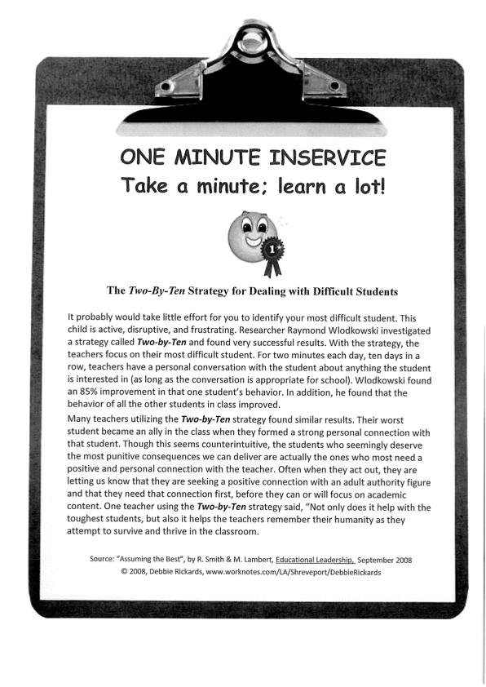
2 x 10 strategy
Notes:
Sandra

Slide 18



Building and maintaining Positive Relationships
Notes:
Nick - why it is important that the students that we work with see us with a smile each day!

Slide 19
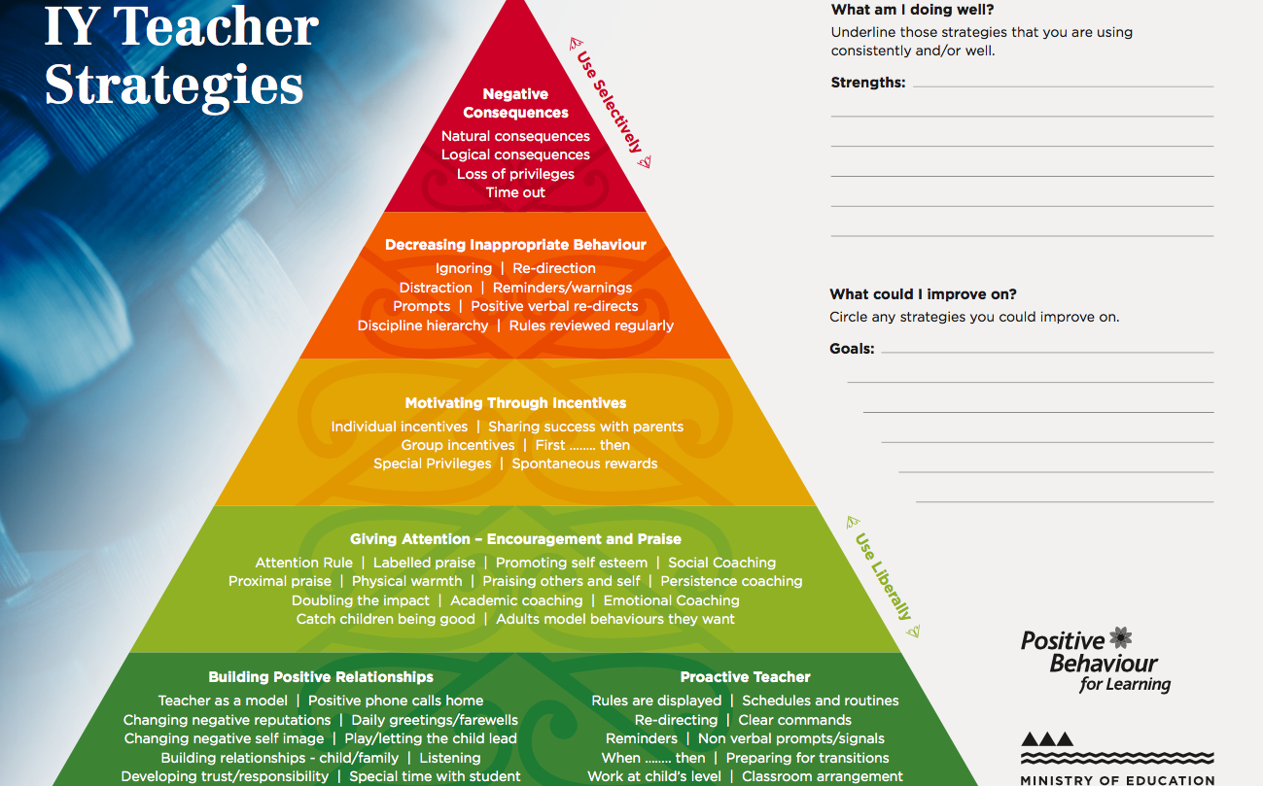
Notes:
Sandra and Nick

Slide 20
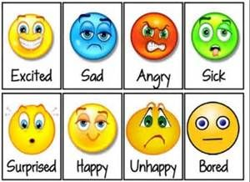
Check in
How are you feeling today?
What are you looking forward today?
How was the weekend?
What was something you enjoyed about the weekend?
Calm down kit
Notes:
Nick

Slide 21
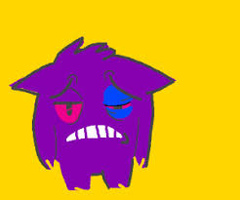
When your student is having a good day,
what does that look like?
When the same student is not having a good day,
what does that look like?
How do you approach the situation?
Notes:
Nick
Discussion with a partner

Slide 22
Have you thought about?
Movement Breaks | Memory, card or dice games
Sensory Breaks | String game
Spot the difference | Glitter Jar
Yoga for Kids | Using the senses
Breathing Exercises
Notes:
Sandra and Nick

Slide 23
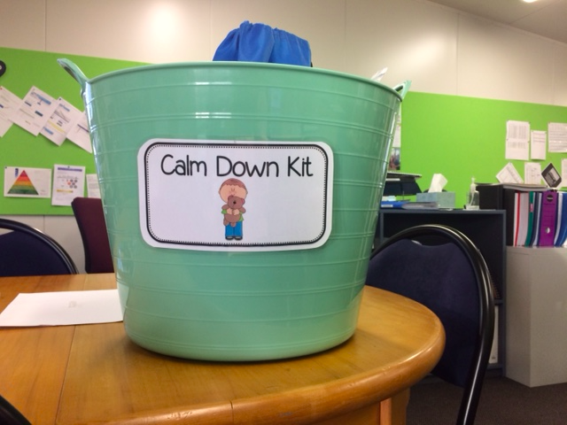
Notes:
Sandra to show the kit

Slide 24
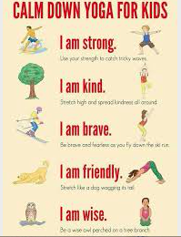

Slide 25
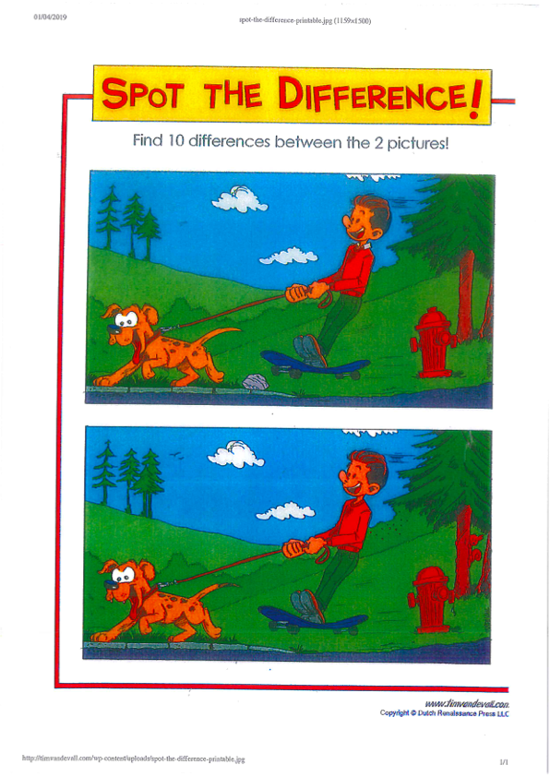

Slide 26
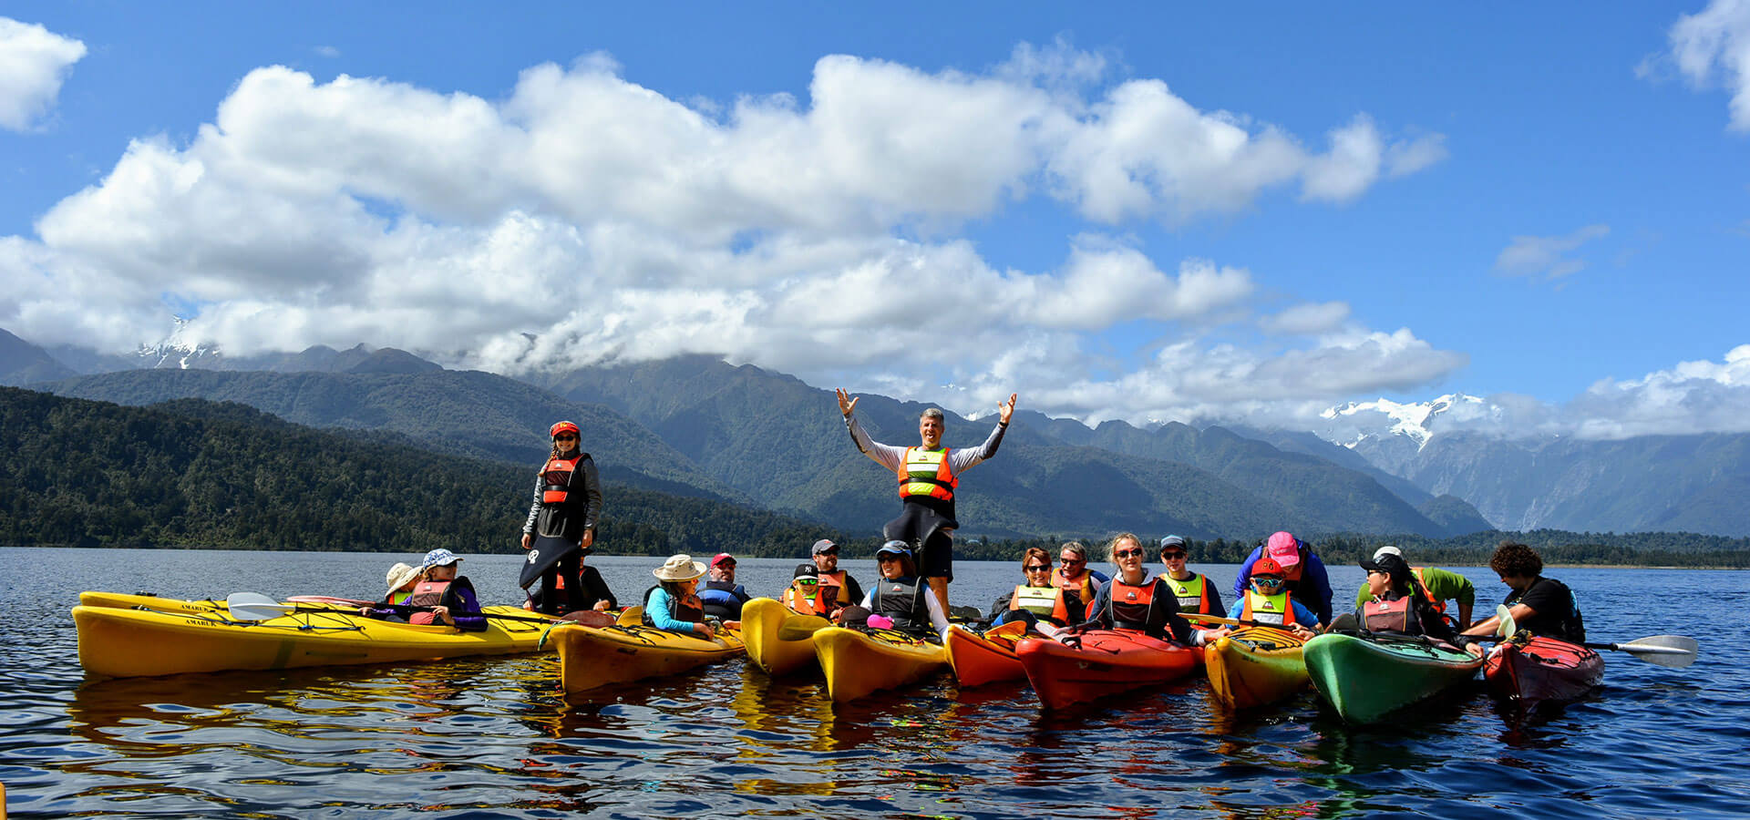

Check out
What did you enjoy about your day?
Why did you enjoy this?
What could make it even better?
I am grateful for……..
Notes:
Nick - what are you grateful for today?

Slide 27
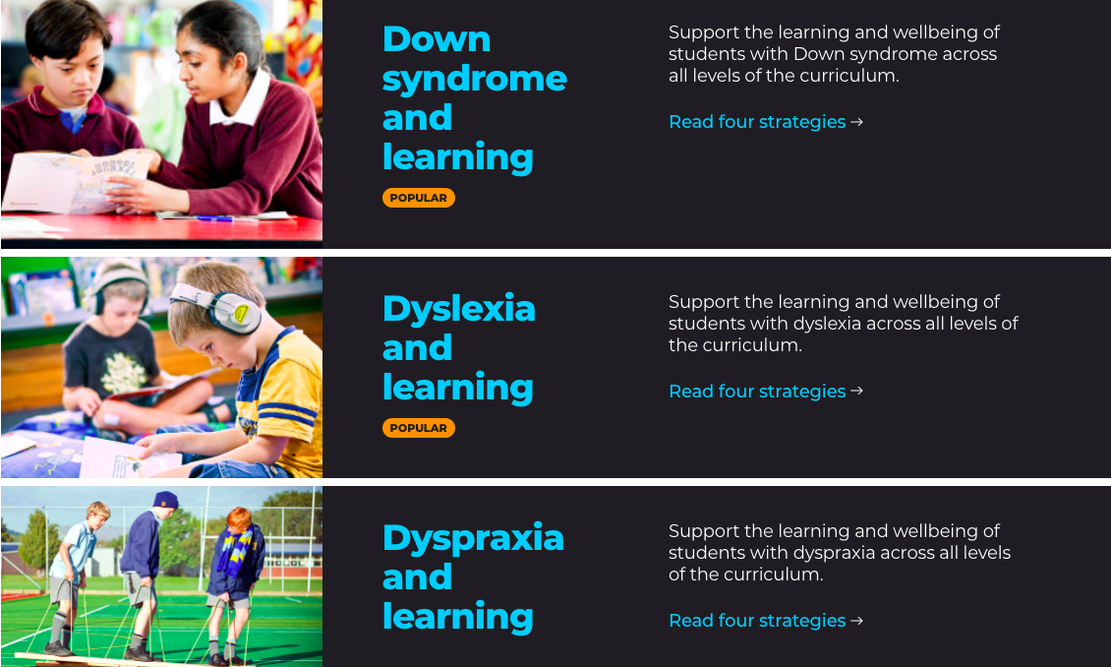
https://www.inclusive.tki.org.nz/guides/
Notes:
Nick - can show website
26 guides - including topics about ADHD - ASD and behaviour - Behaviour and Learning - Teacher Aide Practice and Inclusive classroom culture

Slide 28
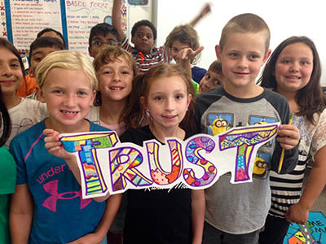
About Learning
Children learn in many different ways, e.g. by watching (visual), listening (aural), or doing (kinesthetic).
Learning requires communication, attention, organisation, and social skills.
Children do best when they:
feel connected to their family/whānau, friends, and school.
are nurtured and cared for by teachers.
feel safe and secure at school, where expectations are clear.
are involved, included, engaged, and experience success.
Leading Lights
Leading Lights
Notes:
Nick

Slide 29
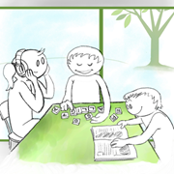
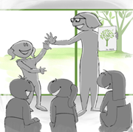
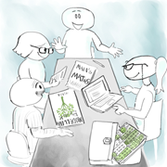
All children learn in different ways at different rates.
Children learn best when they feel engaged, valued, and supported.
Talk to other teachers about their teaching approaches and strategies.
Notes:
Nick
HOLD THIS SLIDE - and get people to guess how much students remember - immediately after learning (80%), by the time they get back from morning tea (lose another 22% - so now remember 58%), by tomorrow (only retain ⅓ of it), next week (25%) - BEFORE showing next slide.

Slide 30
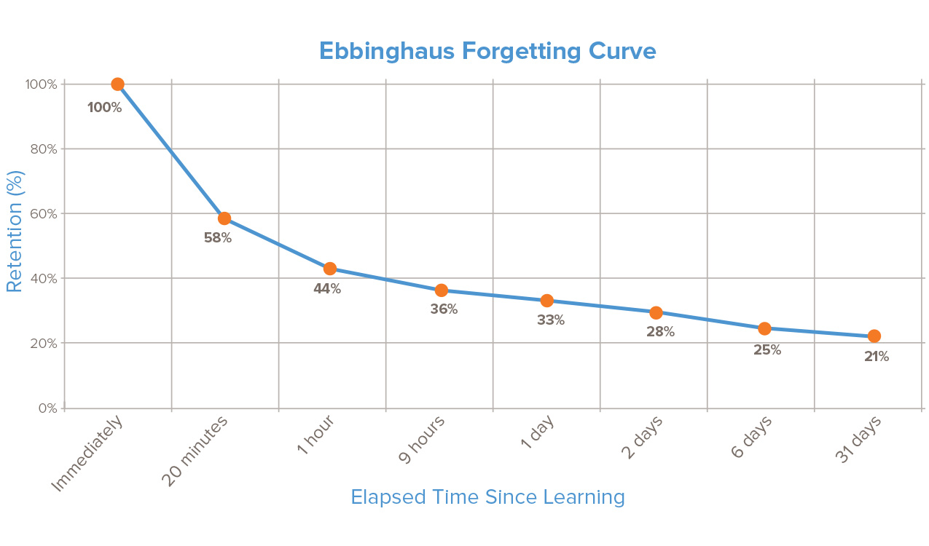
Ebbinghaus Forgetting Curve
Notes:
Sandra - The forgetting curve hypothesizes the decline of memory retention in time. This curve shows how information is lost over time when there is no attempt to retain it.
Baseline memory = chronological age + 2 in minutes eg. 5 years old + 2 = 7 minutes retention.

Slide 31
Memory lite Assessment for Learning
Failing to build in opportunities to re-visit, review and consolidate will significantly affect the impact of teaching for a majority of pupils as retention rates fall to around 58% within 20 minutes.
Pupils with poor working memories are particularly vulnerable to the Eddinghaus Forgetting Curve, which demonstrates the dangers of becoming obsessed with pace and coverage at the expense of opportunities for review and revision.
Lessons built around ‘spaced review’, is a perfect fit for pupils with poor working memories. Here a chunk of learning is reviewed and reprised before moving on, keeping the learning upper most reducing storage demands and enabling a focus on the task or process in hand.
A lesson built around a series of spaced reviews ensures that learning is organised into bite sized chunks, each of which is consolidated by review/reprise activities before moving on.
Each review has the effect of gradually flattening the forgetting curve as knowledge and skills are re-visited throughout the lesson. This ensures that, after several reviews, much of the learning is locked into long term memory.
Total Teaching - Raising the achievement of vulnerable groups - Neil MacKay

Slide 32
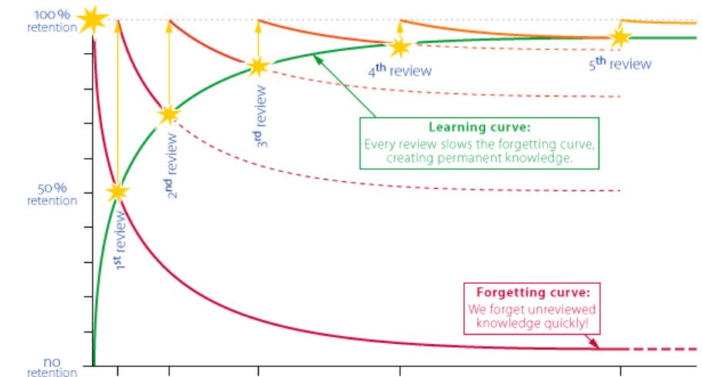
Why spaced review works ...
Notes:
Why it is important to constantly review
How can we review? Recap main points after returning from play - talk to a partner about what you learnt, summarise what you learnt in 3 sentences with a partner and then reduce it to 3 words, draw what you learnt ...

Slide 33
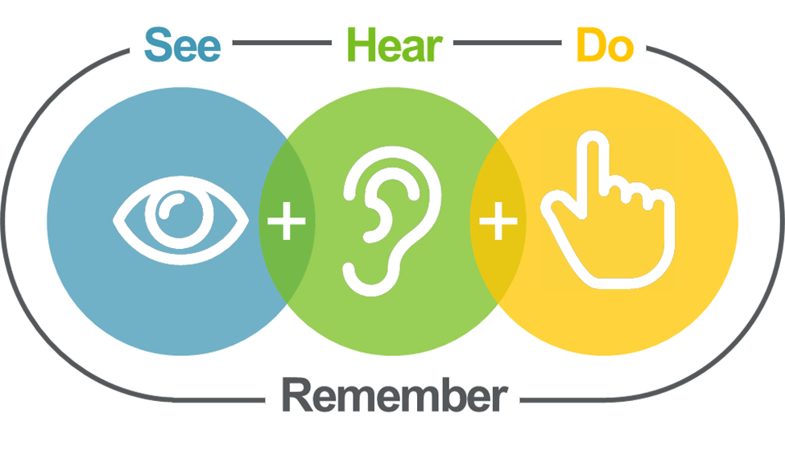
Notes:
Nick

Slide 34
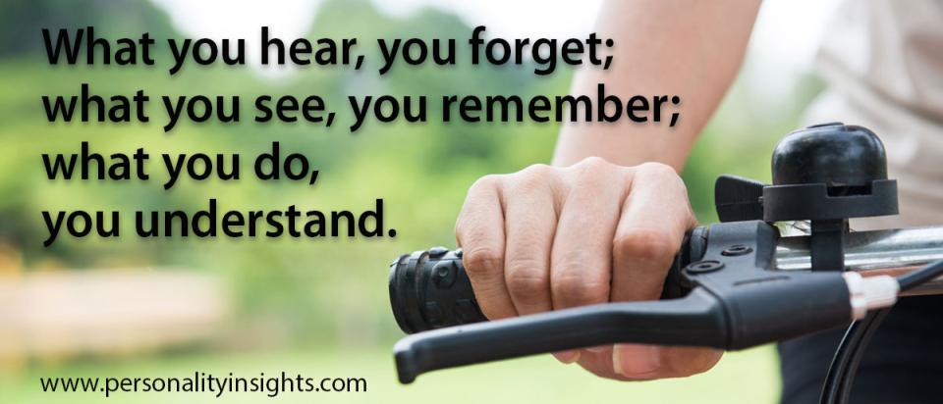
Notes:
Sandra and Nick - thank you and we hope that you have found this useful. Evaluation sheet.
Are there two things that you can take away and use next week?

