Slide 1
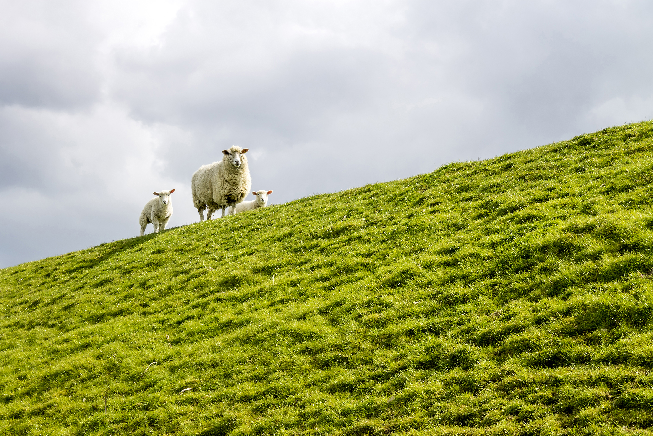

The Scattered People of the Good Shepherd 26 April 2026 Bishop Anne van Gend Acts 2: 42-47 1 Peter 2: 19-25 John 10: 1-10

Slide 2

The Scattered People of the Good Shepherd We will check in with each other from 9.45 am for any prayer requests.

Slide 3


Slide 4
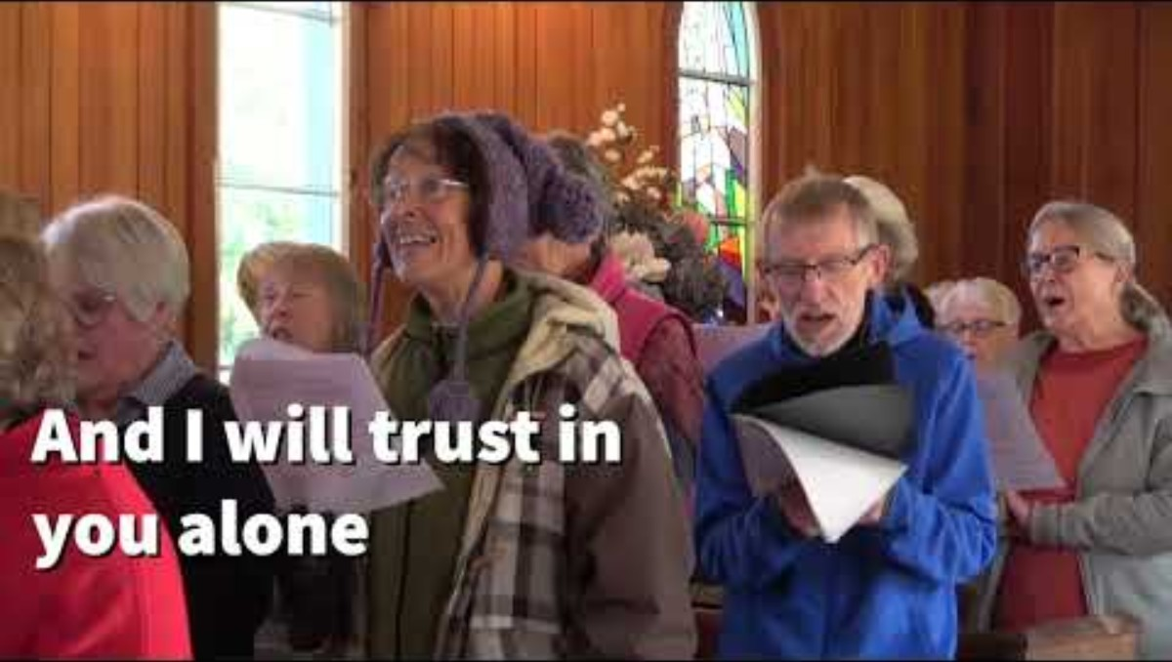

Slide 5

For individual reflection and contemplation:
What questions are this message and readings asking you?
What thought struck you most in the message today?

Slide 6
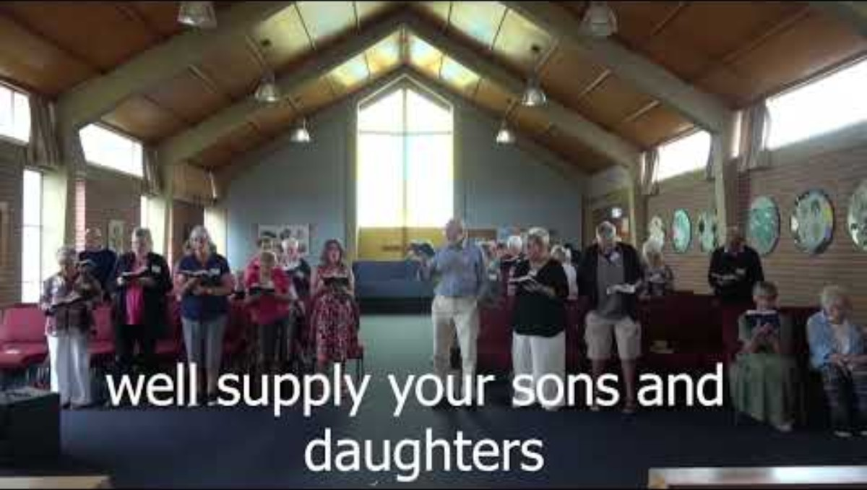

Slide 7


Slide 8


Slide 9
