Slide 1
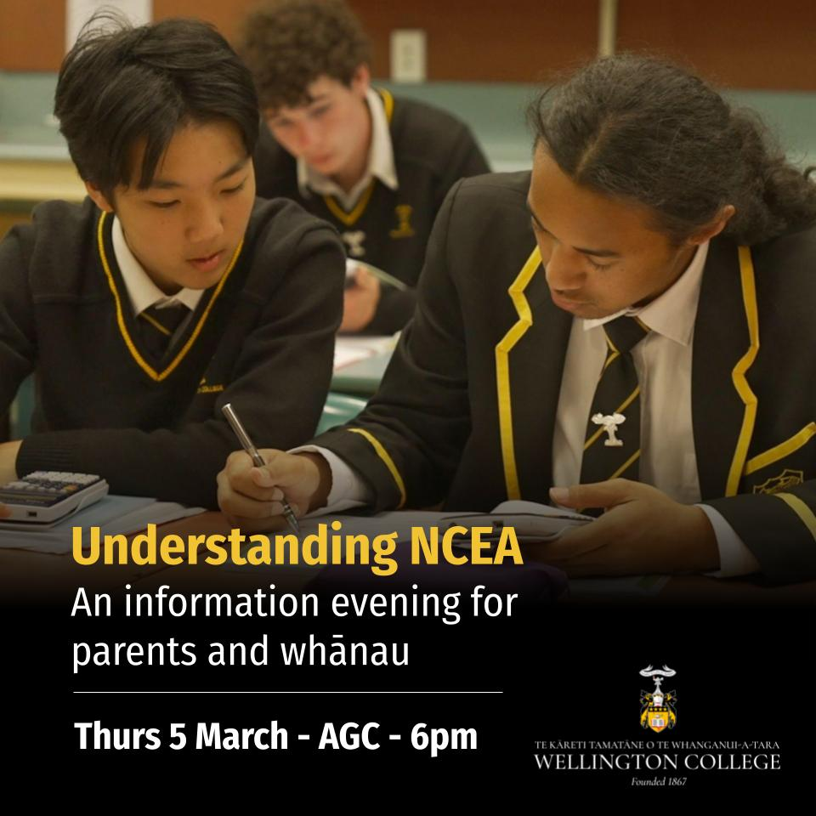

Slide 2
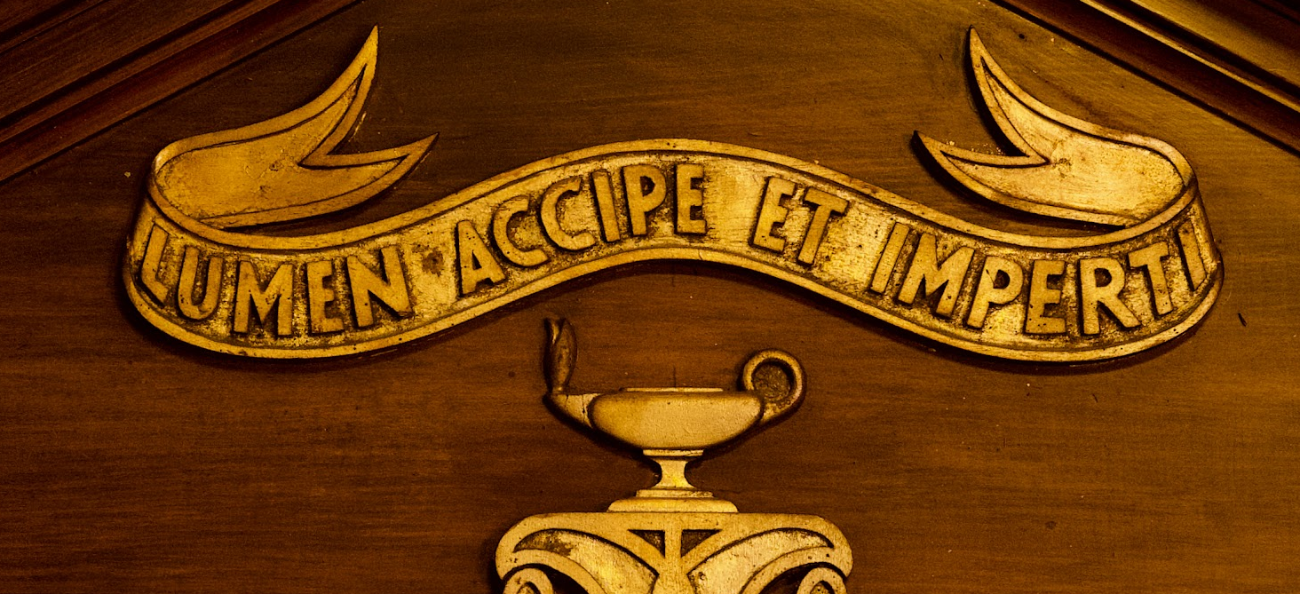
Introduction
Strategic Leadership Team (SLT)
Achievement and Attainment
Serena Lawrence
Jenna Vreeburg
Luci Lendrum
By the end of this presentation, you should have:
A clear understanding of the structure of NCEA
Decoded the language and terminology of NCEA
An understanding of assessment procedures here at WC
An understanding of how we can support our rangitahi to succeed
We will share these slides via the newsletter
We are very happy to take questions about your student’s individual situation at the end of the session
Health and safety:
Toilets are at the back (turn right and right)
Evacuate to the turf if needed - follow a staff member
November, 2023
Notes:
LL

Slide 3
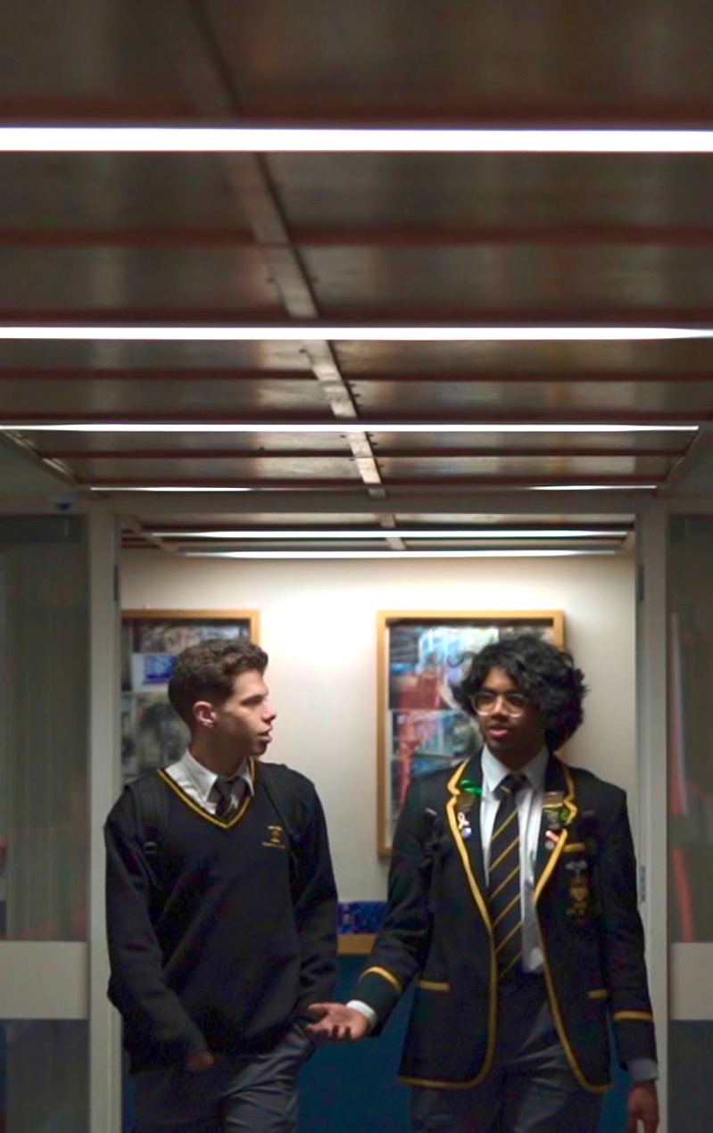
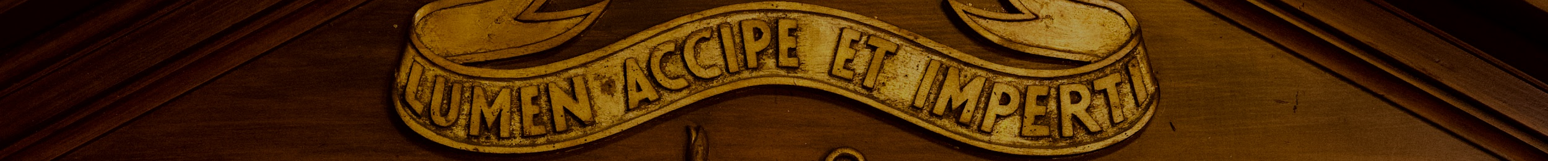

What is NCEA?
NCEA = National Certificate of Educational Achievement
Administered by NZQA (the New Zealand Qualifications Authority)
Internationally recognised
There are three levels of NCEA. Typically, students work through Levels 1 - 3 in Years 11 - 13 at secondary school.
The flexibility of NCEA allows us to deliver learning that is personal, engaging and empowering.
TE KĀRETI TAMATĀNE O TE WHANGANUI-A-TARA
WELLINGTON COLLEGE
RECEIVE THE LIGHT AND PASS IT ON
TIAHO TE AO, TIAHO TE AO MĀRAMA
November, 2023
November, 2023
Notes:
LL - Academic success is something to be proud of, and students can succeed at their own level. This contributes positively to their sense of confidence, achievement and wellbeing,

Slide 4

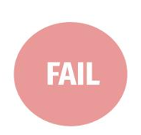
Old vs new
One exam EG: Bursary, School Cert | NCEA Grades
A 80 - 100% | E Excellence
B 65 - 79% | M Merit
C 50 - 64% | A Achieved
D 30 - 49% | N Not Achieved
E 1 - 29%
November, 2023
November, 2023
Notes:
LL - Standards based vs norm referenced, genuine contexts

Slide 5
Old vs new
Bursary (7th form) English
TOPICS | % | TYPE
Close reading | 0 | Test
Shakespeare | 0 | Essay
Language of advertising | 0 | Essay
Novel study | 0 | Essay
Non Shakespearean drama | 0 | Essay
ALL OF THEM TOGETHER! | 100% | End of year Exam
NCEA Level 3 English at WC
STANDARDS | CREDITS | TYPE
3.4 Writing portfolio | 6 | Portfolio of writing (Submitted Term 1)
3.8 Critical texts | 4 | Report (Submitted Term 2)
3.5 Oral presentation | 3 | Seminar (Submitted Term 3)
3.1 Written text | 4 | End of year Exam
3.2 Visual text | 4 | End of year Exam
RECEIVE THE LIGHT AND PASS IT ON
TIAHO TE AO, TIAHO TE AO MĀRAMA
November, 2023
November, 2023
Notes:
LL - Standards based vs norm referenced, genuine contexts

Slide 6
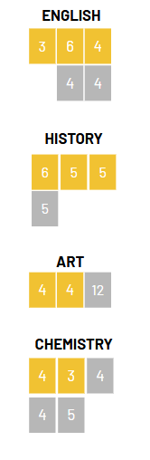
How Does NCEA Work?
Each year, students study a number of courses from different subject areas. E.g. Level 2 Maths
In each course, skills and knowledge are taught according to topics, and assessed against a number of standards. For example, a Mathematics standard could be:
E.g. Use statistical methods to make an inference.
Schools use a range of internal and external assessments to measure how well students meet these standards.
When a student passes a standard, they gain the number of credits.
Students must achieve a certain number of credits to gain an NCEA certificate.
 | INTERNAL |  | EXTERNAL | 4 | CREDITS
Notes:
JV

Slide 7
What are standards?
For each topic that a student studies, they will complete the learning and then sit an assessment – the assessment is based on a standard
Each standard describes what a student needs to know, or what they must be able to achieve, in order to meet the standard
Each standard has a defined credit value. This is based on difficulty, time required to learn master knowledge/skills etc.
As students study new topics, their teachers will explain what will be assessed and how. Teachers ensure that students are prepared for assessment.
Assessments measure what a student knows or can do against the criteria of a standard.
Standards allow students to demonstrate specific skills, often in more authentic contexts than an exam.
An example of an English standard is:
Construct and deliver an oral text
An example from Mathematics: Apply numeric reasoning in solving problems
RECEIVE THE LIGHT AND PASS IT ON
TIAHO TE AO, TIAHO TE AO MĀRAMA
November, 2023
Notes:
JV

Slide 8
What grades are possible?
The grades that a student can earn depend on the type of standard being assessed.
For UNIT STANDARDS all grades may be available, but usually there are just two grades: Achieved or Not Achieved
For ACHIEVEMENT STANDARDS, there are four grades:
Achieved (A) for a satisfactory performance
Merit (M) for very good performance
Excellence (E) for outstanding performance
Not achieved (N) if students do not meet the criteria of the standard
Each standard has credits attached.
The credit value varies depending on the nature of the standard
(from 2 - 12).
A, M, and E are all worth the same number of credits.
Notes:
JV

Slide 9
What does a standard look like?
A sample history criteria:
Achieved (A) for a satisfactory performance
Merit (M) for very good performance
Excellence (E) for outstanding performance
Not achieved (N) if students do not meet the criteria of the standard
Achievement | Achievement with Merit | Achievement with Excellence
Carry out an investigation of an historical event, or place, of significance to New Zealanders. | Carry out an in-depth investigation of an historical event, or place, of significance to New Zealanders. | Carry out a comprehensive investigation of an historical event, or place, of significance to New Zealanders.
The criteria and exemplars are always shared with students, and are publicly available.
Notes:
JV

Slide 10
How are assessments marked?
Internals
These are standards that are assessed at school and marked by WC teachers, with national moderation. They can be practical and are sometimes completed over extended periods.
Internal = marked at school
Externals
These are standards that are assessed externally such as written examinations and portfolios
External = marked out of school
NZQA provides samples (“exemplars”) of the expected level. Every teacher’s marking gets checked, and we have to send samples off to NZQA to ensure fair marking.
November, 2023
Notes:
JV

Slide 11
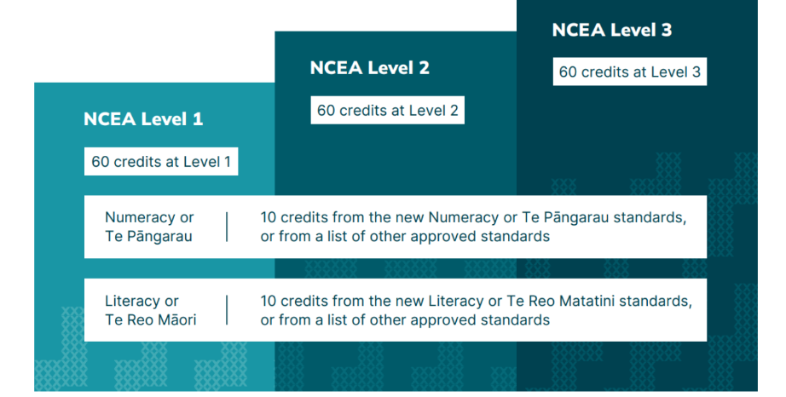
Achieving Level 2 and 3 NCEA
Requires 60 credits (from the level OR above) PLUS Literacy and Numeracy
November, 2023
Notes:
JV

Slide 12
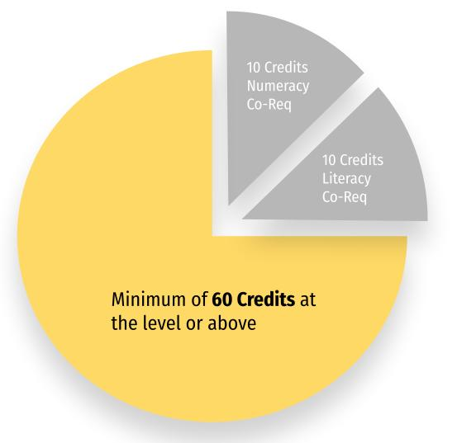
WHAT IS THE NCEA Literacy and Numeracy CO-REQUISITE?
You must meet requirements in Literacy and Numeracy as part of NCEA
The Co-Requisite sits next to NCEA - You will only be awarded an NCEA qualification once you have met the co-requisite requirements. (You can keep banking your credits though!)
You only need to meet the requirement for the co-requisite once
Most students meet Co-Requisite Literacy and Numeracy through CAA tests.
NCEA Qualification
Notes:
SEL

Slide 13
NCEA Co-Requisite at WC
Across Year 9- 11 students prepare for these assessments
They are sat in exam settings twice a year:
Year 10 - Numeracy and Reading
Year 11 - Writing
The assessments are digital and completed using student's laptop & headphones
Students can re-attempt the CAA tests as many times as they need to
Wellington College will support and design interventions where students are struggling to achieve
Until 2027, students can complete 20 extra credits from selected standards to meet the Literacy and Numeracy Co-Requisite
November, 2023
Notes:
SEL

Slide 14
What is endorsement?
Certificate endorsement
NCEA Level 2 or 3 Endorsed with Merit
50+ credits at Merit or higher
NCEA Level 1, 2 or 3 Endorsed with Excellence
50+ credits at Excellence
Course endorsement
14 or more credits at Achieved, Merit or Excellence in a subject, and
At least 3 of these credits from externally assessed standards (Note, this does not apply to Physical Education and Level 3 Visual Art which can gain endorsement entirely through internal standards)
Endorsement is possible in most courses at WC. If not this will be advertised in the course outline.
RECEIVE THE LIGHT AND PASS IT ON
TIAHO TE AO, TIAHO TE AO MĀRAMA
November, 2023
Notes:
LL

Slide 15
WHAT IS UNIVERSITY ENTRANCE?
University Entrance is the highest qualification you can gain at secondary school under NCEA.
University Entrance (UE) is the minimum requirement to gain entry to degree study in New Zealand
If you are aiming for UE, you should think carefully about your subject choices in Y12 and 13. Make sure that you are enrolled in at least FOUR UE approved subjects (in your course selection guide, you can see whether or not courses are UE approved - MOST at WC are)
NCEA is internationally recognised and can be used if you want admission to an overseas university
Notes:
SEL

Slide 16
WHAT ARE THE REQUIREMENTS FOR UNIVERSITY ENTRANCE?
You must pass NCEA LEVEL 3 (60 credits at Level 3 or above)
Note- Unit Standard credits DO count towards the Level 3 total
Plus your credit total MUST also include:
14 achievement standard credits in one approved L3 subject
14 achievement standard credits in a second approved L3 subject
14 achievement standard credits in a third approved L3 subject
U.E. Literacy: 5 credits in Reading and 5 in Writing, from an approved list of Level 2 & 3 standards
+
+
+
These credits can be from your 14 approved credits in a UE subject
If your young person wants to go to university and are in 3 or fewer UE subjects, chat to the Dean to make sure they’re on track.
Notes:
SEL

Slide 17
But my child will apply to University in the middle of their Y13 year… they won’t have finished Level 3!
Level 2 grades are the results that students will send off to apply for halls of residence and for initial acceptance into their chosen course(s).
This acceptance is provisional on the student gaining UE (and meeting any other additional requirements specific to that course).
University Entrance is awarded in January.
We highly recommend that all students make an appointment with one of our excellent careers advisers. They can offer a huge amount of support and guidance.
TE KĀRETI TAMATĀNE O TE WHANGANUI-A-TARA
WELLINGTON COLLEGE
RECEIVE THE LIGHT AND PASS IT ON
TIAHO TE AO, TIAHO TE AO MĀRAMA
November, 2023
Notes:
SEL

Slide 18
Derived grade examinations
All NCEA candidates will sit derived grade exams in Term 3. They are sometimes called ‘mock exams’ or ‘school exams’
These exams help in the following ways:
They help students to understand what they need to focus their study on in preparation for the NCEA examinations
They provide an opportunity to practise exam conditions
They provide a ‘derived grade’ that will be used if they are unable to sit the NCEA examinations.
It is important that students take these exams seriously.
TE KĀRETI TAMATĀNE O TE WHANGANUI-A-TARA
WELLINGTON COLLEGE
RECEIVE THE LIGHT AND PASS IT ON
TIAHO TE AO, TIAHO TE AO MĀRAMA
November, 2023
Notes:
SEL

Slide 19
NCEA (end-of-year) examinations
The NCEA external examinations take place in November - December
They are held here at school
They are run by NZQA and not by WC teachers
Some of them are digital, some are handwritten
Students have a special exam entry slip that they must check for accuracy, and bring to each examination
There are no catch-ups or resits for missed examinations. If a student misses their exam, they will not be awarded a grade for the standards missed.
In some cases, when there are extenuating circumstances, students may apply to NZQA for a derived grade to be awarded. This can be done by contacting the Principal’s Nominee (Deputy Principal Luci Lendrum) on, or as soon as possible after, the day of the exam.
NCEA students go on study leave a few days before exams. This also applies to Year 11 students in L2 or L3 classes, who can work in the library or off site during these lessons. Year 11 students will have some study leave (for example, the day before an exam), but are expected to continue attending all of their other timetabled classes.
RECEIVE THE LIGHT AND PASS IT ON
TIAHO TE AO, TIAHO TE AO MĀRAMA
November, 2023
Notes:
LL

Slide 20
NZ Scholarship
Scholarship is assessed in a separate external assessment at the end of the year. It is open to any student, but is usually sat in Year 12 or 13.
It offers students the opportunity to “demonstrate high-level critical thinking…to synthesise and apply knowledge, skills, understanding and ideas to complex situations.”
Scholarship preparation sessions at WC usually occur outside of timetabled lessons
They are open to any student to attend
Successful students receive $500 per scholarship, with additional monetary rewards for top students
TE KĀRETI TAMATĀNE O TE WHANGANUI-A-TARA
WELLINGTON COLLEGE
RECEIVE THE LIGHT AND PASS IT ON
TIAHO TE AO, TIAHO TE AO MĀRAMA
November, 2023
Notes:
LL

Slide 21
Special assessment conditions
Support is available for students who have additional learning needs when sitting timed assessments.
This can take the form of computer use, a reader/writer, rest breaks, separate accommodation, and extra time.
If you have questions about this, contact Learning Support senco@wc.school.nz
TE KĀRETI TAMATĀNE O TE WHANGANUI-A-TARA
WELLINGTON COLLEGE
RECEIVE THE LIGHT AND PASS IT ON
TIAHO TE AO, TIAHO TE AO MĀRAMA
November, 2023
Notes:
LL

Slide 22
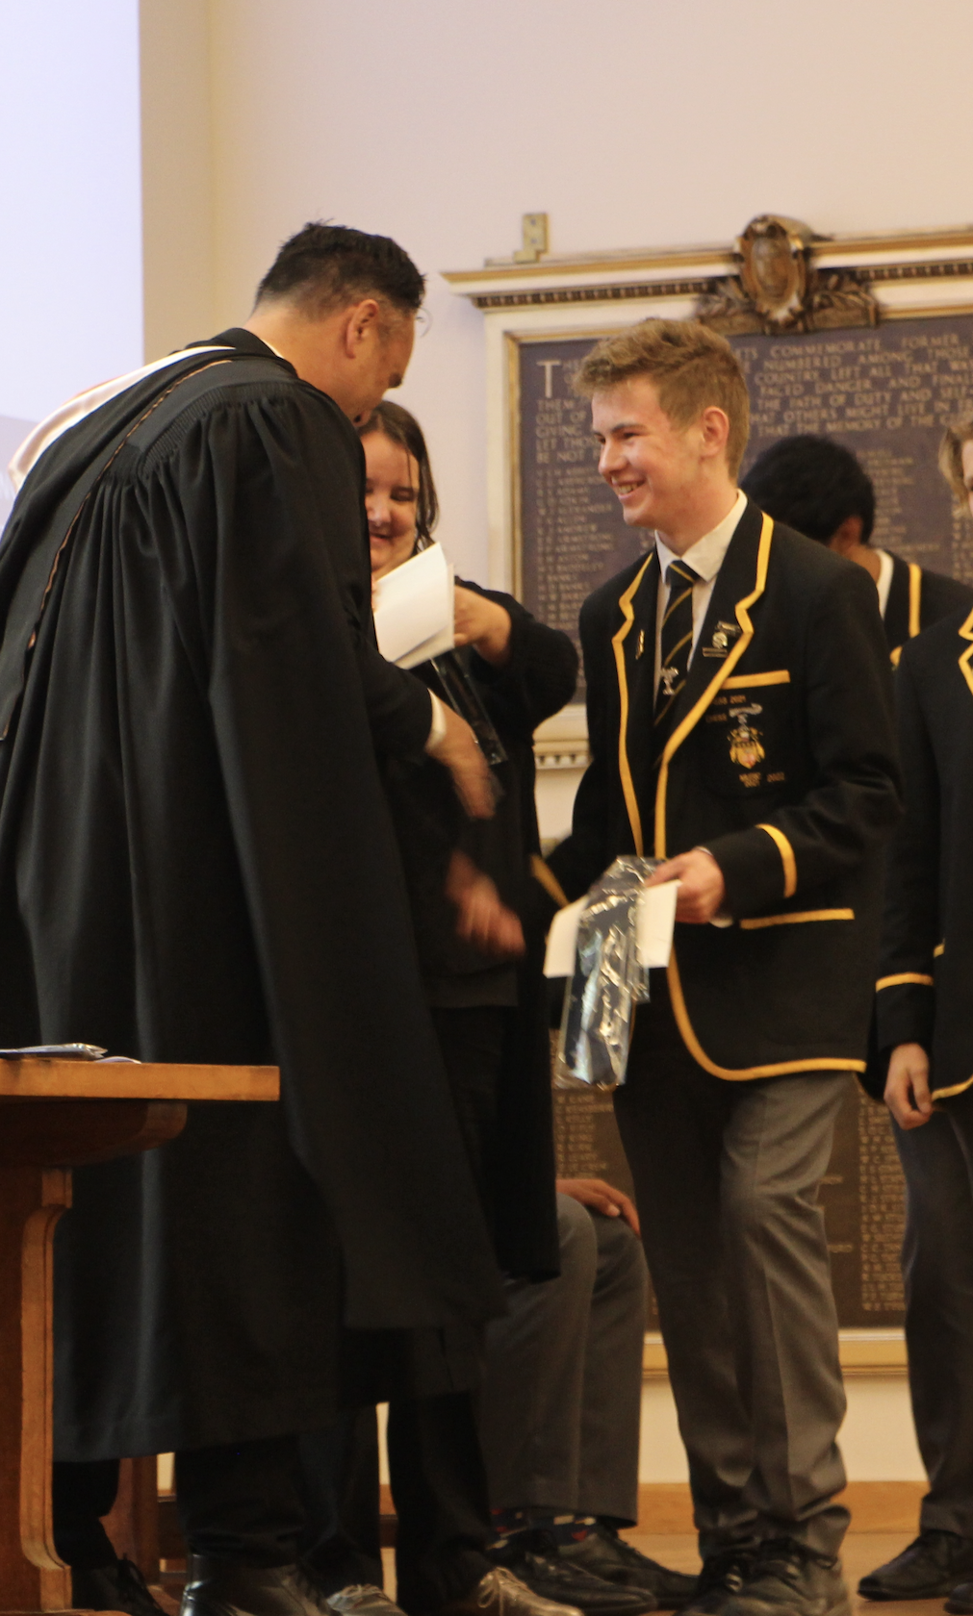
Where do I find assessment information for 2026?
There are a number of sources of information:
The assessment guidelines on the school website. This includes information about reconsiderations, extensions, and withdrawals.
Course outlines provided by subject teachers. This will include key dates for assessment and any assessment rules students need to follow.
These are also linked on the website under course information.
The NZQA website. This includes:
Assessment schedules
Exemplars
The NZQA exam timetable
November, 2023
Notes:
LL

Slide 23
Assessment Procedures
ABSENCES AND NON-SUBMISSIONS
Missing a deadline or absence from an assessment will result in no credit being awarded for that standard.
If you have already been given an adequate opportunity to achieve the standard, a Not Achieved grade will be awarded.
However, if circumstances causing lateness/absence have been discussed with the appropriate HOD, are deemed legitimate, and supported by a doctor’s certificate in the case of illness, the following outcomes may be possible:
provide a specified time extension to submit work for assessment (e.g. an assignment)
schedule the assessment at another agreed time
provide a further assessment opportunity
use relevant standard-specific evidence to award a grade
no credit awarded.
ASSESSMENT OPPORTUNITIES
Most internal standards have one assessment opportunity each year.
A small number of standards may offer a re-assessment (a different task, offered to all students).
Resubmissions may be offered for minor errors only, to gain Achieved (not Merit or Excellence), and only once per standard.
November, 2023
Notes:
LL

Slide 24
Assessment Procedures
EXTENSIONS
Extensions must be applied for before the due date using the school form and approved by the HOD.
Family holidays are not a valid reason.
Be wary as extensions can sometimes compound issues later on.
RECONSIDERATION OF RESULTS
Students can request a reconsideration within 5 days of receiving their grade.
They speak with the teacher first, then follow the school appeal process if needed.
TE KĀRETI TAMATĀNE O TE WHANGANUI-A-TARA
WELLINGTON COLLEGE
RECEIVE THE LIGHT AND PASS IT ON
TIAHO TE AO, TIAHO TE AO MĀRAMA
November, 2023
Notes:
LL

Slide 25
Assessment Procedures
BREACHES OF THE RULES
All submitted work must be the student’s own, and the onus is on the student to prove authenticity.
Students should keep drafts and planning, and use tools such as Google Docs to show evidence of their work. Where work is completed out of class, they will be required to meet checkpoints.
Use of GenAI tools must be explicitly allowed by the teacher, and acknowledged by the student.
Any suspected breach is reviewed by the HOD and the DP Achievement and Attainment.
TE KĀRETI TAMATĀNE O TE WHANGANUI-A-TARA
WELLINGTON COLLEGE
RECEIVE THE LIGHT AND PASS IT ON
TIAHO TE AO, TIAHO TE AO MĀRAMA
November, 2023

Slide 26
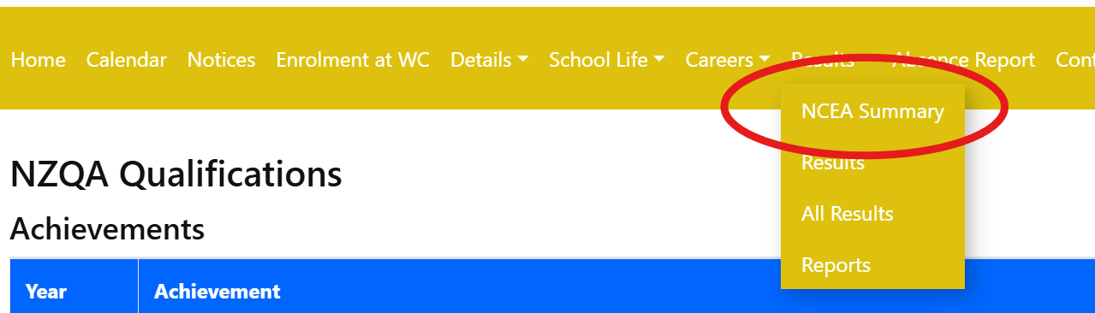
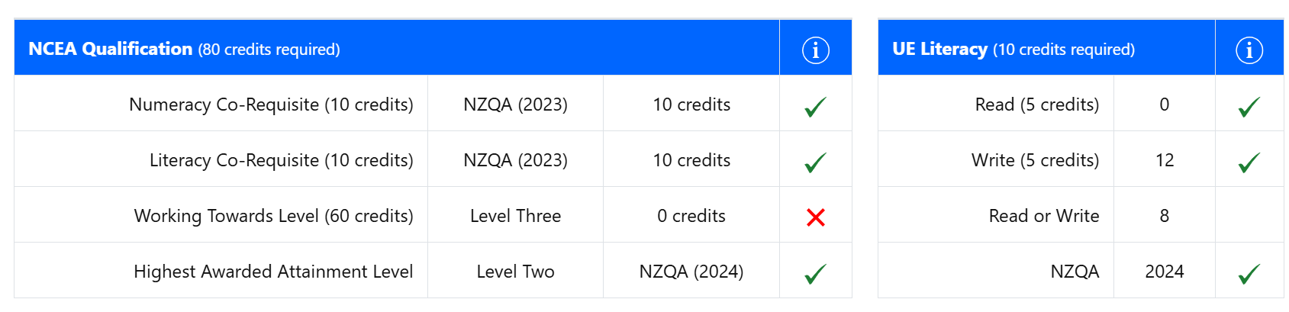
Tracking progress on the Portal
TE KĀRETI TAMATĀNE O TE WHANGANUI-A-TARA
WELLINGTON COLLEGE
RECEIVE THE LIGHT AND PASS IT ON
TIAHO TE AO, TIAHO TE AO MĀRAMA
November, 2023
Notes:
JV

Slide 27
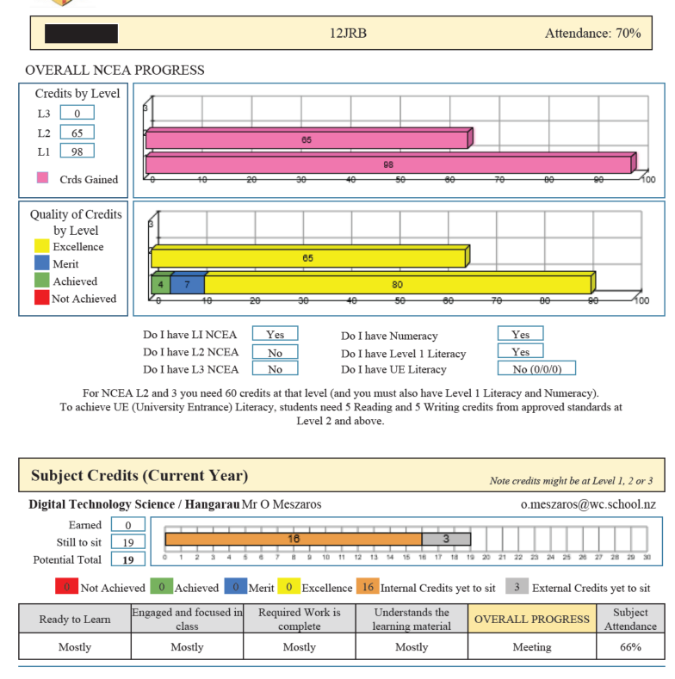
Reports
Notes:
JV

Slide 28
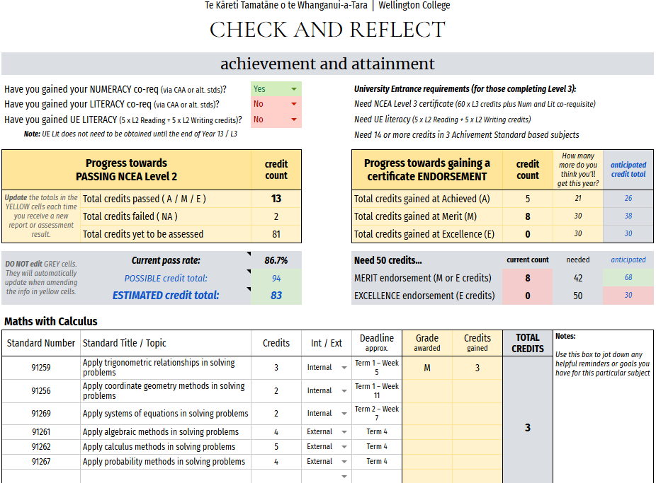
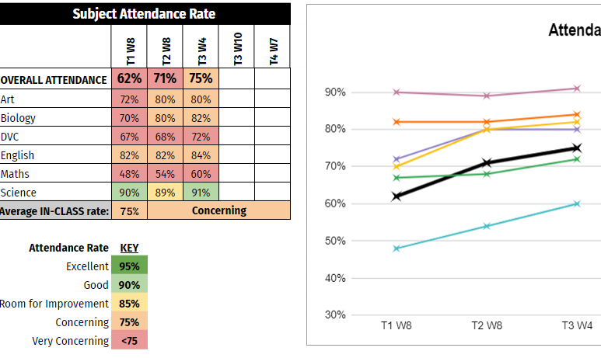
Student
Check and
Reflect
RECEIVE THE LIGHT AND PASS IT ON
TIAHO TE AO, TIAHO TE AO MĀRAMA
November, 2023
Notes:
JV

Slide 29
How can whānau support?
Help with planning, deadlines, and time management
Assessment deadlines are available in subject course booklets, and on Google Classroom
The exam timetable is available on the NZQA website
You can sign up to receive your child’s Google Classroom Guardian Summary
Provide a quiet, distraction-free space for study and revision
Keep lines of communication open - tutor teachers can help with course selection, class teachers with assessment information
Support regular attendance - every lesson counts!
Help your young person keep track of the credits they need for their chosen pathway
Senior students receive NCEA progress reports every 5-6 weeks.
You can also access attendance and results in the parent portal. If you need assistance logging on, please contact the office.
TE KĀRETI TAMATĀNE O TE WHANGANUI-A-TARA
WELLINGTON COLLEGE
RECEIVE THE LIGHT AND PASS IT ON
TIAHO TE AO, TIAHO TE AO MĀRAMA
November, 2023
Notes:
JV

Slide 30
What support is available at WC?
What does success look like?
Creating a safe and engaging learning environment
Setting high expectations
Reporting attendance and achievement accurately
Tracking achievement & designing interventions
Communicating regularly
Subject Teacher- Can help clarify the course and assessment expectations, and due dates
Subject HOD - Can help with assessment procedures
Tutor Teacher - Can check in with subject teachers, help students track credits and achievement
Deans - Wellbeing / pastoral support
Pacific/Māori Mentor Support – Debbie Tiatia, Piri Weepu
Peer tutors - contact the academic prefects or Monique Webster
Career Planning - HOD Careers and Pathways - Hamish Davidson, Sharron Morgan
Subscribe to www.wc.careerwise.school to receive updates and information
Mental Health/Personal Issues - Guidance Counsellors - Lyndon Coppin / Jane Gray / Geoff Charles
Learning Support – Deb Marshall, SENCOs
Achievement & Attainment / Teaching & Learning DPs and APs:
Luci Lendrum (Derived grade applications, exam clashes)
Serena Lawrence and Jenna Vreeburg (tracking attainment, UE Literacy, Co- Requisite Progress)
TE KĀRETI TAMATĀNE O TE WHANGANUI-A-TARA
WELLINGTON COLLEGE
RECEIVE THE LIGHT AND PASS IT ON
TIAHO TE AO, TIAHO TE AO MĀRAMA
November, 2023
Notes:
JV

Slide 31

Looking for more info?
https://www.nzqa.govt.nz/ncea/understanding-ncea/how-ncea-works/
https://www.moneyhub.co.nz/resources-for-ncea-students.html
https://www.nzqa.govt.nz/ncea/understanding-ncea/ncea-and-the-whanau/ncea-and-the-whanau-online/
TE KĀRETI TAMATĀNE O TE WHANGANUI-A-TARA
WELLINGTON COLLEGE
RECEIVE THE LIGHT AND PASS IT ON
TIAHO TE AO, TIAHO TE AO MĀRAMA
November, 2023

Slide 32

Ngā mihi
Mā te wā
Please stay if you have questions / pātai
Notes:
SEL

