Slide 1
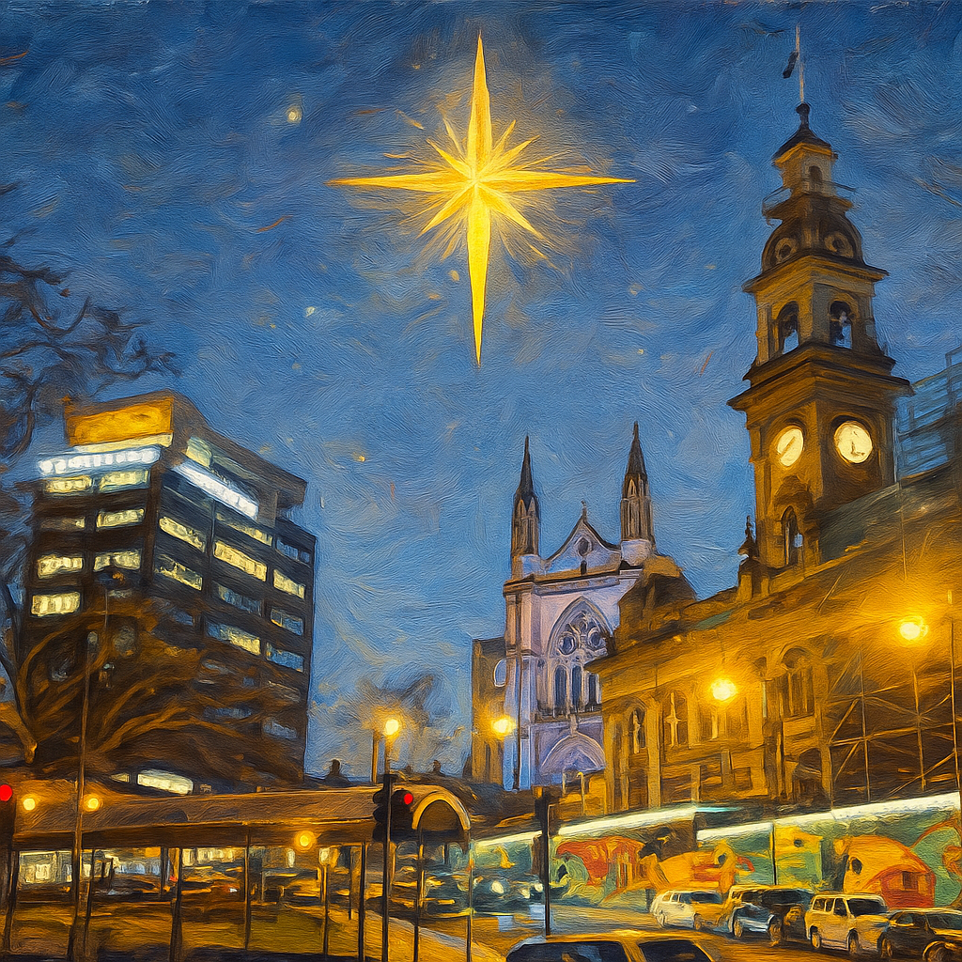

The Scattered People of the Good Shepherd 28 December 2025 Bishop Anne van Gend Isaiah 63: 7-9 Hebrews 2: 10-18 Matthew 2: 13-23

Slide 2

The Scattered People of the Good Shepherd We will check in with each other from 9.45 am for any prayer requests.

Slide 3


Slide 4
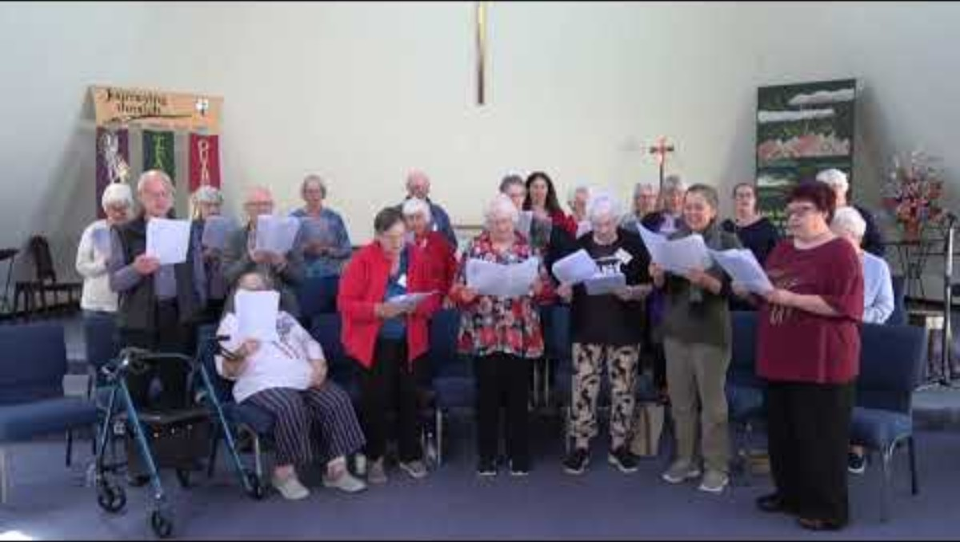

Slide 5

For individual reflection and contemplation:
What questions are this message and readings asking you?
What thought struck you most in the message today?

Slide 6


Slide 7


Slide 8


Slide 9


