Slide 1
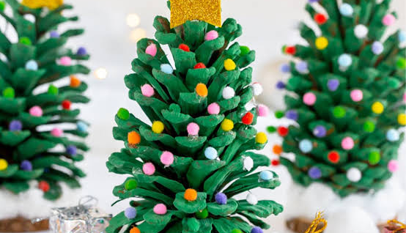
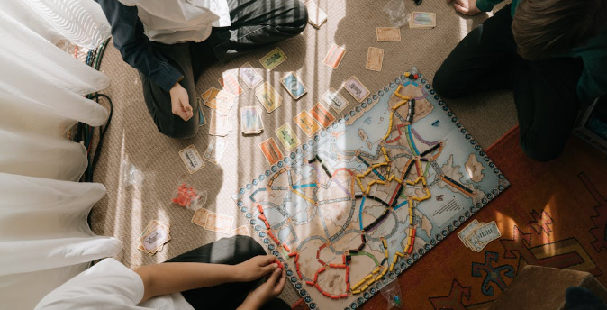

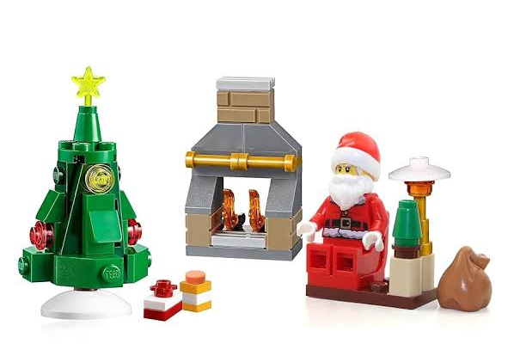
FIND MY TRIBE
Find My Tribe are social groups for Tamariki identifying as Neurodivergent. Providing the opportunity of connection based around a choice of activities.
Low demand, high acceptance.
Come and try, first session is free.
FIND MY TRIBE CLUB
Social groups for Tamariki identifying as Neurodivergent.
Providing the opportunity of connection based around a choice of activities.
Low demand, high acceptance.
Come and try, first session is free.
Christmas Crafts
Term 4
Our weekly club offers a combination of, tinkering, play & craft based activities.
Activities include:
Lego
A variety of board & card games
A weekly craft activity
Tamariki led play
Deconstructing e-waste
Sessions Details:
Tuesdays 3:30pm to 4:30pm
All Saints Church, New Brighton Road
Find My Tribe Club
Term 1 Sessions:
Tuesdays 3:30pm to 4:15pm
All Saints Church, New Brighton Road
We've had a makeover
Due to feedback from our tribers our weekly club will now offer a combination of play & craft based activities to choose from rather than just 1 main activity.
Activities include:
Lego
A variety of board & card games
A weekly craft activity
Deconstruction of e-waste
Contact Hannah for booking and fees
Ph: 021 171 8849
Email: findmytribenz@gmail.com
WWW.FINDMYTRIBE.NZ

