Slide 1


The Scattered People of the Good Shepherd
22 March 2026
Rev’d Esther Clark-Prebble
Ezekiel 37: 1-14
Romans 8: 6-11
John 11: 1-45

Slide 2

The Scattered People of the Good Shepherd
We will check in with each other from 9.45 am for any prayer requests.

Slide 3


Slide 4


Slide 5
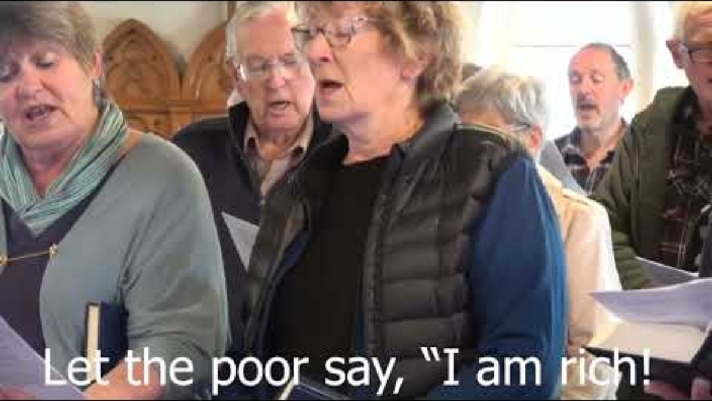

Slide 6

For individual reflection and contemplation:
What questions are this message and readings asking you?
What thought struck you most in the message today?

Slide 7
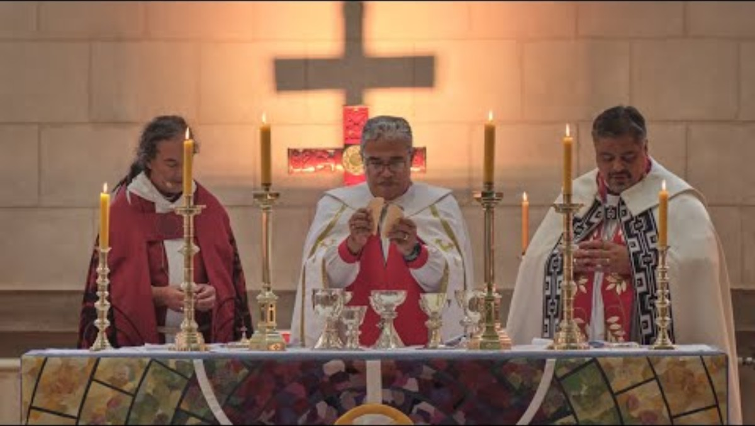

Slide 8


Slide 9


Slide 10


Slide 11


