Slide 1
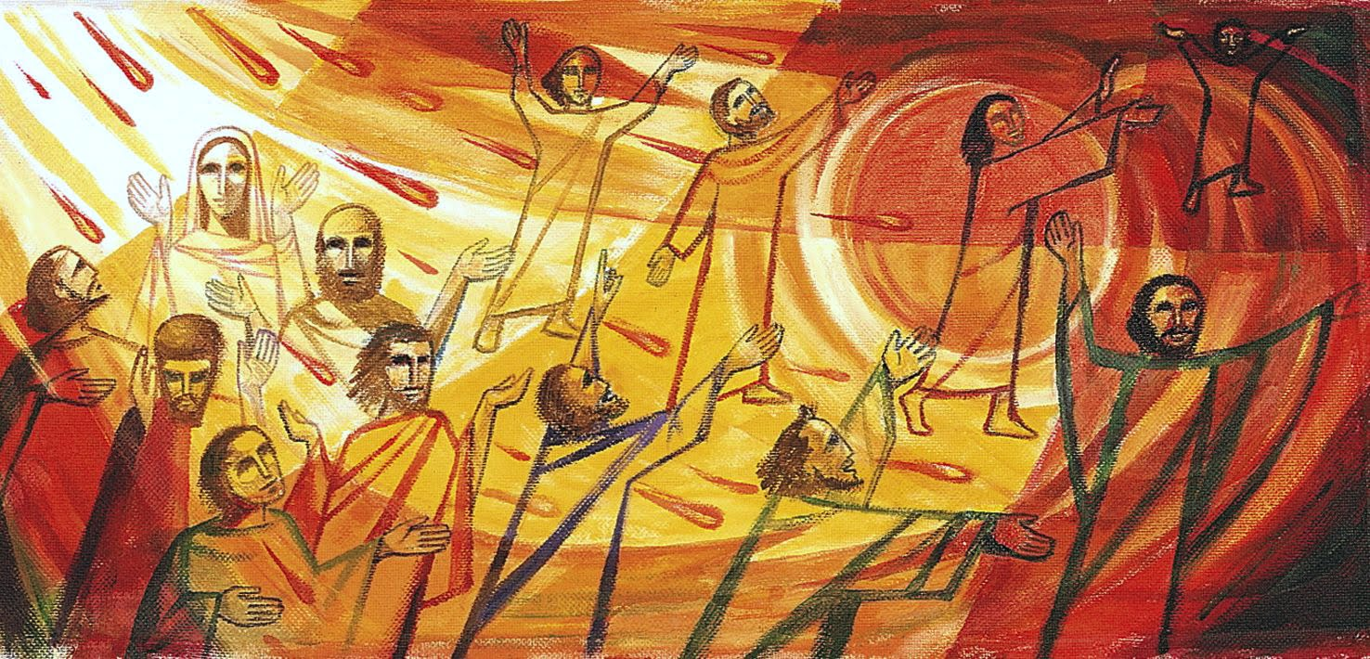

The Scattered People of the Good Shepherd 26 April 2026 Bishop Anne van Gend Acts 2: 1-21 1 Corinthians 12: 3b-13 John 20: 19-23

Slide 2

The Scattered People of the Good Shepherd We will check in with each other from 9.45 am for any prayer requests.

Slide 3
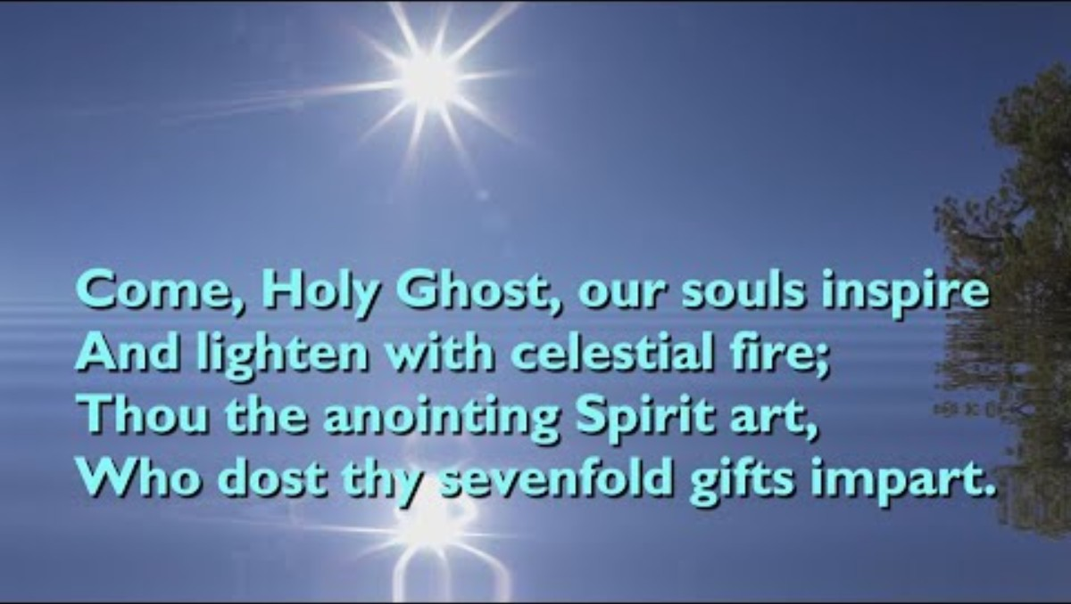

Slide 4


Slide 5
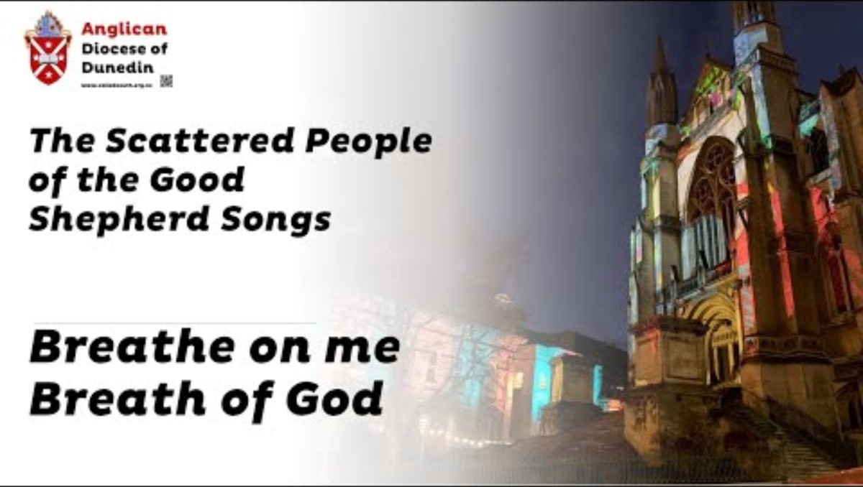

Slide 6

For individual reflection and contemplation:
What questions are this message and readings asking you?
What thought struck you most in the message today?

Slide 7


Slide 8


Slide 9


Slide 10
