Slide 1


The Scattered People of the Good Shepherd
22 February 2026
Bishop Anne van Gend
Genesis 2: 15-17; 3:1-7
Romans 5: 12-19
Matthew 4: 1-11

Slide 2

The Scattered People of the Good Shepherd
We will check in with each other from 9.45 am for any prayer requests.

Slide 3
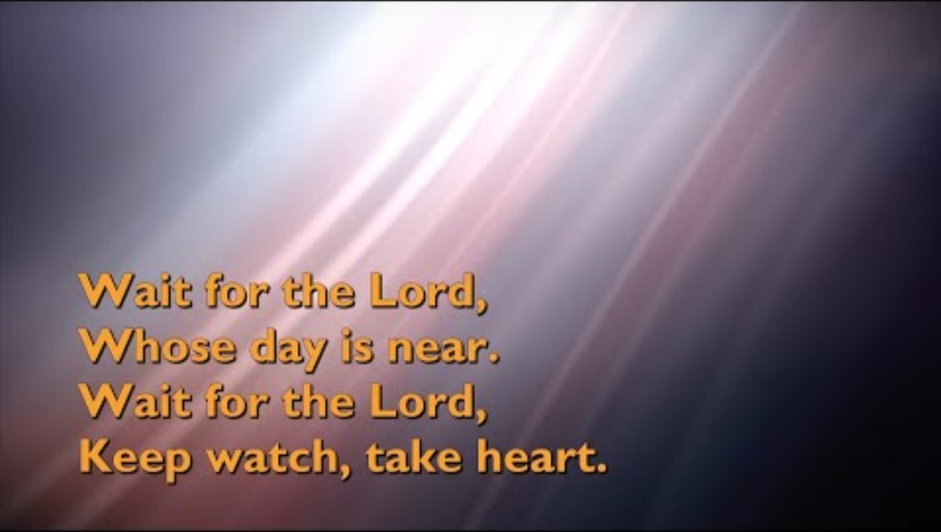

Slide 4


Slide 5


Slide 6

For individual reflection and contemplation:
What questions are this message and readings asking you?
What thought struck you most in the message today?

Slide 7


Slide 8


Slide 9


Slide 10



