Slide 1
Some key dates:
Thursday 12th October – NCEA parents information evening
Friday 13th October – Senior Option Choices open via school point
Friday 20th October – Senior Option Choices close
Friday 27th October – Senior reports published and
emailed to parents on this date (end of week 3)
Thursday 2nd November – Seniors Last Day
Monday 6th November – NCEA Exams start

Slide 2

Our guide to the NCEA Changes
Parents’ Information
Evening

Slide 3
Why are we running this evening?
This is an opportunity to share with parents:
- How NCEA works and how it works here at JPII
- How NCEA is changing initially at Level 1
- What subject choices will look like next year at Level 1
- The importance of the co-requisite and how this works

Slide 4
NCEA

Slide 5
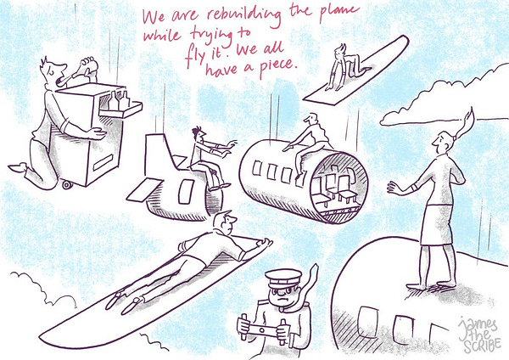

Slide 6


Slide 7
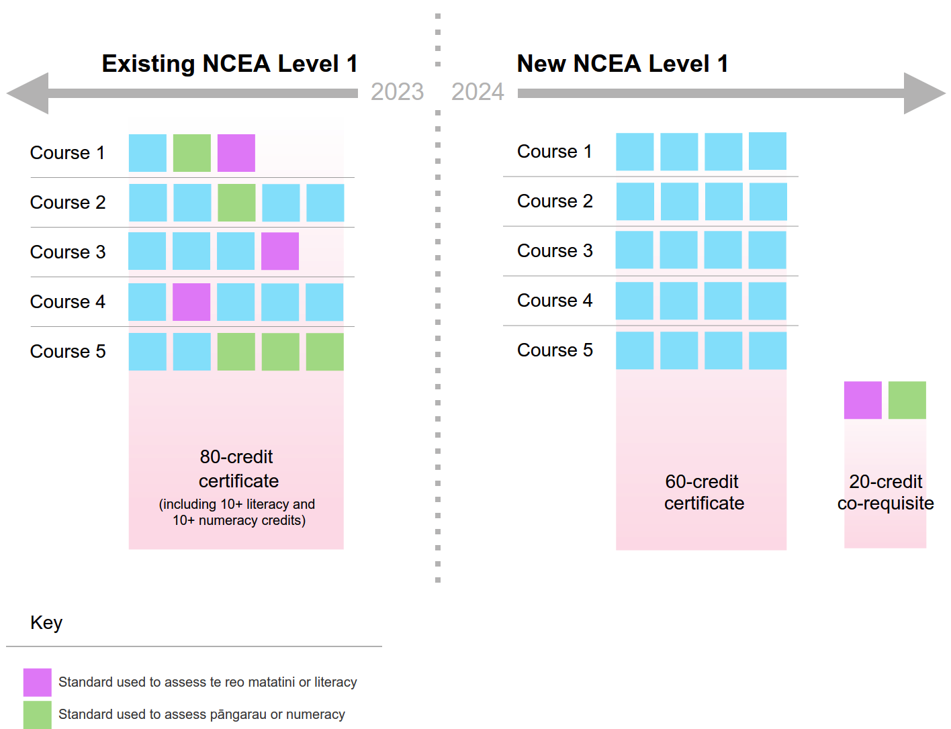
Course and certificate endorsement.
Students will be required to gain 14 or more credits in a course at Achieved, Merit or Excellence (including at least 3 external and 3 internal credits) to gain a course endorsement.
Certificate endorsement require 50 or more credits at Merit or Excellence level.

Slide 8
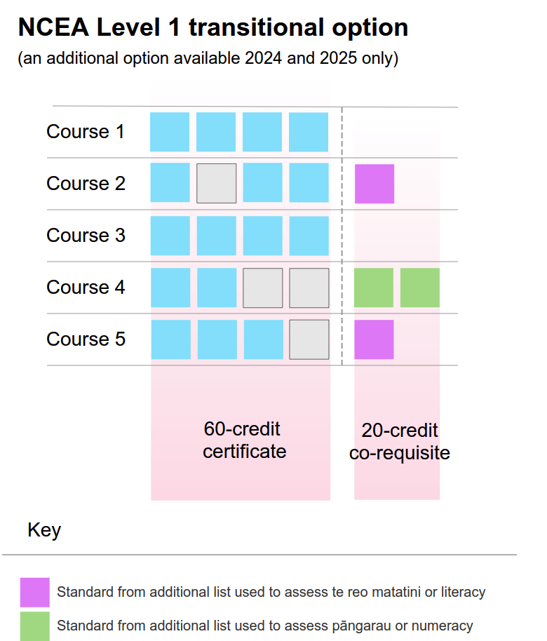
Are there any other
ways to achieve the
co-requisite?

Slide 9
As a Student at JPII – What should you expect?
In the first few weeks of Term 1 – for each subject you have chosen you should be made aware of:
Teaching programme/plan
Assessment programme
Due dates
Appeal procedures
Information about re-assessment and resubmission
A list of the standards that will not be re-assessed
Re-assessments do not have to be offered, and are at the discretion of your teacher

Slide 10
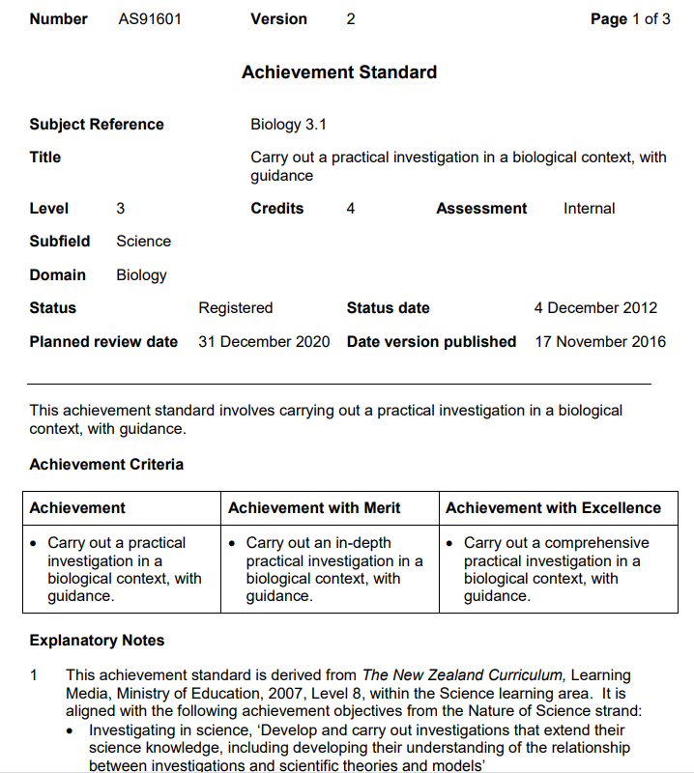
How do Internal Assessments work?
For each standard you take you should be provided with a student information or task sheet
This should give you all the information you need about the standard.
e.g.
Standard no.
Version no.
Level
Credits
Achievement Criteria
Staff will explain any assessment conditions e.g. open/closed book/time limits/word limits etc..

Slide 11
Deadlines
Your deadline should be made clear to you before the start of the assessment and is decided by your teacher.
It is your responsibility to hand in your work on or before this deadline.
If you are going to struggle to meet this deadline, then you MUST have a conversation with your teacher well before the deadline. You MAY be provided with an extension.
Marking and Feedback
Staff at JPII will aim to provide you with a mark and feedback within TWO weeks of your deadline, however since this can only happen once the work has been moderated, at times this may be up to three weeks (as we need to rely on staff from other schools for moderation).
Resubmissions
A resubmission should be limited to specific aspects of the assessment. No more than one resubmission should be provided.
A resubmission can be offered when students have made mistakes which they should be capable of discovering and correcting on their own.
If a resubmission is offered, it must take place before the teacher gives any feedback or reteaching to the whole class (or any student) on the work done.
Students are only able to use resubmissions to move from a Not Achieved grade to an Achieved grade.

Slide 12
Authenticity
Your deadline should be made clear to you before the start of the assessment and is decided by your teacher.
Authenticity statements should be obtained from all students when they submit their assessment where there is opportunity for them to have access to assistance from others. Students should be warned that plagiarism is theft and is not acceptable.
If a teacher suspects that a student has been involved in dishonest practice, either in their own assessment or another student's then a written account of the issue will be passed onto the Principal's Nominee with supporting evidence.
The principles of natural justice and privacy underpin NZQA’s decision making process when investigating possible breaches.
Natural justice includes an opportunity for the student / ākonga to provide an explanation, the right of appeal to a designated independent person, clear and fair timelines, decisions made in good faith and penalties imposed that are proportional to the conduct.
Privacy principles grant students / ākonga the right to privacy about the breach investigation and outcome.
Chat GPT

Slide 13
Student Procedures for Appealing against the Results of Standard Assessments
NZQA Standards clearly specify the performance outcomes expected of students who are to be credited. Your teachers produce assessment events (tests) to measure your ability, and judgement sheets to measure your achievement against these specified outcomes.
The New Zealand Qualifications Authority (NZQA) moderates some of these assessment events and judgement sheets. They will check the fairness and validity of the test and the judgement sheet before they are used and will then check that the judgement sheet has been used correctly after your teacher has marked your test. These procedures are used to ensure that you are treated fairly.
If you feel that you have not been treated fairly by your teacher after they have assessed you, then you may appeal your teacher's decision by taking the following steps:
Step 1 Make an appointment to meet with your teacher within five school days of receiving your script back (You cannot demand teacher time at short notice).
Step 2 Ask your teacher to clarify the reasons why you did not achieve the level of competence which you think you should have in this specific assessment.
(a) If your teacher is able to, they may produce the judgement sheet so that you can see how your performance was measured. It is expected in most cases that this information will prove that you have been treated fairly.
(b) If your teacher is unable to produce the judgement sheet (sometimes they are also used for reassessment), then you may nominate another teacher to act as your representative and they will check, on your behalf, that you have been treated fairly.
(c) If your test is to be externally moderated, then you need not pursue your appeal because the process will protect your interests.
Step 3 If you are still not convinced, for some reason, then you have the right to ask your teacher to take the matter further. This might involve another member of staff, the NZQA Principal's Nominee. At whatever stage agreement is reached, the matter can go no further because fairness has been proven.

Slide 14
New Zealand Scholarship
Scholarship examinations are set to extend the best secondary students and enable top scholars to be identified and acknowledged. The content assessed for NZ Scholarship is the same as that covered for level 3 achievement standards, Assessment is standards based and all assessments are external. There are a variety of levels of scholarship and of monetary award

Slide 15
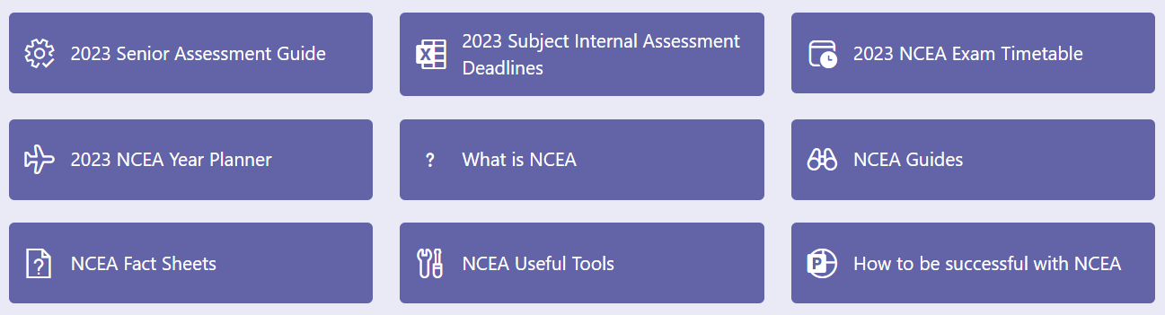
Resources are in the 'Successful Seniors' Team

Slide 16

Special Assessment
Conditions (SAC)
R = Reader
WR = Writer
SA = Separate Accommodation
ET = Extra Time
RB = Rest Breaks
CU = Computer User
CO = Computer Only notification
ICS = IN CLASS SUPPORT

Slide 17
Subject Choices 2024 Level 1

Slide 18
Course Choices – Level 1 2024
English
Maths
Science
Religious Studies
1 ‘CORE’ subject
Hard Materials Tec
Plus
5 ‘choices’
Art
History
Distance Learning
Ara Māori
PE
Digital Technology
Japanese
Drama
Geography
Trades
Design Visual Communication
Food Tec

Slide 19
Ara Māori
Hapaitia te ara tika pumau ai te
Rangatiratanga mo nga uri whakatipu.
Foster the pathway
Of knowledge to strength, independence
And growth for future generations.

Slide 20
The Arts
Whakatauki
Te toi whakairo, ka ihiihi, ka wehiwehi, ka aweawe te ao katoa
Artistic excellence makes the world sit up in wonder
The Arts whakataukī acknowledges ihi, the energy within that allows an artist to inspire, and wehi, the emotional reaction that ihi inspires. It also calls for artists to aspire to aweawe, where their skills and performance are at their peak.

Slide 21

The Arts - Drama
DRAMA is about Inclusivity and a safe place to explore Identity.
It fosters:
Confidence
Leadership skills
Essential personal skills
Communication skills
Creativity
Resilience & Adaptability
Through working alongside others in fun and challenging ways.
Plan for the future – CHOOSE DRAMA

Slide 22
The Arts - Drama
Drama 1.1 (internal) Explore the function of Theatre Aotearoa This is a new focus on the journey of NZ theatre and its impact on society both nationally and globally. It explore a range of plays and focuses on Manaakitanga. | Drama 1.2 (internal) Participate in creative strategies to create a drama This is similar to the devising assessment and is focused on Whanaungatanga. | Drama 1.3 (external) Perform a scripted role for an audience using drama techniques This is similar to the techniques assessment of the past. It focuses on making connections to the audience through Ihi, Wehi, and Wana. It can be a portfolio of evidence. | Drama 1.4 (external) Respond to drama performance This is similar to the live performance assessment however as an external students can submit a portfolio of evidence from over the year, to meet the criteria
BIG IDEAS & SIGNIFICANT LEARNING
Drama explores who we are, where we have come from, and where we could go.
Drama draws on the richness of diverse cultures to create new dramatic works.
In drama, learners can make connections between the real world and imagined worlds. Creating characters and situations grows learners’ ability to comment on, challenge, and ultimately transform society. They can use online platforms to explore their ideas and access worldwide audiences.

Slide 23
Visual Art - Big Ideas and Significant Learning
Whakapapa - Visual Arts descends from, embodies, and creates forms of cultural expression
Curiosity, risk taking, and critical thinking are integral to creativity in Visual Arts
Visual artmaking conventions enable artists to create cohesive and fluent artistic forms
Visual Arts communicates ahurea tuakiri and evokes responses
Whanaungatanga in Visual Arts builds sustainable communities
Taonga Tuku Iho - Visual Arts is a medium to explore, discover, express and value te ao Māori
• use established conventions to learn about techniques, technologies, and processes in order to create effects and communicate ideas
• engage in learning that connects own and others artwork to te ao Māori, and other cultures, in local, historical, contemporary, and authentic contexts
• understand, use, and value both mātauranga Māori and te ao Māori in making art that reflects on and responds to Aotearoa New Zealand's unique history
• use mātauranga Māori contexts as expressed in Toi Tūturu, and/or Toi Whakawhiti, and/or Toi Rerekē to explore aesthetics and symbolism
• demonstrate understanding of the role and value of taonga within a mātauranga Māori context through research, authentic experience, and art making
• understand Visual Arts within Aotearoa New Zealand as part of a wider context of Pacific artmaking histories and practices, rooted within diverse knowledges, cultures and contexts of Pacific peoples
• demonstrate an understanding of intergenerational connections that can exist between people, places, and objects
• use creative thinking processes and demonstrate understanding of creative intent through purposeful art making and exploration
• value the process, embracing both expected and unexpected outcomes
• celebrate diversity, create understanding, and foster well-being through active participation in the arts
• apply understanding of ahurea tuakiri, ethnicity, ideas, feelings, beliefs, political viewpoints, and personal perspectives, and create artwork as a representation, response or means of self-expression.

Slide 24
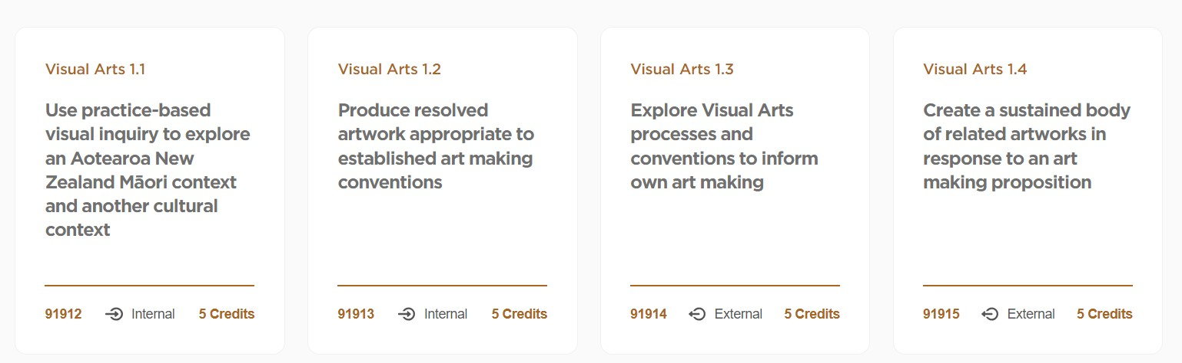
Visual Art - Level 1 Course Overview
Local histories and pūrākau.
Greymouth landscape and river, surrounding areas, our school, forests, pounamu, and sites of significance.
Student's own cultural identity.
We will study 3 out of the 4 standards listed below.
Research Ko wai au? Who am I? Using Visual Arts practice, students will show their understanding of Māori concepts by exploring local histories, pūrākau, taonga, local places of significance, and their own cultural heritage. They will complete research in class and on field trips around Greymouth in the form of drawings, wet and dry media studies, art conventions, artist studies, photographs, reading and written notes. | Resolved Artwork Students create a vessel using sculptural techniques and processes that demonstrate an understanding of artist models and is informed by research and development of ideas. | Workbook Learn and develop skills and techniques in drawing, painting and printmaking. Experimenting with media, techniques, art elements and conventions. Combining media and ideas to develop thematic concepts. Using written annotations and artist model studies to support development of ideas. | Folio They will work towards creating successful outcomes to form a cohesive and sustained body of related works in response to an art making proposition (1.1, 1.2 and 1.3).

Slide 25
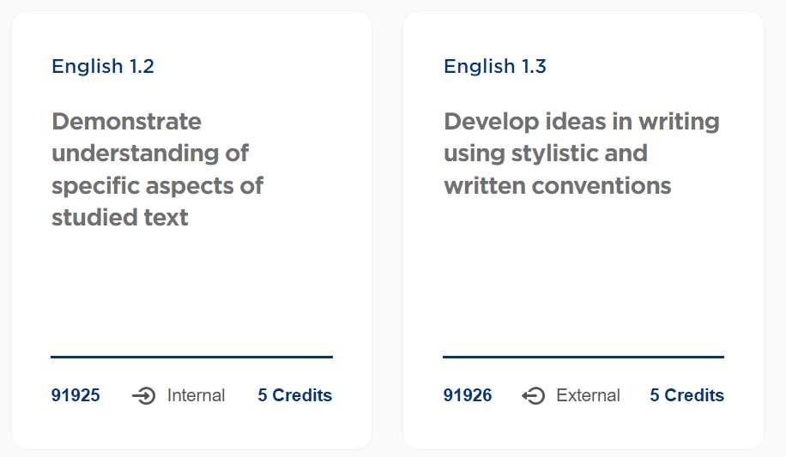
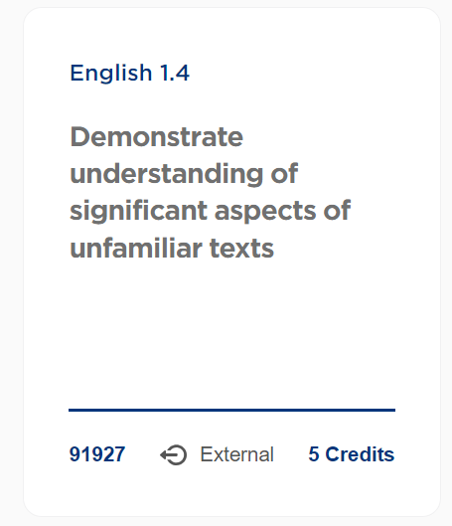
English
Similar to current Exams Critical analysis of a visual or oral text Character – Plot – Themes – Ideas – Symbolism In class essay on how deliberate choices have specific effects | Similar to current Formal and Creative Writing Receive a range of prompts in Term 3 Marked on word choice, style, quality & synthesis of ideas, engagement Sent away for marking | Similar to current Exams Analysing the use of deliberate and specific language in written texts Using all of the specific knowledge of language from 1.3, discuss how an author uses language to create meaning

Slide 26
English
So What's Changing? Much more of a concerted curriculum focus on language Less assessments, but greater depth needed No assessments Term 1. More opportunity to engage with more complex texts and understand how literature and language help us to build connection with others. Intended result is all students growing literacy skills and being confident language in an array of situations

Slide 27
Mathematics
Mathematics 1.1 Explore Data using a Statistical Enquiry Process 5 Credits Internal emati | Mathematics 1.3 Interpret and apply mathematical and statistical information in context 5 Credits External | Mathematics 1.4 5 Credits External Demonstrate Mathematical reasoning 5 Credits External
Similar to 2 current internals Students must use the statistical enquiry process to pose and answer their own question based around a given context Pose a question Collect relevant Data Plot an apropprite graph and calculate statistics Discuss the features of their graph and statistcs Answer their question with statistical justification | Similar to a current external Analyse and answer questions by interpreting a wide variety of statistical graphs and tables, usually based around a common context Marked on a students ability to interpret information. Using Level 6 NZC in Statistics Probability Number Graphs | Similar to several current external and Internals Marked on a students ability to answer a mathematical problem(multiple steps) Using Level 6 of NZC in Number Algebra Tables and Graphs Measurement Geometry (Shapes, transformations and Trigonometry)

Slide 28
Mathematics
Changes in 2024
Four broad standards
Content basically the same, but we have to cover everything
Can't cherry pick topics to do
More use of technology
Students must answer questions in context
How far a student gets into a problem will determine their grade(s)

Slide 29
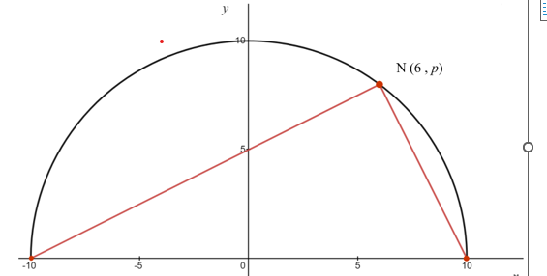
Mathematics
1.4 EXAMPLE Question Prove that this a right-angled triangle

Slide 30
Physical Education
PHYSICAL EDUCATION NCEA CHANGES 2024
Physical Education currently offers 5 internally assessed achievement standards at level 1.
Next year, the 5 standards will be replaced by 4 new achievement standards - 2 internally assessed standards and 2 externally assessed standards.
Each standard is worth 5 credits.
The new standards are as follows:
1.1 Apply movement strategies in an applied setting
1.2 Demonstrate understanding of the application of strategies in movement
1.3 Demonstrate understanding of the influence of personal movement experiences on hauora
1.4 Demonstrate understanding of influences on movement in Aotearoa New Zealand or the Pacific

Slide 31
Religious Studies
"I have come that they may have life and have it to the fullest."
John 10:10
The call of Jesus, Light of the World, is as profound here in Māwhera today on the West Coast of the South Island of Aotearoa as it was on the shores of Galilee when he first said to Simon and Andrew, ‘Follow me.’ (Mt. 4:19).
From the gospels we can learn that following Jesus can often be challenging but that we are never alone. Jesus walks with us and feeds us as we grow in love of him and others in the light of his Gospel.
Our Religious Studies Curriculum is called To Tātou Whakapono (Our Faith). It highlights Catholic understandings such as Te Rama Wakapono (the Light of Faith) and Te Rama Aroha (The Light of Love).
It provides themes, topics and opportunities for learning about God, our relationship with God, our story and being Church and connects this to lived experiences of grace, holiness, wisdom, justice and prayer, all in a context of us being on a hīkoi wairua (spiritual journey).

Slide 32
Religious Studies
Unit and Assessment One: Te Rongopai/Good News
This topic answers the question - How do we know about Jesus? It also helps ākonga to develop an understanding of Jesus by exploring in detail one Gospel’s approach and message about Jesus and what it means to be Christian.
Content Outline
Formation of the Gospel
Types of Truths in the Bible
Literary forms and themes
The process of reading the Bible
Development and features of the four Gospel accounts
Focus on Matthew’s Gospel
Ignatian Prayer/ Lectio Divina
Assessment: AS 1.2 - 5 Credits (internal) Demonstrate the understanding of how a significant narrative relates to a religious or spiritual tradition

Slide 33
Religious Studies
Unit and Assessment Two: Ā Tātou Whakapapa: Our Story
This topic answers the question - What is the Catholic story in Aotearoa? It helps ākonga to understand the Māori context into which the first Catholics came and the development of the Catholic Church in Aotearoa New Zealand. It also helps ākonga to understand the challenges to, and contributions of, Catholics in Aotearoa New Zealand, and the place of the Church in our country.
Content Outline
Māori spirituality
The response of Māori to the Catholic mission
The contribution of individuals, groups and events in the establishment of the early development of the Catholic Church in Aotearoa New Zealand.
The positive contribution of different cultures to the Catholic Church in Aotearoa New Zealand
The Catholic involvement in and commitment to, Te Tiriti o Waitangi
Places of holiness and spiritual significance
Prayers and waiata that are part of the Catholic cultural landscape of Aotearoa New Zealand
Assessment: AS 1.1 - 5 Credits (internal) Demonstrate understanding of the development of a community that shares religious or spiritual beliefs

Slide 34
Religious Studies
Unit and Assessment Three: Te Atua: God
This topic answers the question - What do people believe about God? It helps ākonga to explore the key Catholic beliefs about God, particularly as expressed in the Apostles Creed, and how Catholics live those beliefs. It also helps ākonga explore how others view God and live those beliefs.
Content outline
● The Nicene and Apostle Creeds
● Identify and investigate the beliefs of one other major religion or belief system and explore how these are lived in ritual and in daily life
● How the divine reaches out to humanity in Catholicism and another religion
● The lives of inspiring people who have influenced the development or direction of Catholicism and another religious tradition
● How the sacred texts are used in rituals and worship in Catholicism and another religious Tradition
● Compare ways of praying in Catholicism and another religion
Assessment: AS1.3 - 5 Credits (External)
Demonstrate understanding of a characteristic of religious or spiritual tradition

Slide 35
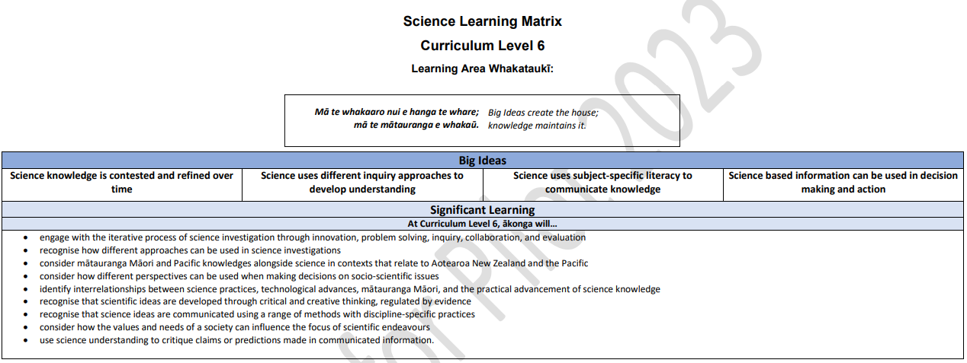
Science

Slide 36
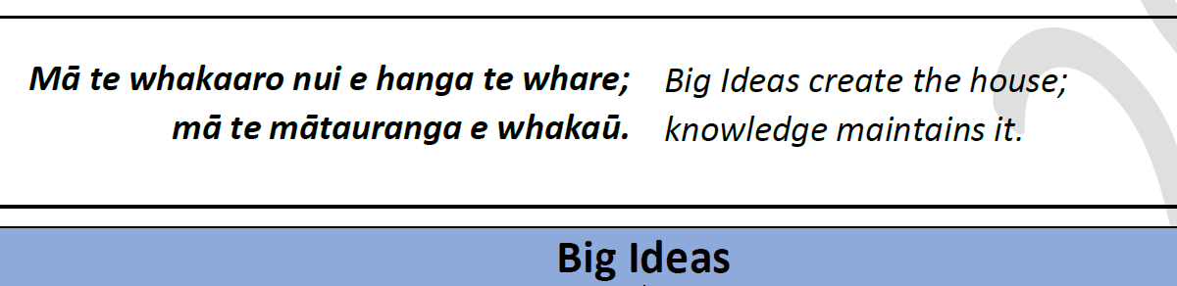
Science

Slide 37
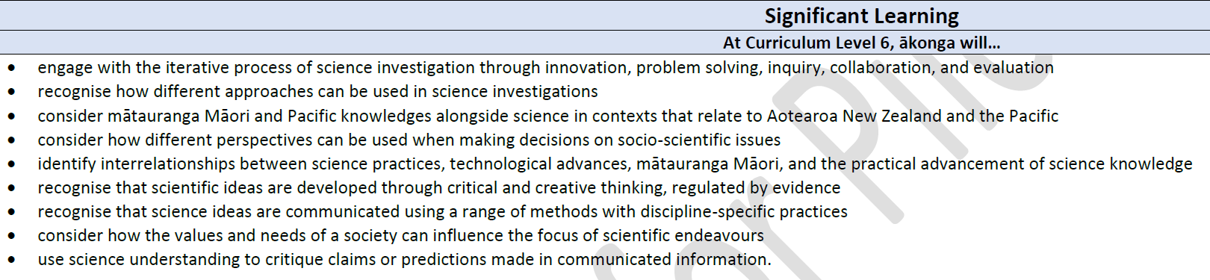
Science

Slide 38
Science year 11 course
Biology | Chemistry | Physics | Earth Science
Biodiversity and threats – overnight field trip to Mt Te Kinga at Lake Brunner | Chemical reactions and types of chemical bonds. Acids, bases, and pH. Ocean acidification (field trip – rocky shore animals, plankton collection and microscopy) | Electrical circuits, waves. Alpine fault – earthquake waves AF8 | Explore the impact of climate on the region – across topics term 1-3 (physics - global warming, biology – climate change, chemistry – ocean acidification)

Slide 39
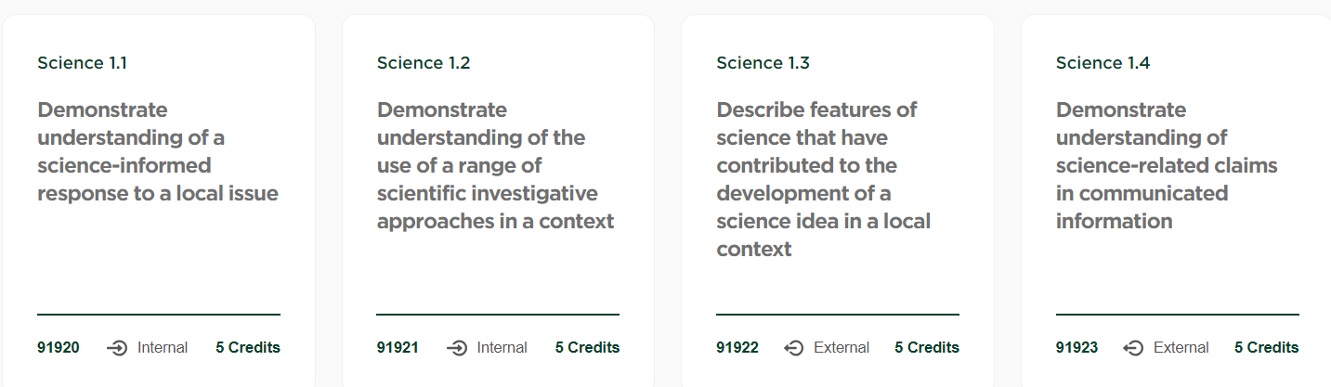
Science

Slide 40
Science
Biology | Chemistry | Physics | Earth Science
Biodiversity and threats – overnight field trip to Mt Te Kinga at Lake Brunner | Chemical reactions and types of chemical bonds. Acids, bases, and pH. Ocean acidification (field trip – rocky shore animals, plankton collection and microscopy) | Electrical circuits, waves. Alpine fault – earthquake waves AF8 | Explore the impact of climate on the region – across topics term 1-3 (physics - global warming, biology – climate change, chemistry – ocean acidification)

Slide 41
Social Sciences
History
Geography
Nature of History
Narratives are constructed
Narratives are contested
Historical Knowledge
Power Relationships
Place
Identity
Five BIG Ideas
Four BIG Ideas
Interconnected
Relationships
Shaped by natural processes
Perspectives & Power

Slide 42
Social Sciences
History
Term 1
Introduction to History and effective research
Term 2
Significance
Term 3
Significance
Kiingitanga: An assertion of mana
The Waikato and Taranaki War
War and Remembrance
Background - Establishing the historical context
Invasion of Parihaka
Historical Biographies
Dame Whina Cooper and the 1975 Land March
Hīkoi

Slide 43
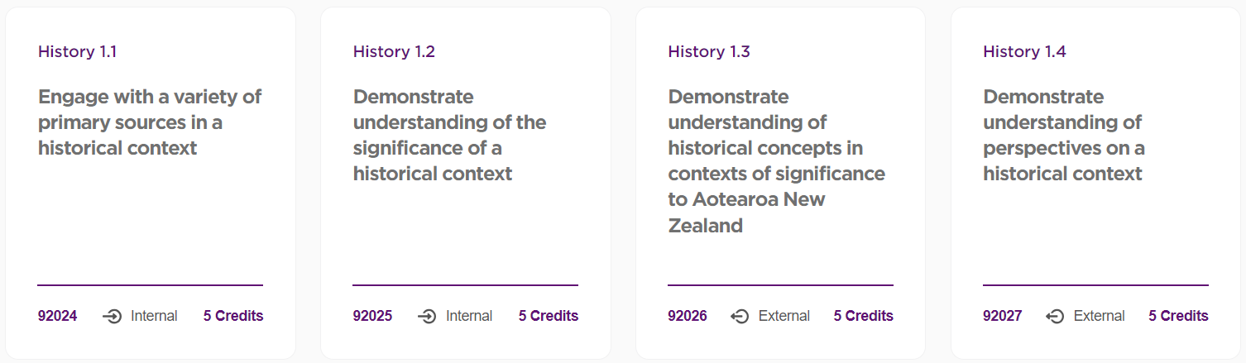

Social Sciences
History

Slide 44
Social Sciences
Geography
Term 1
Introduction to Geography
Term 2
Term 3
Aotearoa New Zealand's global connections
A Sense of place and our local area
Settlement patterns of New Zealand
Pūrākau, Māori explained volcanism in Aotearoa New Zealand
Volcanic Landscapes
Effects & Significance on people
Physical shaping of Aotearoa New Zealand
Migration
Visiting sites of significance
Scientific explanation of volcanism in Aotearoa New Zealand

Slide 45
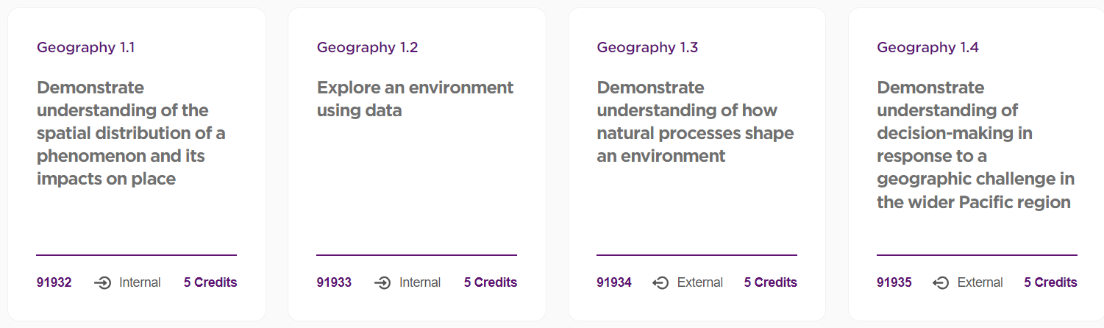
Social Sciences
Geography

Slide 46
Technology
11 DVC
The focus for Level 1 Design and Visual Communication is product design. The design is developed by studying artifacts from two different cultural backgrounds, one being a te ao Maori design influence and another design influence that is relevant to the student as a designer. An artifact can be a piece of furniture or a product. Students will present their evidence for assessment as a portfolio of work for the brief. This will be marked for internal assessment before being sent for external assessment. External Assessment is achieved using a portfolio process and will contain best examples of work completed throughout the year.
Students will use a range of visual communication techniques including sketching, rendering, instrumental drawing, and CAD (computer aided design).
11 MATERIALS TECHNOLOGY
Students are required to develop and make a project for an authentic context using one or more hard materials such as wood, metal, acrylic. This requires students to use basic procedures using resistant materials in a manner that economises time, effort, and materials to make a specified product, for example, a study desk. The project will draw upon the student’s interests, cultural background, and local environment and meet their or a selected stakeholder’s needs.
The skills developed in this course are: Brief Development, Planning, Research including knowledge of local materials and their historical use, Design Development, Traditional and contemporary techniques and how they relate to each other, Project Construction, Testing and evaluation
11COM will reflect or promote kaitiakitanga, aiding in the guardianship of our natural environment. Digital technologies can help us to gather information about our environment, improve processes to sustain it, and connect with people to increase our knowledge around this issue. 11COM students well create a digital outcome which promotes kaitiakitanga. This will involve a wide range of digital technologies e.g programming and electronics.

Slide 47
The Co-Requisite

Slide 48
NZQA Numeracy and Literacy Exams 2023
Each exam should last approximately 1 hour
Literacy – Reading – Monday 30th October am
Literacy – Writing – Tuesday 31st October am
Numeracy – Thursday 2nd November am
You will need:
Working laptop
Headphones
Calculator
NZQA log in
Ability to access assessment master

Slide 49
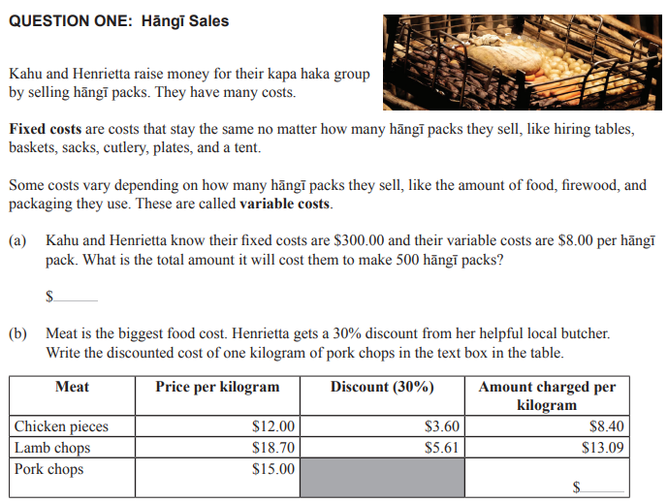
Numeracy

Slide 50
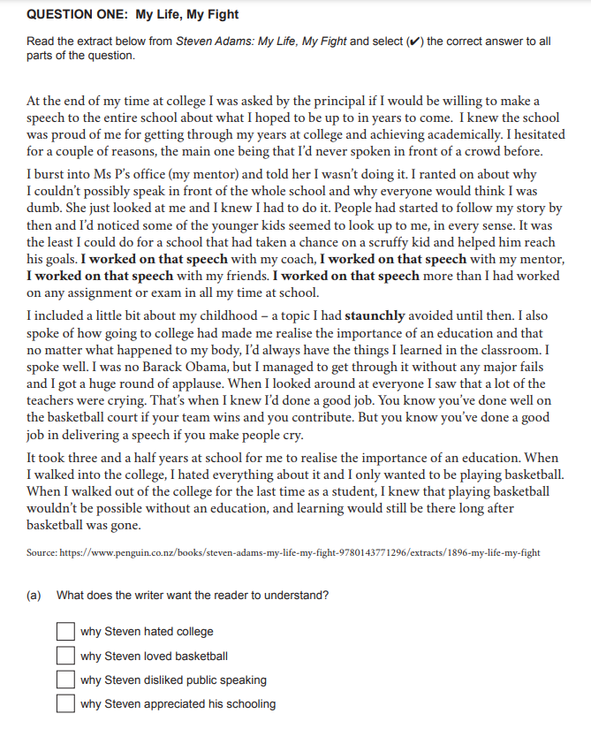
Literacy
(Reading)

Slide 51
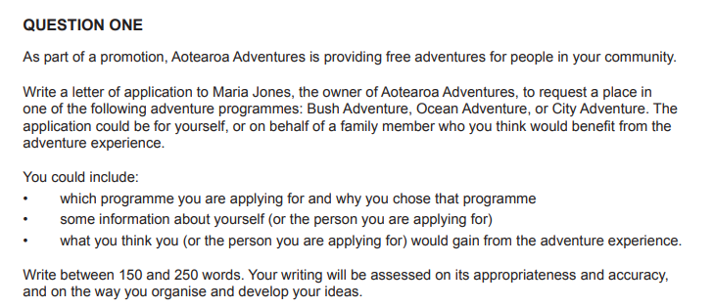
Literacy Writing

Slide 52
Assessment Conditions
The following is NOT permitted
Material Displayed in the room must not advantage the students
Cell phones and other unauthorized electronic devices, notes and watches
Accessing the internet (on any site except the assessment master platform)
Copying the assessment or assessment materials
Leaving the Assessment Master platform
Communicating with others.
Students MAY use the following:
Rulers and approved Calculators for the numeracy assessment. There is no calculator functionality available in Assessment Master
Power Banks
Headphones (for use of POLLY – text to speech)
Blank Paper, for workings

Slide 53

Some helpful resources

Slide 54
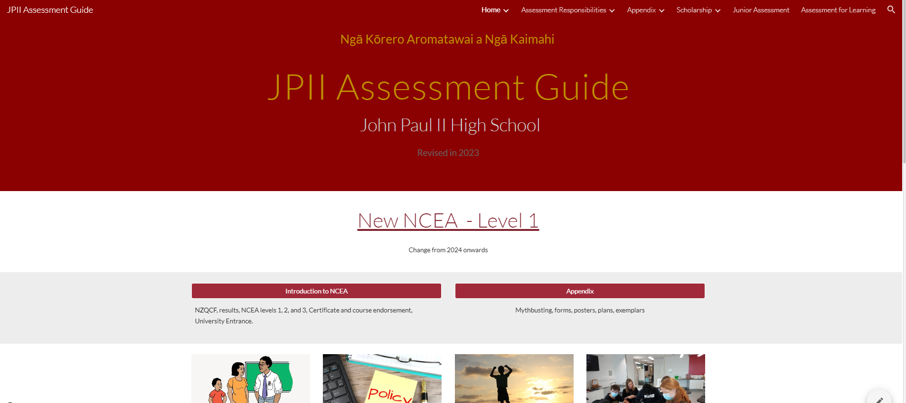
Useful Sites
NZQA
https://www2.nzqa.govt.nz/
JPII – Assessment Guide
https://sites.google.com/johnpaul.ac.nz/jpii-assessmentprocedures/home
Numeracy/Literacy - Practice Exams
https://www.nzqa.govt.nz/ncea/ncea-exams-and-portfolios/external/digital-exams/find-past-digital-exams/

Slide 55
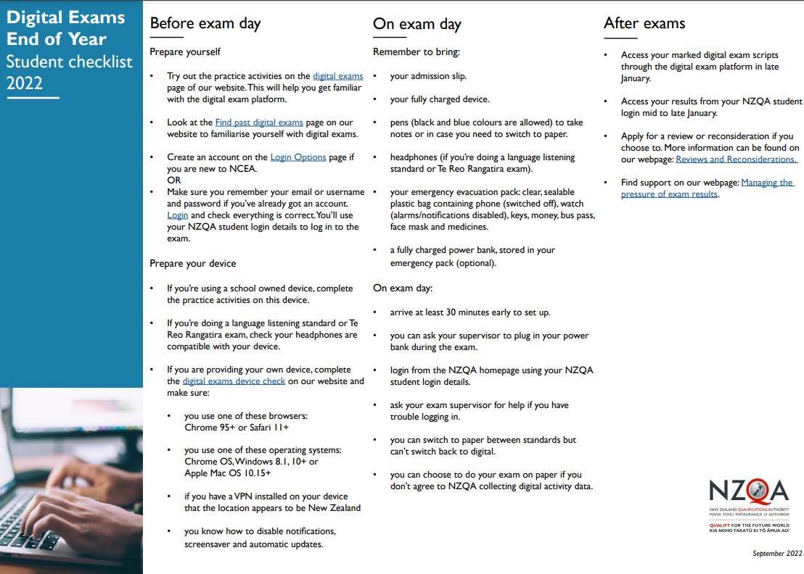
https://www.nzqa.govt.nz/assets/About-us/Future-State/NCEA-Online/Getting-ready-for-exams/EOY-student-checklist-2022.pdf

