Slide 1
Literary Tourism in the UK
Jackie McMillan
Collection Specialist
Dunedin Public Libraries

Slide 2
If Only Travel Could As Easily Do What Reading Does…
Virginia Woolf says this about READING in her essay How Should One Read a Book?
…so that merely going from friend to friend, from garden to garden, from house to house, we have passed from one end of English Literature to another and wake to find ourselves here again in the present … we can make them light up the many windows of the past; we can watch the famous dead in their familiar habits and fancy sometimes that we are very close and can surprise their secrets…

Slide 3
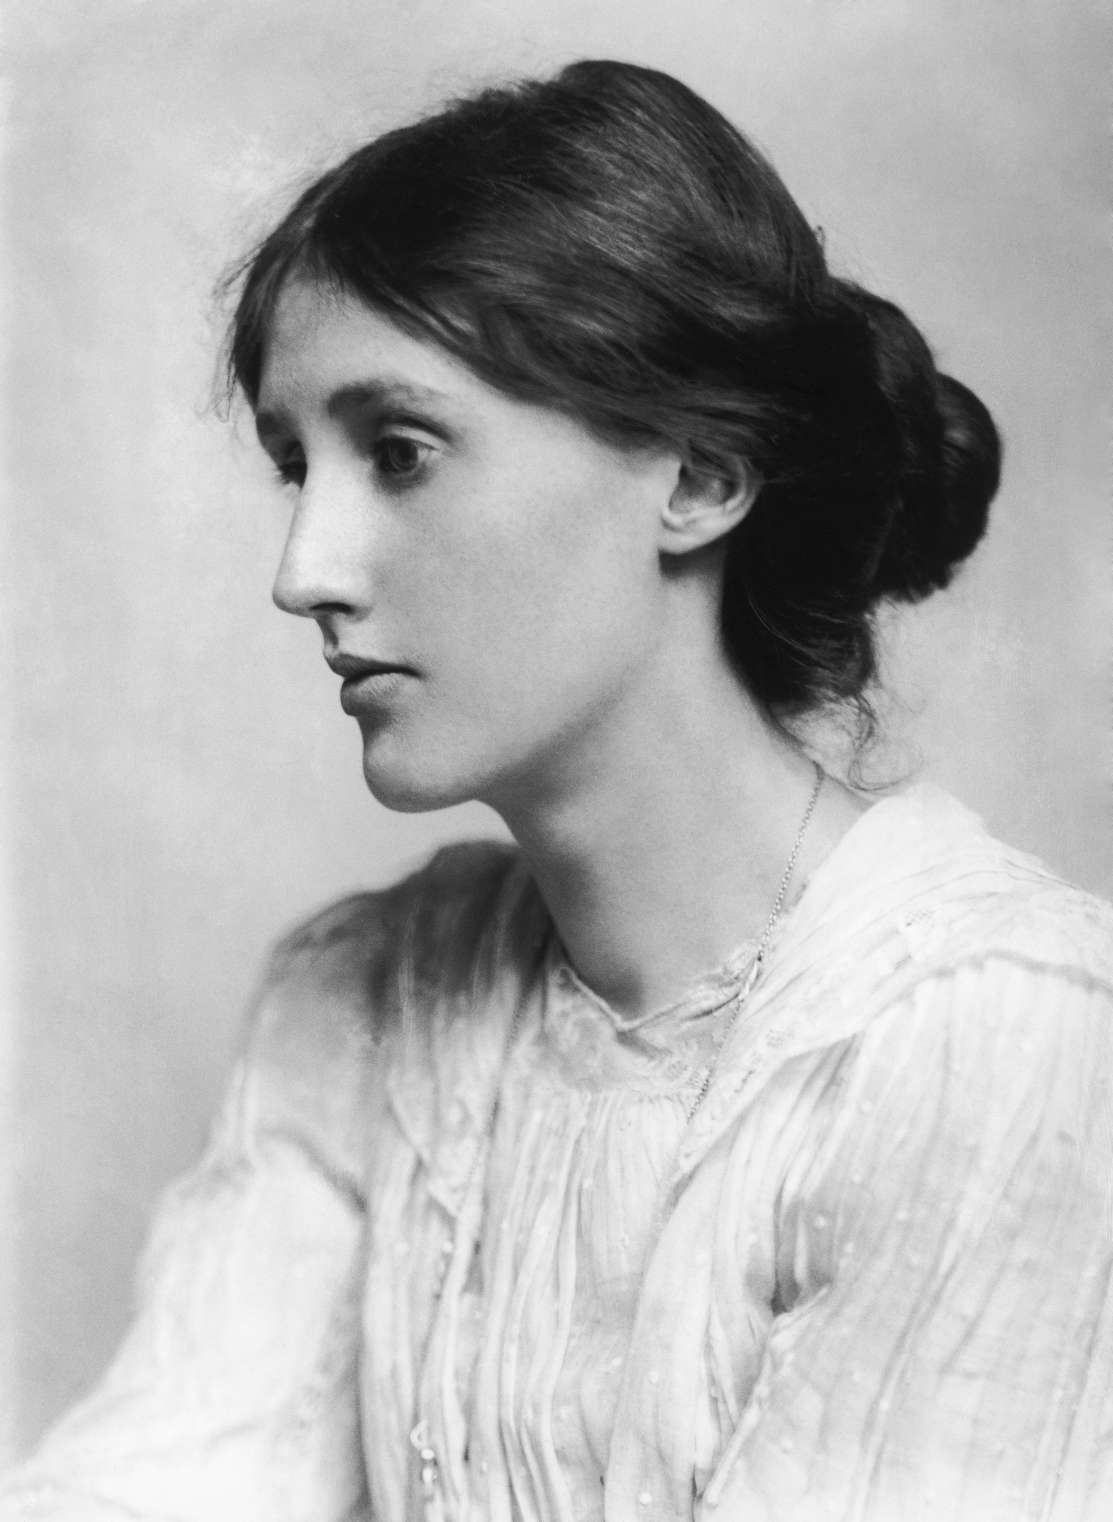
Nothing New in Literary Pilgrimage
Virginia Woolf’s TLS book review Literary Geography (1905) of two literary guidebooks acknowledges:
We are both “pilgrims from sentiment” and “scientific in our pilgrimage” to understand the influence of an author’s surroundings upon their writing.
But she warns:
“a writer’s country is a territory within his own brain;
and we run the risk of disillusionment if we try and
turn such phantom cities into tangible brick and mortar.”
Would Woolf be amused literary tourism
today includes her own home?

Slide 4
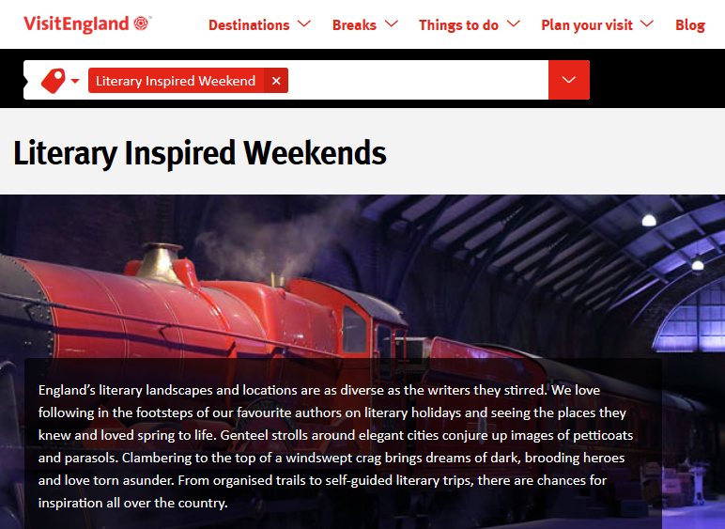
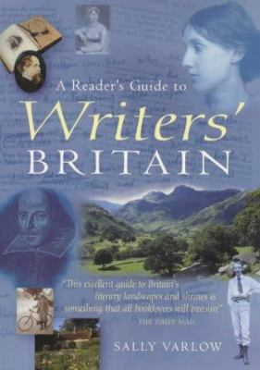
Where to Start With Planning
https://www.visitengland.com/things-to-do/literary-inspired-weekend#

Slide 5
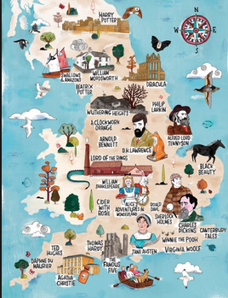
http://literarytourist.org/2018/01/31/interactive-literary-map-england-can-use/

Slide 6



Recommended Reading
Treasured Island by Frank Barrett (AA, 2015)
Writers’ Houses: Where Great Books Began by Nick Channer (Robert Hale, 2015)

Slide 7
There were 33.3 million visits to the UK in the first ten months of the year (up 5% on January – October 2016) and 39.3 million visits in the 12 months to October 2017 (up 7% on the 12 months to October 2016).
Spending: October 2017 spending rose 1% compared to October 2016 to reach £1.9 billion.
Britain will have a tourism industry worth over £257 billion by 2025 – just under 10% of UK GDP and supporting almost 3.8 million jobs, which is around 11% of the total UK number. Wikipedia
Quick
Tourism Statistics
for the UK

Slide 8
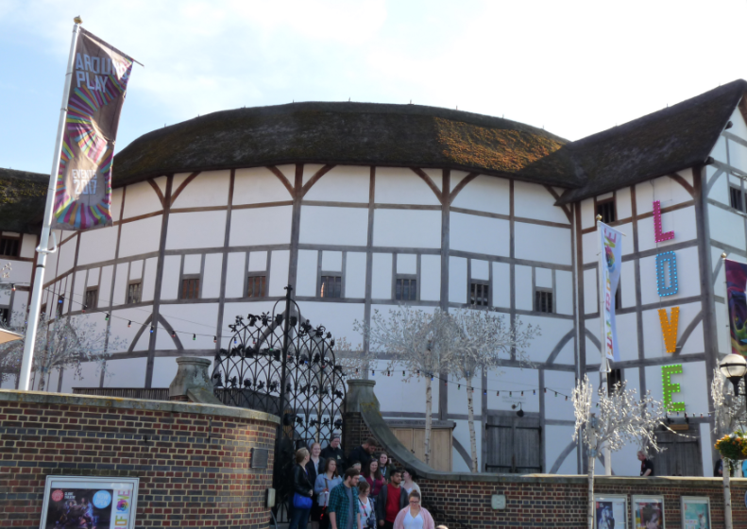
Literary Tourism
Plays its Part
Heritage tourism is a vital part of the UK economy. In 2015, domestic and international tourists made 192 million trips to visit the UK’s cultural, historic and natural heritage assets.
  https://www.oxfordeconomics.com/recent-releases/the-impact-of-heritage-tourism-for-the-uk-economy
Shakespeare’s Globe Theatre - reconstructed

Slide 9
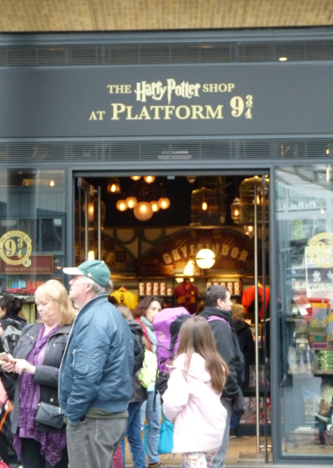
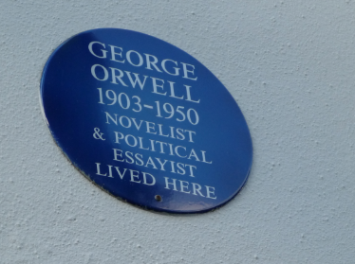
Alight just about anywhere in the UK and you can find a literary link, from dots on private homes through to commercial operations.

Slide 10
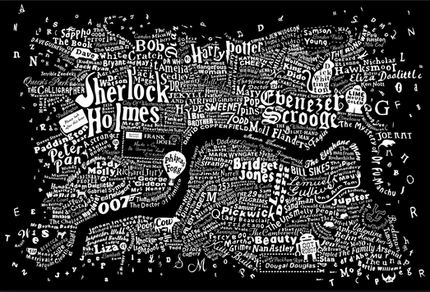
Literary links, just in London!

Slide 11
My 2017 Literary Tourism Sample (4 weeks in England)
Dickens Trail: Rochester castle, significant town buildings and museum
Lamb House, Rye. Former home of Henry James, E. F. Benson and Rumer Godden (at different times)
Canterbury Tales Museum, in Canterbury (chose to visit cathedral and NOT museum)
Bateman’s, former home of Rudyard Kipling
Sissinghurst Castle tower and gardens, former home of Vita Sackville-West
Charleston Farmhouse, former home of Vanessa Bell (Virginia Woolf’s sister)and artist Duncan Grant and retreat for Bloomsbury set. And a session at the 2017 Charleston Festival
Monk’s House, Rodmell former home of Virginia and Leonard Woolf
Shakespeare’s former school in Stratford-upon-Avon, and the RSC theatre
Jane Austen’s grave Winchester Cathedral, and Bath
Hay-on-Wye, Wales (the town NOT the festival)
Bodleian Library tour, Oxford and various Oxford colleges
Oxford Story Museum (Lewis Carroll, J. R.R. Tolkien and C. S. Lewis et al)
C.S. Lewis’s former home, church, and his grave
Globe Theatre, London. Daytime performance of Romeo and Juliet
2017 Barnes Children’s Literature Festival, London
Samuel Johnson’s House, London
Harry Potter’s Platform 9 and ¾ at King’s Cross Station, London, and sites in Oxford
Bookshops: new, second-hand, including charity bookshops

Slide 12
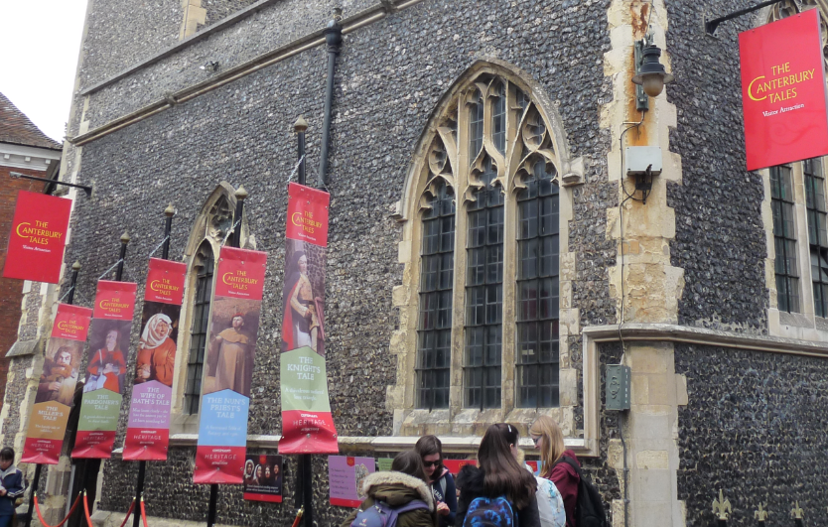
Varieties of Literary Tourism
Walking tours (self-guided or guided)
(Dead) Writers’ Homes and Gardens
Museums (sometimes in Writers’ Houses) and Visitor Attractions
Literary Festivals
The Canterbury Tales “Visitor Attraction”

Slide 13
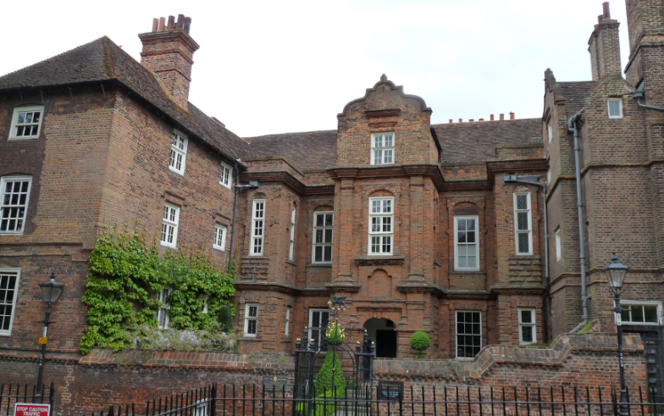
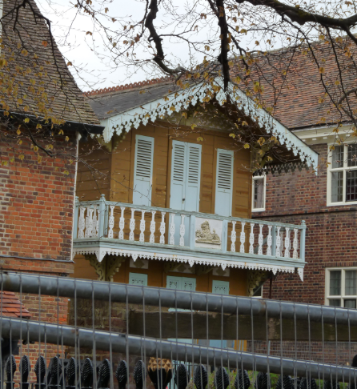
Dickens’ Trail in Rochester
Descriptions of Rochester appear in Pickwick Papers, Great Expectations and (lightly fictionalised as "Cloisterham") in The Mystery of Edwin Drood
Dicken’s Writing Chalet
Restoration House (aka Satis House)

Slide 14
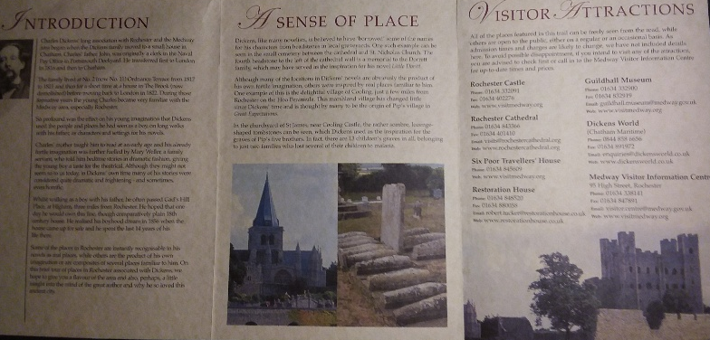
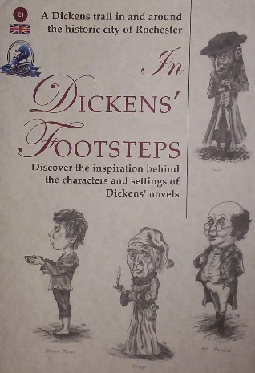
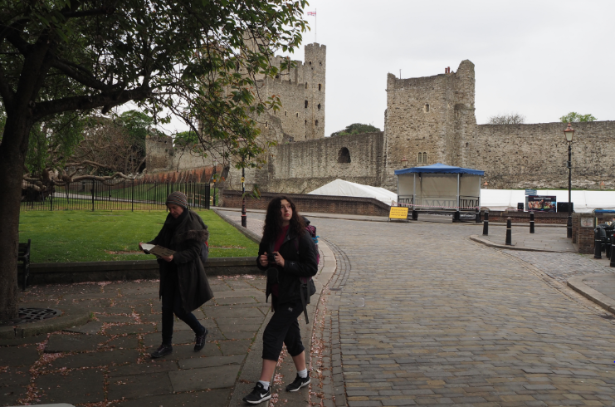

Slide 15
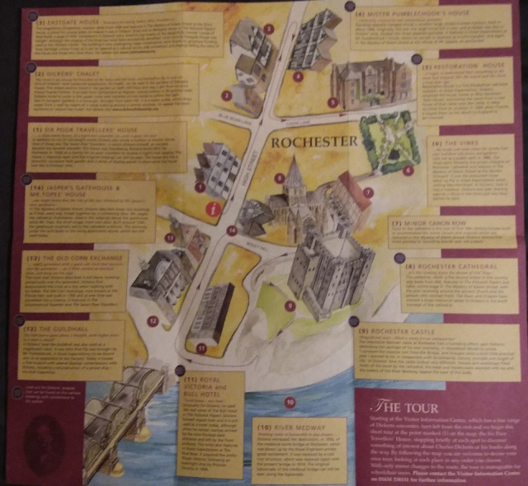
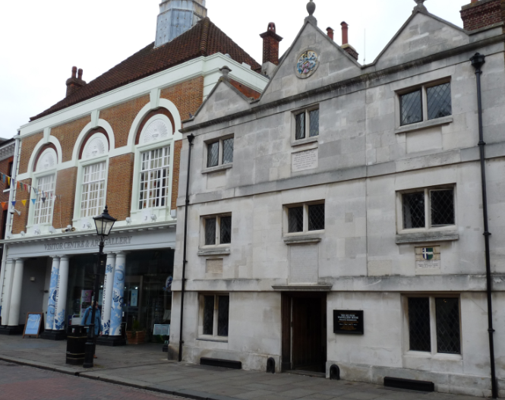
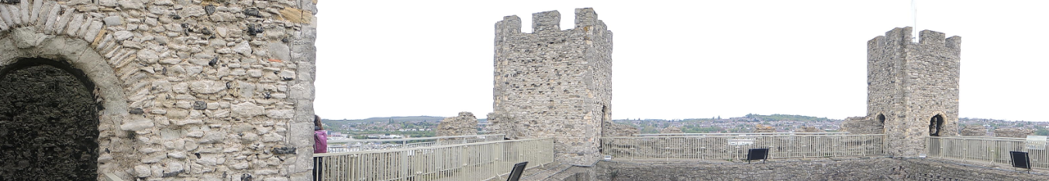

Slide 16
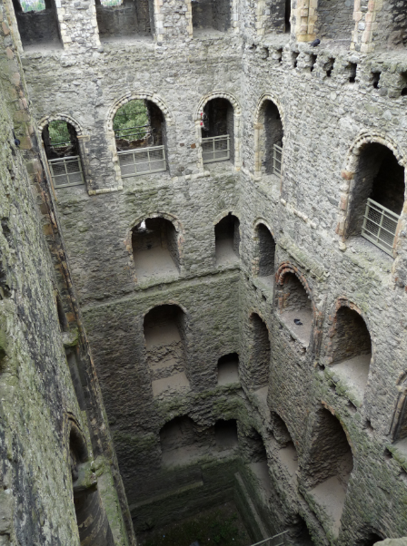
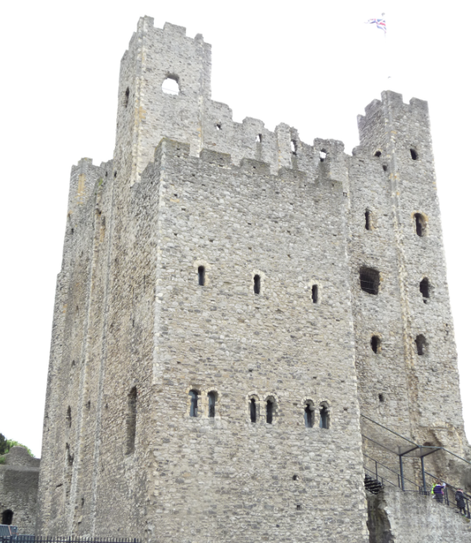
Behind it rose the ancient castle, its towers roofless, and its massive walls crumbling away, but telling us proudly of its old might and strength, as when, seven hundred years ago, it rang with the clash of arms, or resounded with the noise of feasting and revelry.
Pickwick Papers

Slide 17
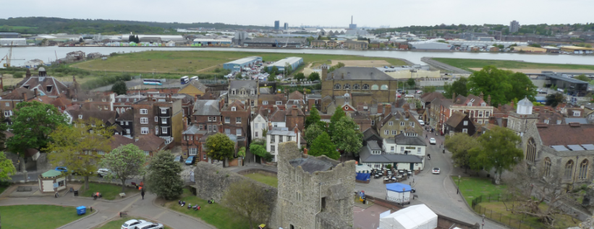
On either side, the banks of the Medway, covered with cornfields and pastures, with here and there a windmill, or a distant church, stretched away as far as the eye could see, presenting a rich and varied landscape, rendered more beautiful by the changing shadows which passed swiftly across it as the thin and half-formed clouds skimmed away in the light of the morning sun.
Pickwick Papers

Slide 18
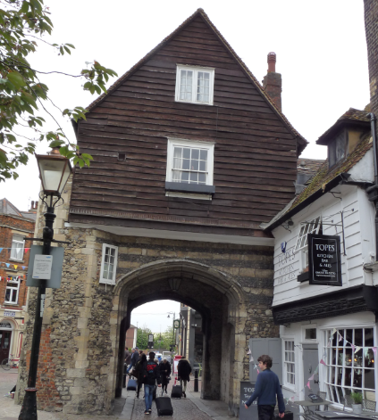
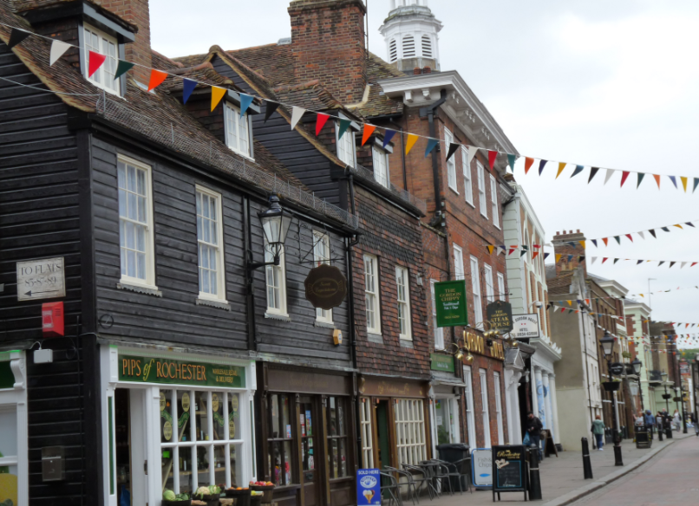
Rochester honours Dickens with two annual Dickens Festivals (in June and December)
Some shops are named after Dickens’ characters
The town museum has several exhibits about Dickens (and also interactive displays about the Medway’s prison hulks)

Slide 19
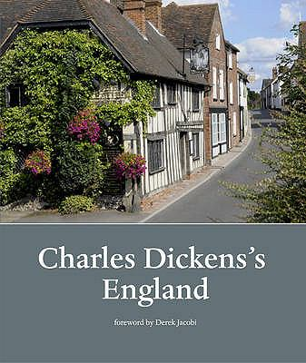
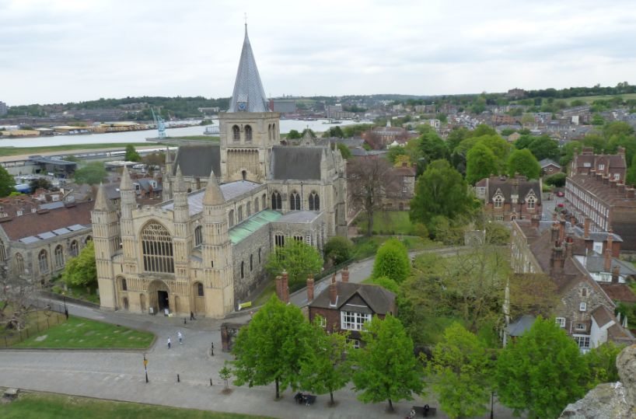

Slide 20
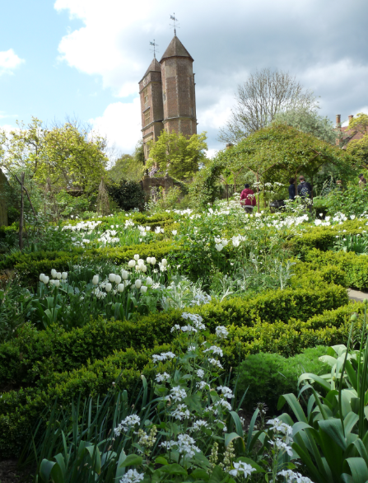
Dead Writers’ Houses
The National Trust owns: Bateman’s, Sissinghurst and Monk’s House (free for NZers with affiliation to Heritage NZ)
Charleston Farmhouse is owned by a private trust and home to annual literature festival
Sissinghurst

Slide 21
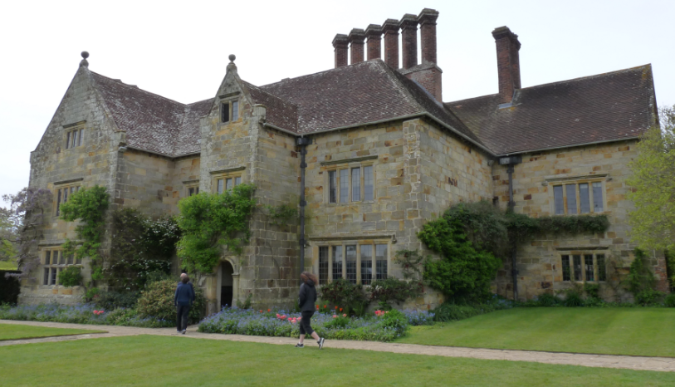
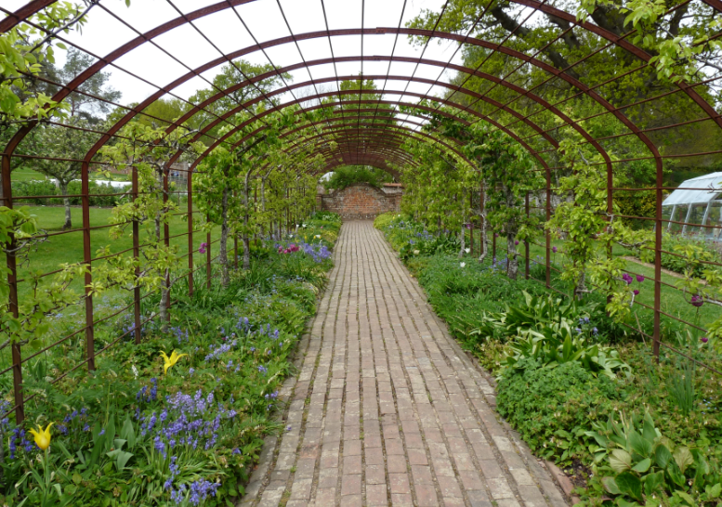
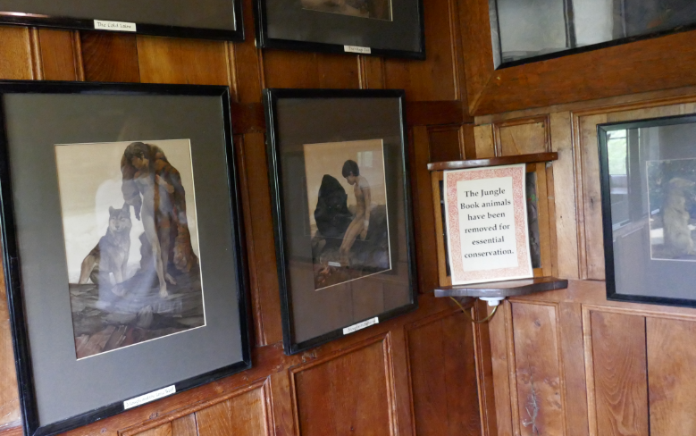
Bateman’s & Rudyard Kipling

Slide 22
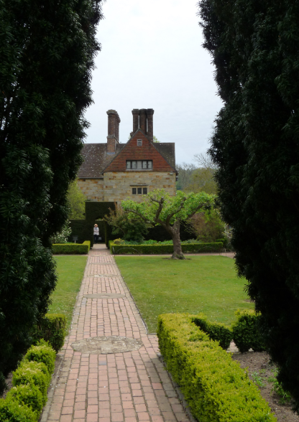
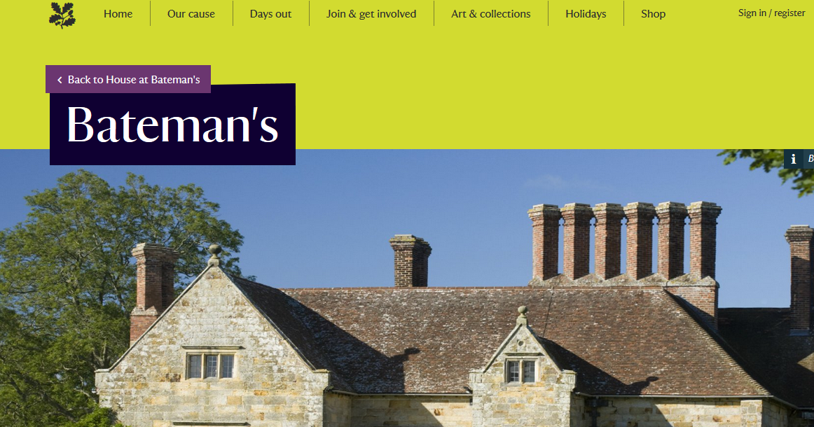
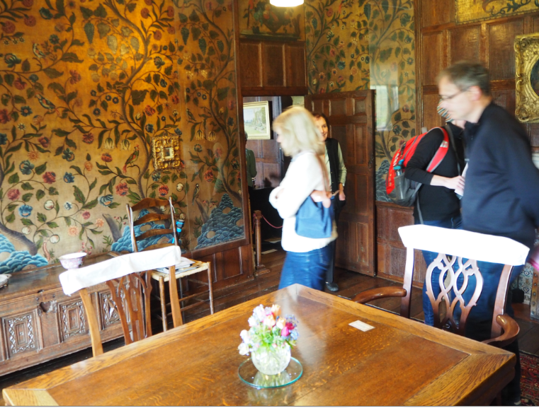

Slide 23
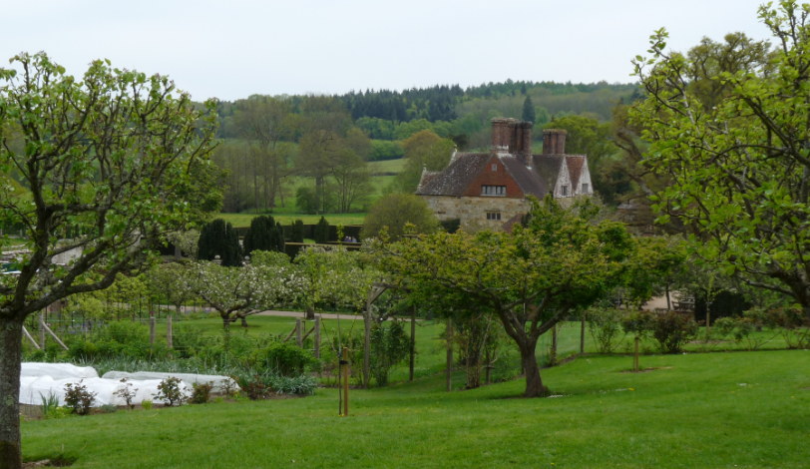
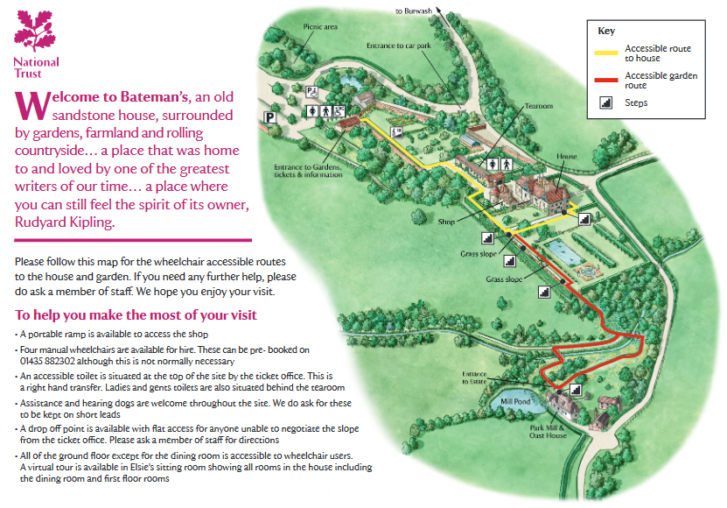
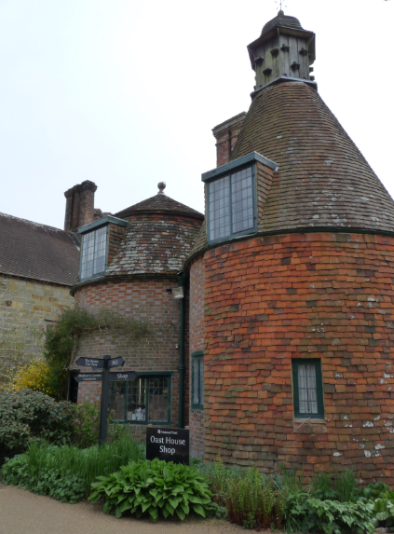

Slide 24
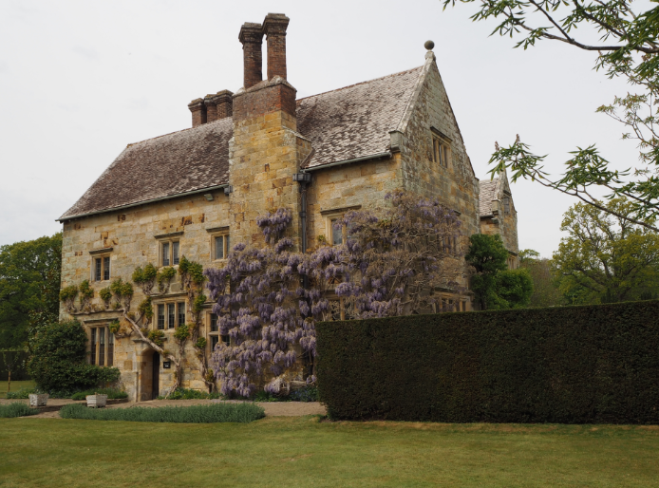
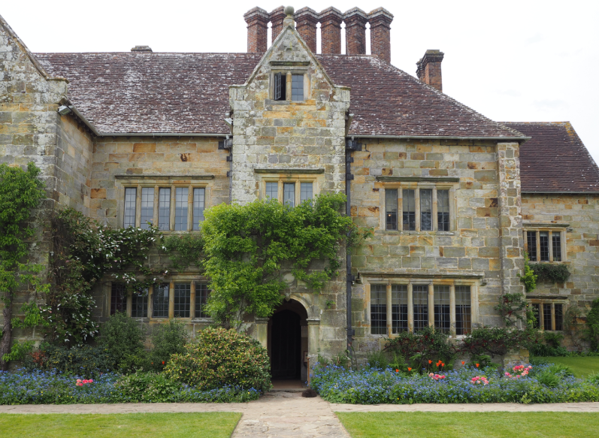
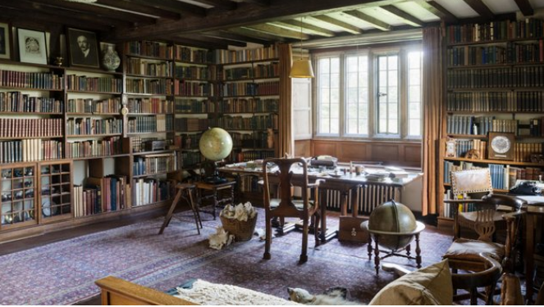

Slide 25
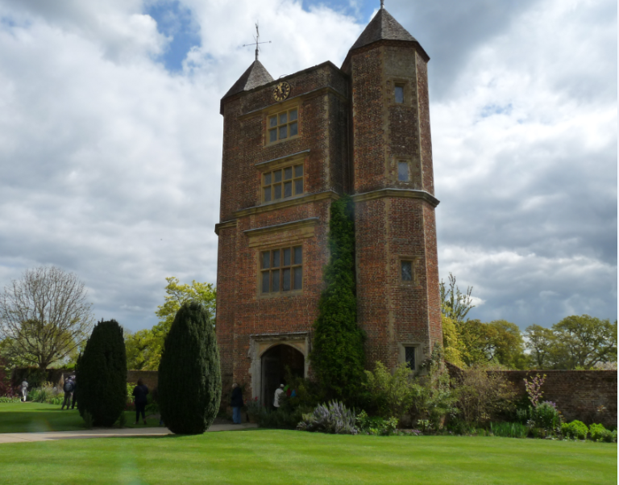
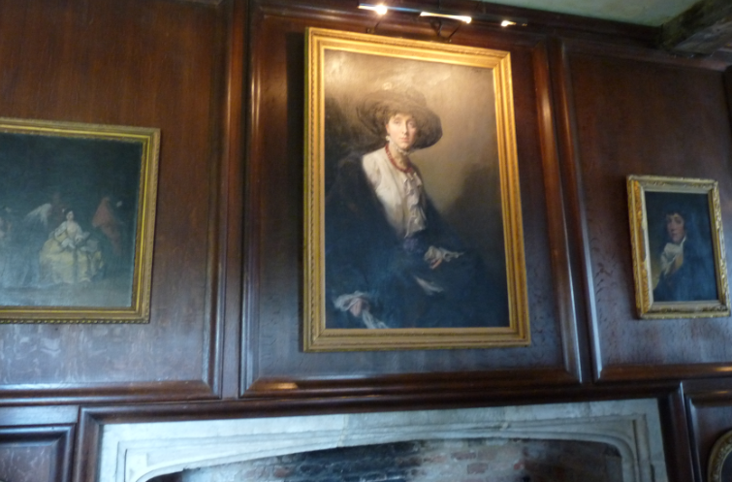
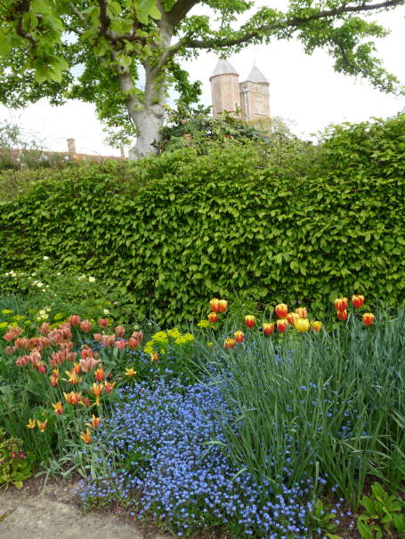
Sissinghurst &
Vita Sackville-West

Slide 26
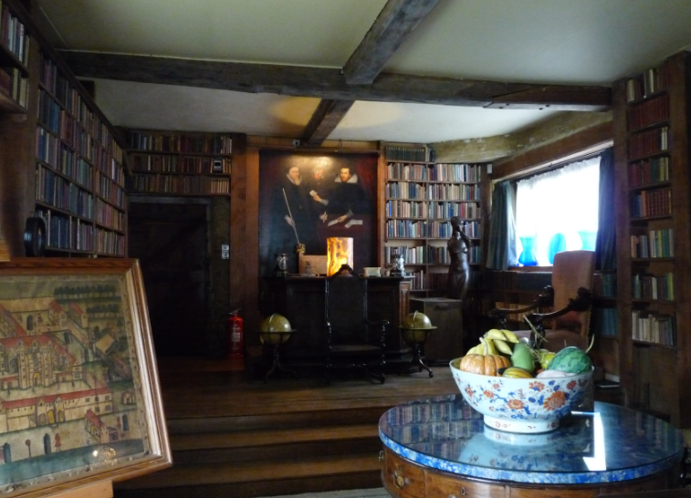
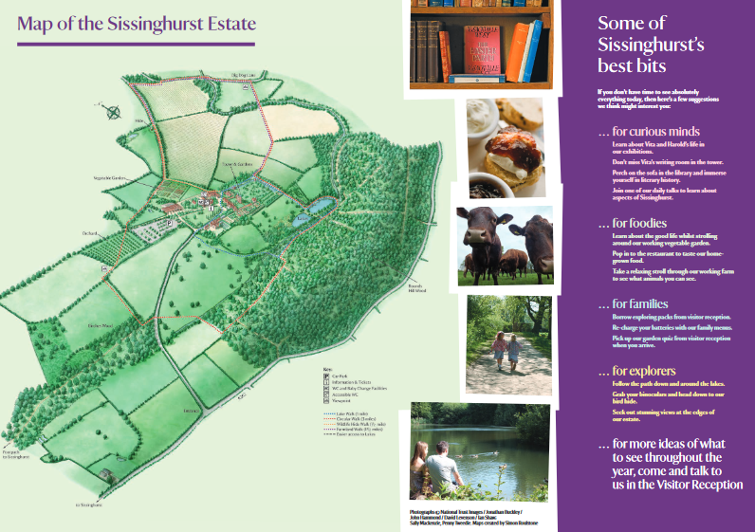
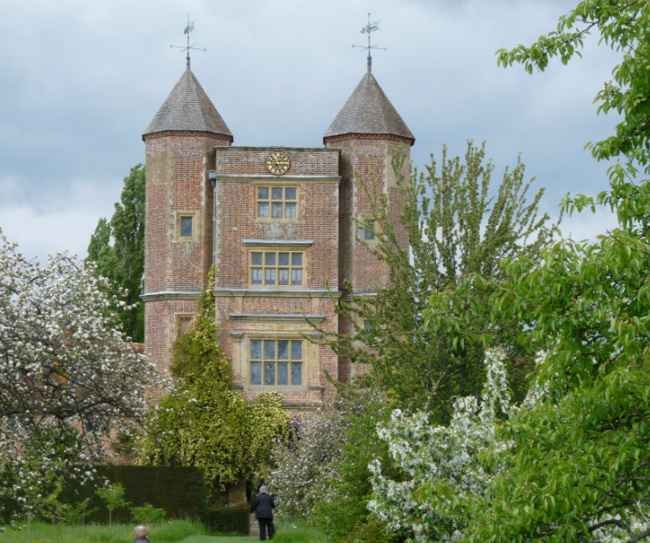
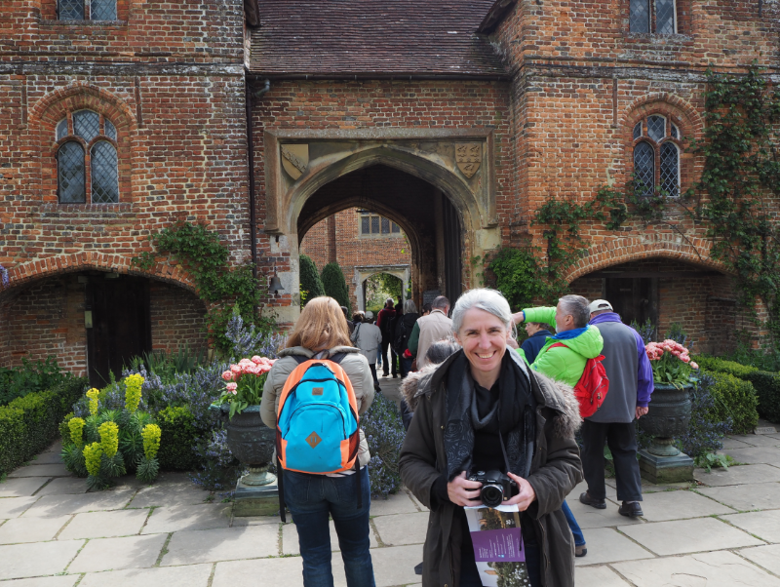

Slide 27
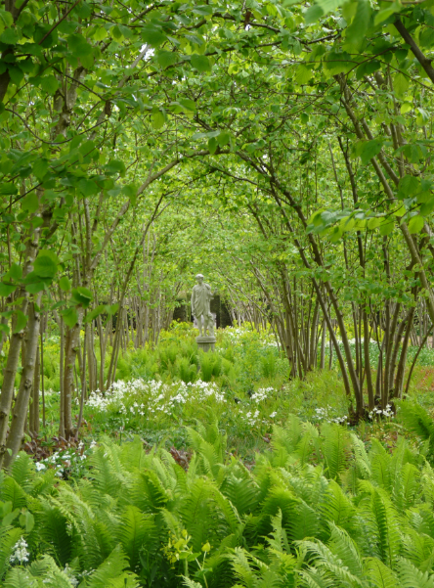
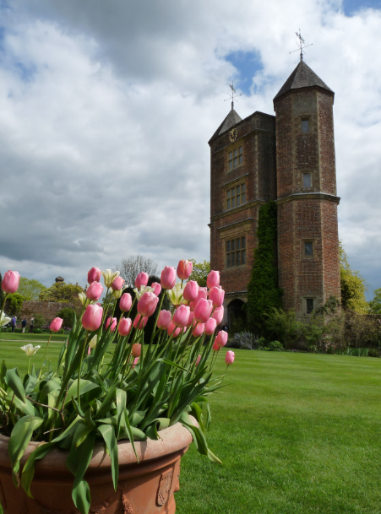
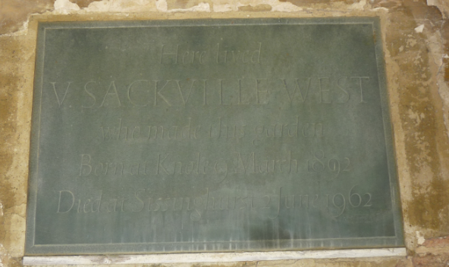

Slide 28
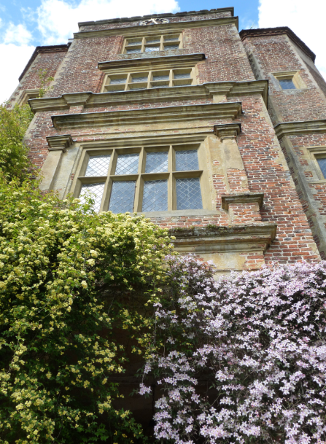
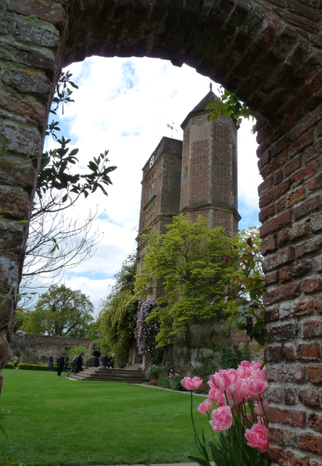

Slide 29
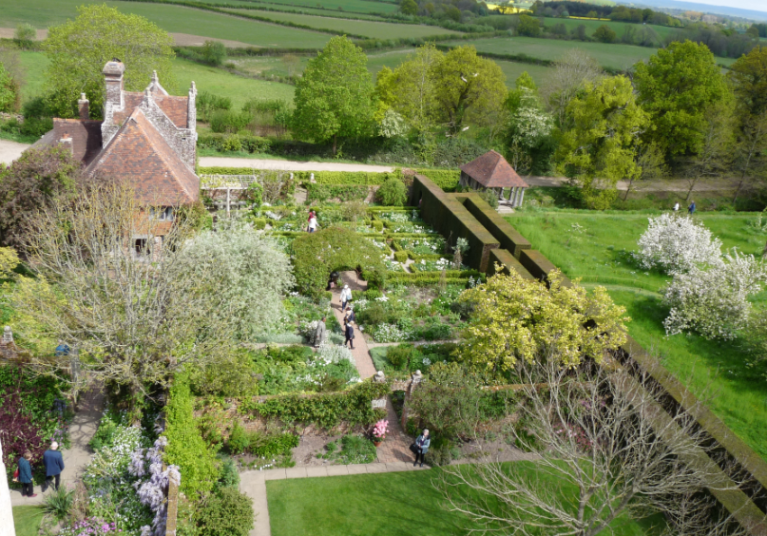


Slide 30




Slide 31







Slide 32


Monk’s House and Virginia Woolf

Slide 33



Slide 34




Slide 35



Virginia Woolf’s Writing Shed

Slide 36



Slide 37




Booklet available at Monk’s House

Slide 38

Literary Festivals
There are over 350 Literary Festivals each year in the UK, mostly attracting locals and domestic tourists
Chipping Campden’s annual
week- long literature festival

Slide 39

Finding a Literary Festival
Timing: most run March to October
Themes : Some Linked to Specific Writers
Levels: e.g. Children’s,
International focus or Local Town or City
Use local buildings, or stately homes, or big marquees
££ Some very pricey
Available nearby accommodation
http://www.literaryfestivals.co.uk

Slide 40

https://www.thewordtravels.com/literary-festivals.html
Some literary festivals are very BIG
Bath: 10 days, 15,000 visitors
Hay-on-Wye: 10 days, 80,000 visitors (more than 30 years)
Edinburgh International Book Festival: 17 days, 800 writers, 750 events and 250,000 visitors

Slide 41



Charleston & Vanessa Bell

Slide 42




Slide 43




New ed. of this book due for publication Sept. 2018

Slide 44




Slide 45




Slide 46





Slide 47




Other Books on
Literary Tourism
in the UK
available at
Dunedin Public Libraries

