Slide 2

Te Kura Kahurangi
Ko wai tātou?

Slide 4

BLUE SCHOLAR AWARDS 2022

Slide 5
2022 YEAR 11 ACADEMIC BLUE AWARDS
(for EXCELLENCE ENDORSEMENT)
Will Allott
Mahmoud Alshaqquri
Koa Arakawa
Avi Aulakh
Ethan Chang
Herbie Cottrell
Josh Findlay
Harry Galvan
Ahmed Garour
Brooklyn Green
Maddox Haglund
Bradley Hickford
Jong Yoon Lee
Lachy Leech
Ryan Mansbridge-Croy
Toby Morris
James Moss
Oliver Murphy
Jacob Needham
Frankie Sherriff Babot
Ollie Singleton
Rory Telfer
Harry Thomas
Josh Tonga
Jared Toughey
Gabe Wallace
Mark Weir
James Whelan
Oliver Wilson

Slide 6
2022 YEAR 12 ACADEMIC BLUE AWARDS
( for EXCELLENCE ENDORSEMENT)
Faraj Abbasi
Max Abbott
Lachy Anderson
Charlie Bailey
Jimmy Dawson
Jack Dysart
Chris Ellison
Tom Geesink
Ethan Hamilton
Kaine Hartley
Jacob Hinman
Matt Horn
Jack Irwin
Mathew Lolesio
Gary Mendoza
Max Mitchell
Bach Nguyen
Damon Noakes
Jasper O'Loughlin
Jakob Pascoe
Oscar Perrim
Ryan Samson
James Simpson
Kennadie Smith
Mitchell Suddaby
Malakai Tahaafe

Slide 7
2022 YEAR 13 ACADEMIC BLUE AWARDS
(for EXCELLENCE ENDORSEMENT)
Andy Cao
Michael Dickson
Sam Howden
Jerry Hsu
Noah Kember
George Kinney
Cory Kinzett
Ezekial Malcolm
Gabriel Newton
Hamish Norrie
Hadley Van Rij
Louis Zhou
Jack Zino

Slide 8
SCHOLARSHIPS

Slide 9
2022 YEAR 13 SCHOLARSHIPS
Shannon Alexander (Biology)
Liam Bately (Chemistry)
Liam Bately (Calculus)
Jackson Fontaine (Calculus)
Geordie Prebble (Geography)
Kayden Leftly (English)

Slide 10
GOLD SCHOLAR AWARDS

Slide 11
Year 12

Slide 12
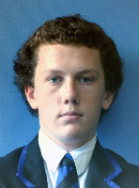
James Baggott
LEVEL ONE EXCELLENCE CREDITS: 65
LEVEL TWO EXCELLENCE CREDITS: 7
COURSE ENDORSEMENT WITH EXCELLENCE:
Physical Science
OTHER ACADEMIC ACHIEVEMENTS:
IGCSE Mathematics A*
IGCSE English Literature B
Year 11 Geography Competition
INTERESTS:
2nd XI Cricket
Rugby
FUTURE STUDY/CAREER:
Health Science at Otago

Slide 13
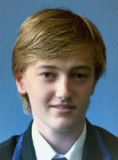
Nathan Dixon
LEVEL ONE EXCELLENCE CREDITS: 78
LEVEL TWO EXCELLENCE CREDITS: 11
COURSE ENDORSEMENT WITH EXCELLENCE:
Japanese
Physical Science
OTHER ACADEMIC ACHIEVEMENTS:
IGCSE English Literature A*
IGCSE Mathematics A
2022 History Prize
2022 Physical Science Prize
2022 Inter-school history quiz
INTERESTS:
Big Ideas
Tramping
Woodworking
FUTURE STUDY/CAREER:
To study Mechanical Engineering

Slide 14
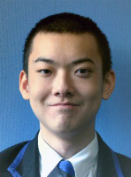
Clay Lubis
LEVEL ONE EXCELLENCE CREDITS: 101
COURSE ENDORSEMENT WITH EXCELLENCE:
Biochemistry
English
Japanese
Physical Science
OTHER ACADEMIC ACHIEVEMENTS:
2022 English - NCEA (Les Bloxham Prize for Excellence)
2022 Mathematics - Main
2022 Biochemistry (Tench Award)
INTERESTS:
Travelling
FUTURE STUDY/CAREER:
Studying medicine is a possible option.

Slide 15
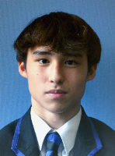
Jayden Palmer
LEVEL ONE EXCELLENCE CREDITS: 83
LEVEL TWO EXCELLENCE CREDITS: 8
COURSE ENDORSEMENT WITH EXCELLENCE:
History
Physical Science
OTHER ACADEMIC ACHIEVEMENTS:
IGCSE English Literature A*
IGCSE Mathematics A
2022 History (Pollock Prize for NZ History)
INTERESTS:
Rugby
Taekwondo
FUTURE STUDY/CAREER:
To study Psychology

Slide 16
Year 13

Slide 17
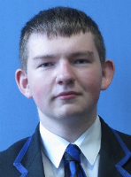
Richard Anderson
LEVEL TWO EXCELLENCE CREDITS: 82
COURSE ENDORSEMENT WITH EXCELLENCE:
Japanese
History
OTHER ACADEMIC ACHIEVEMENTS:
2022 Year 12 Scholar
INTERESTS:
Japanese
Big Ideas
FUTURE STUDY/CAREER:
Study overseas

Slide 18
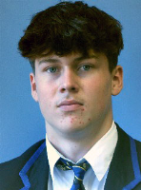
Matthew Buchan
LEVEL TWO EXCELLENCE CREDITS: 77
COURSE ENDORSEMENT WITH EXCELLENCE:
Accounting
OTHER ACADEMIC ACHIEVEMENTS:
2022 Year 12 Scholar
INTERESTS:
Football
Golf
Gym
FUTURE STUDY/CAREER:
Bachelor of Commerce - UC

Slide 19
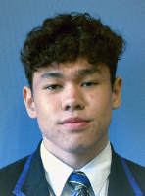
Tana Davies
LEVEL TWO EXCELLENCE CREDITS: 98
COURSE ENDORSEMENT WITH EXCELLENCE:
Physics
OTHER ACADEMIC ACHIEVEMENTS:
2022 Engineering Prize
INTERESTS:
Skiing
Football
FUTURE STUDY/CAREER:
Engineering at UC

Slide 20
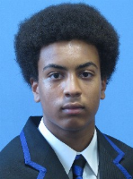
Sean Izuora
LEVEL TWO EXCELLENCE CREDITS: 48
LEVEL THREE EXCELLENCE CREDITS: 51
COURSE ENDORSEMENT WITH EXCELLENCE:
13 Physics
13 Calculus
12 Mathematics AS
12 Physics
OTHER ACADEMIC ACHIEVEMENTS:
A in Cambridge AS Mathematics

Slide 21
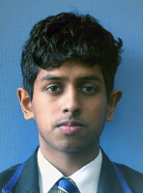
Jonathan Joseph
LEVEL TWO EXCELLENCE CREDITS: 79
COURSE ENDORSEMENT WITH EXCELLENCE:
Physics
OTHER ACADEMIC ACHIEVEMENTS:
2021 Gold Scholar
INTERESTS:
Football
FUTURE STUDY/CAREER:
Dentistry or Technology

Slide 22
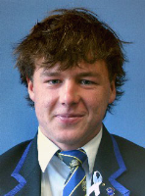
William Knight
LEVEL TWO EXCELLENCE CREDITS: 78
COURSE ENDORSEMENT WITH EXCELLENCE:
English
Geography
Physical Education
INTERESTS:
Rowing
Rugby
Snowsports.
Hunting
Fishing
Water sports
FUTURE STUDY/CAREER:
Professional Sportsman

Slide 23
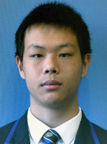
Jonathan Kuo
LEVEL TWO EXCELLENCE CREDITS: 126
LEVEL THREE EXCELLENCE CREDITS: 12
COURSE ENDORSEMENT WITH EXCELLENCE:
Biology
Chemistry
Chinese
English
Physics
OTHER ACADEMIC ACHIEVEMENTS:
A in Cambridge AS Mathematics
2022 Distinction for ICAS Science
2022 Biology prize
2022 Physics prize
INTERESTS:
Hadlee house leader (2023)
UC STAR mathematics (2023)
Studying for NZ Chemistry Olympiad (2022-2023)
Study club founder (2023)
Reading
Studying sciences and mathematics
FUTURE STUDY/CAREER:
Engineering, Physics, Chemistry, or Mathematics

Slide 24
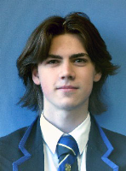
Ed Leonard
LEVEL TWO EXCELLENCE CREDITS: 100
COURSE ENDORSEMENT WITH EXCELLENCE:
Digital Technologies (Computing)
Physics
OTHER ACADEMIC ACHIEVEMENTS:
B in Cambridge AS Mathematics
2022 Digital Technologies Prize
INTERESTS:
Football
Australian Football
Guitar
FUTURE STUDY/CAREER:
Study Engineering at the University of Canterbury

Slide 25
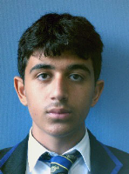
Yousef Mohammed
LEVEL TWO EXCELLENCE CREDITS: 77
COURSE ENDORSEMENT WITH EXCELLENCE:
Mathematics
Physics
Chemistry
OTHER ACADEMIC ACHIEVEMENTS:
2022 Year 12 Scholar
INTERESTS:
Football
FUTURE STUDY/CAREER:
Studying Health Science in Otago

Slide 26
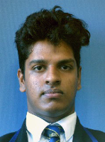
Nethidu Perera
LEVEL TWO EXCELLENCE CREDITS: 86
COURSE ENDORSEMENT WITH EXCELLENCE:
Japanese
English
OTHER ACADEMIC ACHIEVEMENTS:
A in Cambridge AS Mathematics
2022 Japanese Prize
INTERESTS:
Football
Piano
FUTURE STUDY/CAREER:
Mechanical Engineering at UC

Slide 27
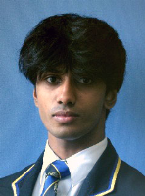
Sonal Rajapaksha
LEVEL TWO EXCELLENCE CREDITS: 93
LEVEL THREE EXCELLENCE CREDITS: 24
COURSE ENDORSEMENT WITH EXCELLENCE:
English
Physics
Calculus (Level Three)
OTHER ACADEMIC ACHIEVEMENTS:
2nd Year University Mathematics
New Zealand Math and Physics competition finalist
2022 Year 12 Scholar
INTERESTS:
Music (piano and alto saxophone)
Jazz band and funk band
Media Team
FUTURE STUDY/CAREER:
Study Health Science (med) at Otago
or Mechanical Engineering in Australia or the US

Slide 28
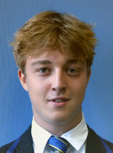
Ashley Shearer
LEVEL TWO EXCELLENCE CREDITS: 78
COURSE ENDORSEMENT WITH EXCELLENCE:
Physical Education
OTHER ACADEMIC ACHIEVEMENTS:
Blue Scholar 2021
2022 Statistics prize
INTERESTS:
Business Studies.
Squash and tennis.
Boating/fishing
Skiing
FUTURE STUDY/CAREER:
Bachelor of Entrepreneurship or B-com - Otago University or UC.

Slide 29
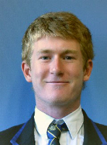
Nick Smith
LEVEL TWO EXCELLENCE CREDITS: 89
COURSE ENDORSEMENT WITH EXCELLENCE:
Economics
Accounting
Physics
OTHER ACADEMIC ACHIEVEMENTS:
2022 Accounting Prize
INTERESTS:
Golf
Football
CBHS 1st XI Cricket team
FUTURE STUDY/CAREER:
Engineering or Finance at UC

Slide 30
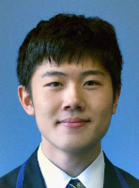
Helius Tee
LEVEL TWO EXCELLENCE CREDITS: 130
LEVEL THREE EXCELLENCE CREDITS: 22
COURSE ENDORSEMENT WITH EXCELLENCE:
Biology
Chemistry
English
Japanese
Physics
OTHER ACADEMIC ACHIEVEMENTS:
A in Cambridge AS Mathematics
2022 Chemistry Prize
ICAS Science Distinction
Japanese Language Proficiency Test N3 at 88.7th Percentile
INTERESTS:
String Orchestra with GGHS as Concertmaster
String Group at CBHS as violin 1
QSA Leader
Study Club Founder
CBHS Orchestra Concertmaster
House Leader of Sutton
Playing violin with lessons and piano and guitar in spare time
FUTURE STUDY/CAREER:
Complete a degree in Medicine at Monash, Auckland or Otago University.

Slide 31
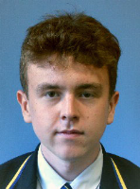
Thomas Tracey
LEVEL TWO EXCELLENCE CREDITS: 116
COURSE ENDORSEMENT WITH EXCELLENCE:
Economics
History
English
Geography
OTHER ACADEMIC ACHIEVEMENTS:
B in Cambridge AS Mathematics
2022 Economics Prize
2022 Te Reo Maori Prize
2022 History Prize (Jack Birdling Scholarship)
2022 English (R.A. Devlin Prize)
Year 12 General Excellence Scholar (G.J. Lancaster Prize)
INTERESTS:
CBHS Media Team
Tennis
FUTURE STUDY/CAREER:
Bachelor of Arts, and a Bachelor of Communications - UC

Slide 32
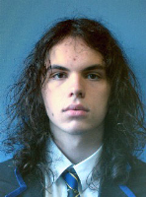
James Woods
LEVEL TWO EXCELLENCE CREDITS: 96
COURSE ENDORSEMENT WITH EXCELLENCE:
Chemistry
Physics
INTERESTS:
Mountain biking,
Programming
Listening to music.
FUTURE STUDY/CAREER:
Studying Physics at UC

Slide 33
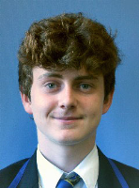
Ben Wright
LEVEL TWO EXCELLENCE CREDITS: 103
COURSE ENDORSEMENT WITH EXCELLENCE:
Chemistry
Accounting
Physics
Mathematics
OTHER ACADEMIC ACHIEVEMENTS:
B in Cambridge AS Mathematics
2022 Year 12 Scholar
INTERESTS:
Football
Cricket
Chess
FUTURE STUDY/CAREER:
Engineering and/or Mathematics at the University of Canterbury

Slide 34
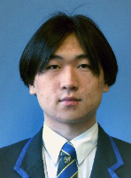
Jermaine Yee
LEVEL TWO EXCELLENCE CREDITS: 120
COURSE ENDORSEMENT WITH EXCELLENCE:
Biology
Chemistry
Chinese
English
Physics
OTHER ACADEMIC ACHIEVEMENTS:
B in Cambridge AS Mathematics
2022 Cambridge Mathematics Prize
INTERESTS:
Study Club Founder
QSA
Sutton House Leader
STAR Mathematics at UC
FUTURE STUDY/CAREER:
Medicine

Slide 35
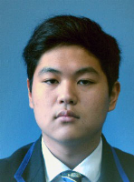
Alex Yoshikane
LEVEL TWO EXCELLENCE CREDITS: 76
COURSE ENDORSEMENT WITH EXCELLENCE:
Japanese
OTHER ACADEMIC ACHIEVEMENTS:
Blue Scholar in 2021
INTERESTS:
Reading
FUTURE STUDY/CAREER:
Engineering at UC

Slide 36
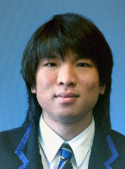
Bobby Zhang
LEVEL TWO EXCELLENCE CREDITS: 84
COURSE ENDORSEMENT WITH EXCELLENCE:
Mathematics
English
Physics
INTERESTS:
Drawing
Big ideas group
FUTURE STUDY/CAREER:
To study Biochemisty at UC

Slide 37
2022 YEAR 13 ACADEMIC GOLD AWARDS
(for EXCELLENCE ENDORSEMENT)
Liam Bately
Jackson Fontaine
Joey Huang
Ryan Ko
Ben Kuruvilla
Gene Lee
Kaden Leftly
Geordie Prebble
Jack Prebble
Hugo Wilson

Slide 39
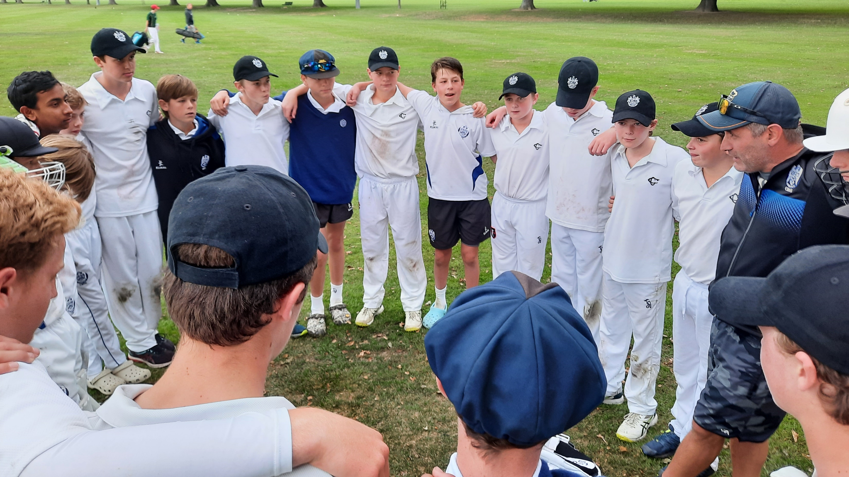

Slide 40
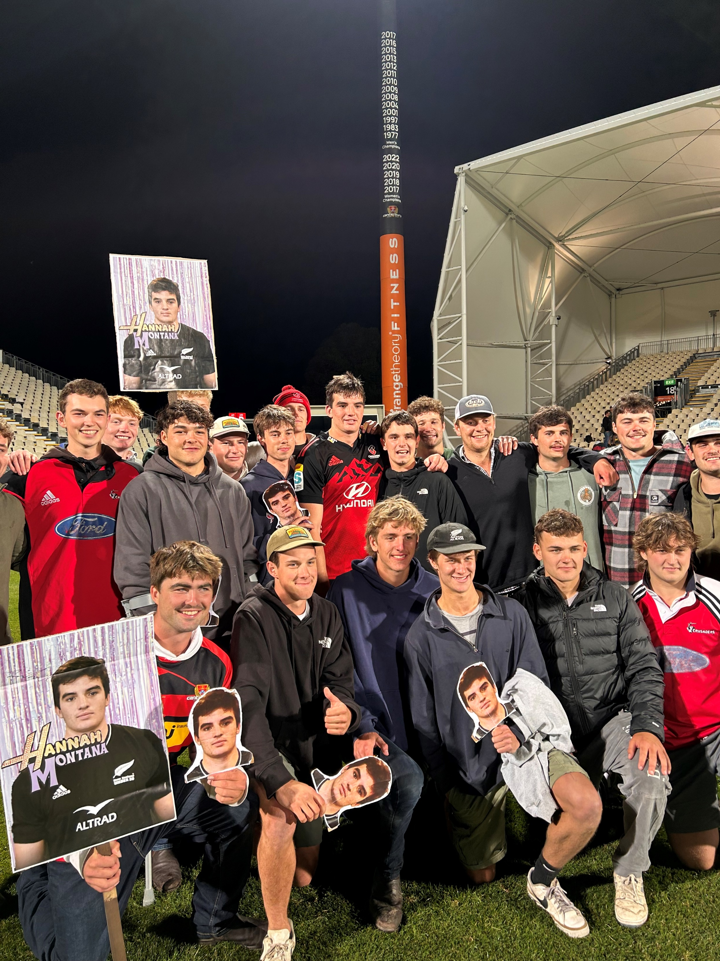

Slide 41
The School we magnify,
for us no school comes nigh it;
holds us by such a tie, both are exalted by it.
In class, and scrum, and scathe,
we strive but for her merit,
and she rewards our faith,
who bids the climbing spirit.
Altiora Peto, Altiora Peto!
Honour the School that keeps the rule:
Altiora Peto!

Slide 42
Not here alone descried,
unchanged by skies above her,
She is where'er her pride is
kept by sons who love her.
They share her triumphs still,
the men who went before us.
With ours their voices thrill,
in the immortal chorus:
Altiora Peto, Altiora Peto!
Honour the School that keeps the rule:
Altiora Peto!

